Slide 1
Subject / Lesson | Time
Maths | 1 hour
Spelling Test | 10 minutes
English | 30 minutes
Physical Activity | 30 minutes
Music | 30 minutes

Slide 2
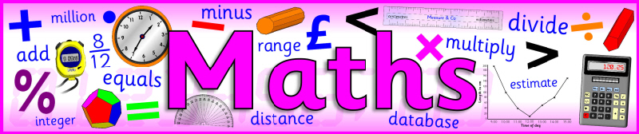
I would like you to try one of the three maths investigations. You can try another if you have time.
The three options are on the next three slides.

Slide 3
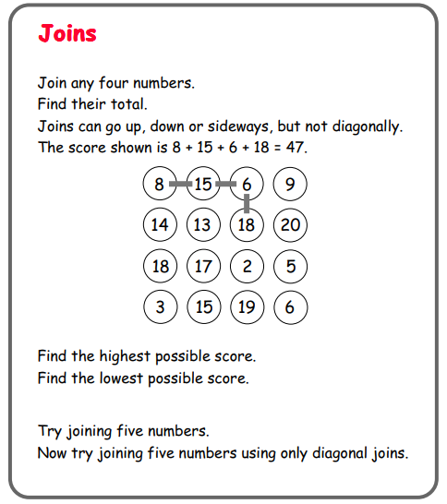

Slide 4
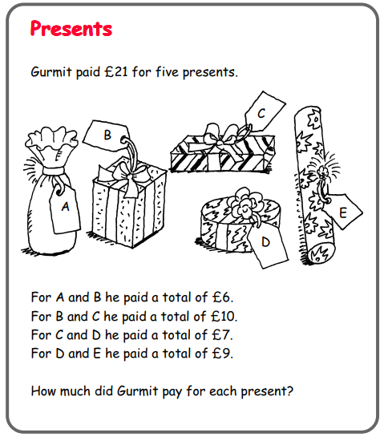

Slide 5
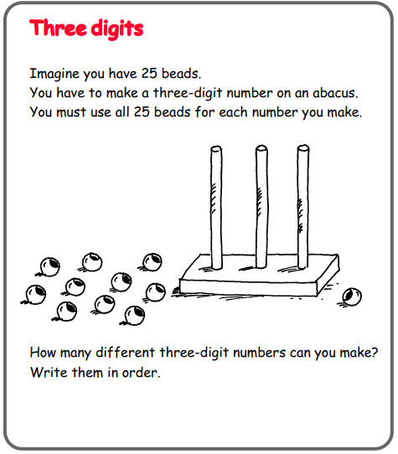
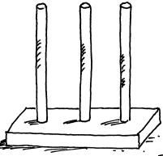
An abacus works like a place value chart. In the above example the number is 325.
Can you see why?
When you make your numbers you must use 25 beads.

Slide 6

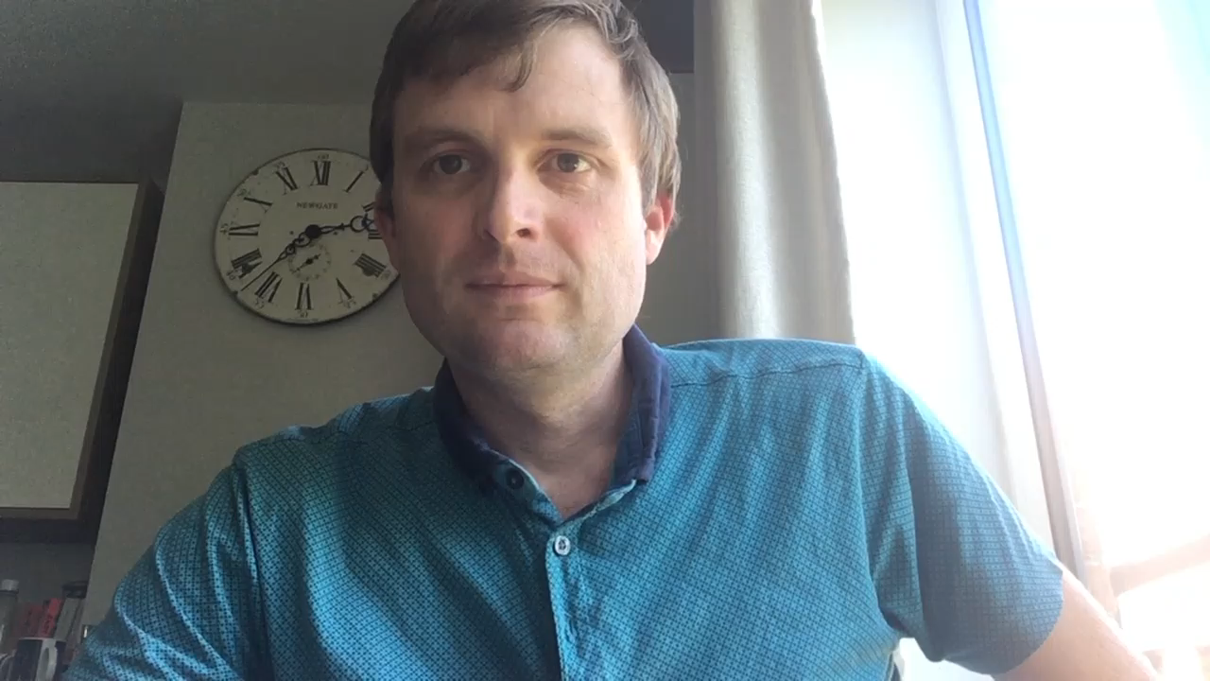
Spelling Test – important proper nouns to know

Slide 7
Spelling Test – important proper nouns to know
Farnborough
Orpington
London
England
United Kingdom
Europe

Slide 8

What can you see?
What questions could you ask?
What can you infer from the image?
Can you write the first 3 lines of a story for this picture?

Slide 9
Physical activity – minimum 30 minutes each day | Link to resource
5 a day User Name: FPS53 / Password: JFz4XqG7 | https://player.5-a-day.tv/
Joe Wicks – PE sessions | https://www.youtube.com/channel/UCAxW1XT0iEJo0TYlRfn6rYQ
Cosmic Kids Yoga | https://www.youtube.com/user/CosmicKidsYoga
PE Hub Parents Portal | https://pehubportal.co.uk/
Go Noodle | https://www.gonoodle.com/good-energy-at-home-kids-games-and-videos/
Go for a walk/run. You must go with an adult from your home and make sure you stay 2 metres away from other people.

Slide 10

Pick a song to try
https://www.singup.org/singupathome/all-songs
I always like a fun song – My Hat has Three Corners, Tony Chestnut – but there are lots to choose from. Which are you going to choose?

