Slide 1
Subject / Lesson | Time
Maths | 1 hour
English | 1 hour
Physical Activity | 30 minutes
Science | 30 minutes

Slide 2
Maths Task | Time
Maths Frame – Reading scales Username: Farnborough / Password: Farnborough https://mathsframe.co.uk/en/resources/resource/124/reading-scales | 15 minutes
Complete Power Maths or My Maths task on the next page. | 40 minutes
The below You Tube Channel may help you to understand things if you find them tricky – thanks to Aarav for suggesting this: https://www.youtube.com/user/mathantics/featured

Slide 3
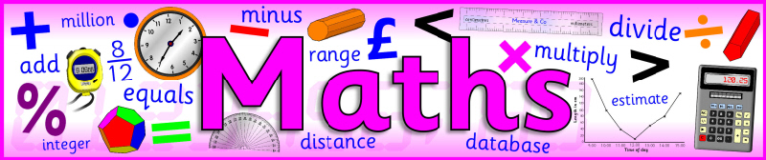
I would like you to continue with Power Maths or carry out the tasks on My Maths.
Power Maths (instructions on next slide)
Read and complete from page 60 to page 63. (Answers start from page 164)
My Maths (log in details should have been emailed to you)
Complete ‘Modelling percentages’

Slide 4
Instructions for Power Maths
Click on-
http://go.pardot.com/e/749453/PowerMathsYear6/51zwx/107010261?h=9zEkYm9Vv36T0kIK2mGoBlvXYizjLxGA8JPqztzRvMQ
(You might need to copy and paste this link into your web browser)
Agree to the terms and conditions and click ‘Continue’.
Click on ‘Power Maths Year 6’
Click on ‘Power Maths Year 6 Practice Book Summer Home Edition’

Slide 5

Try to finish off your story today
Remember you have chosen which story you are writing:
The story you planned before half term
A new story you have created
The story I have planned
It will not be a long story but we must try to make it as exciting and interesting as possible.

Slide 6
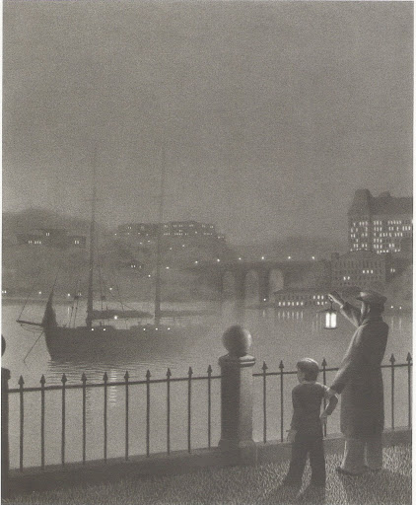

Captain Tory
He swung his lantern three times and slowly the schooner appeared.

Slide 7
Remember: you can use the story you planned before half term; create a new one; use my plan.
Pattern of the story | Mr Atkinson’s plan based on Captain Tory
Main character (MC) finds magical portal and enters new world | Boy (Billy, 12) grabbed by Captain Tory and Billy is told he is the Captain’s only chance of survival. Sail off into a fog; Billy passes out.
Describe new world | When Billy awakes, boat is sailing through clouds. Clouds act like an ocean.
MC explores new world and encounters a problem | Billy told he must find a special potion. The Captain takes Billy to a mountain in the sky which Billy must climb to find the potion.
MC has to escape and return through the portal | Billy finds potion but the mountain is actually a volcano and starts to erupt (potion was keeping the volcano quiet). He makes it back to the ship and the Captain takes him home.
MC cannot find portal again | Billy often returns to the docks but Captain never returns.

Slide 8
Remember: you can use the story you planned before half term; create a new one; use my plan.
Pattern of the story | You can plan your own story if you would like to
Main character (MC) finds magical portal and enters new world
Describe new world
MC explores new world and encounters a problem
MC has to escape and return through the portal
MC cannot find portal again

Slide 9
Physical activity – minimum 30 minutes each day | Link to resource
5 a day User Name: FPS53 / Password: JFz4XqG7 | https://player.5-a-day.tv/
Joe Wicks – PE sessions | https://www.youtube.com/channel/UCAxW1XT0iEJo0TYlRfn6rYQ
Cosmic Kids Yoga | https://www.youtube.com/user/CosmicKidsYoga
PE Hub Parents Portal | https://pehubportal.co.uk/
Go Noodle | https://www.gonoodle.com/good-energy-at-home-kids-games-and-videos/
Go for a walk/run. You must go with an adult from your home and make sure you stay 2 metres away from other people.

Slide 10

Living Things and their habitats
I would like you to try and identify as many trees as you can that are around you. You can do this on a walk, from inside your house or in your garden.
How many different types of trees can you find?
This is your task for today and tomorrow. Can you look in 2 different places. The link below may help you:
https://www.woodlandtrust.org.uk/blog/2020/03/tree-id-kids/

