Slide 1
Subject / Lesson | Time
Maths | 1 hour
English | 1 hour
Physical Activity | 30 minutes
Thinking about Secondary School
Art | 30 minutes

Slide 2
Maths Task | Time
Maths Frame – Telling the time Username: Farnborough / Password: Farnborough https://mathsframe.co.uk/en/resources/resource/246/Telling-the-Time-Dominoes | 15 minutes
Complete Power Maths or My Maths task on the next page. | 40 minutes
The below You Tube Channel may help you to understand things if you find them tricky – thanks to Aarav for suggesting this: https://www.youtube.com/user/mathantics/featured

Slide 3

I would like you to continue with Power Maths or carry out the tasks on My Maths.
Power Maths (instructions on next slide)
Read and complete from page 56 to page 59. (Answers start from page 164)
My Maths (log in details should have been emailed to you)
Complete ‘Percentage of amounts 1’

Slide 4
Instructions for Power Maths
Click on-
http://go.pardot.com/e/749453/PowerMathsYear6/51zwx/107010261?h=9zEkYm9Vv36T0kIK2mGoBlvXYizjLxGA8JPqztzRvMQ
(You might need to copy and paste this link into your web browser)
Agree to the terms and conditions and click ‘Continue’.
Click on ‘Power Maths Year 6’
Click on ‘Power Maths Year 6 Practice Book Summer Home Edition’

Slide 5

New Spellings for Friday – important proper nouns to know
Farnborough
Orpington
London
England
United Kingdom
Europe

Slide 6

For today and tomorrow, we will write a portal story based on the work you did on ‘doors’ before half term.
You may choose which story you write up:
The story you planned before half term
A new story you have created
The story I will plan
It will not be a long story but we must try to make it as exciting and interesting as possible.

Slide 7
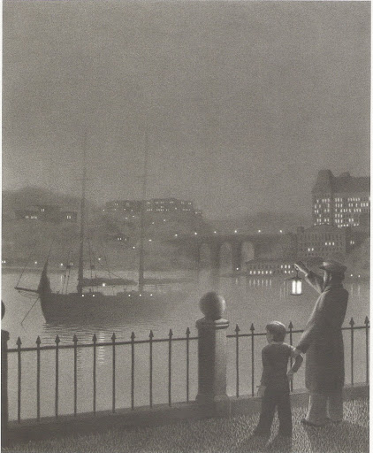

Captain Tory
He swung his lantern three times and slowly the schooner appeared.

Slide 8
Remember: you can use the story you planned before half term; create a new one; use my plan.
Pattern of the story | Mr Atkinson’s plan based on Captain Tory
Main character (MC) finds magical portal and enters new world | Boy (Billy, 12) grabbed by Captain Tory and Billy is told he is the Captain’s only chance of survival. Sail off into a fog; Billy passes out.
Describe new world | When Billy awakes, boat is sailing through clouds. Clouds act like an ocean.
MC explores new world and encounters a problem | Billy told he must find a special potion. The Captain takes Billy to a mountain in the sky which Billy must climb to find the potion.
MC has to escape and return through the portal | Billy finds potion but the mountain is actually a volcano and starts to erupt (potion was keeping the volcano quiet). He makes it back to the ship and the Captain takes him home.
MC cannot find portal again | Billy often returns to the docks but Captain never returns.

Slide 9
Remember: you can use the story you planned before half term; create a new one; use my plan.
Pattern of the story | You can plan your own story if you would like to
Main character (MC) finds magical portal and enters new world
Describe new world
MC explores new world and encounters a problem
MC has to escape and return through the portal
MC cannot find portal again

Slide 10
For today, try to write the first 2 parts of the story.

Slide 11
Physical activity – minimum 30 minutes each day | Link to resource
5 a day User Name: FPS53 / Password: JFz4XqG7 | https://player.5-a-day.tv/
Joe Wicks – PE sessions | https://www.youtube.com/channel/UCAxW1XT0iEJo0TYlRfn6rYQ
Cosmic Kids Yoga | https://www.youtube.com/user/CosmicKidsYoga
PE Hub Parents Portal | https://pehubportal.co.uk/
Go Noodle | https://www.gonoodle.com/good-energy-at-home-kids-games-and-videos/
Go for a walk/run. You must go with an adult from your home and make sure you stay 2 metres away from other people.

Slide 12


Slide 13
We need to start thinking about Secondary School.
To start off, I would like you to have a think about how you are feeling about it. When you think about Secondary School what do you feel?

Slide 14
I would like you to think about 3 questions:
What are you excited about?
What are you worried about?
What don’t you know but wished you did?
It doesn’t need to be today, but when you have a question or answer, email me. I will gather together the questions and answers and we will think about and discuss them. I will find a way that we can share all our questions with each other and we will share the answers.
We will be looking at other tasks each week about Secondary schools so you anytime you have a question email me.

Slide 15

Pick a character from the link below and have a go at drawing it. If you can, email a picture in to yearsixlearning@Farnborough.Bromley.sch.uk and I will put them on the website for us all to enjoy.
http://www.robbiddulph.com/draw-with-rob

