Slide 1
Subject / Lesson | Time
Maths | 1 hour
Spelling Test | 10 minutes
Comprehension–What can you see? | 20 minutes
English | 30 minutes
Physical Activity | 30 minutes
Science | 30 minutes

Slide 2
Maths Task | Time
Maths Frame Interactive Quiz Username: Farnborough / Password: Farnborough https://mathsframe.co.uk/en/resources/resource/366/interactive-maths-quiz | 15 minutes
Try this version of Count Down at home https://thirdspacelearning.com/blog/fun-maths-games-activities-for-kids/ The instructions for this game are near the top. It the first game of the top 3 indoor games. There is a video that explains how it works. | 40 minutes

Slide 3

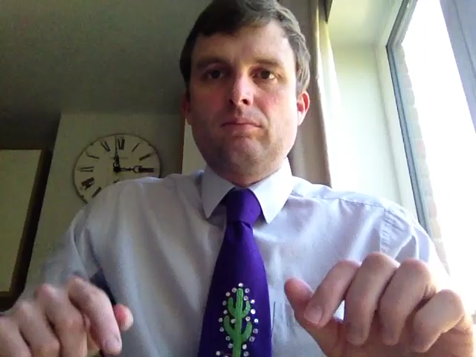
Spelling test – Monday’s spellings

Slide 4
Check your spellings against the list
appreciate
community
guarantee
individual
neighbour
variety

Slide 5
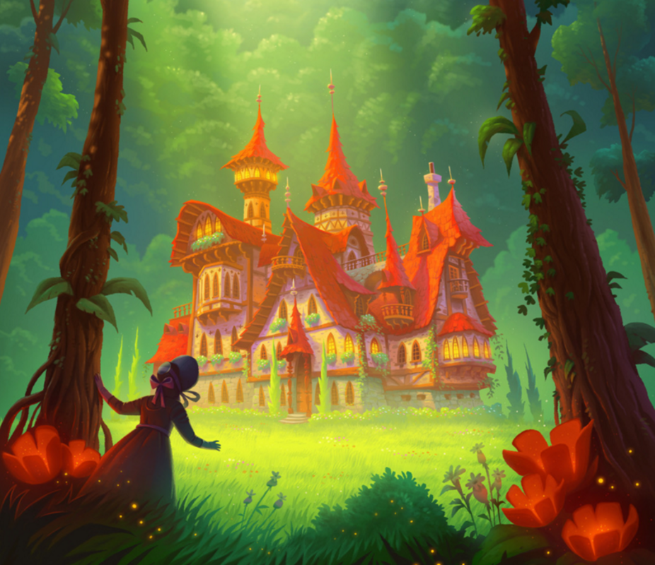
What can you see?
What questions could you ask?
What can you infer from the image?

Slide 6
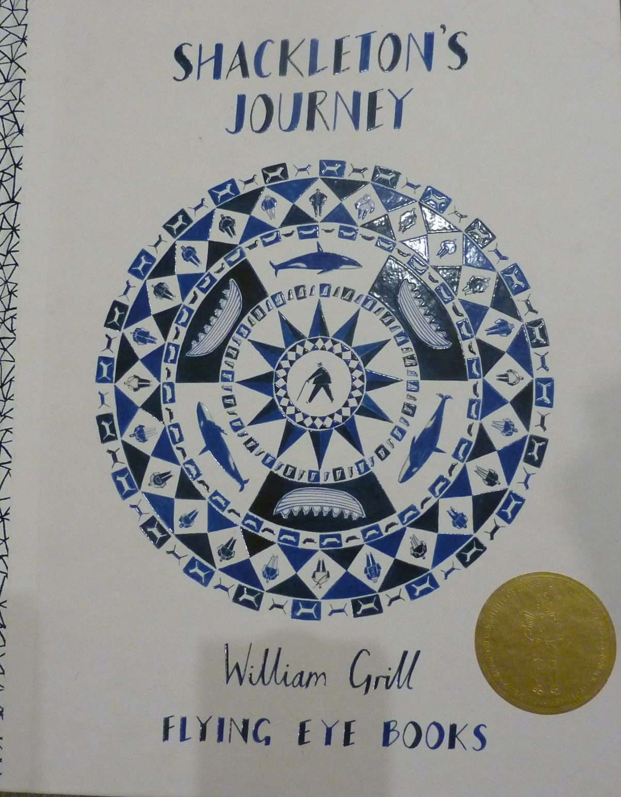
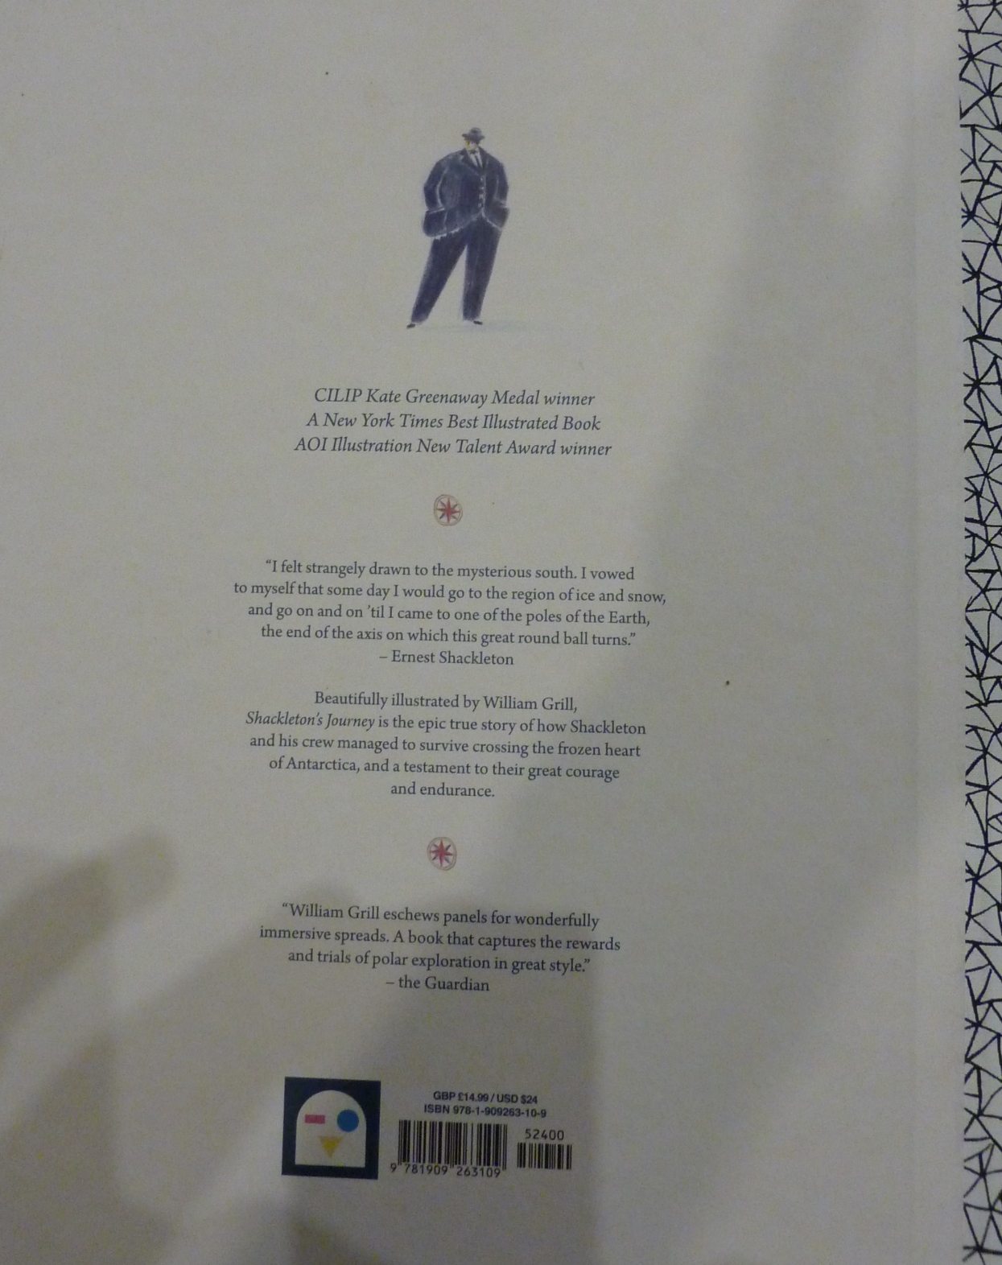

Slide 7

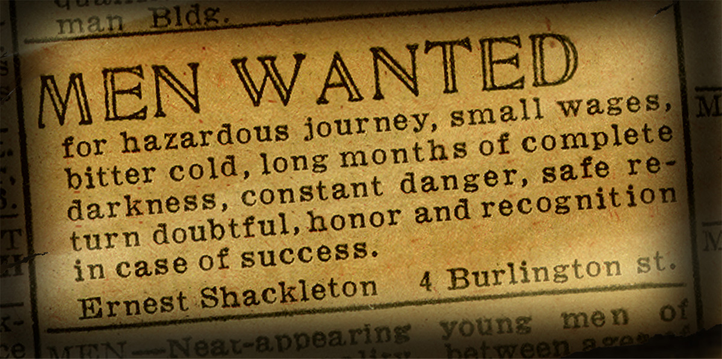
Unbelievably, Shackleton was not finished with exploring. He wanted to go back and try again. We started off this book by looking at his original job advert.
Have a go at writing a new
one for his new expedition
to Antarctica.

Slide 8
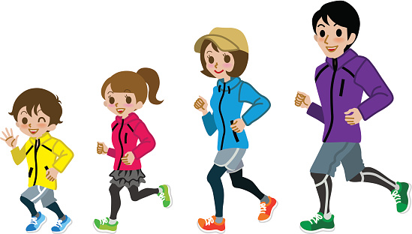

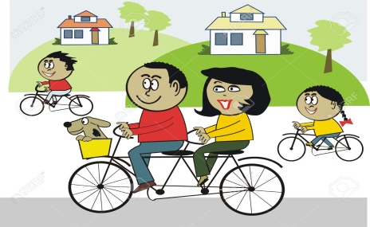
Our active challenge starts Thursday 14th May and ends Wednesday 20th May.
Farnborough gets Active
When going out for your daily exercise, measure how many kilometres you cover across 7 days (dates above).
All activities count - walking a dog, walking through the woods, running, cycling, scooting are all perfect.
Once you have completed the week, email your class teacher on the class email with the total of kilometres: year____learning@farnborough.bromley.sch.uk
The final day to supply teachers with your total is Friday 22nd May.
Which class will be crowned the most active?

Slide 9
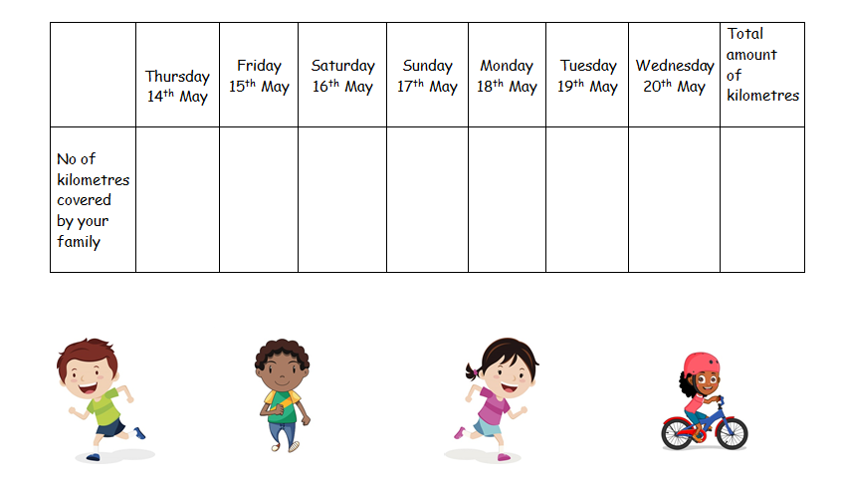
Here is a table your child can use to record your distances
Farnborough gets Active

Slide 10
Physical activity – minimum 30 minutes each day | Link to resource
5 a day User Name: FPS53 / Password: JFz4XqG7 | https://player.5-a-day.tv/
Joe Wicks – PE sessions | https://www.youtube.com/channel/UCAxW1XT0iEJo0TYlRfn6rYQ
Cosmic Kids Yoga | https://www.youtube.com/user/CosmicKidsYoga
PE Hub Parents Portal | https://pehubportal.co.uk/
Go Noodle | https://www.gonoodle.com/good-energy-at-home-kids-games-and-videos/
Go for a walk/run. You must go with an adult from your home and make sure you stay 2 metres away from other people.

Slide 11
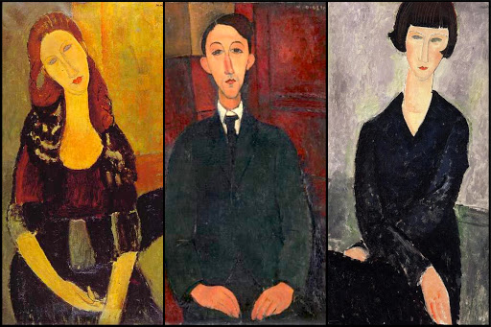
Modigliani’s portraits are so characteristic that it is easy to copy them!
Draw Like Modigliani

Slide 12
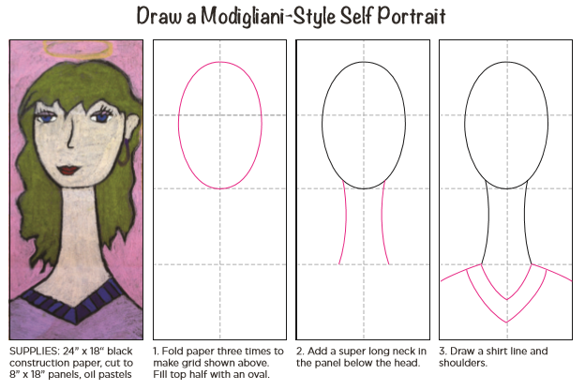

Slide 13
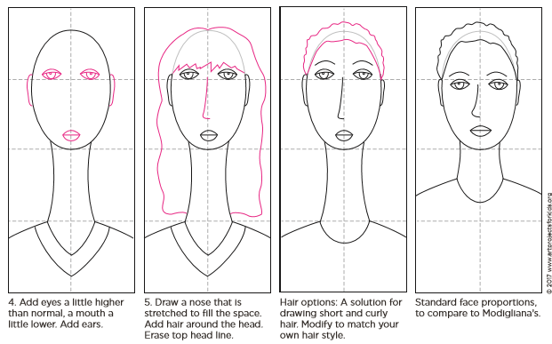

Slide 14
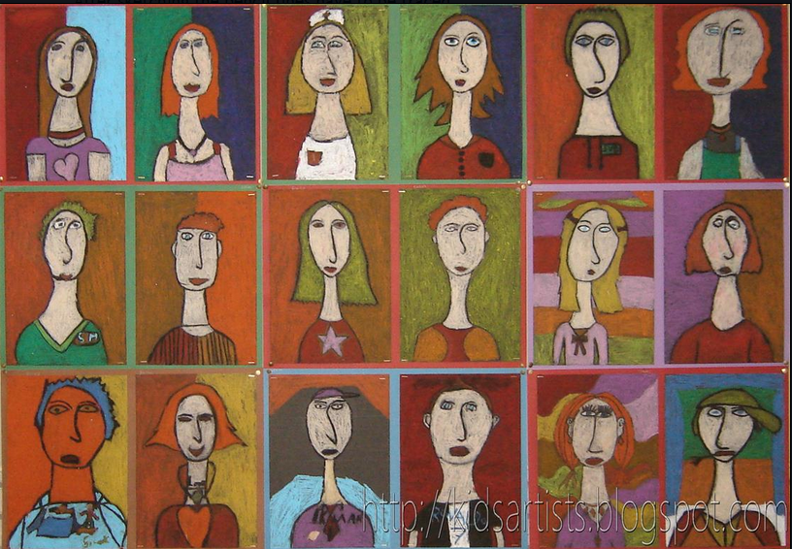
If you have pastels use to colour as these children have, if not use what you have and be creative.
Maybe try a monochrome version (Black and White), it could be very effective.

Slide 15
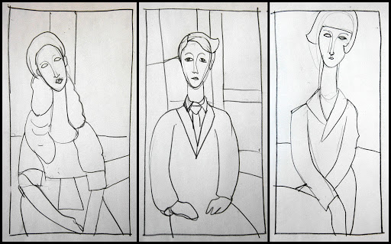
If you really enjoy doing these Modigliani Portraits, checkout my favourite art website for another lesson!
http://arteascuola.com/2012/11/modigliani-style-with-oil-pastels/

