Slide 1
Subject / Lesson | Time
Maths | 1 hour
Grammar | 20 minutes
English | 40 minutes
Physical Activity | 30 minutes
Science | 30 minutes

Slide 2
Maths Task | Time
Maths Frame – Roman Numerals Username: Farnborough / Password: Farnborough https://mathsframe.co.uk/en/resources/resource/248 | 15 minutes
Complete Power Maths or My Maths task on the next page. | 40 minutes

Slide 3
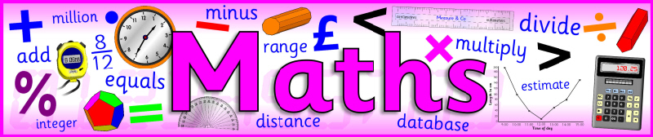
I would like you to continue with Power Maths or carry out the tasks on My Maths.
Power Maths (instructions on next slide)
Read and complete from page 40 to page 43. (Answers start from page 164)
My Maths (log in details should have been emailed to you)
Complete ‘Starting to multiply decimals’

Slide 4
Instructions for Power Maths
Click on-
http://go.pardot.com/e/749453/PowerMathsYear6/51zwx/107010261?h=9zEkYm9Vv36T0kIK2mGoBlvXYizjLxGA8JPqztzRvMQ
(You might need to copy and paste this link into your web browser)
Agree to the terms and conditions and click ‘Continue’.
Click on ‘Power Maths Year 6’
Click on ‘Power Maths Year 6 Practice Book Summer Home Edition’

Slide 5
Grammar Task | Time
Have a go at the relative clause task. http://farnboroughprimary.co.uk/wp-content/uploads/2020/05/relative_clauses.pdf Answers: http://farnboroughprimary.co.uk/wp-content/uploads/2020/05/relative_clauses_answers.pdf Below is a BBC bitesize page about relative clauses https://www.bbc.co.uk/bitesize/topics/zwwp8mn/articles/zsrt4qt | 20 minutes

Slide 6

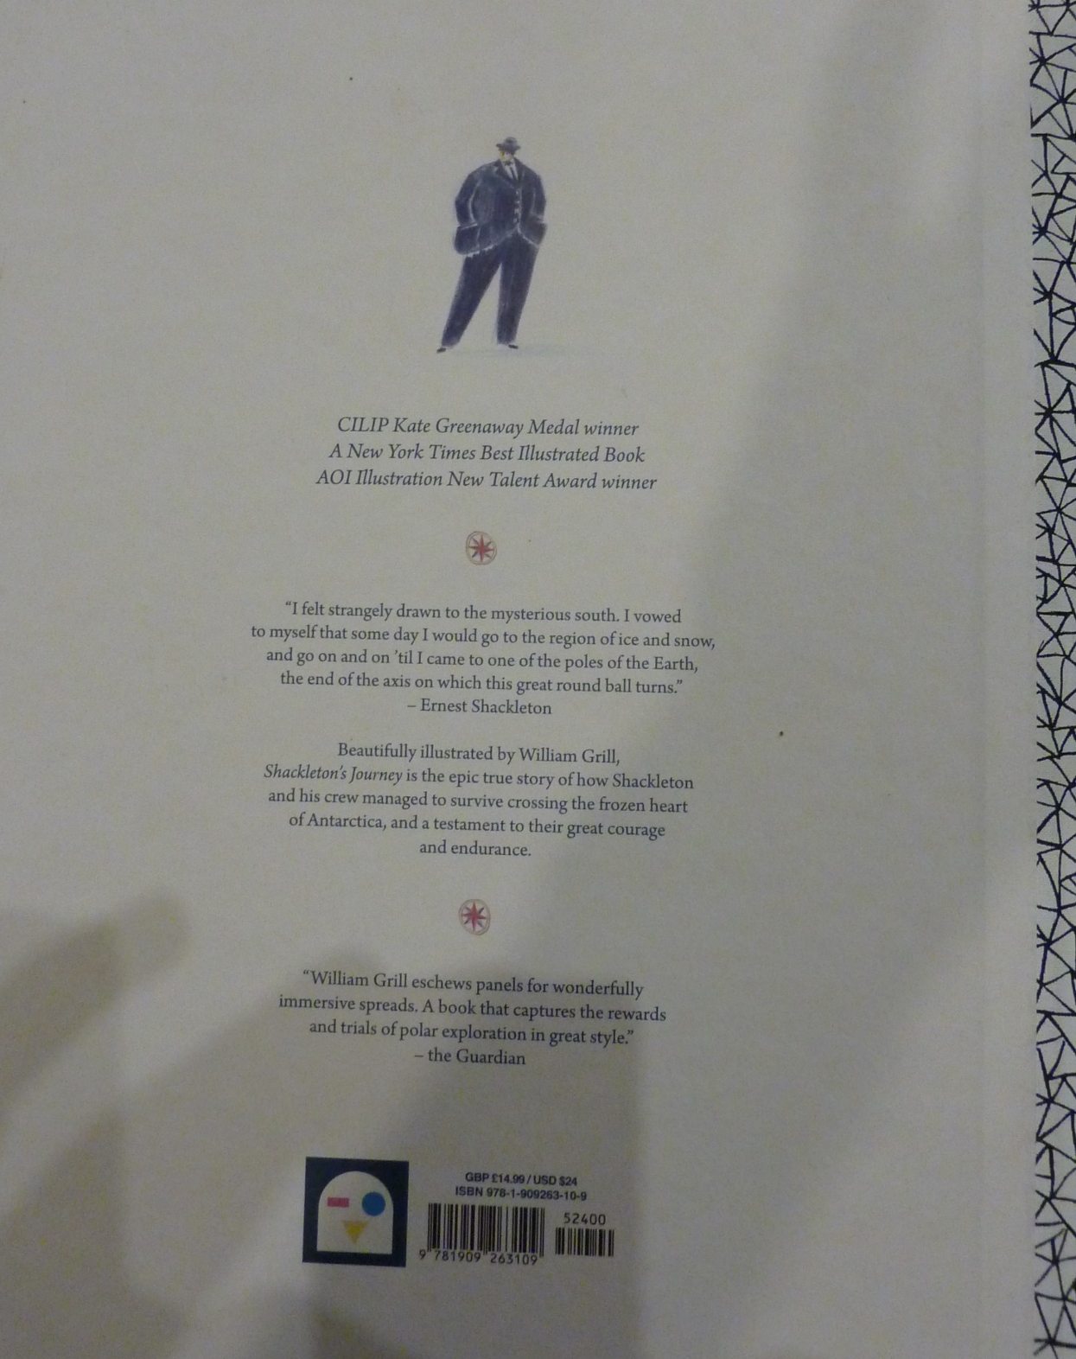

Slide 7
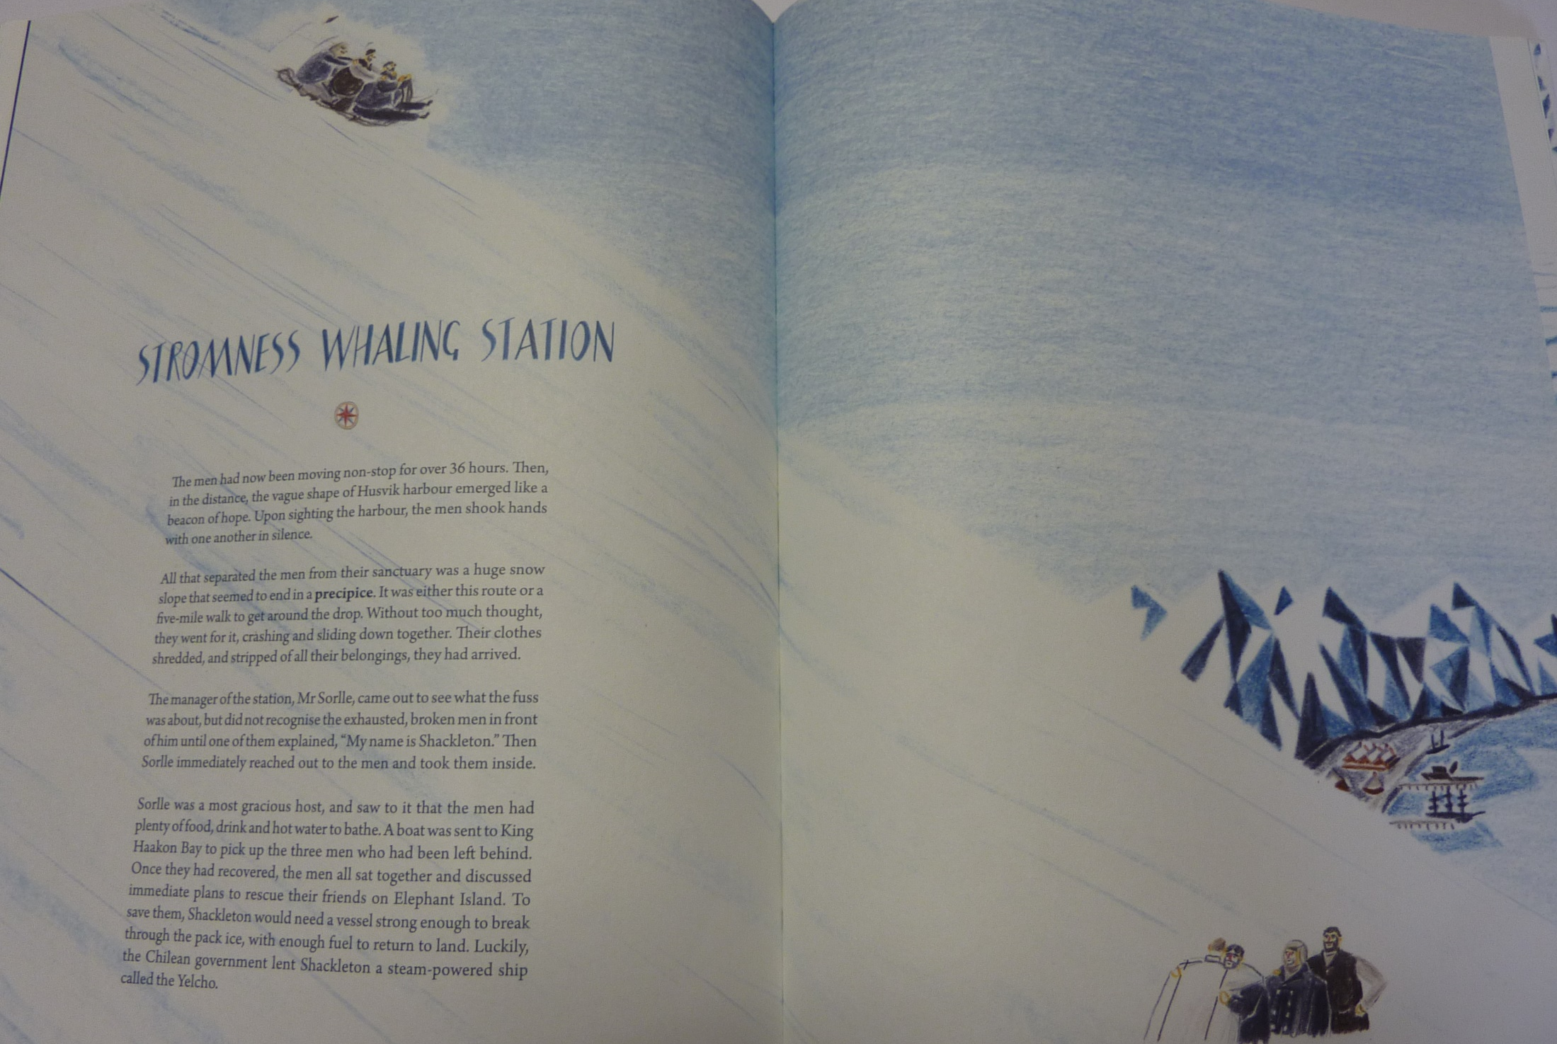

Slide 8
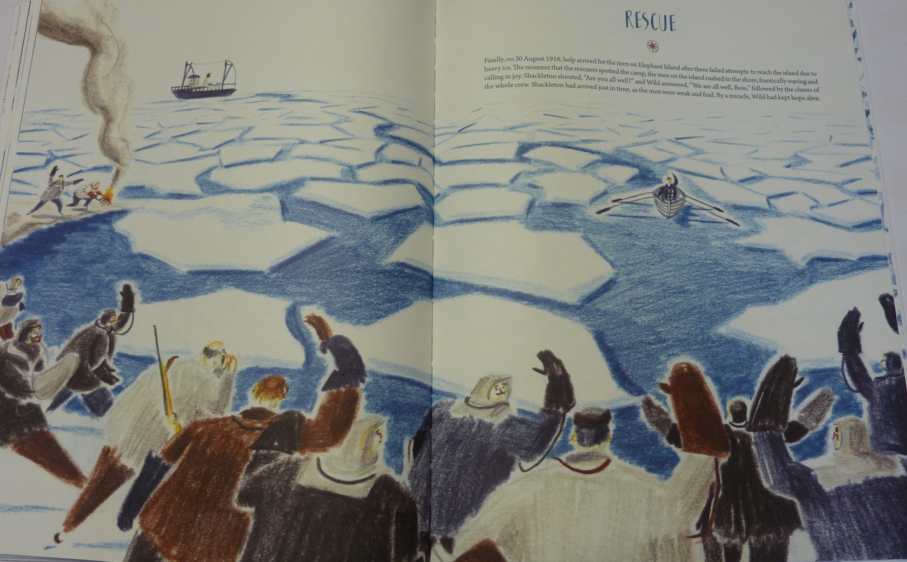

Slide 9
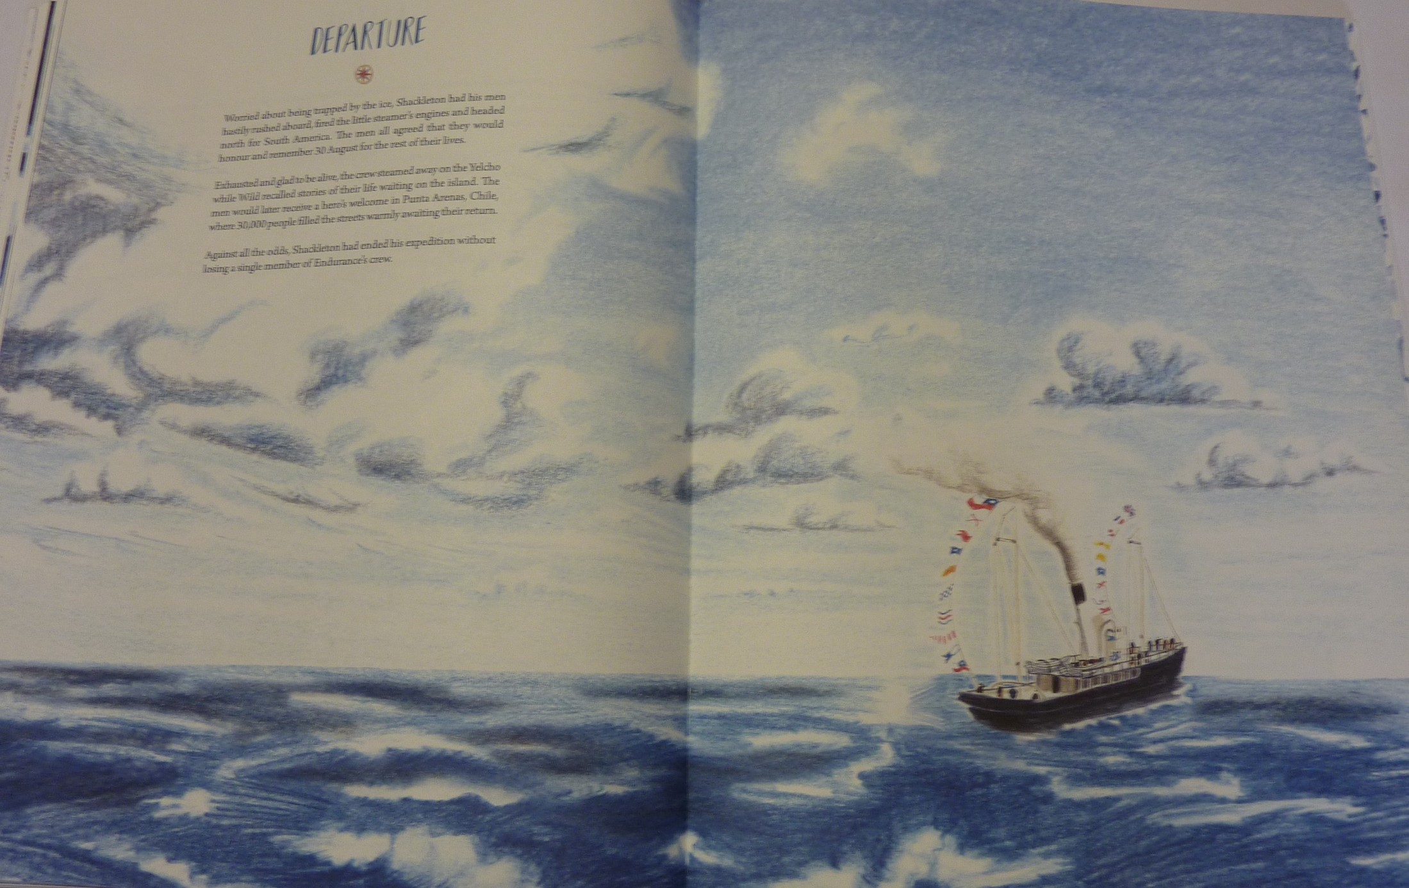

Slide 10
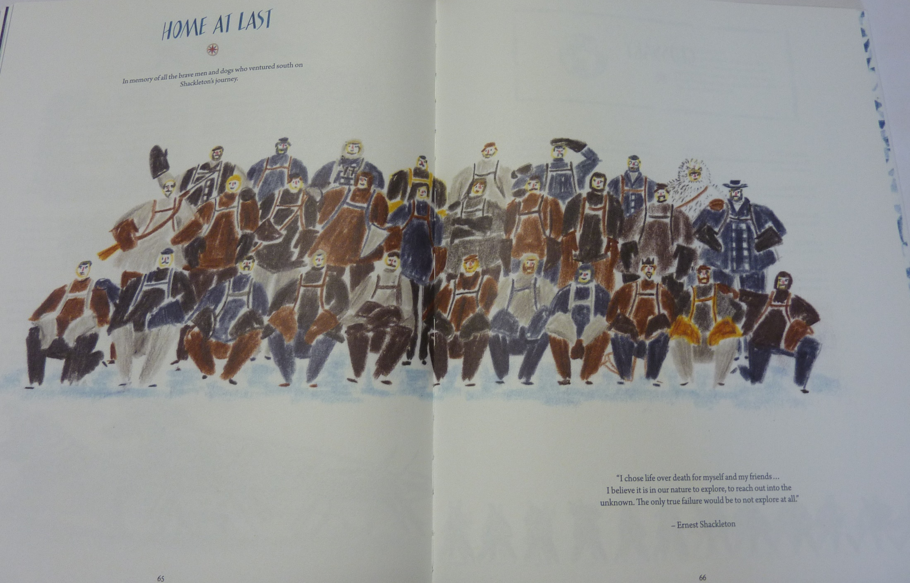

Slide 11

Shackleton Makes it Home
Shackleton’s achievements were unbelievable. To keep all his men alive over those years seemed like an impossible task. He returned a hero and what do we do when a hero returns?
We have a party of course.
Write a party invitation to invite some important people to a special celebration. Can you add a picture/photo?

Slide 12
Physical activity – minimum 30 minutes each day | Link to resource
5 a day User Name: FPS53 / Password: JFz4XqG7 | https://player.5-a-day.tv/
Joe Wicks – PE sessions | https://www.youtube.com/channel/UCAxW1XT0iEJo0TYlRfn6rYQ
Cosmic Kids Yoga | https://www.youtube.com/user/CosmicKidsYoga
PE Hub Parents Portal | https://pehubportal.co.uk/
Go Noodle | https://www.gonoodle.com/good-energy-at-home-kids-games-and-videos/
Go for a walk/run. You must go with an adult from your home and make sure you stay 2 metres away from other people.

Slide 13

Living Things and their habitats
Complete you zoo.
http://farnboroughprimary.co.uk/wp-content/uploads/2020/05/zoo.pdf
Send me a picture of it:
yearsixlearning@Farnborough.Bromley.sch.uk

