Slide 1
Subject / Lesson | Time
Maths | 45 minutes
Comprehension–What can you see? | 20 minutes
English – read Shackleton
Physical Activity | 30 minutes
VE day activities | 1 hour

Slide 2
Maths Task | Time
Try this negative number game https://www.oxfordowl.co.uk/api/interactives/24443.html | 15 minutes
Multiplication task http://farnboroughprimary.co.uk/wp-content/uploads/2020/04/multiplication.pdf Answers http://farnboroughprimary.co.uk/wp-content/uploads/2020/04/multiplication-answers.pdf | 30 minutes

Slide 3
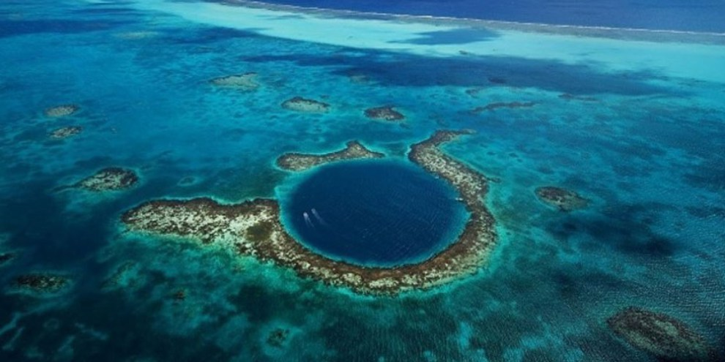
What can you see?
What questions could you ask?
What can you infer from the image?

Slide 4

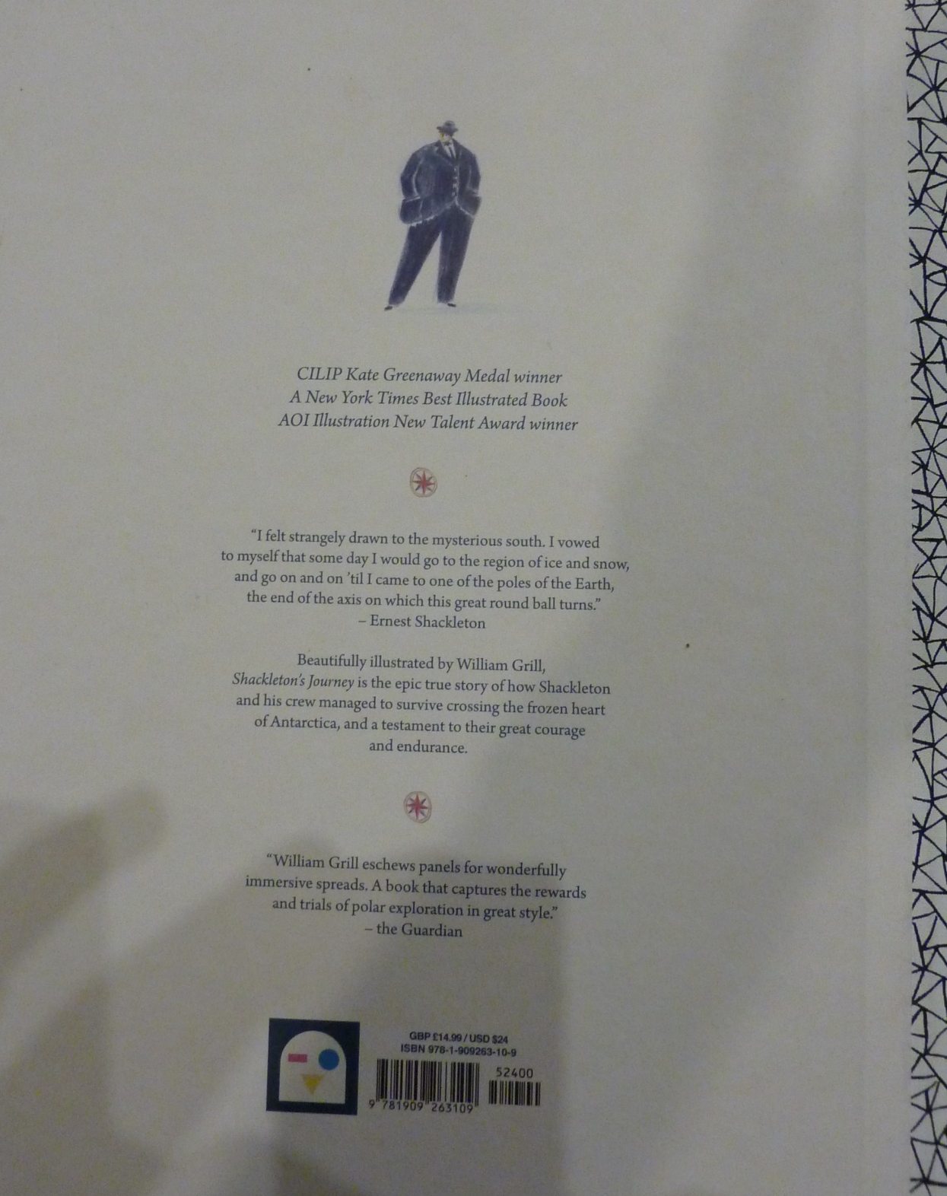

Slide 5
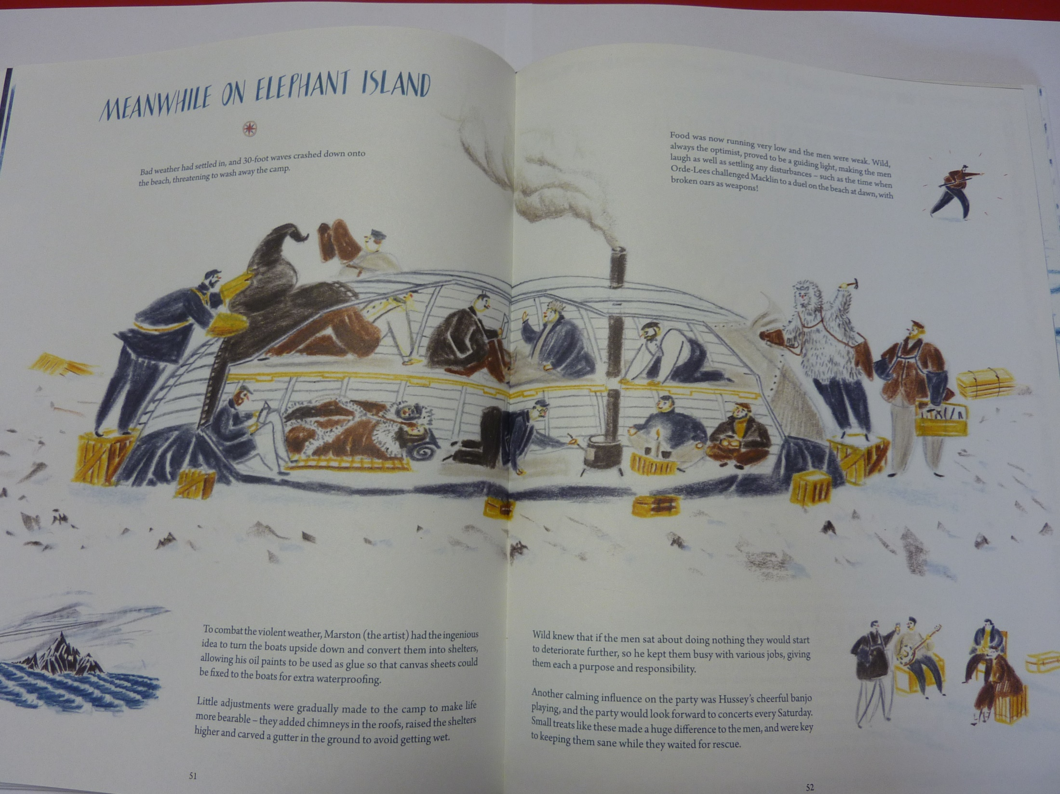

Slide 6
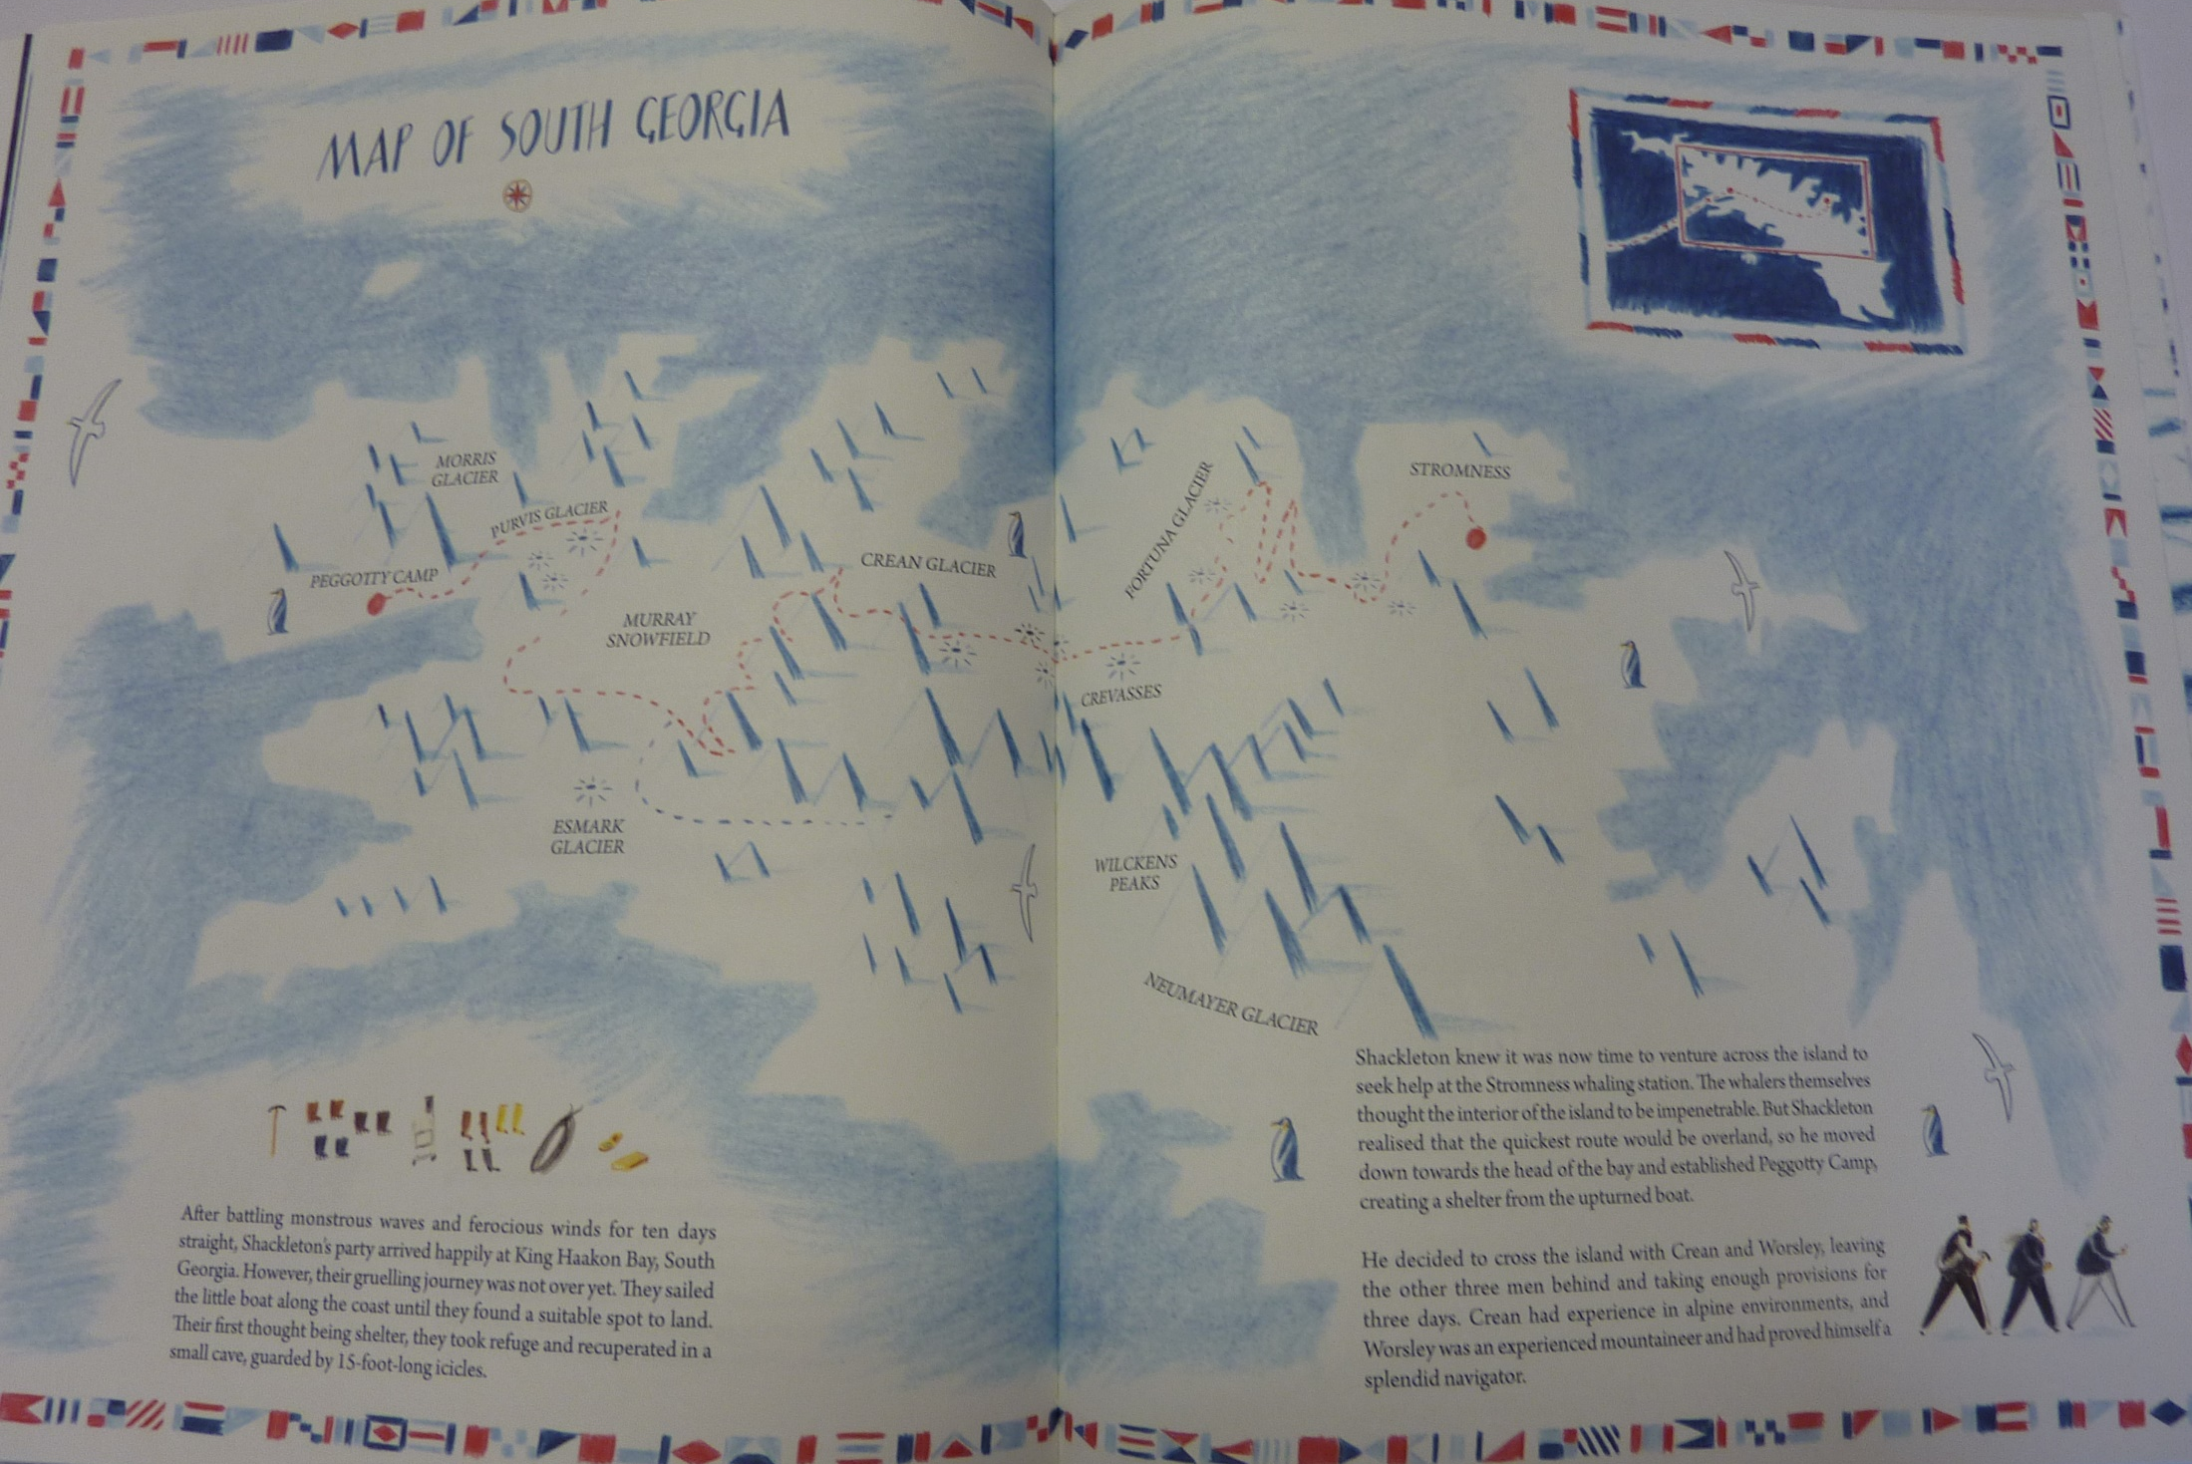

Slide 7
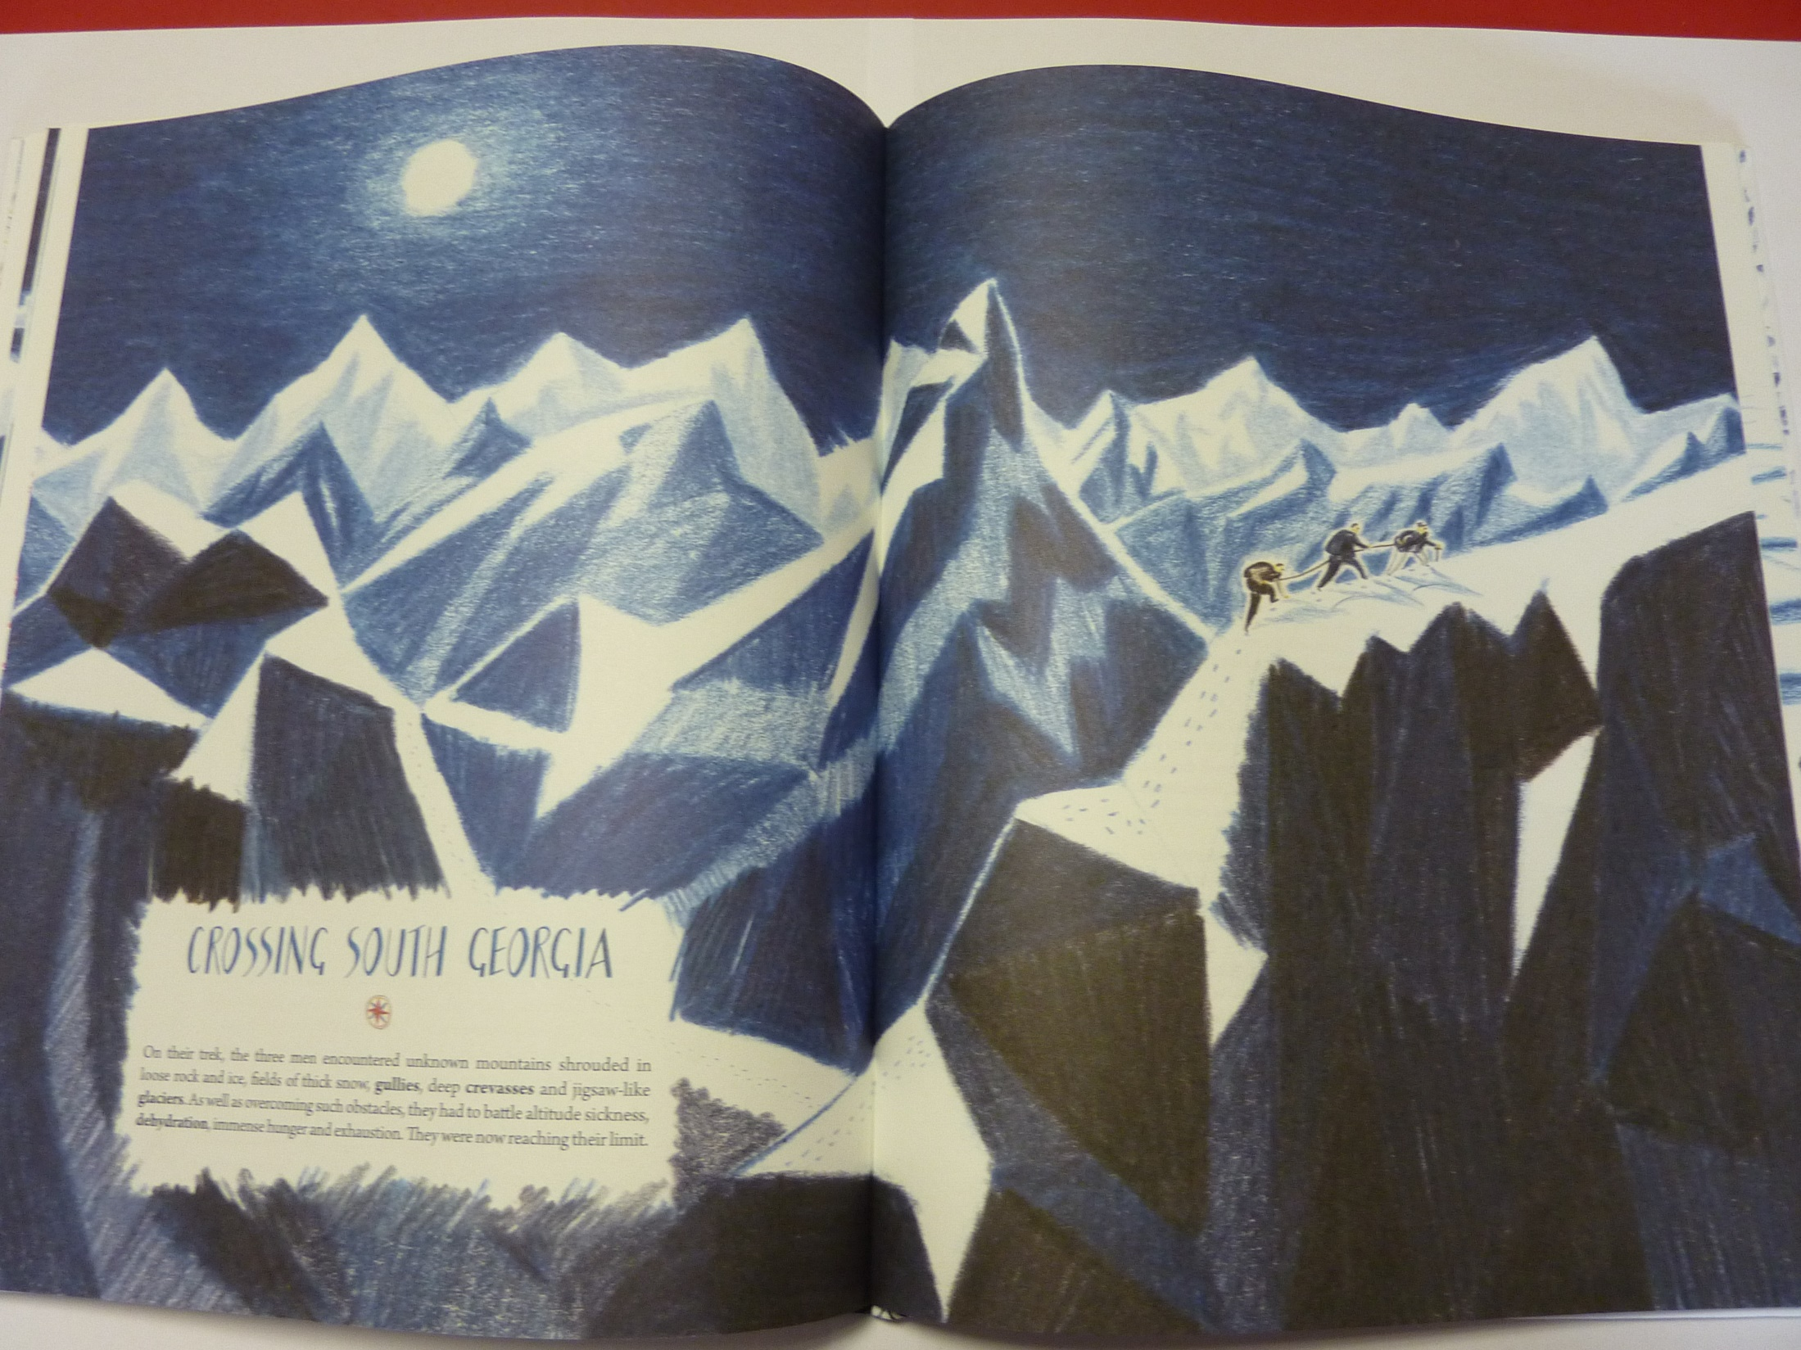

Slide 8
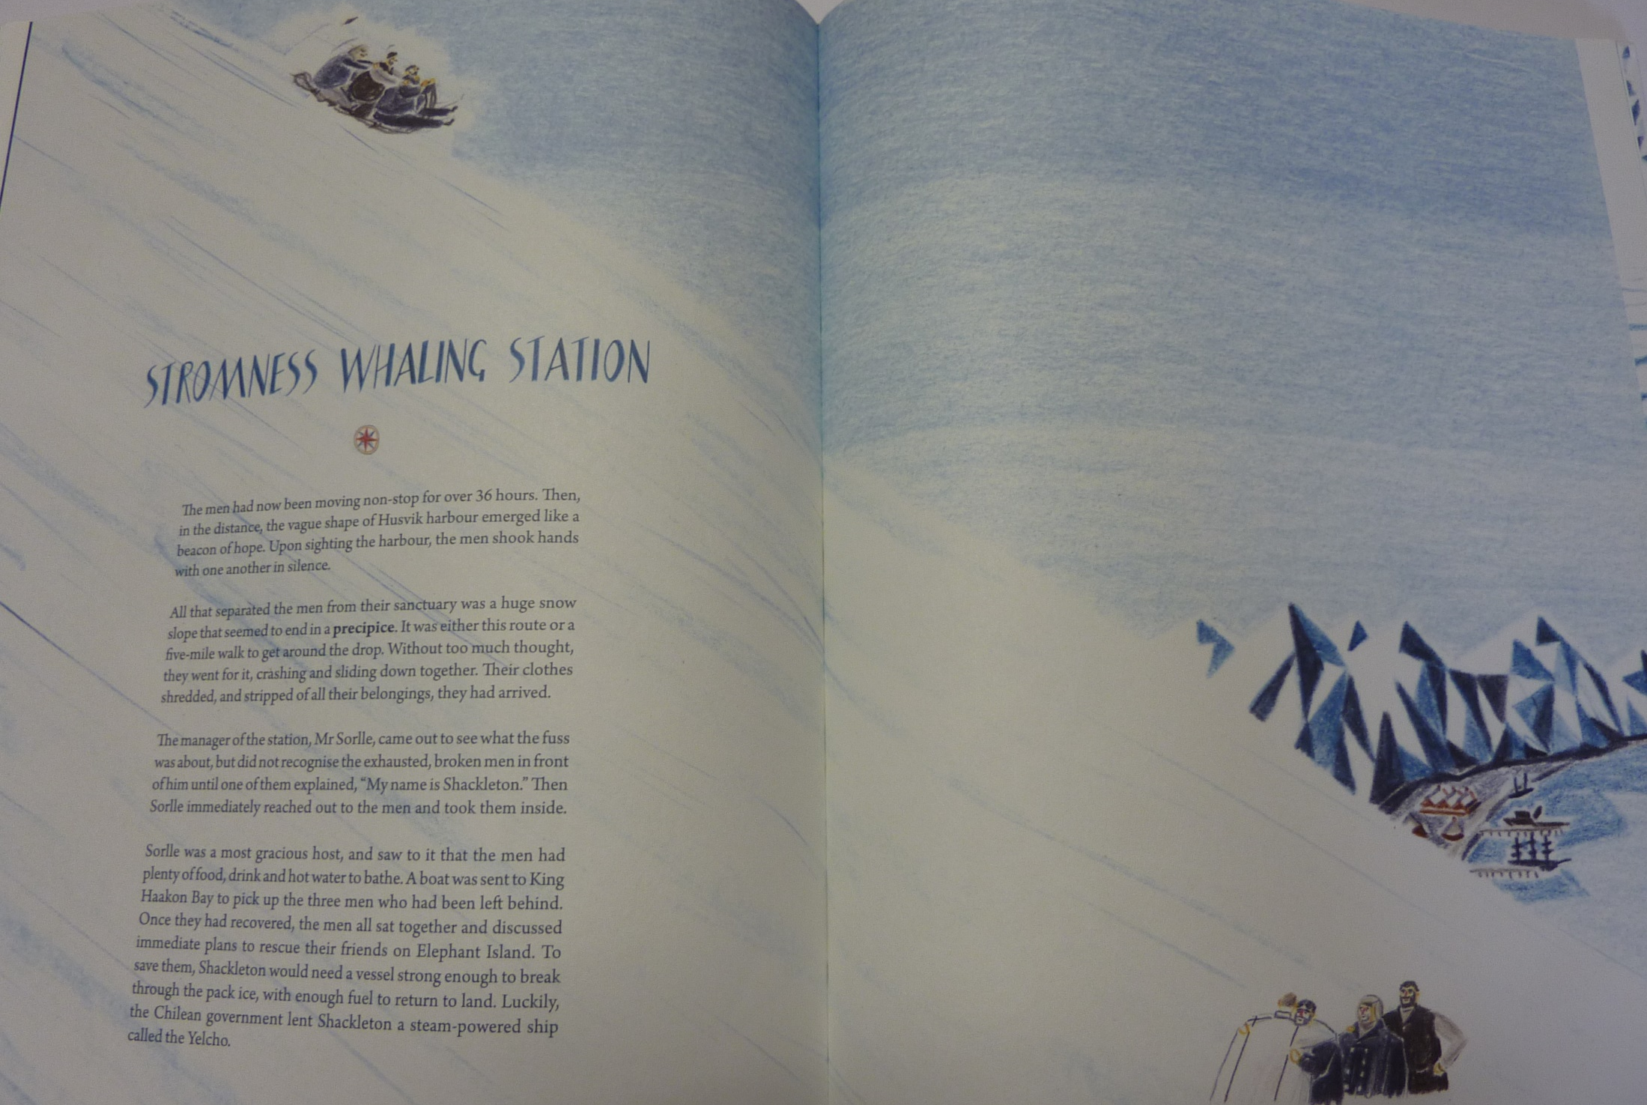

Slide 9
Physical activity – minimum 30 minutes each day | Link to resource
5 a day User Name: FPS53 / Password: JFz4XqG7 | https://player.5-a-day.tv/
Joe Wicks – PE sessions | https://www.youtube.com/channel/UCAxW1XT0iEJo0TYlRfn6rYQ
Cosmic Kids Yoga | https://www.youtube.com/user/CosmicKidsYoga
PE Hub Parents Portal | https://pehubportal.co.uk/
Go Noodle | https://www.gonoodle.com/good-energy-at-home-kids-games-and-videos/
Go for a walk/run. You must go with an adult from your home and make sure you stay 2 metres away from other people.

Slide 10

Find some facts out about VE day (pick a link you want to look at)
https://www.bbc.co.uk/teach/class-clips-video/history-ks2-ve-day/z7xtmfr
https://www.english-heritage.org.uk/ve-day
https://www.iwm.org.uk/history/what-you-need-to-know-about-ve-day
Try a VE day activity:
http://farnboroughprimary.co.uk/wp-content/uploads/2020/04/VE-Day-Kids-2020.pdf

