Slide 1
Subject / Lesson | Time
Maths | 1 hour
Grammar | 20 minutes
Comprehension | 20 minutes
English | 40 minutes
Physical Activity | 30 minutes
Music Project | 30 minutes

Slide 2
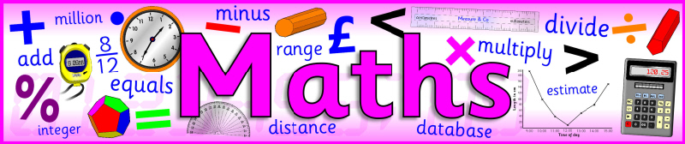
I would like you to continue with Power Maths or carry out the tasks on My Maths.
Power Maths (instructions on next slide)
Read and complete from page 28 to page 31. (Answers start from page 164)
My Maths (log in details should have been emailed to you)
Complete ‘Multiplying fractions by fractions’

Slide 3
Instructions for Power Maths
Click on-
http://go.pardot.com/e/749453/PowerMathsYear6/51zwx/107010261?h=9zEkYm9Vv36T0kIK2mGoBlvXYizjLxGA8JPqztzRvMQ
(You might need to copy and paste this link into your web browser)
Agree to the terms and conditions and click ‘Continue’.
Click on ‘Power Maths Year 6’
Click on ‘Power Maths Year 6 Practice Book Summer Home Edition’

Slide 4
Grammar Task | Time
Complete the task about bullet points. http://farnboroughprimary.co.uk/wp-content/uploads/2020/04/bullet-points.pdf Answers http://farnboroughprimary.co.uk/wp-content/uploads/2020/04/g-answers-5.pdf | 20 minutes

Slide 5
Comprehension Task | Time
Complete the text about rainforest animals Choose either normal or hard http://farnboroughprimary.co.uk/wp-content/uploads/2020/04/rainforest-normal.pdf http://farnboroughprimary.co.uk/wp-content/uploads/2020/04/rainforest-hard.pdf | 20 minutes

Slide 6

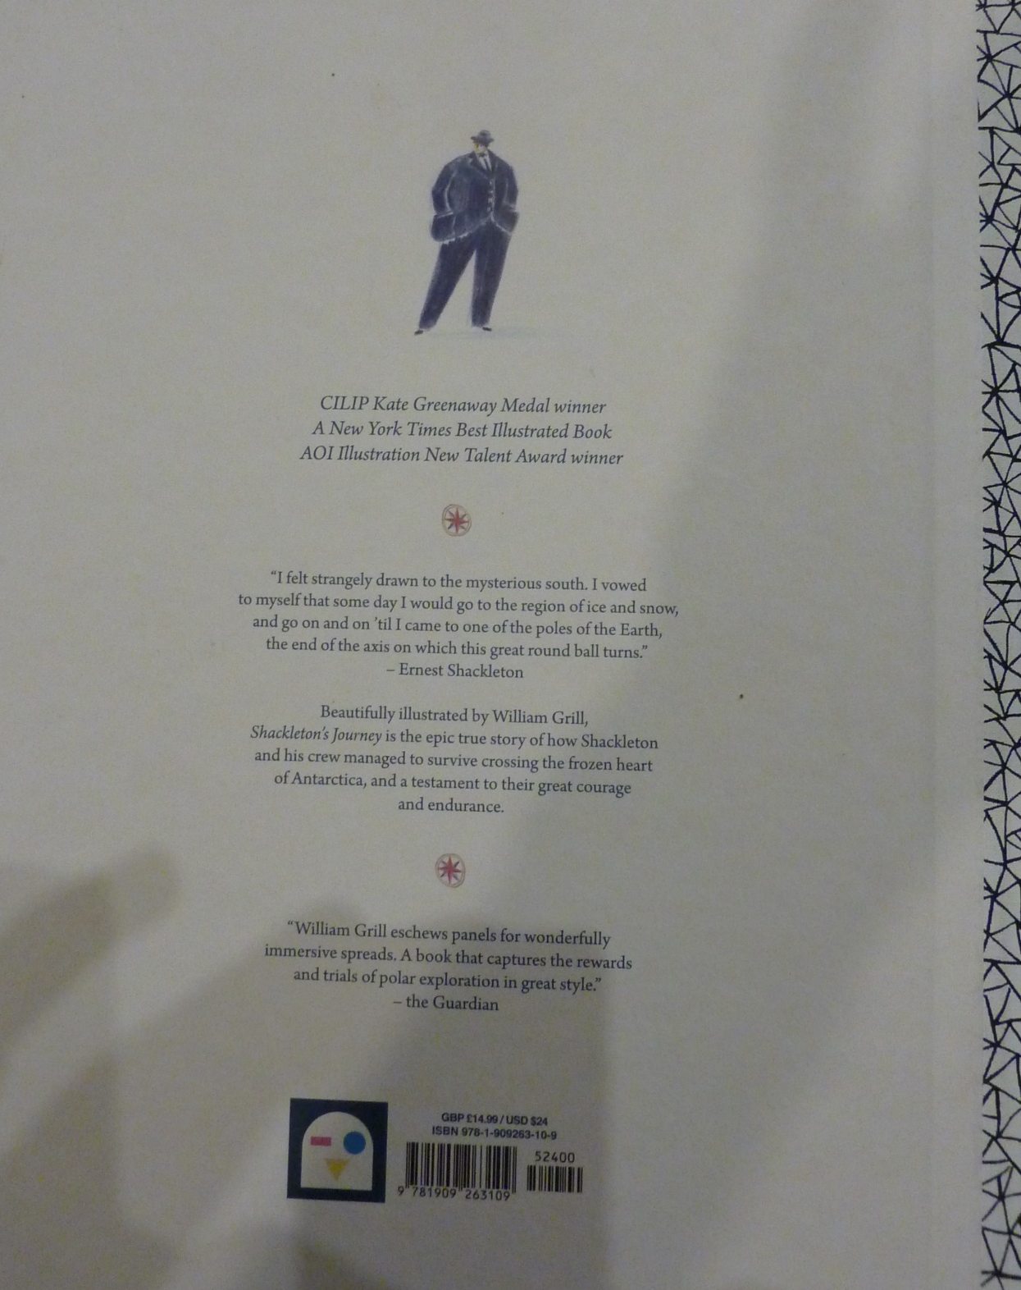

Slide 7
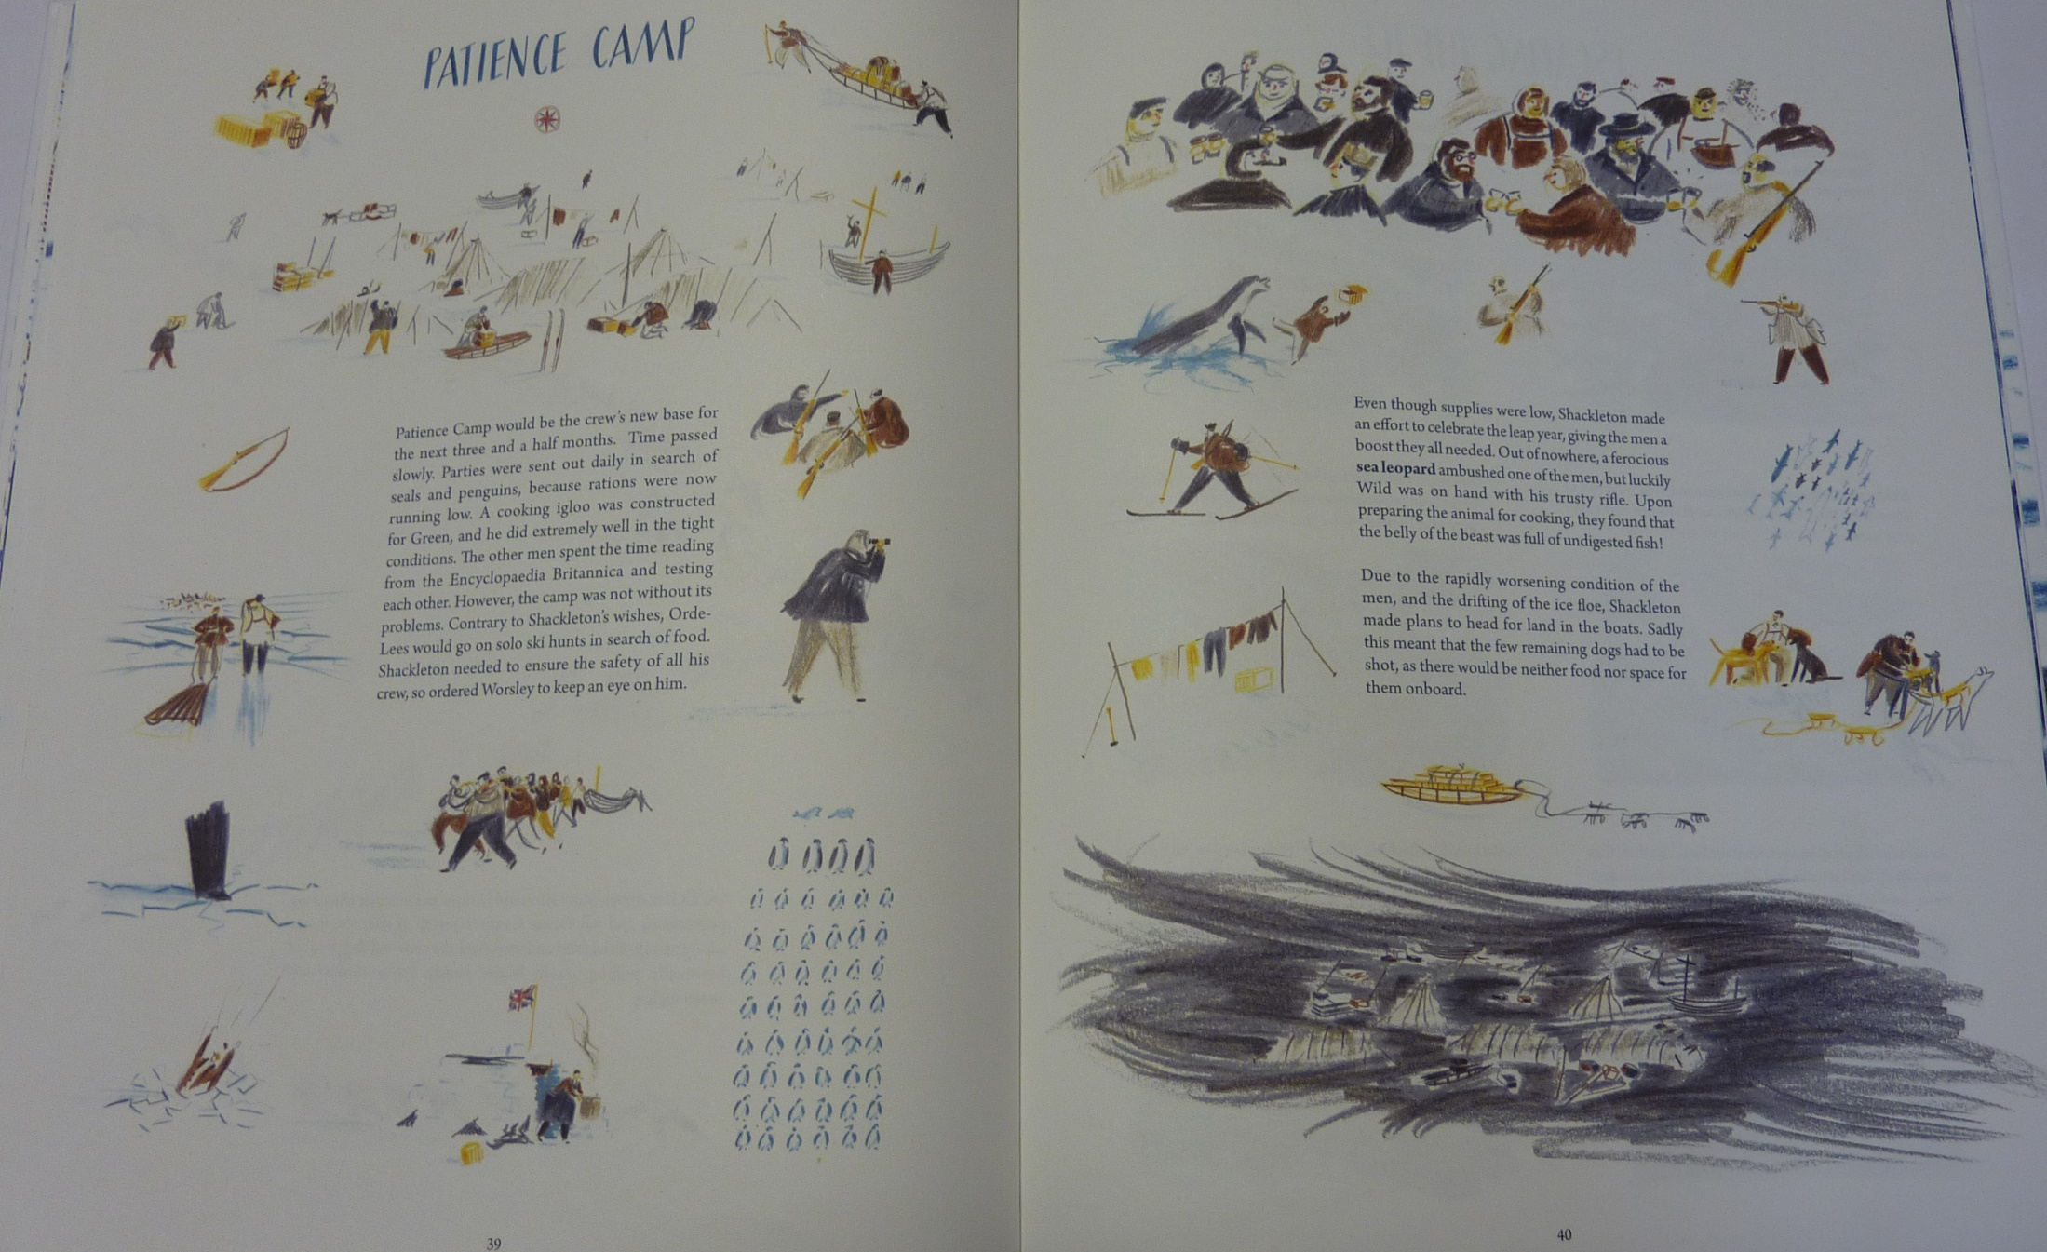

Slide 8
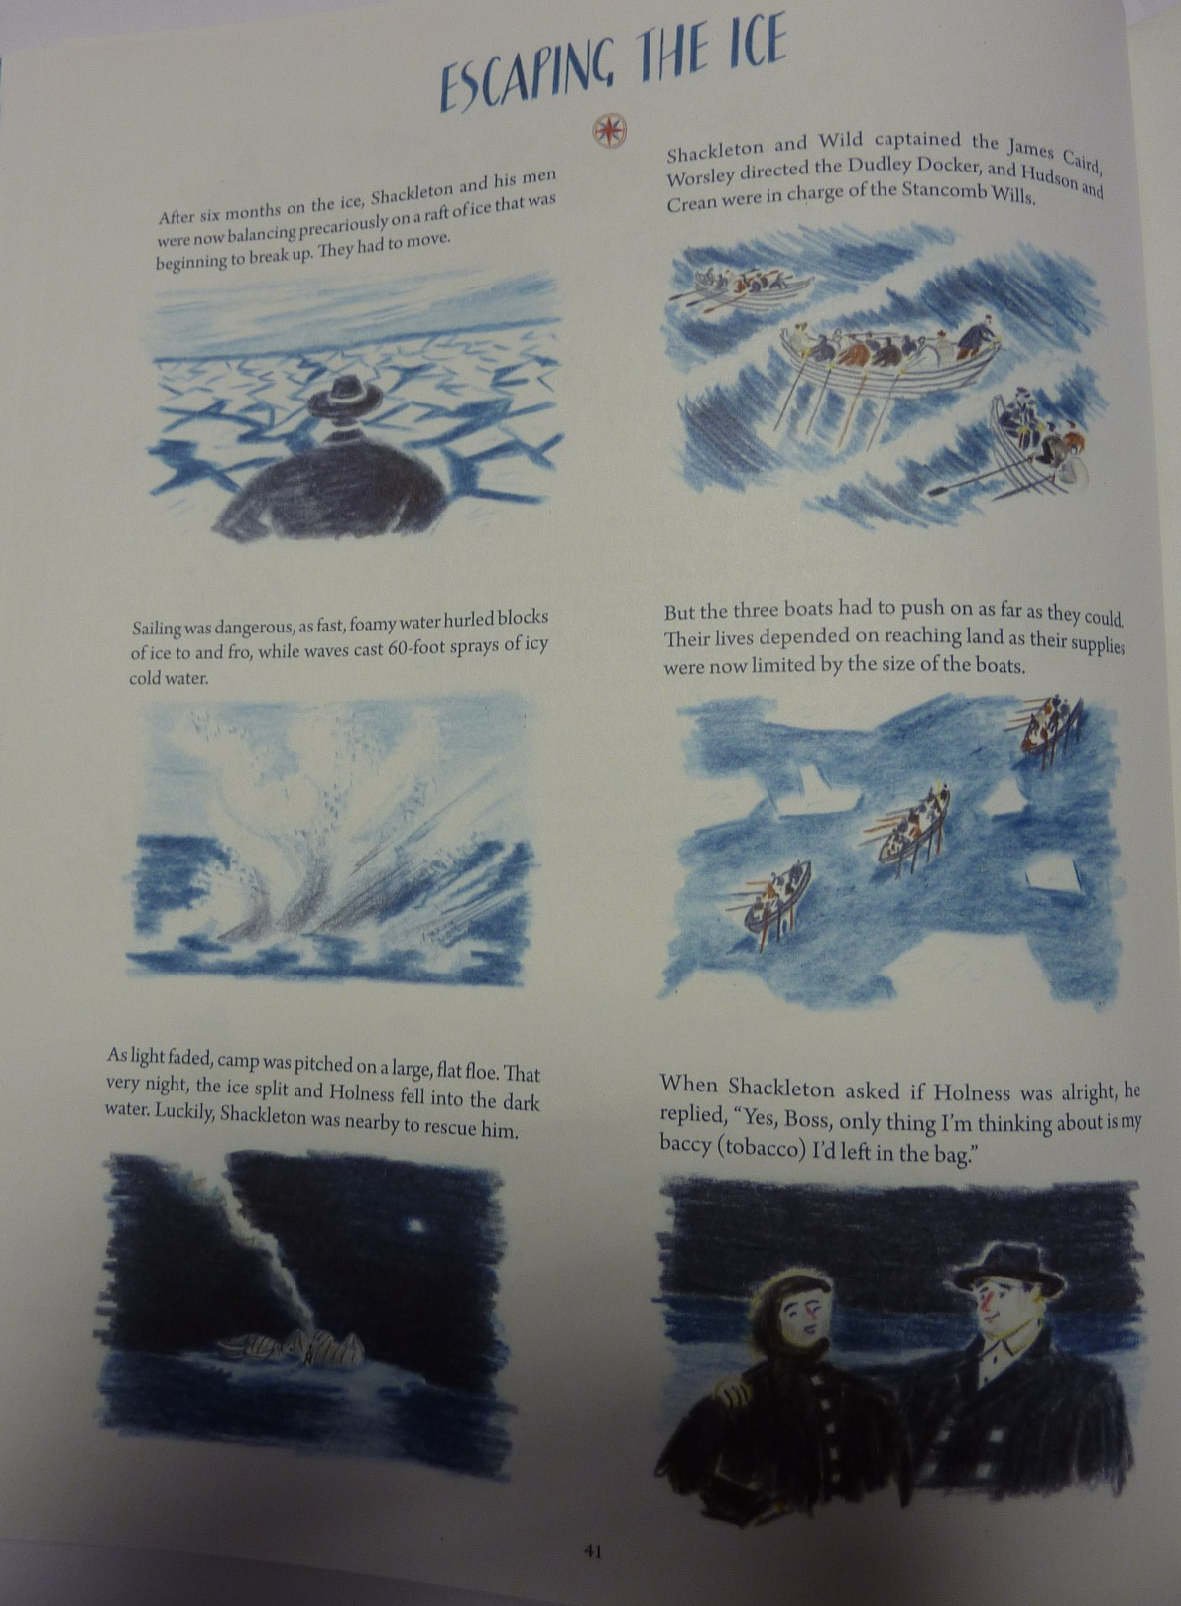
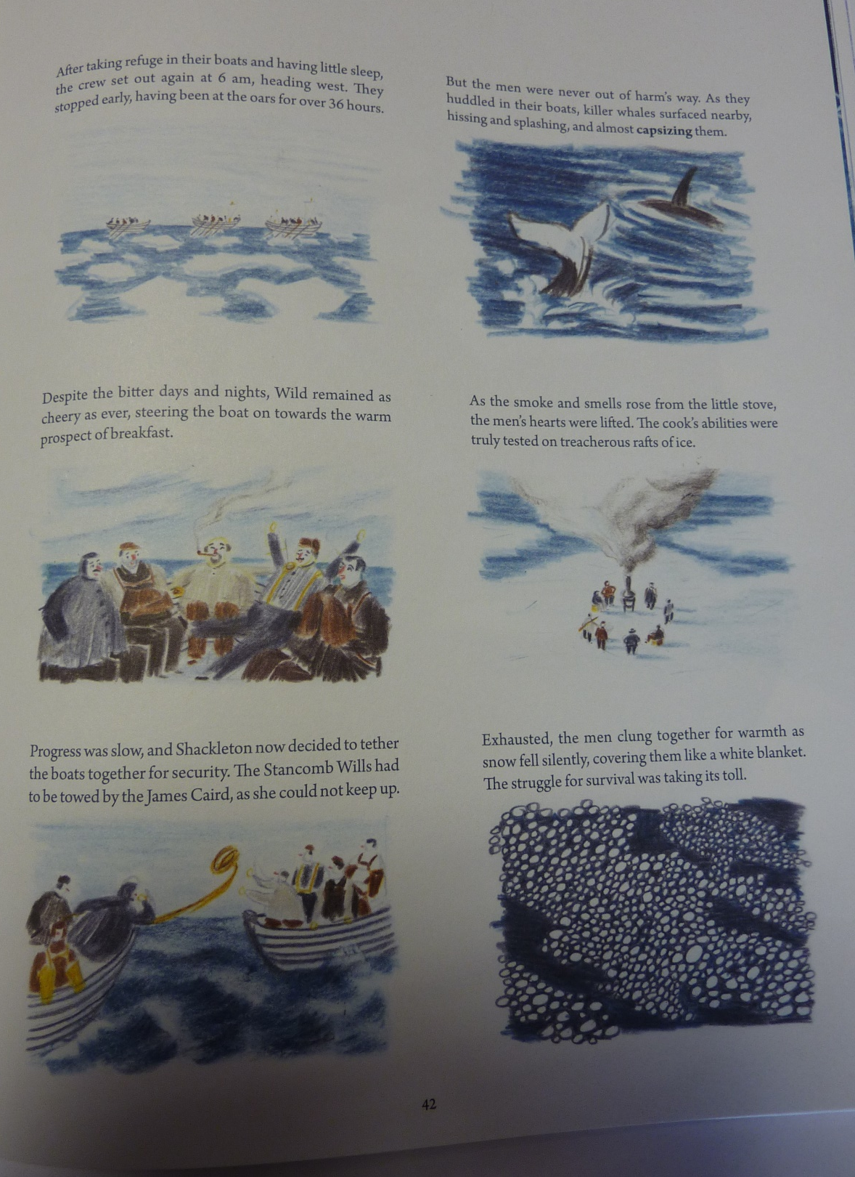

Slide 9
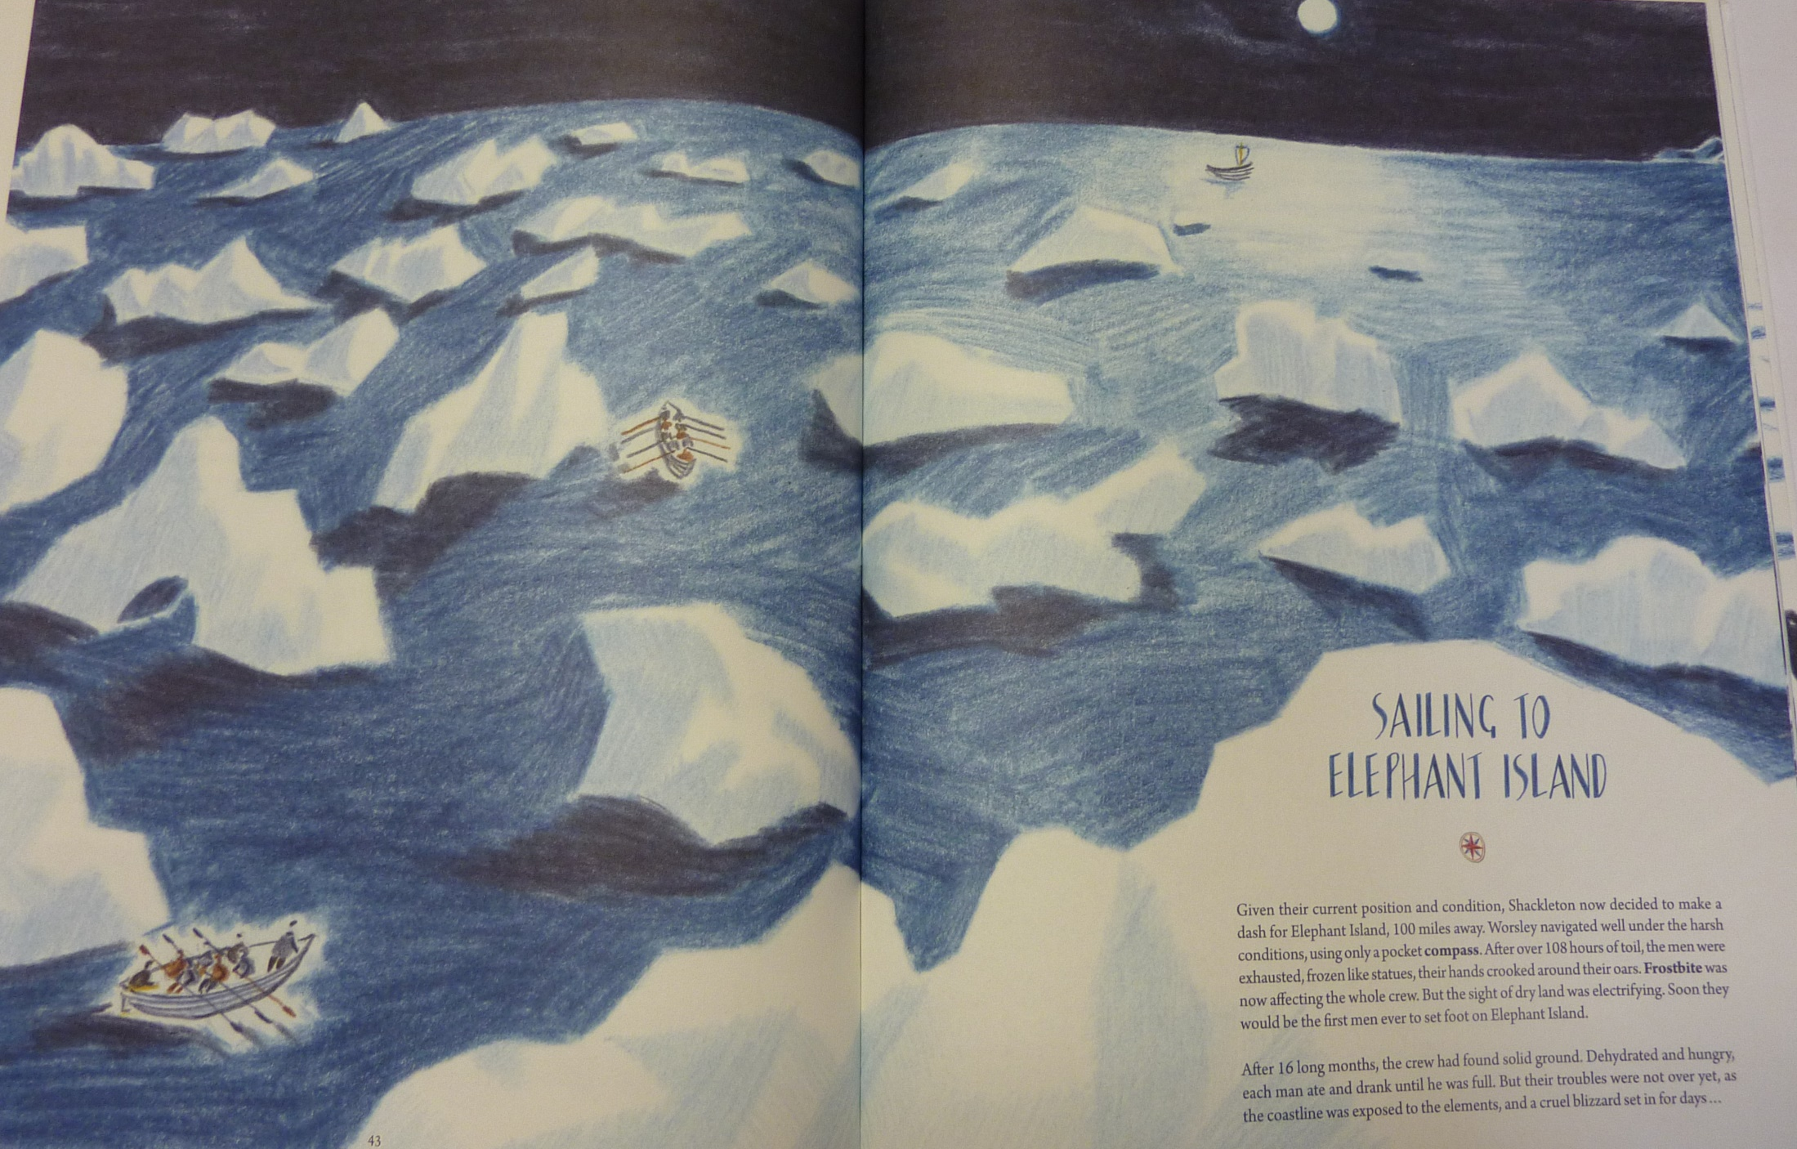

Slide 10
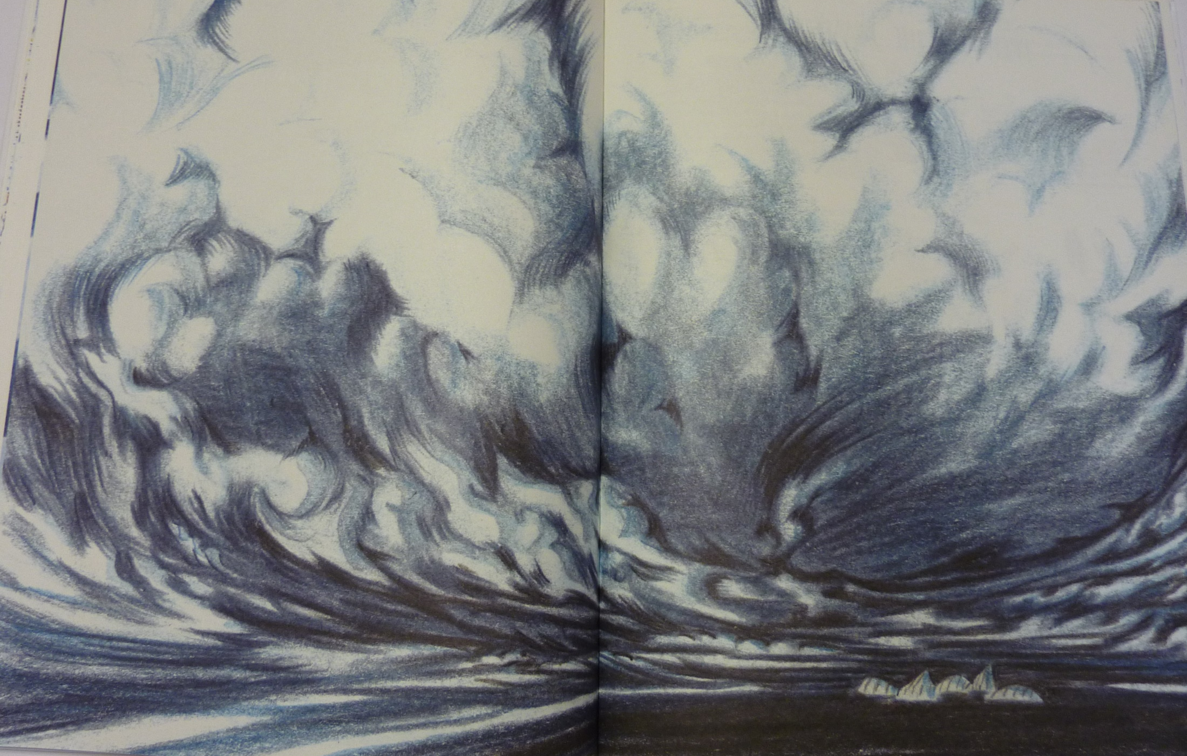

Slide 11
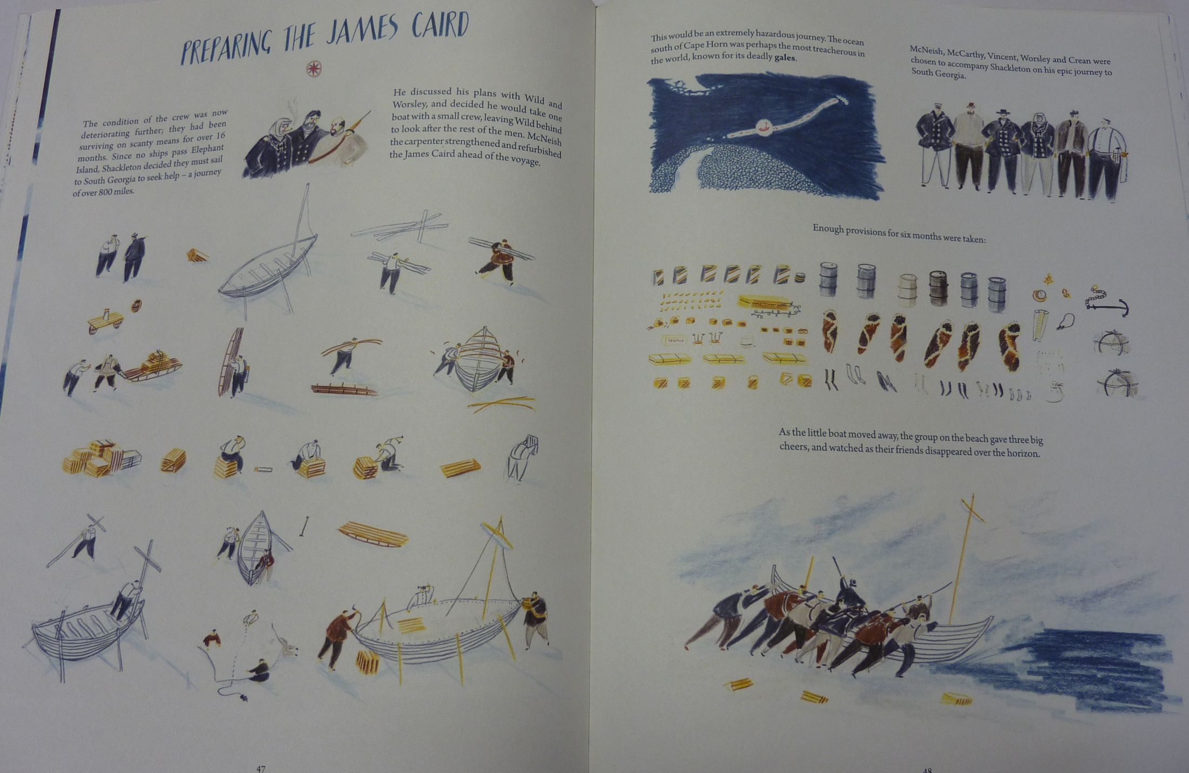

Slide 12
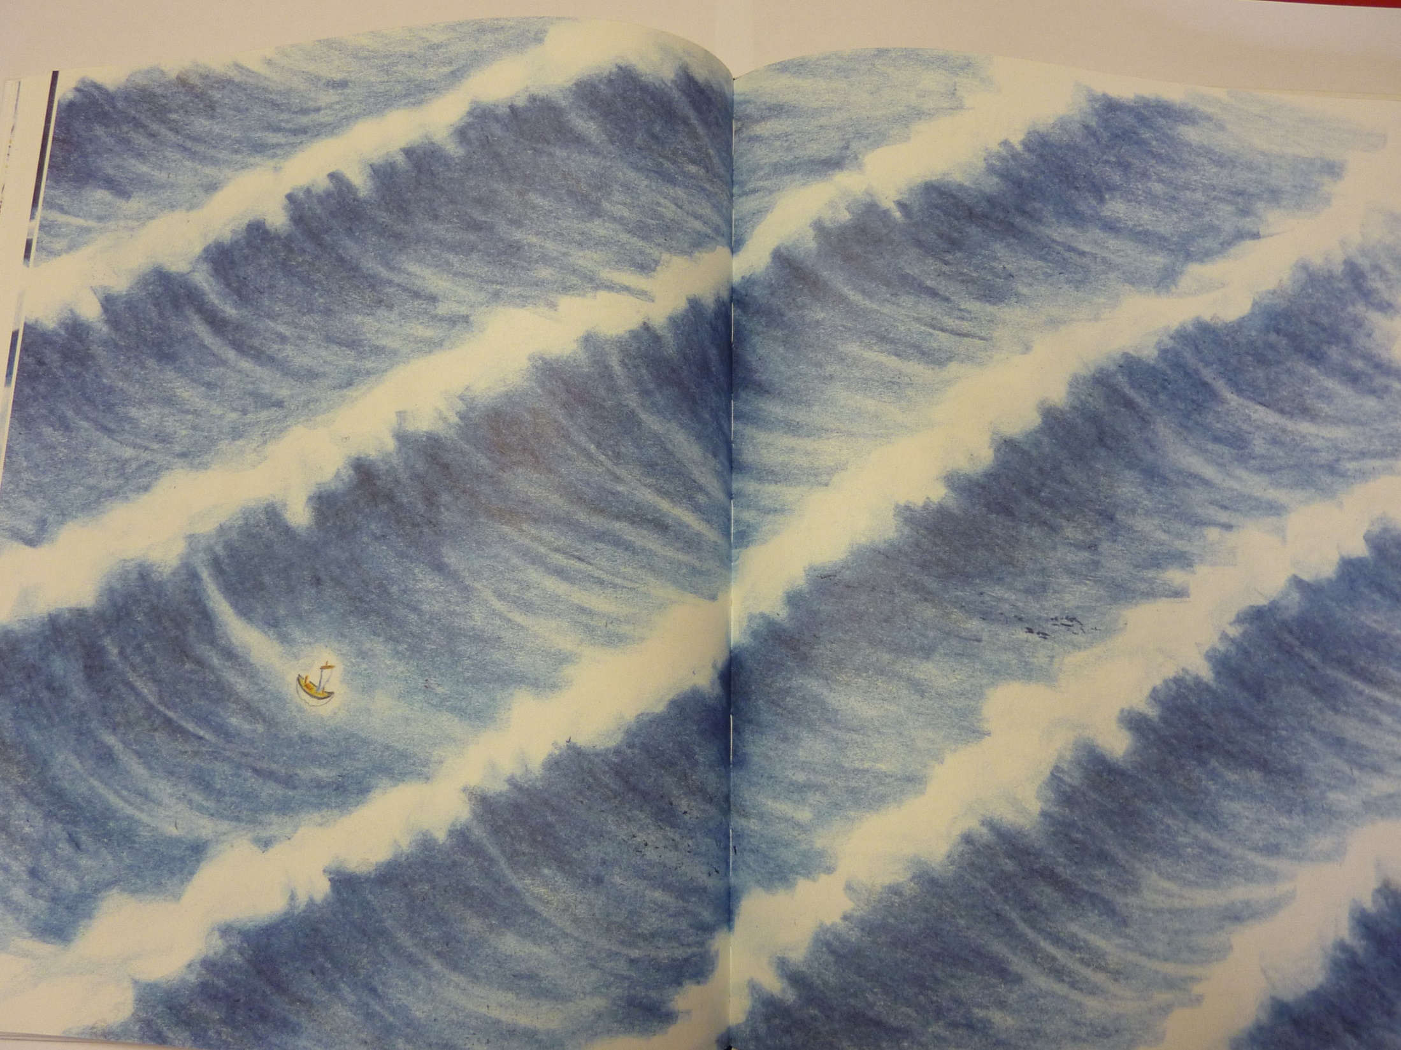

Slide 13

Today we will create another spine poem but using an image from the book. You can use your imagination to fill in any gaps.

Slide 14
To create a sense of isolation, we are going to start with a noun in the boat and then focus on larger and larger nouns.
Think now what your 4 nouns could be. Use your imagination.

Slide 15
Draw a table in your book like mine. Add in your 4 nouns.
Write as many possible adjectives for each noun
Write as many possible verbs for each noun
(Spend 15 minutes in total for all 4 – don’t judge the words yet – just write them down)
Adjective | Noun | Verb
Tiny, shiny, compact | compass | Sitting in a hand, unmoving
 | man
 | boat
 | waves | Rolling, crushing, grasping

Slide 16
Now convert your table into a 4 line poem – try and remember how we would do it in class.
Write a line down
Say it aloud
If you like it, keep it. If you don’t like it, change it.
Send your poems to yearsixlearning@Farnborough.Bromley.sch.uk

Slide 17
Physical activity – minimum 30 minutes each day | Link to resource
5 a day User Name: FPS53 / Password: JFz4XqG7 | https://player.5-a-day.tv/
Joe Wicks – PE sessions | https://www.youtube.com/channel/UCAxW1XT0iEJo0TYlRfn6rYQ
Cosmic Kids Yoga | https://www.youtube.com/user/CosmicKidsYoga
PE Hub Parents Portal | https://pehubportal.co.uk/
Go Noodle | https://www.gonoodle.com/good-energy-at-home-kids-games-and-videos/
Go for a walk/run. You must go with an adult from your home and make sure you stay 2 metres away from other people.

Slide 18

We will continue with the project. Warm your voice up.
Starting at the top of page 5, try the ‘Writing melodies’ activity.
The link for the whole project is:
http://farnboroughprimary.co.uk/wp-content/uploads/2020/04/Songwriting-Project.pdf

