Slide 1
Subject / Lesson | Time
Maths | 1 hour
Grammar | 20 minutes
Comprehension | 20 minutes
English | 40 minutes
Physical Activity | 30 minutes
Music Project | 30 minutes

Slide 2
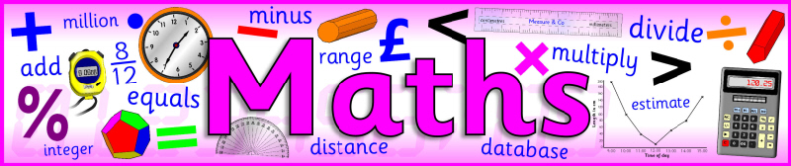
I would like you to continue with Power Maths or carry out the tasks on My Maths.
Power Maths (instructions on next slide)
Read and complete from page 24 to page 27. (Answers start from page 164)
My Maths (log in details should have been emailed to you)
Complete ‘Multiply Divide fractions intro’

Slide 3
Instructions for Power Maths
Click on-
http://go.pardot.com/e/749453/PowerMathsYear6/51zwx/107010261?h=9zEkYm9Vv36T0kIK2mGoBlvXYizjLxGA8JPqztzRvMQ
(You might need to copy and paste this link into your web browser)
Agree to the terms and conditions and click ‘Continue’.
Click on ‘Power Maths Year 6’
Click on ‘Power Maths Year 6 Practice Book Summer Home Edition’

Slide 4
Grammar Task | Time
Complete the task about parenthesis. http://farnboroughprimary.co.uk/wp-content/uploads/2020/04/parenthesis.pdf Answers http://farnboroughprimary.co.uk/wp-content/uploads/2020/04/g-answers-5.pdf | 20 minutes

Slide 5
Comprehension Task | Time
Complete the Sherlock Holmes text http://farnboroughprimary.co.uk/wp-content/uploads/2020/04/Sherlock.pdf | 20 minutes

Slide 6

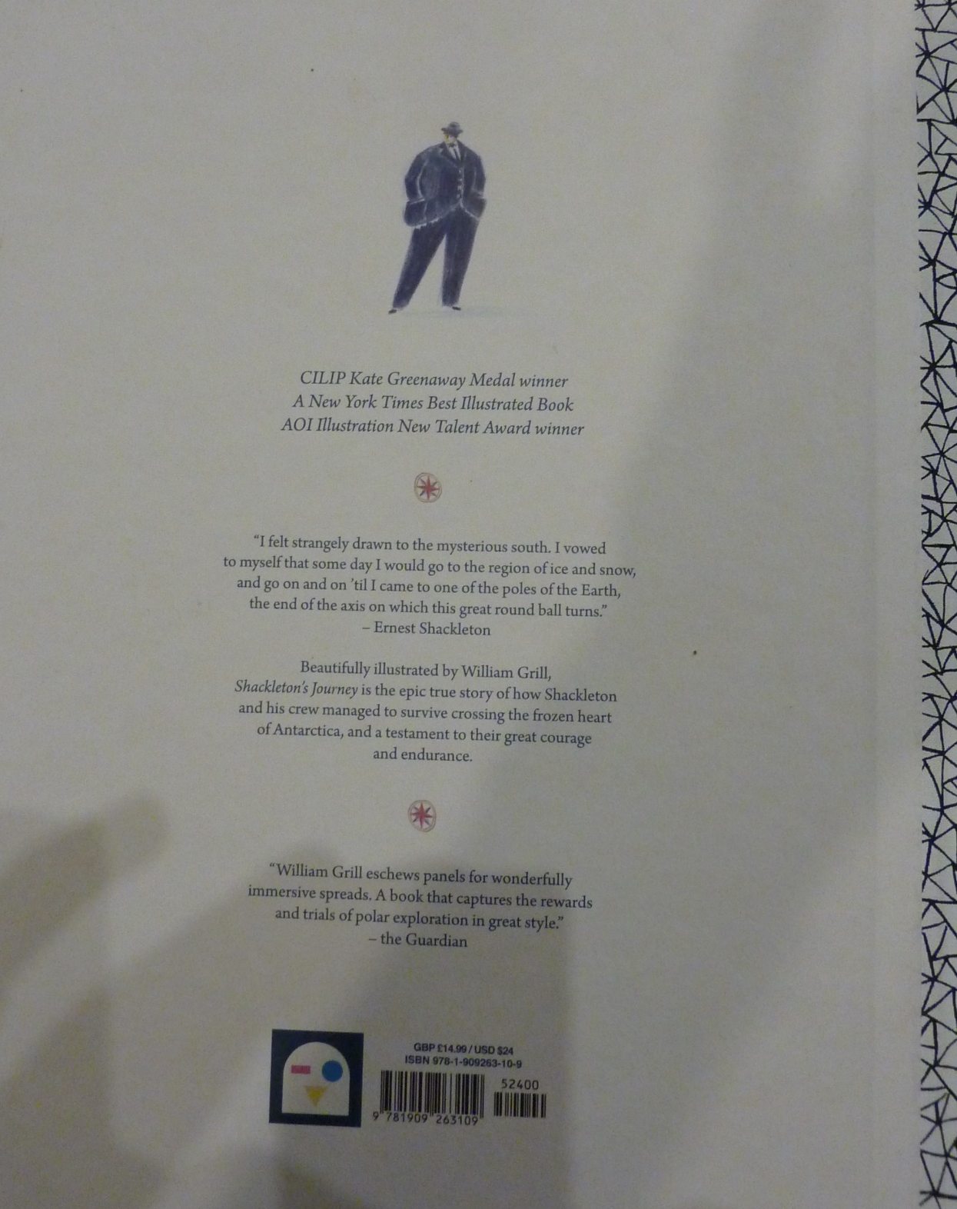

Slide 7
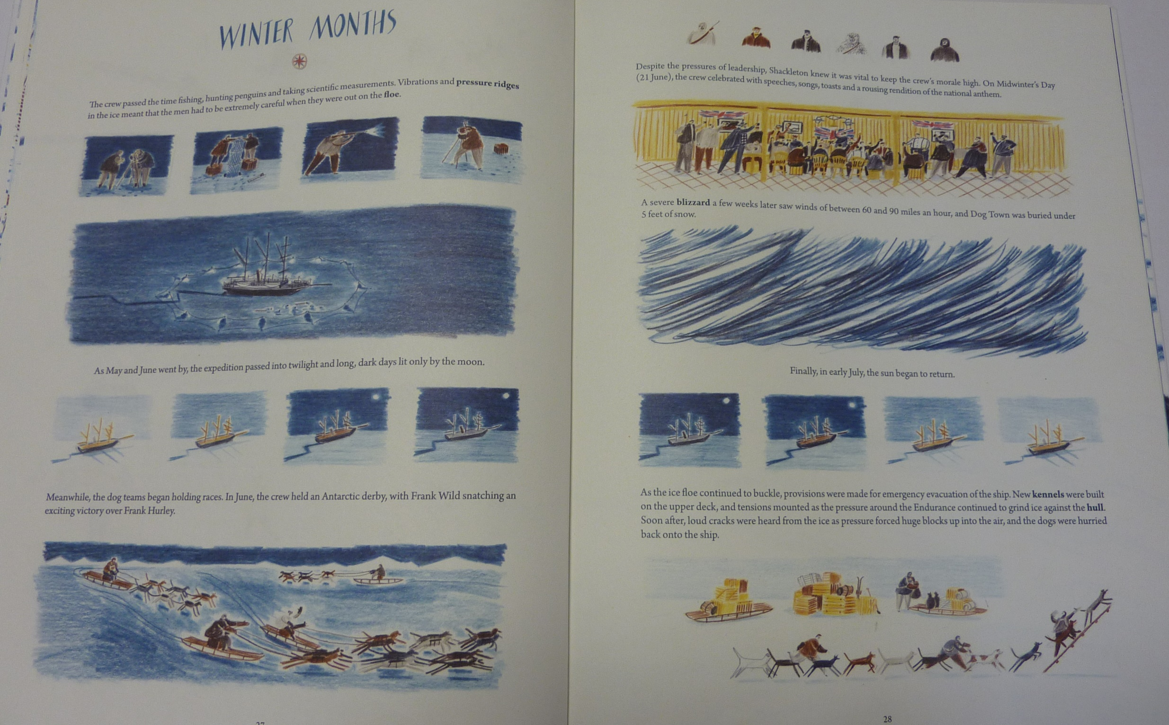

Slide 8
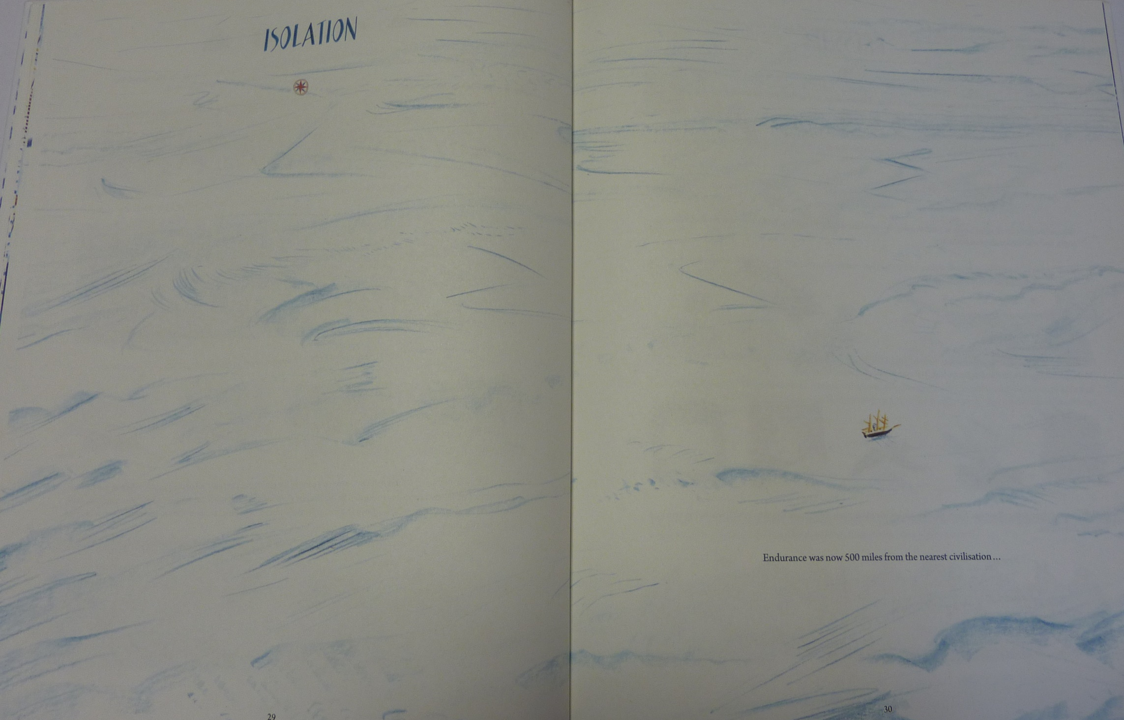

Slide 9
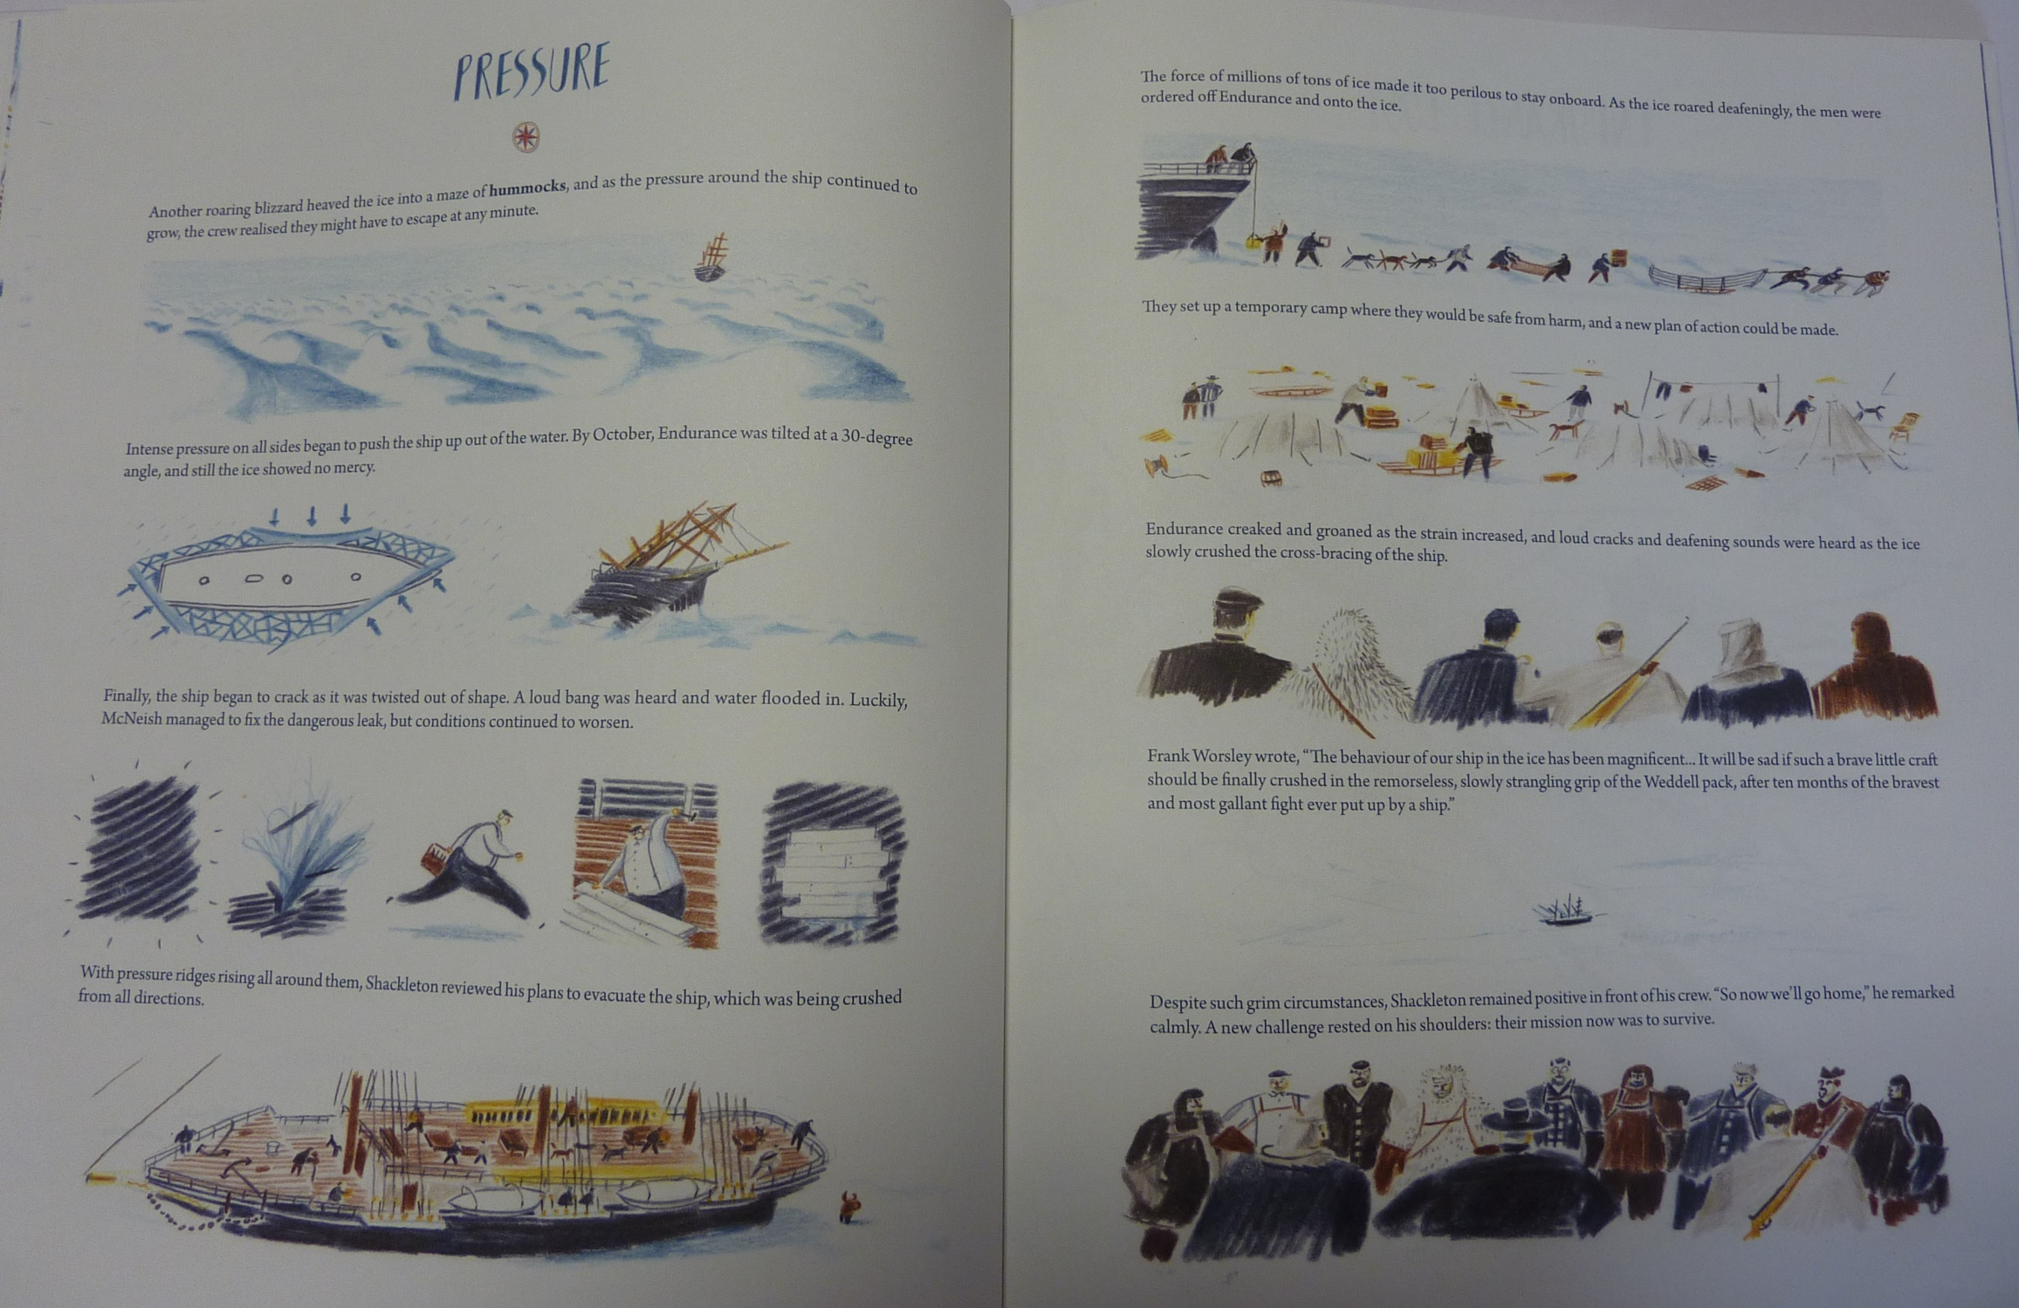

Slide 10
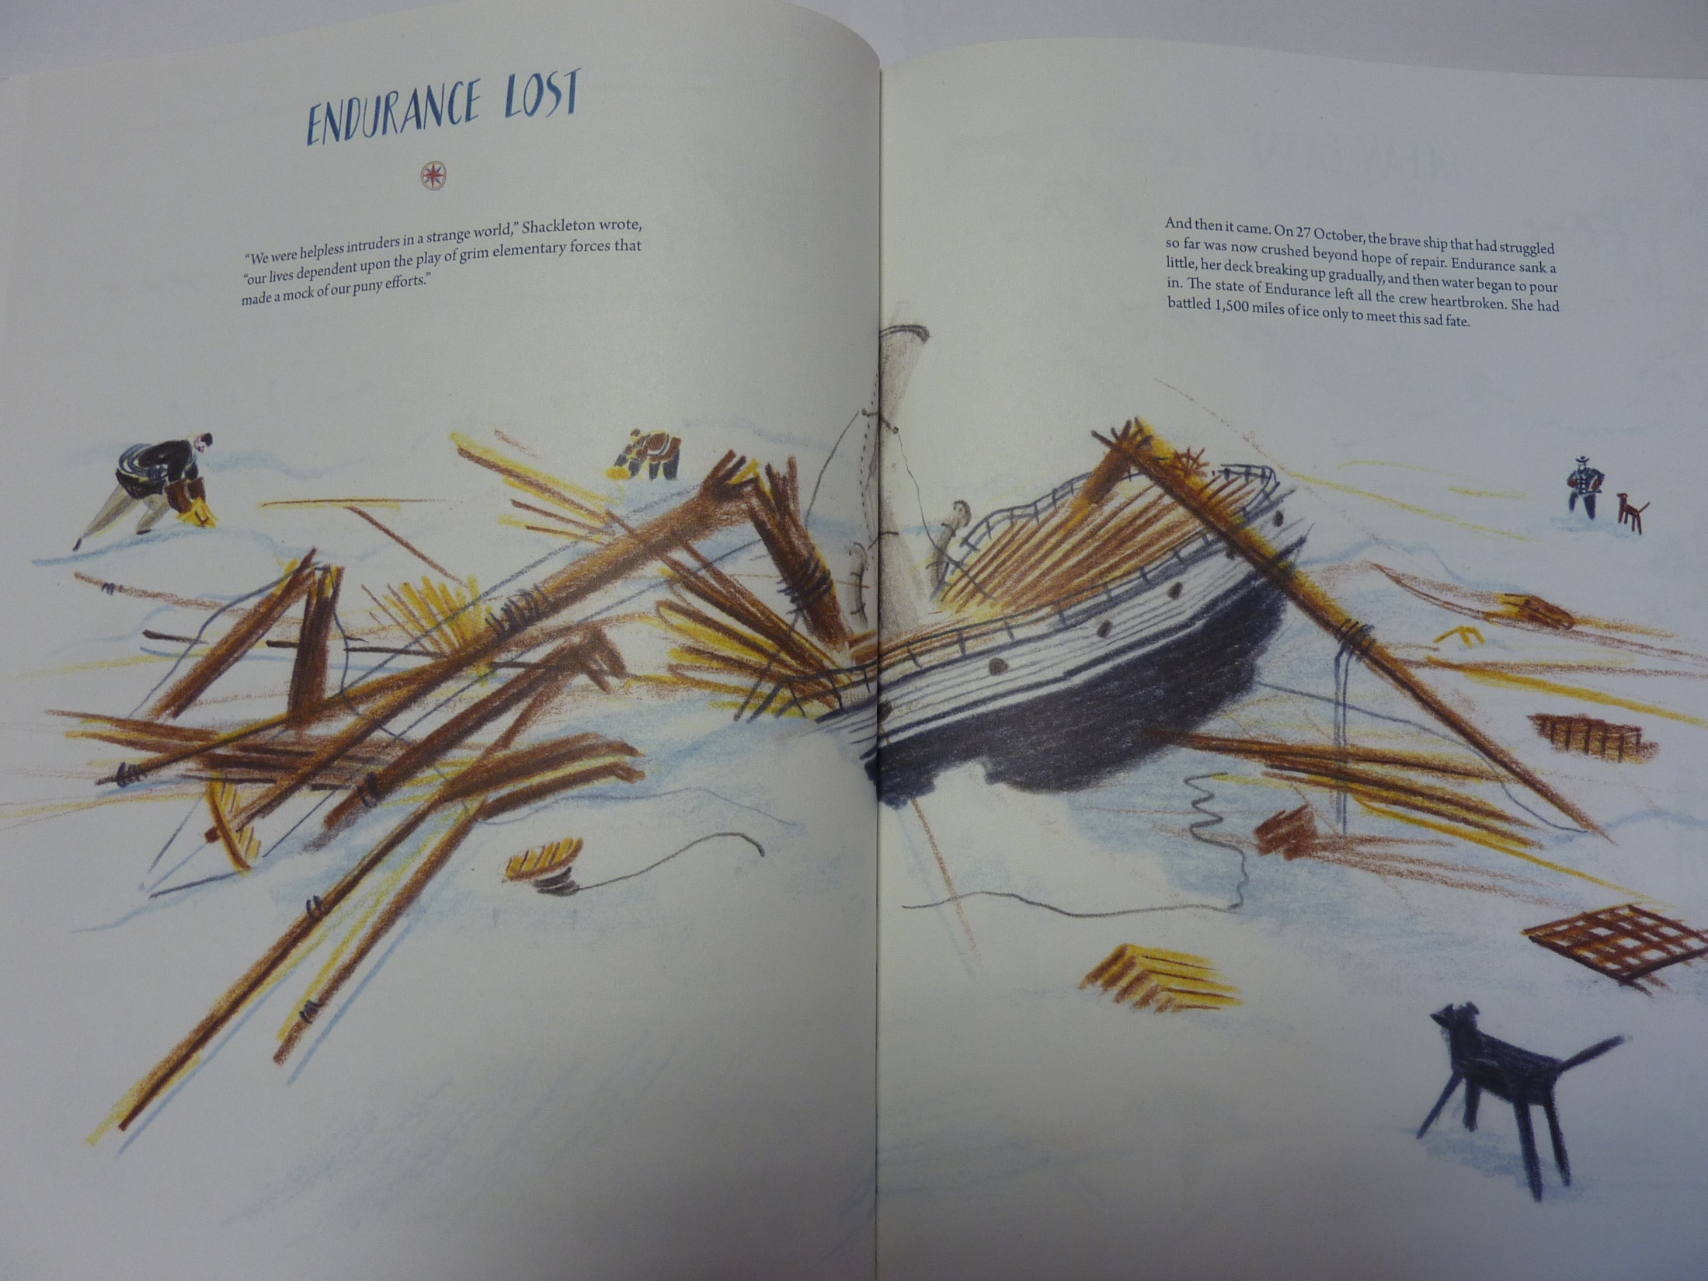

Slide 11
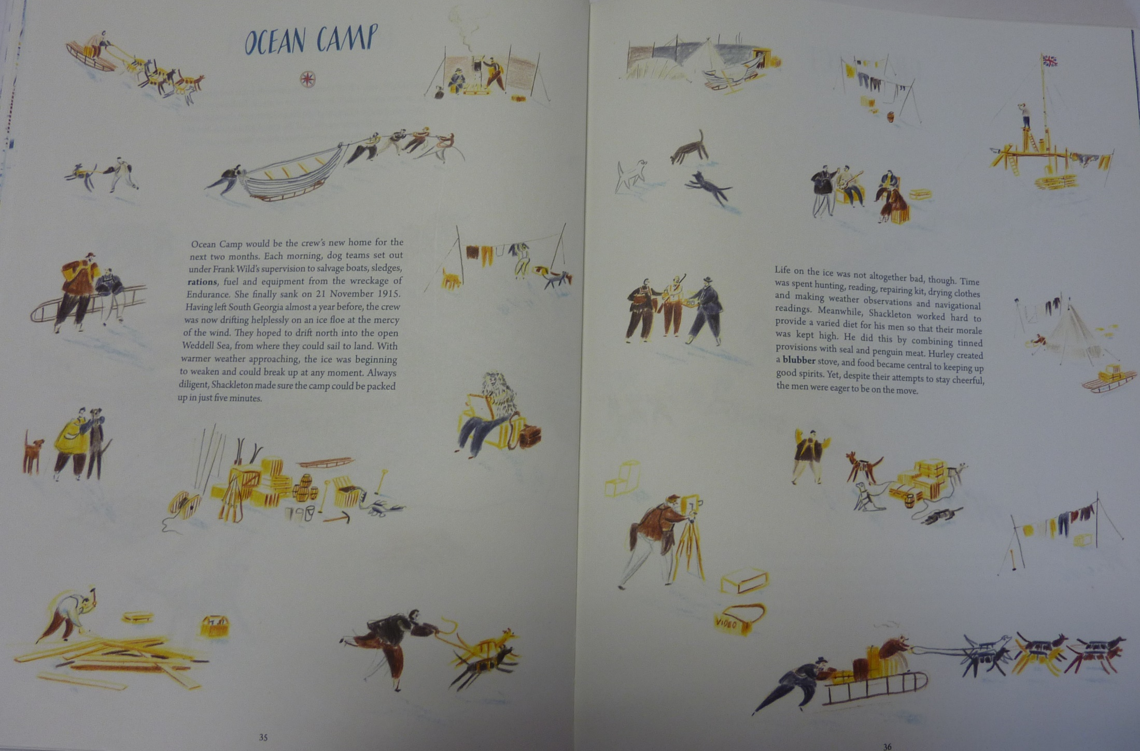

Slide 12
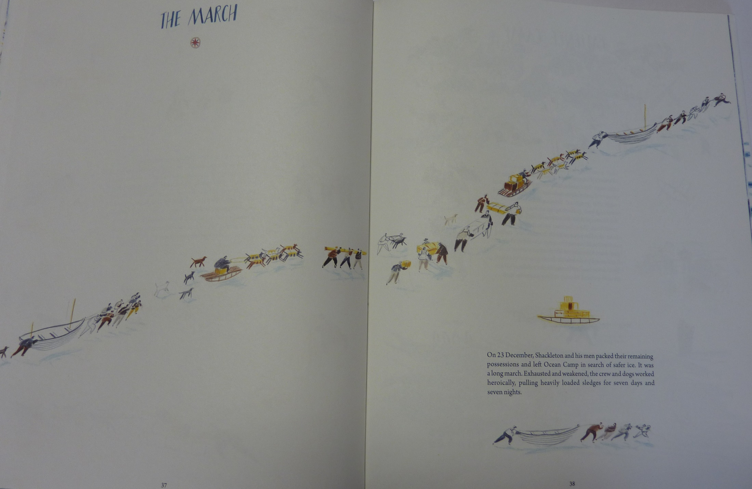

Slide 13

The story of Shackleton has become of survival now!
Make sure you have read the story up to this point.
Today we will create a spine poem. Can you remember what that is?
We pick 4 nouns and then think of some adjectives and verbs to describe them. We will have a go on the next slide.

Slide 14
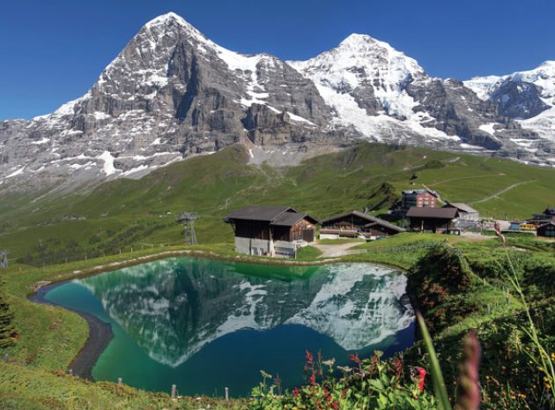
Pick 4 prominent nouns from the picture (you can compare them to mine on thee next page).
Remember you can pick what you want – they can be the same as mine or different.

Slide 15
Draw a table in your book like mine. Add in your 4 nouns.
Write as many possible adjectives for each noun
Write as many possible verbs for each noun
(Spend 15 minutes in total for all 4 – don’t judge the words yet – just write them down)
Adjective | Noun | Verb
White-capped, slate-grey, rough, rubble-strewn | mountain | Standing, observing, dominating
 | lake
 | hut
 | flower

Slide 16
Now convert your table into a 4 line poem – try and remember how we would do it in class.
Write a line down
Say it aloud
If you like it, keep it. If you don’t like it, change it.
Send your poems to yearsixlearning@Farnborough.Bromley.sch.uk

Slide 17
Physical activity – minimum 30 minutes each day | Link to resource
5 a day User Name: FPS53 / Password: JFz4XqG7 | https://player.5-a-day.tv/
Joe Wicks – PE sessions | https://www.youtube.com/channel/UCAxW1XT0iEJo0TYlRfn6rYQ
Cosmic Kids Yoga | https://www.youtube.com/user/CosmicKidsYoga
PE Hub Parents Portal | https://pehubportal.co.uk/
Go Noodle | https://www.gonoodle.com/good-energy-at-home-kids-games-and-videos/
Go for a walk/run. You must go with an adult from your home and make sure you stay 2 metres away from other people.

Slide 18

We will continue with the project. Warm your voice up by trying a couple of the warm ups from yesterday.
Starting at the bottom of page 2, try the Olay activity. Send me the lyrics you create – I will try to sing them and put the video on the website.
Now try the minibeast rap!
The link for the whole project is:
http://farnboroughprimary.co.uk/wp-content/uploads/2020/04/Songwriting-Project.pdf

