Slide 1
Subject / Lesson | Time
Maths | 1 hour
Spellings | 10 minutes
English – Door project | 50 minutes
Physical Activity | 30 minutes
Music | 30 minutes

Slide 2
Maths Task | Time
Maths Frame Interactive Quiz Username: Farnborough / Password: Farnborough https://mathsframe.co.uk/en/resources/resource/366/interactive-maths-quiz | 15 minutes
Times Table Rock Stars | 15 minutes
Try Challenge 1 http://farnboroughprimary.co.uk/wp-content/uploads/2020/05/challenge1.pdf And Challenge 2 if time http://farnboroughprimary.co.uk/wp-content/uploads/2020/05/challenge2.pdf | 30 minutes

Slide 3

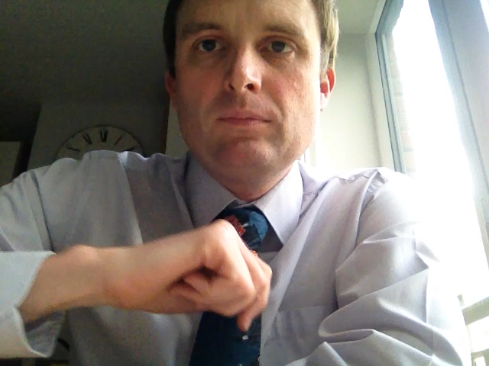
Spelling Test

Slide 4
Spelling Test
achieve
competition
determined
excellent
frequently
occupy

Slide 5

You can access the booklet via this link:
http://farnboroughprimary.co.uk/wp-content/uploads/2020/05/T4W-Y6-Doors.pdf
Tasks for today
Try Activity 9
We have now reached the stage of planning your own story. Follow the guidance in Activity 9 and I work like you to plan 2 different stories, using different portals into different lands. When we pick this back up again after half-term, you can decide which one you prefer.

Slide 6
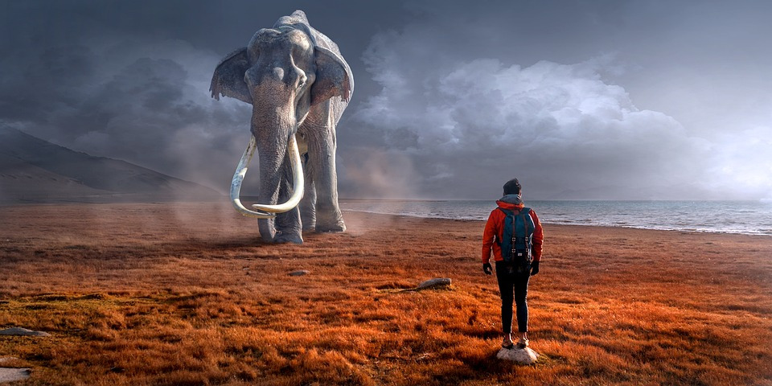

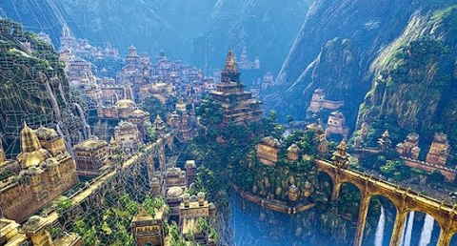
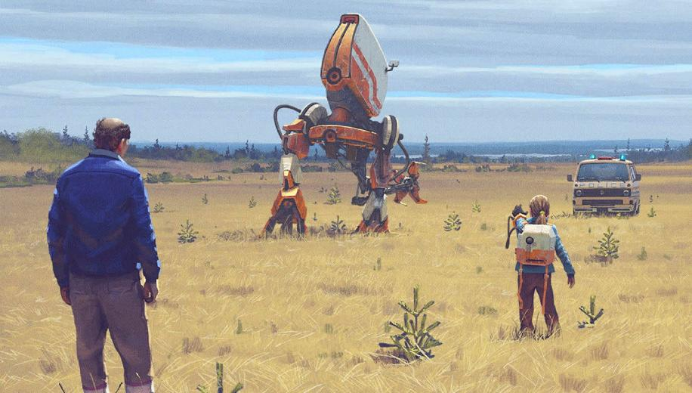
Ideas for mysterious worlds

Slide 7
Physical activity – minimum 30 minutes each day | Link to resource
5 a day User Name: FPS53 / Password: JFz4XqG7 | https://player.5-a-day.tv/
Joe Wicks – PE sessions | https://www.youtube.com/channel/UCAxW1XT0iEJo0TYlRfn6rYQ
Cosmic Kids Yoga | https://www.youtube.com/user/CosmicKidsYoga
PE Hub Parents Portal | https://pehubportal.co.uk/
Go Noodle | https://www.gonoodle.com/good-energy-at-home-kids-games-and-videos/
Go for a walk/run. You must go with an adult from your home and make sure you stay 2 metres away from other people.

Slide 8

Makaton
Pick a song from the channel below and try and learn some of the Makaton moves to it:
https://www.youtube.com/channel/UCXvjFogIH4hDHKTGV2PMavw

Slide 9


