Slide 1
Good morning Unicorns!
Here’s your work for today: Wednesday 13th May

Slide 2
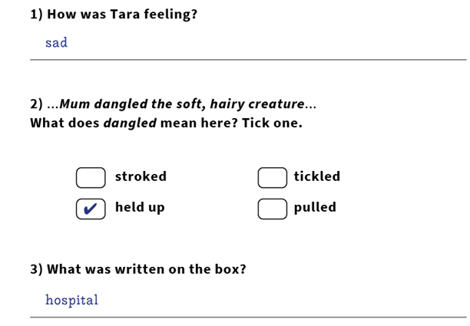
Reading answers from yesterday:

Slide 3
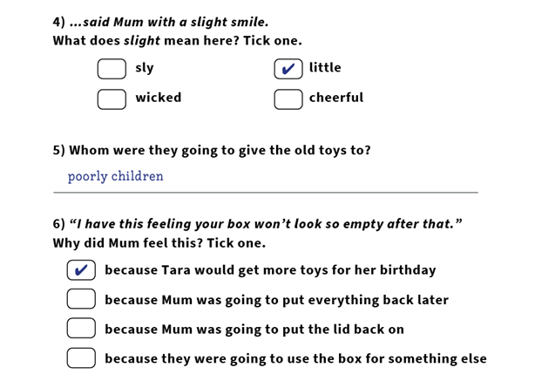

Slide 4
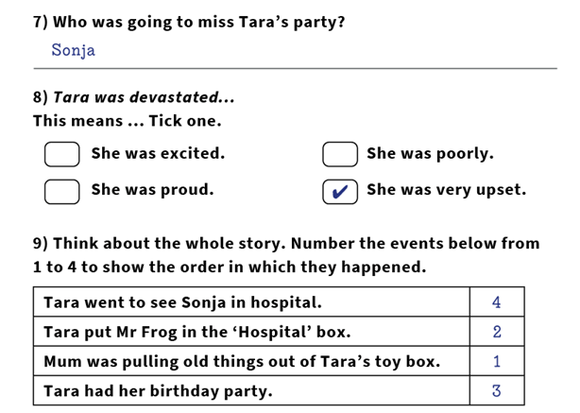

Slide 5
Reading online
Please log on to Bug Club and read for at least 15 minutes.
Make sure you answer your bug questions!

Slide 6
Maths answers from yesterday:
Children could have written many different objects into the table, e.g. Less than 1 metre: pencil, ruler, book Equal to 1 metre: metre stick Greater than 1 metre: table, whiteboard, door
Answers will vary.
Children should have matched: pencil case ➜ 30 cm, table ➜ 2 metres, rubber ➜ 5 cm and playground ➜ 20 metres .
Children should have ticked the following boxes: a) 6 metres b) 90 centimetres c) 20 centimetres

Slide 7
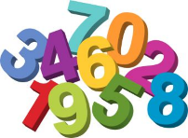
Maths
Today we are going to compare lengths

Slide 8
Click on this link:
https://www.youtube.com/watch?v=2Q4c0CtK9M0

Slide 9
What is in the display case? Why do you think the museum would put a ruler in with the bones?
Why do you think scientists might measure the bones of ancient animals like this?
Let’s look at the answers and how you could have worked them out on the next page…

Slide 10
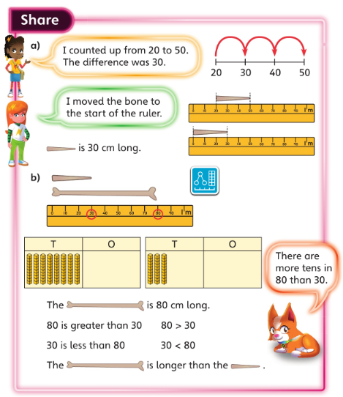
How can this place value grid help you decide which of the numbers is bigger?
Can you answer the question without using the place value grid?

Slide 11
Now I would like you to have a go at completing the questions on the next slides. You can write your answers in your exercise books.
If you would like to try Gruffalo work, complete questions 1 and 2.
If you would like to try Horrid Henry work, complete questions 1, 2, 3 and 4
If you would like to try James and the Giant Peach work, complete questions 1, 2, 3 ,4 and the Challenge question on the following slide.

Slide 12
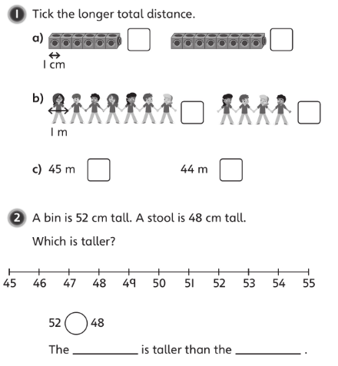

Slide 13
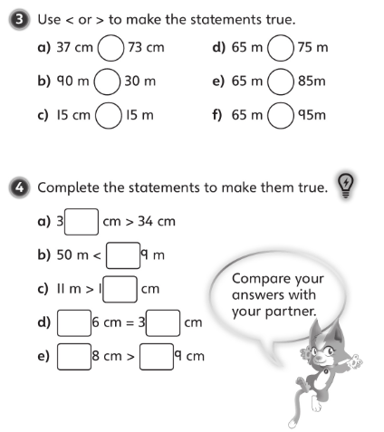

Slide 15
If you’d like an extra challenge, (or have some spare time) I have created a Maths Challenge PowerPoint which has an extra challenge for every day. You can have a go at that now.

Slide 16
Handwriting
Please look at the high frequency words on the next slide and copy them into your exercise book.

Slide 17
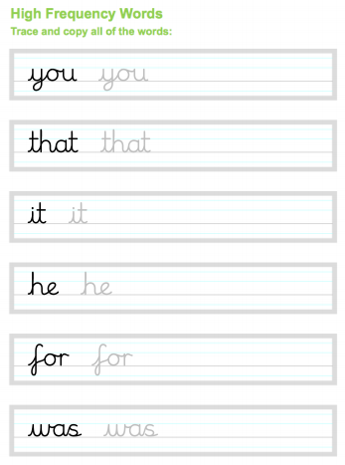

Slide 18
Independent Learning

Slide 19
English
Today you are going to write your setting description using the vocabulary that you collected yesterday. You’ve done most of the hard work already!
Re-watch the film:
https://vimeo.com/24962214
You are going to put your vocabulary into sentences. An example is on the next slide.

Slide 20
You could play around with the word order.
For example, we could say:
Shoals of stripy, colourful sock fish dart up and down.
But equally we could begin with the word darting and say:
Darting up and down are shoals of stripy, colourful sock fish.

Slide 21
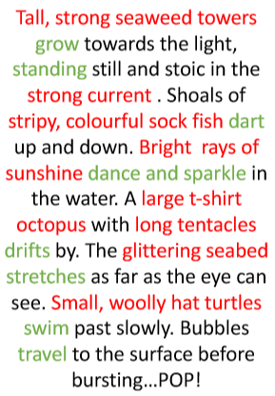

Slide 22
Now read your setting out loud to someone else. Can they shut their eyes and imagine being there? What is their favourite sentence? Why?

Slide 23
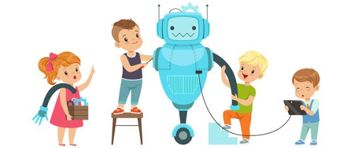
D.T
Today I would like you to design a useless product!
You will then need to try to convince someone in your household that it's actually brilliant.
Some ideas of useless products are on the next slide.

Slide 24
A fire guard made of chocolate A window made of metal A pillow made of concrete

Slide 25
Enjoy, Unicorns!

