Slide 1
Welcome back Elves!
I have lots of activities planned for you this week.
Let’s get busy Elves.

Slide 2
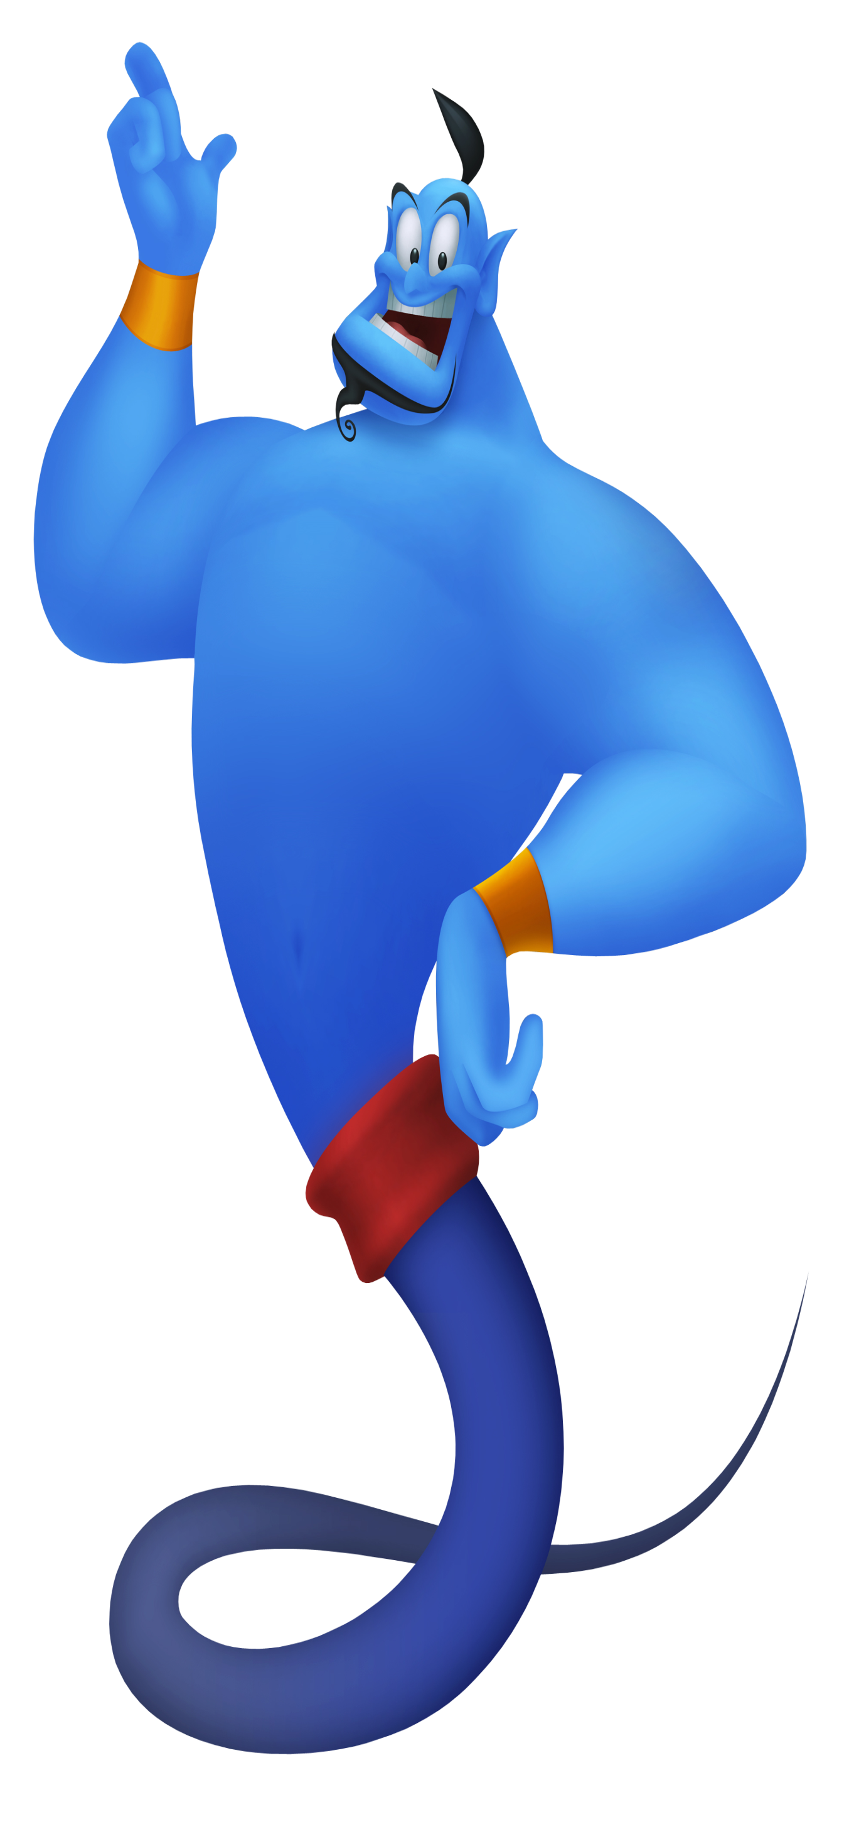
Yellow group’s
Monday’s
Maths Answers
Challenge 1
2 equal teams with 5 in each team
Challenge 2
9 is an odd number as there are 2 unequal teams (they are not the same)
Challenge 3
1. Show 2 4 6 8 and so on.

Slide 3
Green group
Friday’s
Maths Answers
Challenge 1
Unequal equal
Unequal equal
Equal unequal
Equal unequal
Equal unequal
Challenge 2
There are 4 groups of bananas
There are 5 groups of 3 ice cream scoops
There are 5 groups of 6 flower petals
There are 2 groups of 10 fish.
Challenge 3
False. There are 5 groups of 4 pencils.

Slide 4
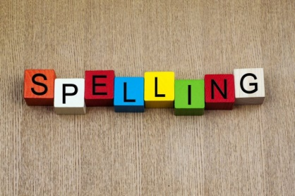
Spellings
This weeks spellings are posted on the
Year 1 Learning page to learn.
Your grown up can carry out the spelling test on Friday!
Happy Spelling

Slide 5
It’s Tuesday!
Tuesday 5th May 2020
Here’s your work for today…
.

Slide 6
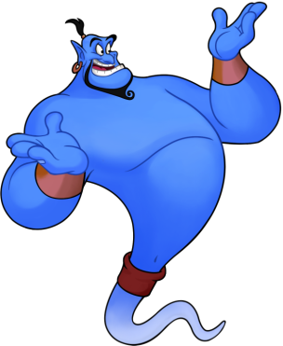
Reading online
I’m so impressed with your reading Elves.
You should be very proud of yourselves!
Please log on to Bug Club
Read for at least 15 minutes.
Please read the key words inside the front cover first.
When you find the bug questions, click and complete them.
Please note down the books you’ve read in your reading
record book.
Your personal login details are on the inside of your reading record book.

Slide 7
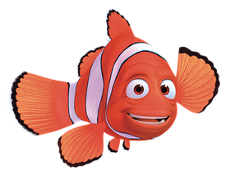
Maths
Today we are learning to
add equal groups

Slide 8
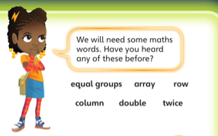
Green group
Maths
Remember reading the words above last week? Re-read these words with a grown up. Which words do you remember?

Slide 9
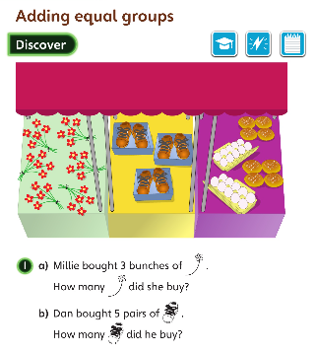
Green group
Maths
What equal
groups do
you see?
How many flowers in each bunch?
Are all the bunches
of flowers equal?
Can you see any
unequal groups?
Can you answer these questions? Let’s look at the next page to find out the answers and how you could have worked them out.

Slide 10
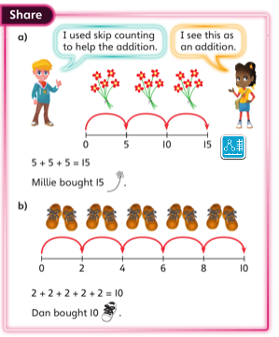
Green group
Maths
Why is there an addition
sentence? Yes because
5 pairs of shoes is the same as
2 + 2 + 2+ 2+ 2 =10
How does the number line help you count?
3 bunches of 5 flowers is
5 + 5 + 5 = 15
Try this addition sentence out using 5 pairs of shoes.
Try this addition sentence out. Draw pictures to make 3 bunches of 5 flowers.
Try this addition sentence out using 5 pairs of shoes.

Slide 11
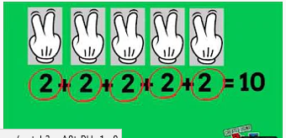
Green group
Maths
Follow this link to learn about adding equal groups.
You Tube Adding Equal Groups
https://www.youtube.com/watch?v=A8trPHq1rx8

Slide 12
Please can you complete the challenge questions which follow this slide. I will supply you with the answers for the challenge questions on tomorrow’s slide
If you would like to try Gruffalo work, complete challenge question 1
If you would like to try Horrid Henry work, complete challenge question 1 and 2
If you would like to try James and the Giant Peach work, complete challenge question 1, 2 and 3.
Please write your answers to the maths questions in your blue books.

Slide 13
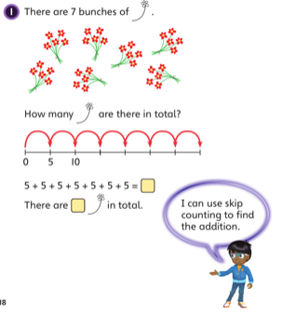
Green group
Maths
Challenge 1
What number will you skip count in?
What do you need to notice about the
bunches of flowers
before you can find
the total?
How can you use the number line to help you count?
Do you notice how
the addition sentence is written?

Slide 14
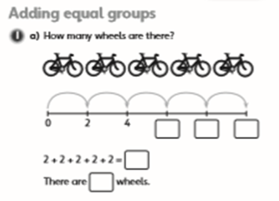
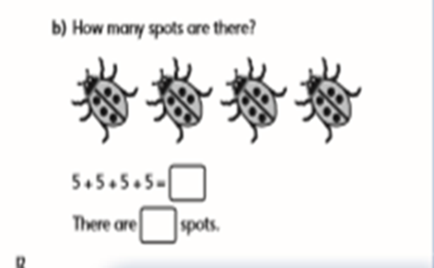
Green group
Maths
Challenge 2
a)Find objects to represent the wheels
(lego pieces, pasta pieces).
Create the addition sentence using
the objects.
Complete the question in your book.
Keep practising this if you think your child isn’t quite sure yet. Create a new question (like the one above i.e. How many wings are on 3 butterflies? This is a new concept for the children so it can take time for some children to understand it.

Slide 15
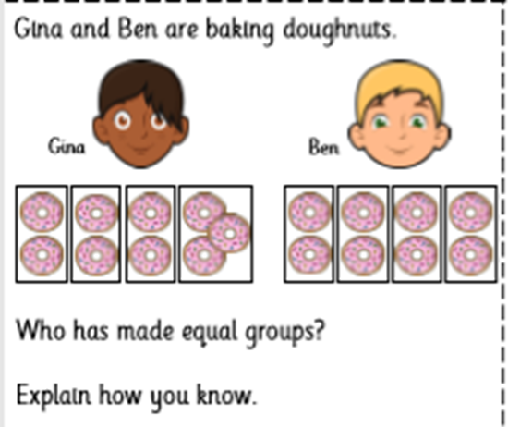
Green group
Maths
Challenge 3

Slide 16
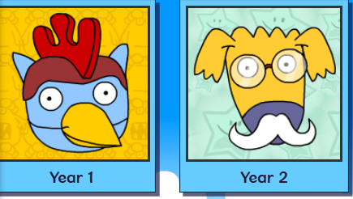
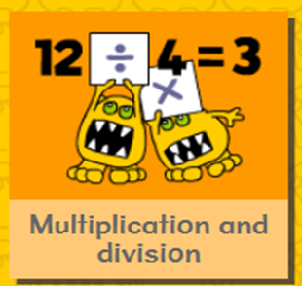
.
.
.
.
Logon on to Busy Things.
On your marks, get set, go. Play this game to number skills.

Slide 17
If you’ve completed your maths quickly, go to the Maths Challenge
Powerpoint on the Year 1 learning page for this week and complete one or more challenges. There are challenges linked to this lesson ‘Adding equal groups’.

Slide 18
Today we are learning to find odd and even numbers
Yellow group
Maths

Slide 19
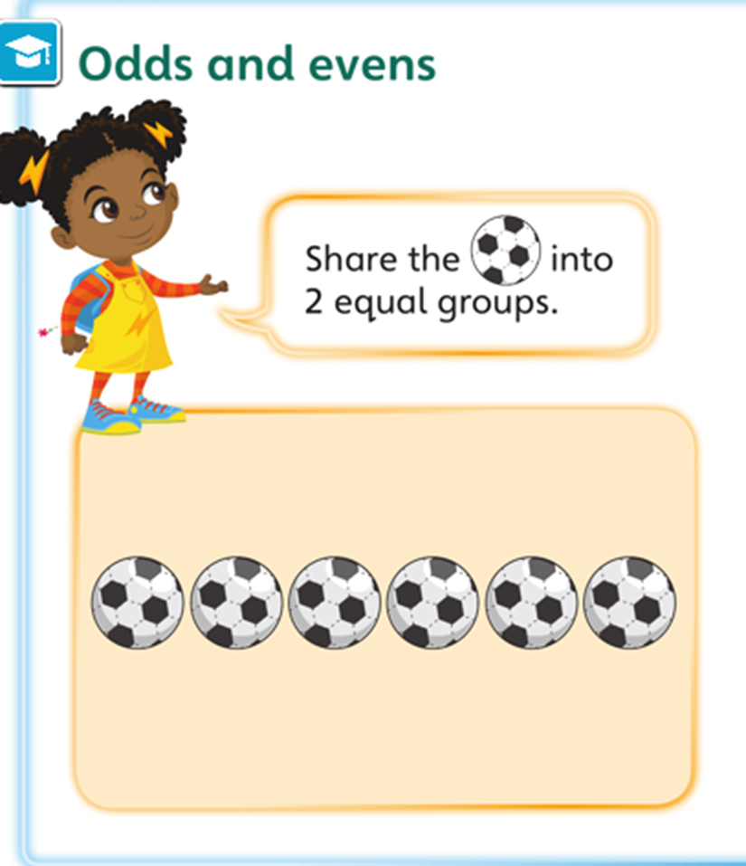
Yellow group
Maths
Let’s recap on
Yesterday.
What does equal mean?
Yes that’s right
it means ‘the same’
Two groups with the same amount
of objects.

Slide 20
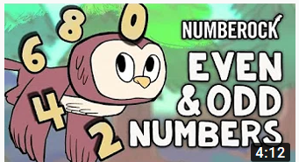
Yellow group
Maths
Follow this link to listen about odd and even numbers.
Odd and Even numbers song
https://www.youtube.com/watch?v=-kHtGbnYKGc

Slide 21
Now I would like you to have a go at completing work in your CGP Maths workbook. The answers are in the back of the book.
Yellow group
Maths
If you would like to try Gruffalo work, complete Challenge 1
If you would like to try Horrid Henry work, complete Challenge 1 and 2
If you would like to try James and the Giant Peach work, complete Challenge 1, 2 and 3

Slide 22
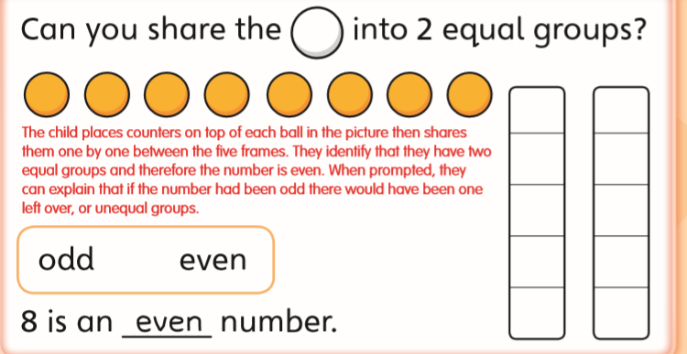
Yellow group
Maths

Slide 23
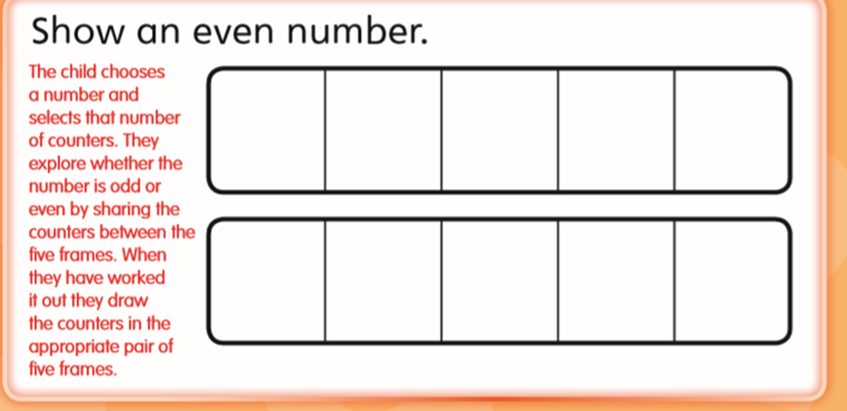
Yellow group
Maths
Challenge 2

Slide 24
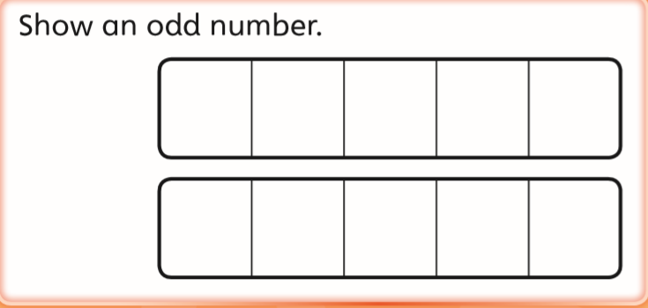
Yellow group
Maths
Challenge 3

Slide 25
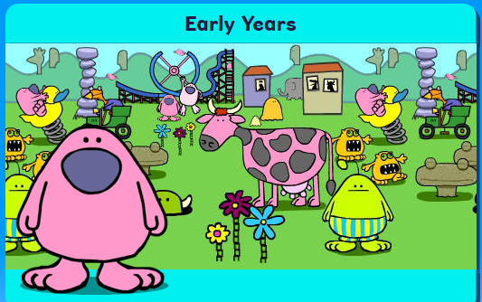
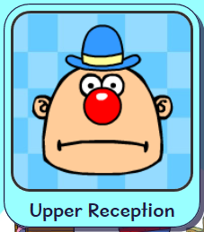
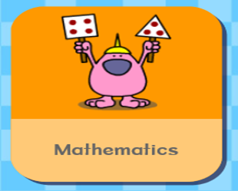
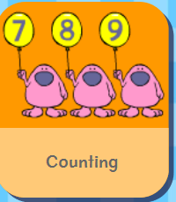
.
Logon on to Busy Things. On your marks, get set and go. Play following game to practise your counting skills.

Slide 26
Handwriting
.

Slide 27
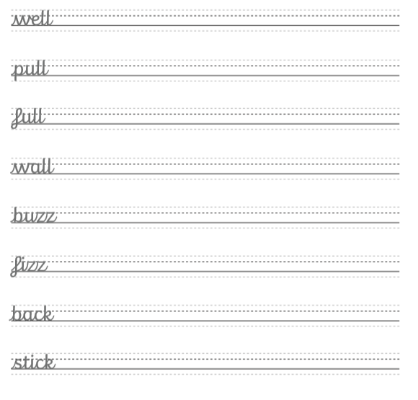
Handwriting
.

Slide 28
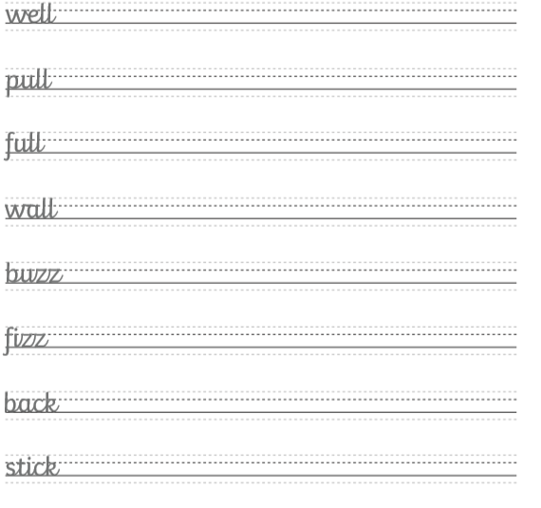
Handwriting
.

Slide 29
English

Slide 30
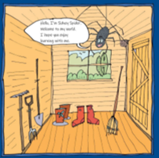
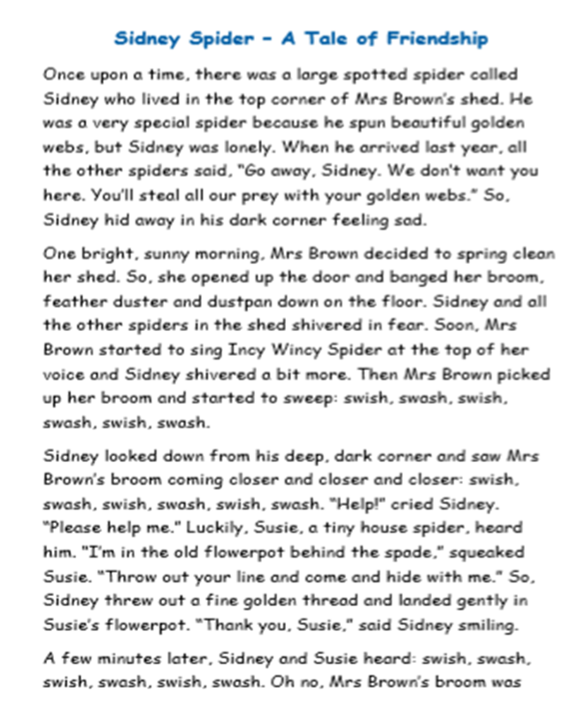
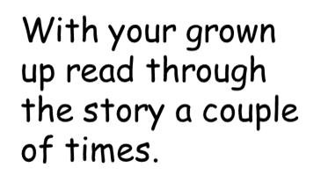
English

Slide 31
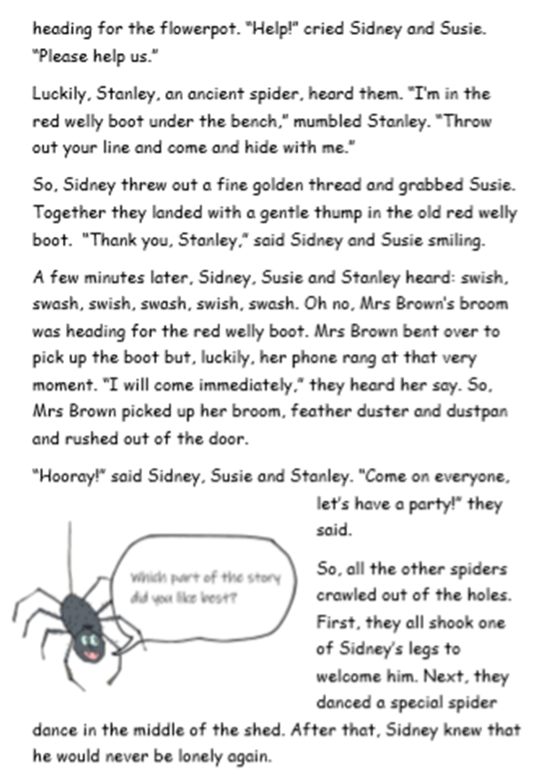
English

Slide 32
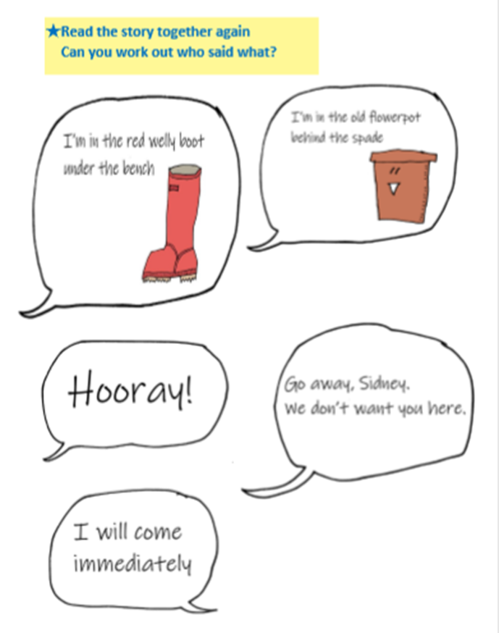
English

Slide 33
English
Can you find any props around your house to act out the story?
Can you make props (like a red welly boot) to act out
the story?

Slide 34
Phonics
Green group
Phonics
Complete pages 2 and 3 in Phonics booklet 2
To re cap on the sounds you have covered this year at school. Follow this link to Phonicsplay to practise your sounds. How quickly can you complete the speed trial?
Login for Phonicsplay: Username: march 20 password: home Phase 5
Flashcards game Phase 5
https://www.phonicsplay.co.uk/member-only/Flashcards.html

Slide 35
Phonics
Yellow group
Phonics
I would like you to work through pages 14 and 15 in your Phonics booklet 1.
Let’s remind ourselves of our sounds.
Follow the orange link below (the web address is in red in case you are unable to follow the link)
Jolly Phonics Phase 2
https://www.youtube.com/watch?v=1Qpn2839Kro
Jolly Phonics Phase 3
https://www.youtube.com/watch?v=W8Jp5MutVlQ

Slide 37
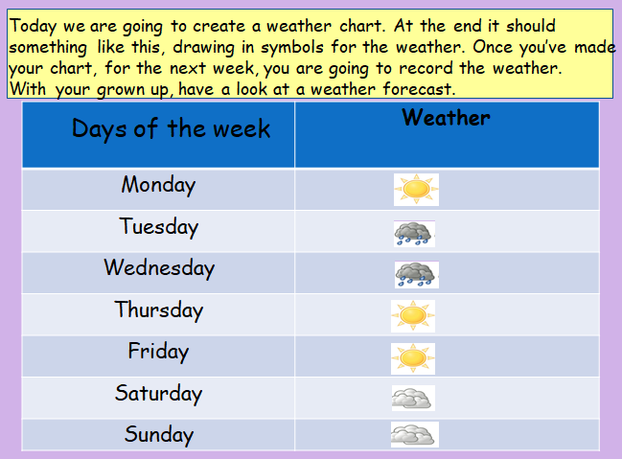

Slide 38
Active Learning

Slide 39
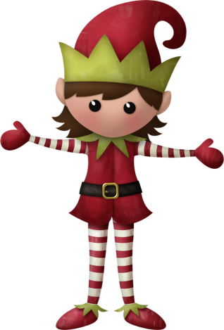
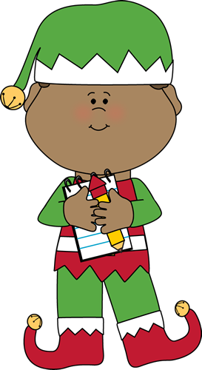
Well done for
your super work today!
Let me know how you are getting on!
admin@farnborough.bromley. sch.uk

