Slide 1
Good Morning Unicorns!
Here’s your work for today:
Thursday 14th May

Slide 2
Reading Comprehension
Today you are going to read a text and answer questions about it. You can write your answers in your exercise book.

Slide 5
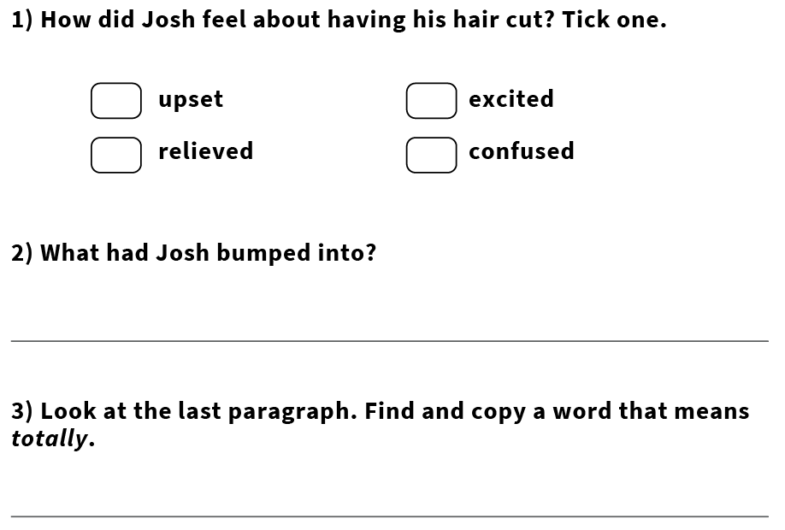

Slide 10
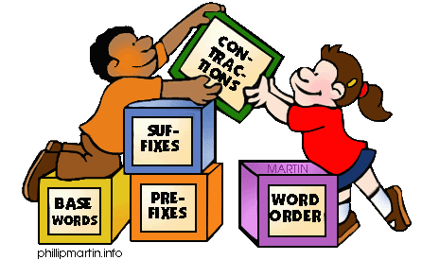
Grammar
Today you will be focussing on: Opposites
Watch this link and enjoy the video:
https://www.youtube.com/watch?v=HGeuA4iJ8vI

Slide 11
Grammar
Please complete pages 22 and 23 in your Nelson Grammar workbook.

Slide 12
Maths answers from yesterday:
1.a) Children could have chosen different ways of making 75p, e.g. 50p, 20p and 5p 50p 10p, 10p, 2p, 2p and 1p 50p, 20p, 2p, 1p, 1p and 1p
b) Children could have chosen different ways of making £25, e.g. £10, £10 and £5 £10, £5, £5, £2, £2 and £1 £10, £10, £2, £1, £1 and £1
2. Children could have completed the part-whole diagram in different ways, e.g. 10p (one part) and 10p (other part) 20p (one part) and 0 (other part) 10p (one part) and 5p, 2p, 2p and 1p (other part)
3. a) Children could have circled different coins, e.g. 10p + 1p + 1p + 1p or 5p, + 5p + 2p + 1p b) 1p + 2p + 5p + 5p c) There are two possible answers: £2 + £2 + £2 + £2 + £10 + £20 £1 + £1 + £2 + £2 + £2 + £10 + £20 d) There are three possible answers: £1 + £1 + £1 + £5 + £10 + £20 £1 + £1 + £1 + £5 + £5 + £5 + £20 £1 + £1 + £1 + £5 + £5 + £5 + £5 + £5 + £10
4. Marie uses a 20p coin and a 5p coin. Max uses a 20p coin, a 5p coin and a 2p coin.
Challenge
Children could choose £10 + £1 + 20p + 2p to make £11 and 22p or they could cross out 1p, 5p, 10p, 50p, £2, £5, £20 to leave the exact amount of £11 and 22p.

Slide 13
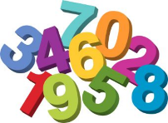
Maths
Today we are going to continue to look at money.

Slide 14
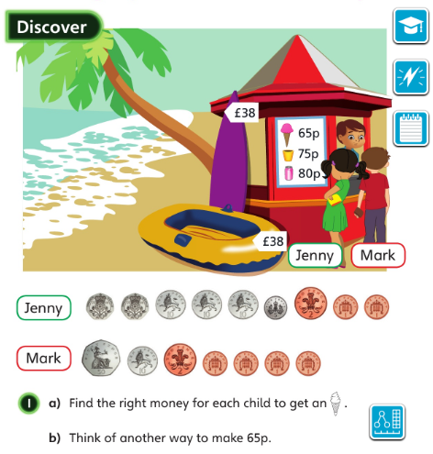
• How many solutions can you find to make 65p?
• Which solution uses the greatest number of coins?
Let’s look at the answers and how you could have worked them out on the next page…

Slide 15
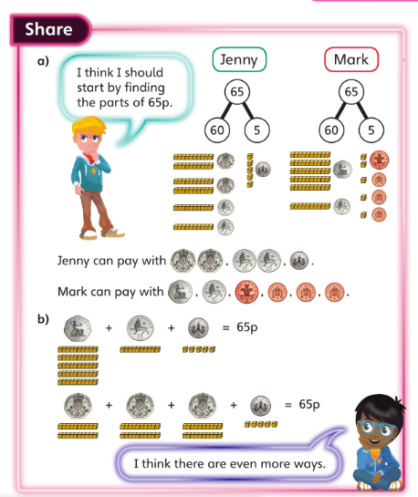
• How can you tell if you have found all of the solutions?
• Which solution uses 11 coins?
•

Slide 16
Now I would like you to have a go at completing the questions on the next slides. You can write your answers in your exercise books.
If you would like to try Gruffalo work, complete questions 1 and 2.
If you would like to try Horrid Henry work, complete questions 1, 2, 3 and 4
If you would like to try James and the Giant Peach work, complete questions 1, 2, 3 ,4 and the Challenge question on the following slide.

Slide 17
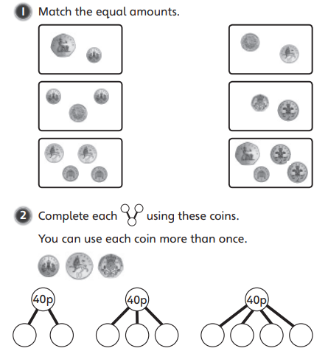

Slide 18
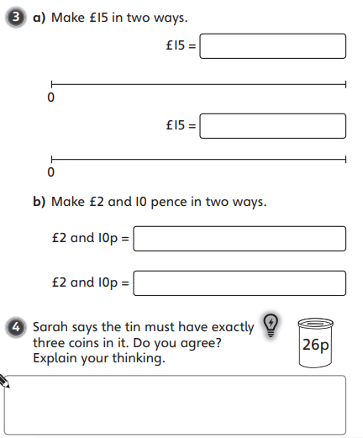

Slide 19
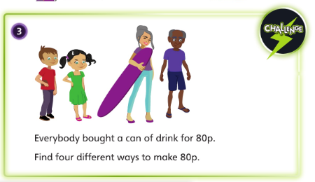

Slide 20
If you’d like an extra challenge, (or have some spare time) I have created a Maths Challenge PowerPoint which has an extra challenge for every day. You can have a go at that now.

Slide 21
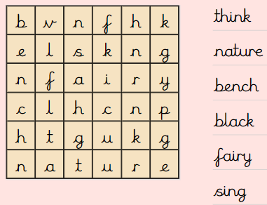
Independent Learning
Can you find the words?

Slide 22
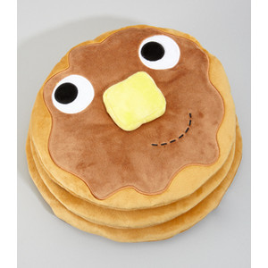
English
Today you are going to write the next paragraph where you will be describing the pancake meeting their second character.
Here’s a reminder of what happened in the original story:

Slide 23
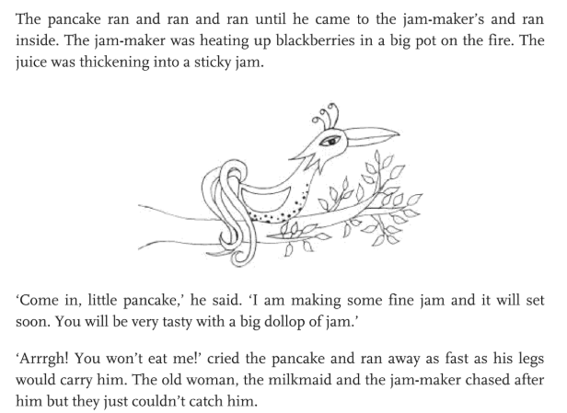
My first person was:
A Dad scrambling eggs for a hungry boy’s birthday breakfast.
So I will write my first paragraph about him…

Slide 24
The pancake ran and ran and ran until he came to Eddie’s house where his Dad was scrambling eggs for his birthday breakfast. He smiled and said “ Come in, little pancake, I have some eggs left over and you will be very tasty with some on toast.”
“ Arrrgh! You won’t eat me!” cried the pancake and ran away as fast as his legs would carry him. The old woman, Shayla and Eddie’s Dad chased after him but they just couldn’t catch him.

Slide 25
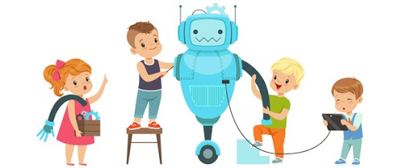
D.T
Today I would like you to take part in a sculpture challenge!
Watch this video:
https://vimeo.com/407558759
What will you create?

Slide 26
Enjoy, Unicorns!

