Slide 1
Good Morning Unicorns!
Here’s your work for today:
Thursday 14th May

Slide 2
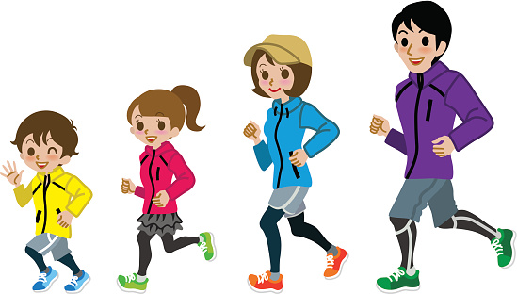
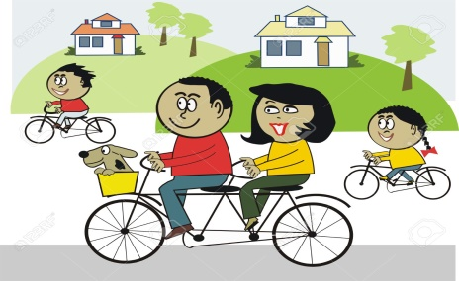
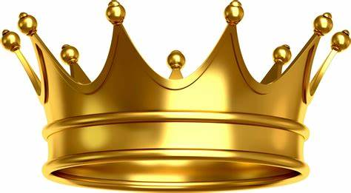
Our active challenge starts Thursday 14th May and ends Wednesday 20th May.
Farnborough gets Active
When going out for your daily exercise, measure how many kilometres you cover across 7 days (dates above).
All activities count - walking a dog, walking through the woods, running, cycling, scooting are all perfect.
Once you have completed the week, email your class teacher on the class email with the total of kilometres: yeartwolearning@farnborough.bromley.sch.uk
The final day to supply teachers with your total is Friday 22nd May.
Which class will be crowned the most active?

Slide 3
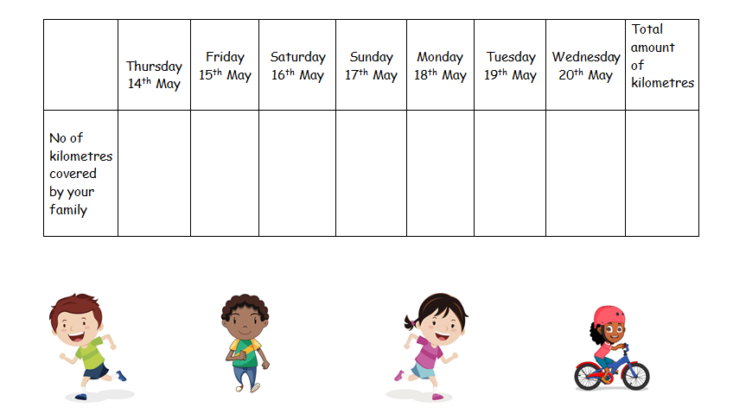
Here is a table your child can use to record your distances
Farnborough gets Active

Slide 4
Reading Comprehension
Today you are going to read a text and answer questions about it. You can write your answers in your exercise book.

Slide 5
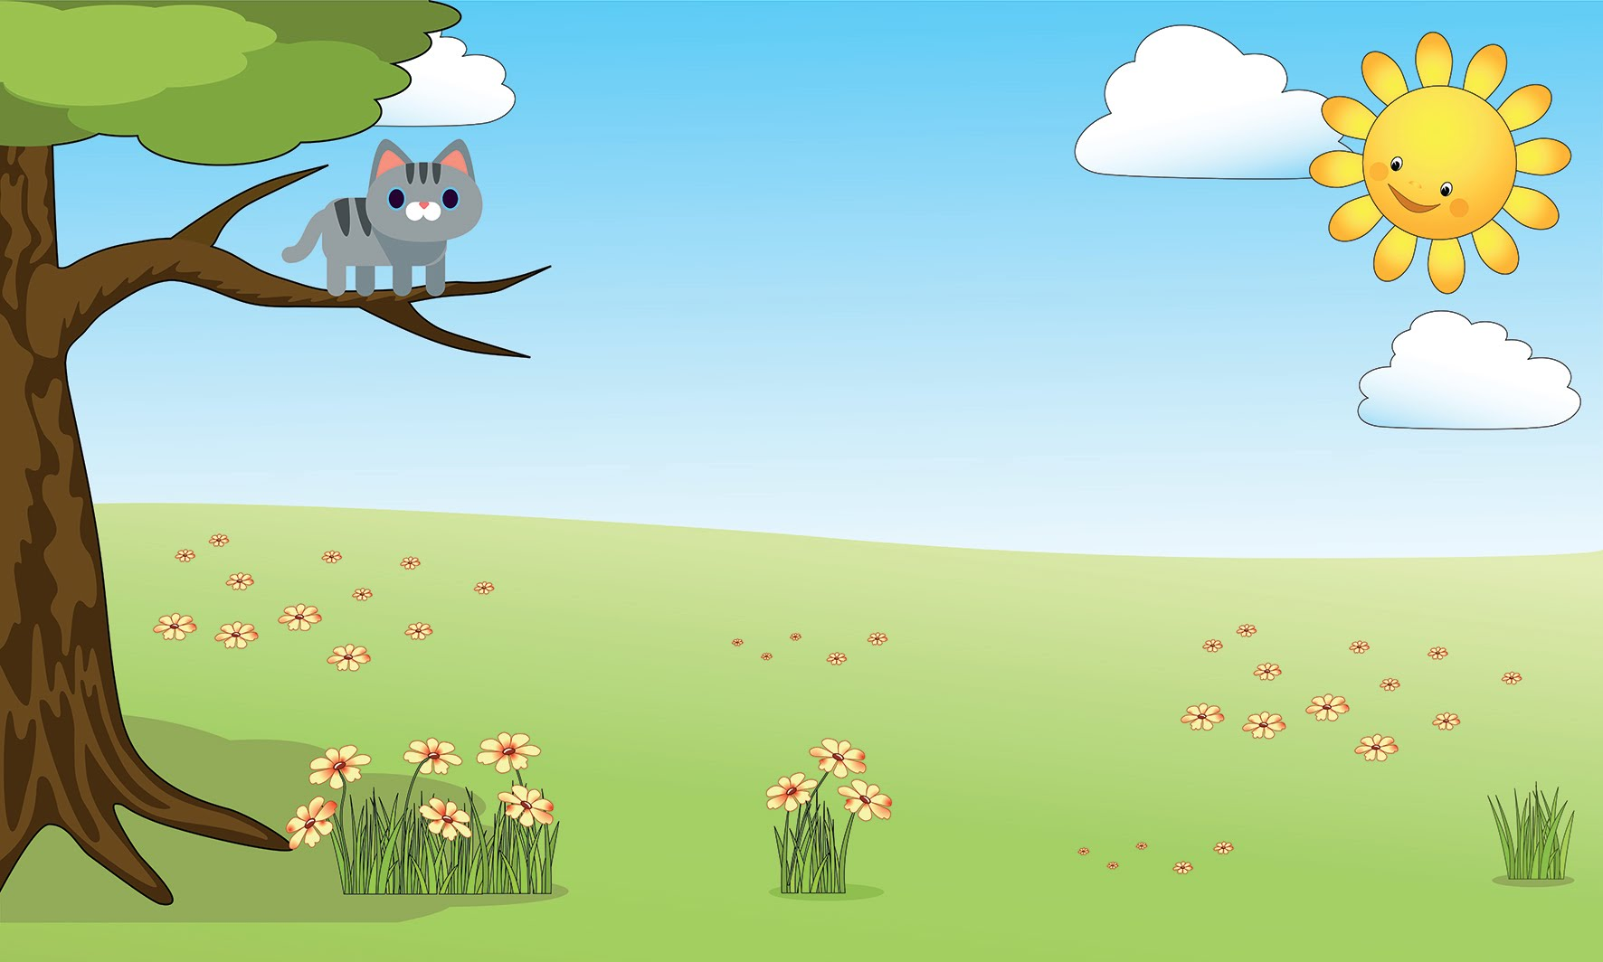

Slide 7
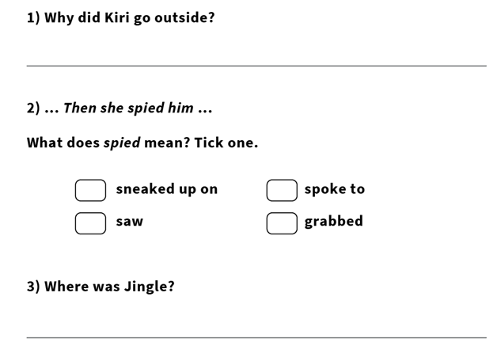

Slide 8
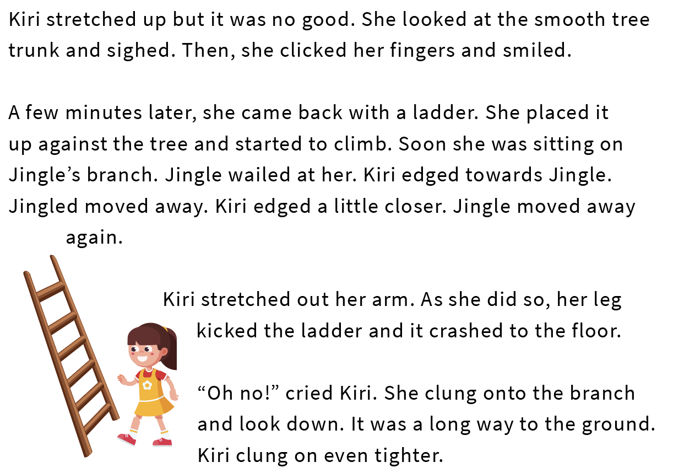

Slide 10
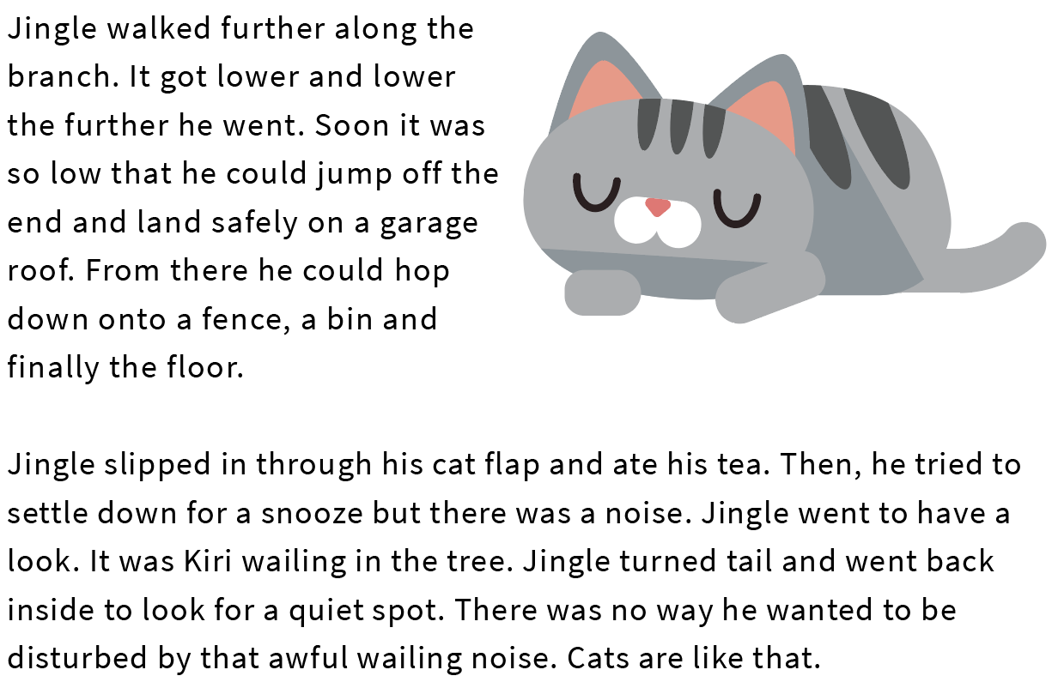

Slide 12
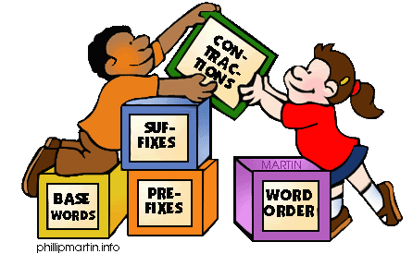
Grammar
Today you will be focussing on:
Special naming words
Watch this link and enjoy the video:
https://www.youtube.com/watch?v=XfkHRgqCn0M

Slide 13
Grammar
Please complete pages 22 and 23 in your Nelson Grammar workbook.

Slide 14
Maths answers from yesterday:
Children should have ticked the following: a) second set of cubes b) first group of children c) 45 m
52 > 48. The bin is taller than the stool.
a) < b) > c) < d) < e) < f) <
Children should have put the following digits in the boxes: a) Any digit greater than 4 b) Any digit greater than 4 c) Any digit d) 3, 6 e) The digit in the first box must be greater than the digit written into the second box.

Slide 15
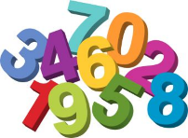
Maths
Today we are going to look at ordering lengths

Slide 16
Click on this link:
https://www.youtube.com/watch?v=Yx_Lcp9tkmE

Slide 17
What does ‘order the three distances’ mean?
Let’s look at the answers and how you could have worked them out on the next page…

Slide 18
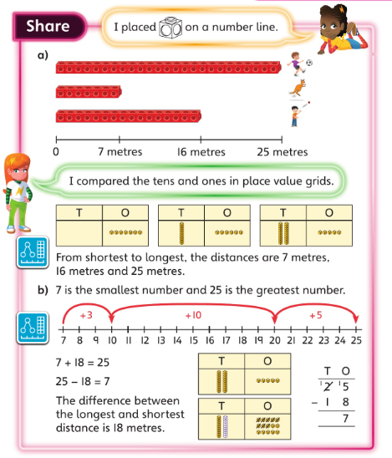
Why did Flo make a model for each of the numbers? How do the models help her to put the numbers in
order?
Astrid did it differently – she used place value grids. Can you tell which number each grid represents?
How did the grids help Astrid to put the numbers in order?
•

Slide 19
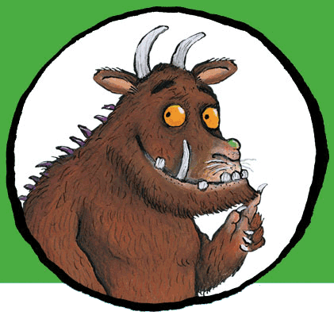
Now I would like you to have a go at completing the questions on the next slides. You can write your answers in your exercise books.
If you would like to try Gruffalo work, complete questions 1 and 2.
If you would like to try Horrid Henry work, complete questions 1, 2, 3 and 4
If you would like to try James and the Giant Peach work, complete questions 1, 2, 3 ,4 and the Challenge question on the following slide.

Slide 20
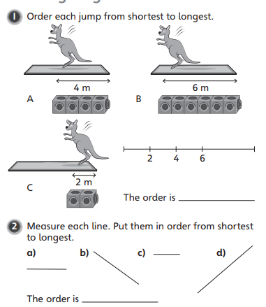

Slide 21
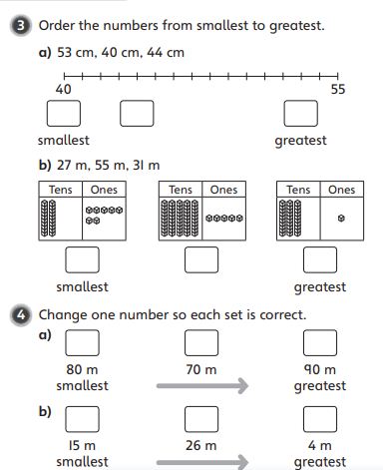

Slide 22
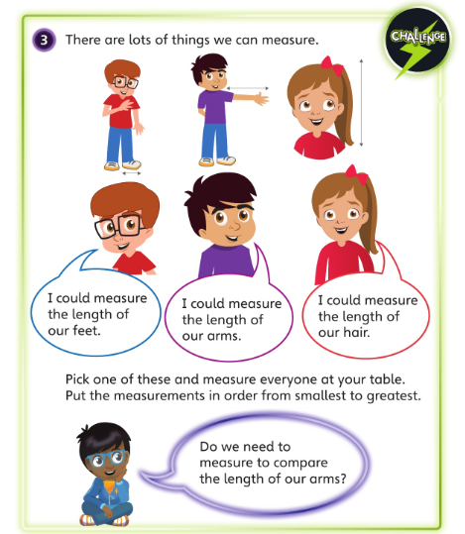

Slide 23
If you’d like an extra challenge, (or have some spare time) I have created a Maths Challenge PowerPoint which has an extra challenge for every day. You can have a go at that now.

Slide 24
English
Today you will be writing in role, becoming the character in the story and writing about what happened.
Re-watch the film:
https://vimeo.com/24962214
I’d like you to use your story maps that you made on Monday to help you to remember the film.
You will need to write in the first person ,(I) recall the events in order and describe your feelings.
There is an example on the next few slides.

Slide 25
Today I went to the launderette to do my washing because it was Thursday. Thursday was washing day. I was tired as it was late. Suddenly, I noticed something strange inside the washing machine. It was a fish! Was I dreaming? It couldn’t be a fish, surely it was just a sock…

Slide 26
Slowly, I got out of my seat and went to have a closer look. Shocked, I saw it again. My sock had transformed into a fish and there were schools of them! Did I own that many socks?
After that, I opened the door. Carefully, I reached out and touched the bubble of water leading to the underwater world. Then, I took a deep breath and put my head inside. I swam through a dark, narrow tunnel and that’s when I saw it…

Slide 27
Tall, strong seaweed towers grow towards the light, standing still and stoic in the strong current. Shoals of stripy, colourful sock fish dart up and down. Bright rays of sunshine dance and sparkle in the water. A large t-shirt octopus with long tentacles drifts by. The glittering seabed stretches as far as the eye can see. Small, woolly hat turtles swim past slowly. Bubbles travel to the surface before bursting…POP!

Slide 28
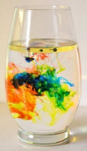
Science
Today you’re going create your own mini ‘explosions’ in a glass!

Slide 29
Fireworks in a glass
You will need:
A glass
A small bowl
3-4 tablespoons of oil
Warm water
Food colouring
A fork

Slide 30
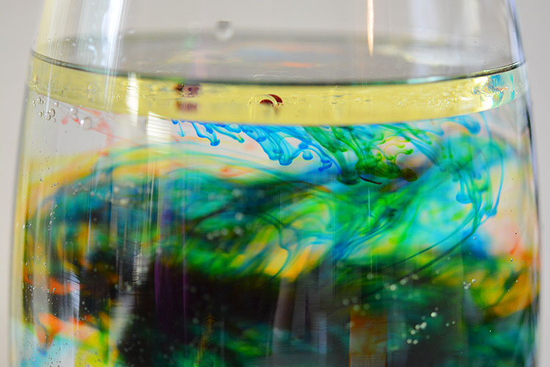
Fill the glass about ¾ full with warm water.
In a separate bowl, add 3-4 tablespoons of oil and carefully add a few drops of different food colouring.
Mix it all gently with a fork- just enough to disperse the food colouring a little bit. You’ll notice it doesn’t mix with the oil- it just breaks up into smaller dots.
Pour the oils and colour mixture into the warm water.
Watch as the coloured drops sink down into the water and mix together creating a firework effect.

Slide 31
What’s the Science behind it? This is all to do with the density of each liquid ( how heavy it is for its size.) Food colouring dissolves in water but not in oil. As they sink to the bottom of the oil, they mix with the water and begin to dissolve, creating tiny ‘explosions’.

Slide 32
Enjoy, Unicorns!

Slide 33
Tomorrow we are going to have another themed day. You’re going to take part in…
Farnborough’s Film Festival!
You’ll have instructions on how to create your own animation!

