Slide 1
Farnborough Primary School’s story writing day!

Slide 2
If the video doesn't play, click this link but watch without sound

Slide 3
If you had a magic crayon, where would you go?
Make a list of all of the magical places you might travel to with your magic crayon.

Slide 4
Just like the children in our story you are going to draw your own adventure today.
Make a mind map of all of your ideas.
How will your adventure start?

Slide 5
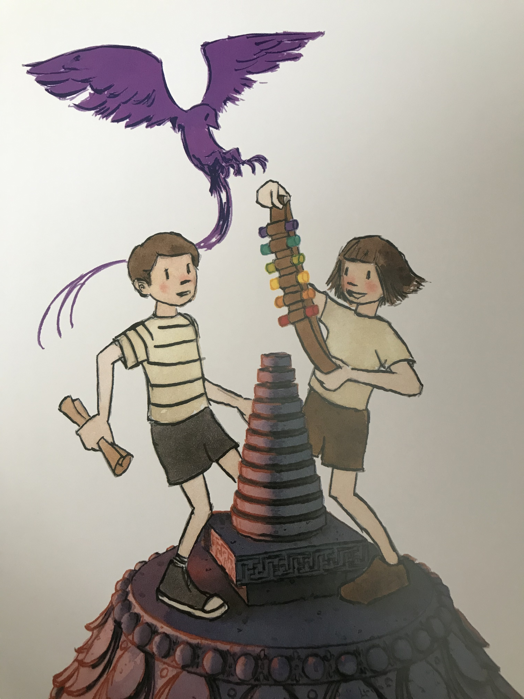
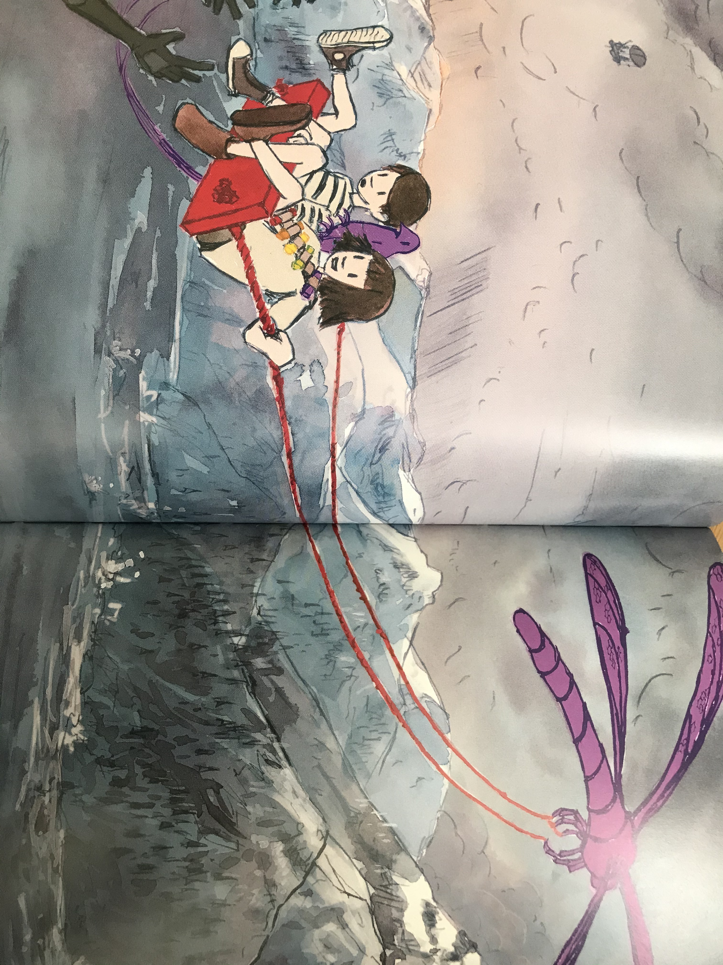
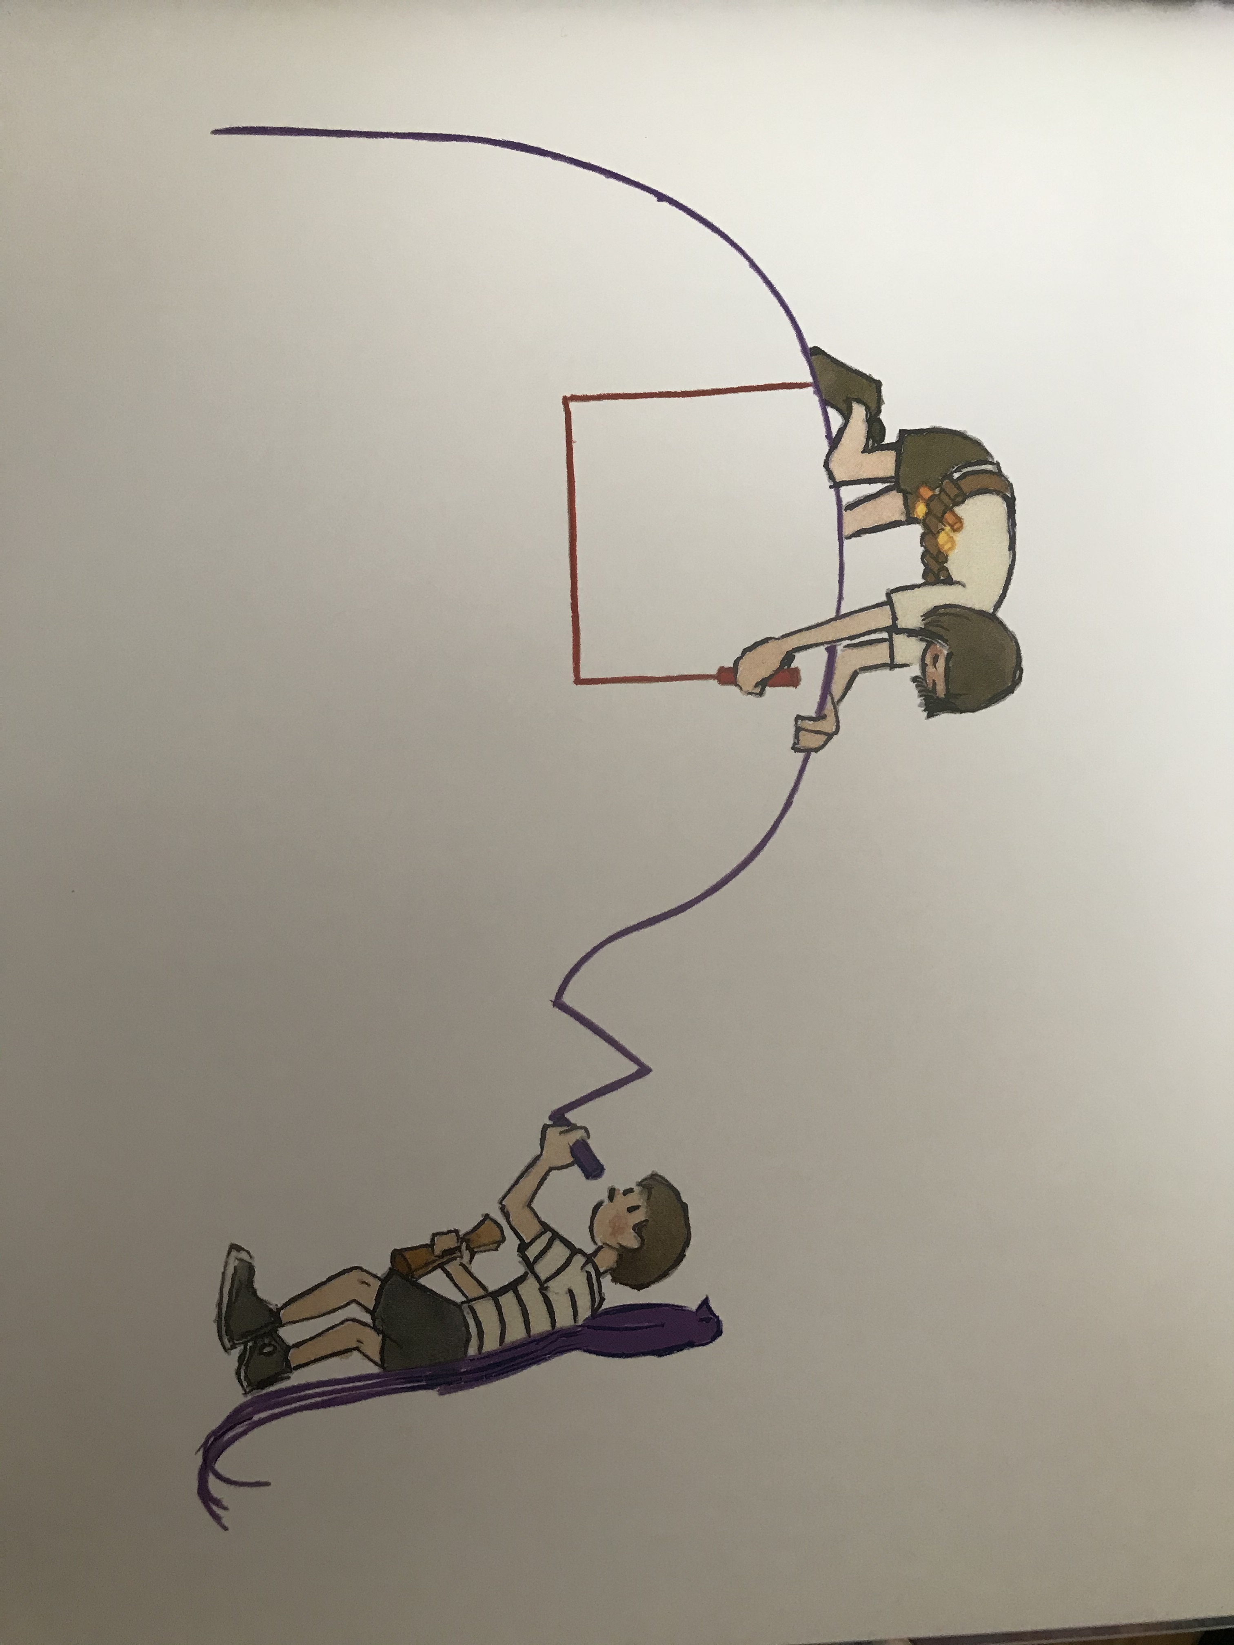
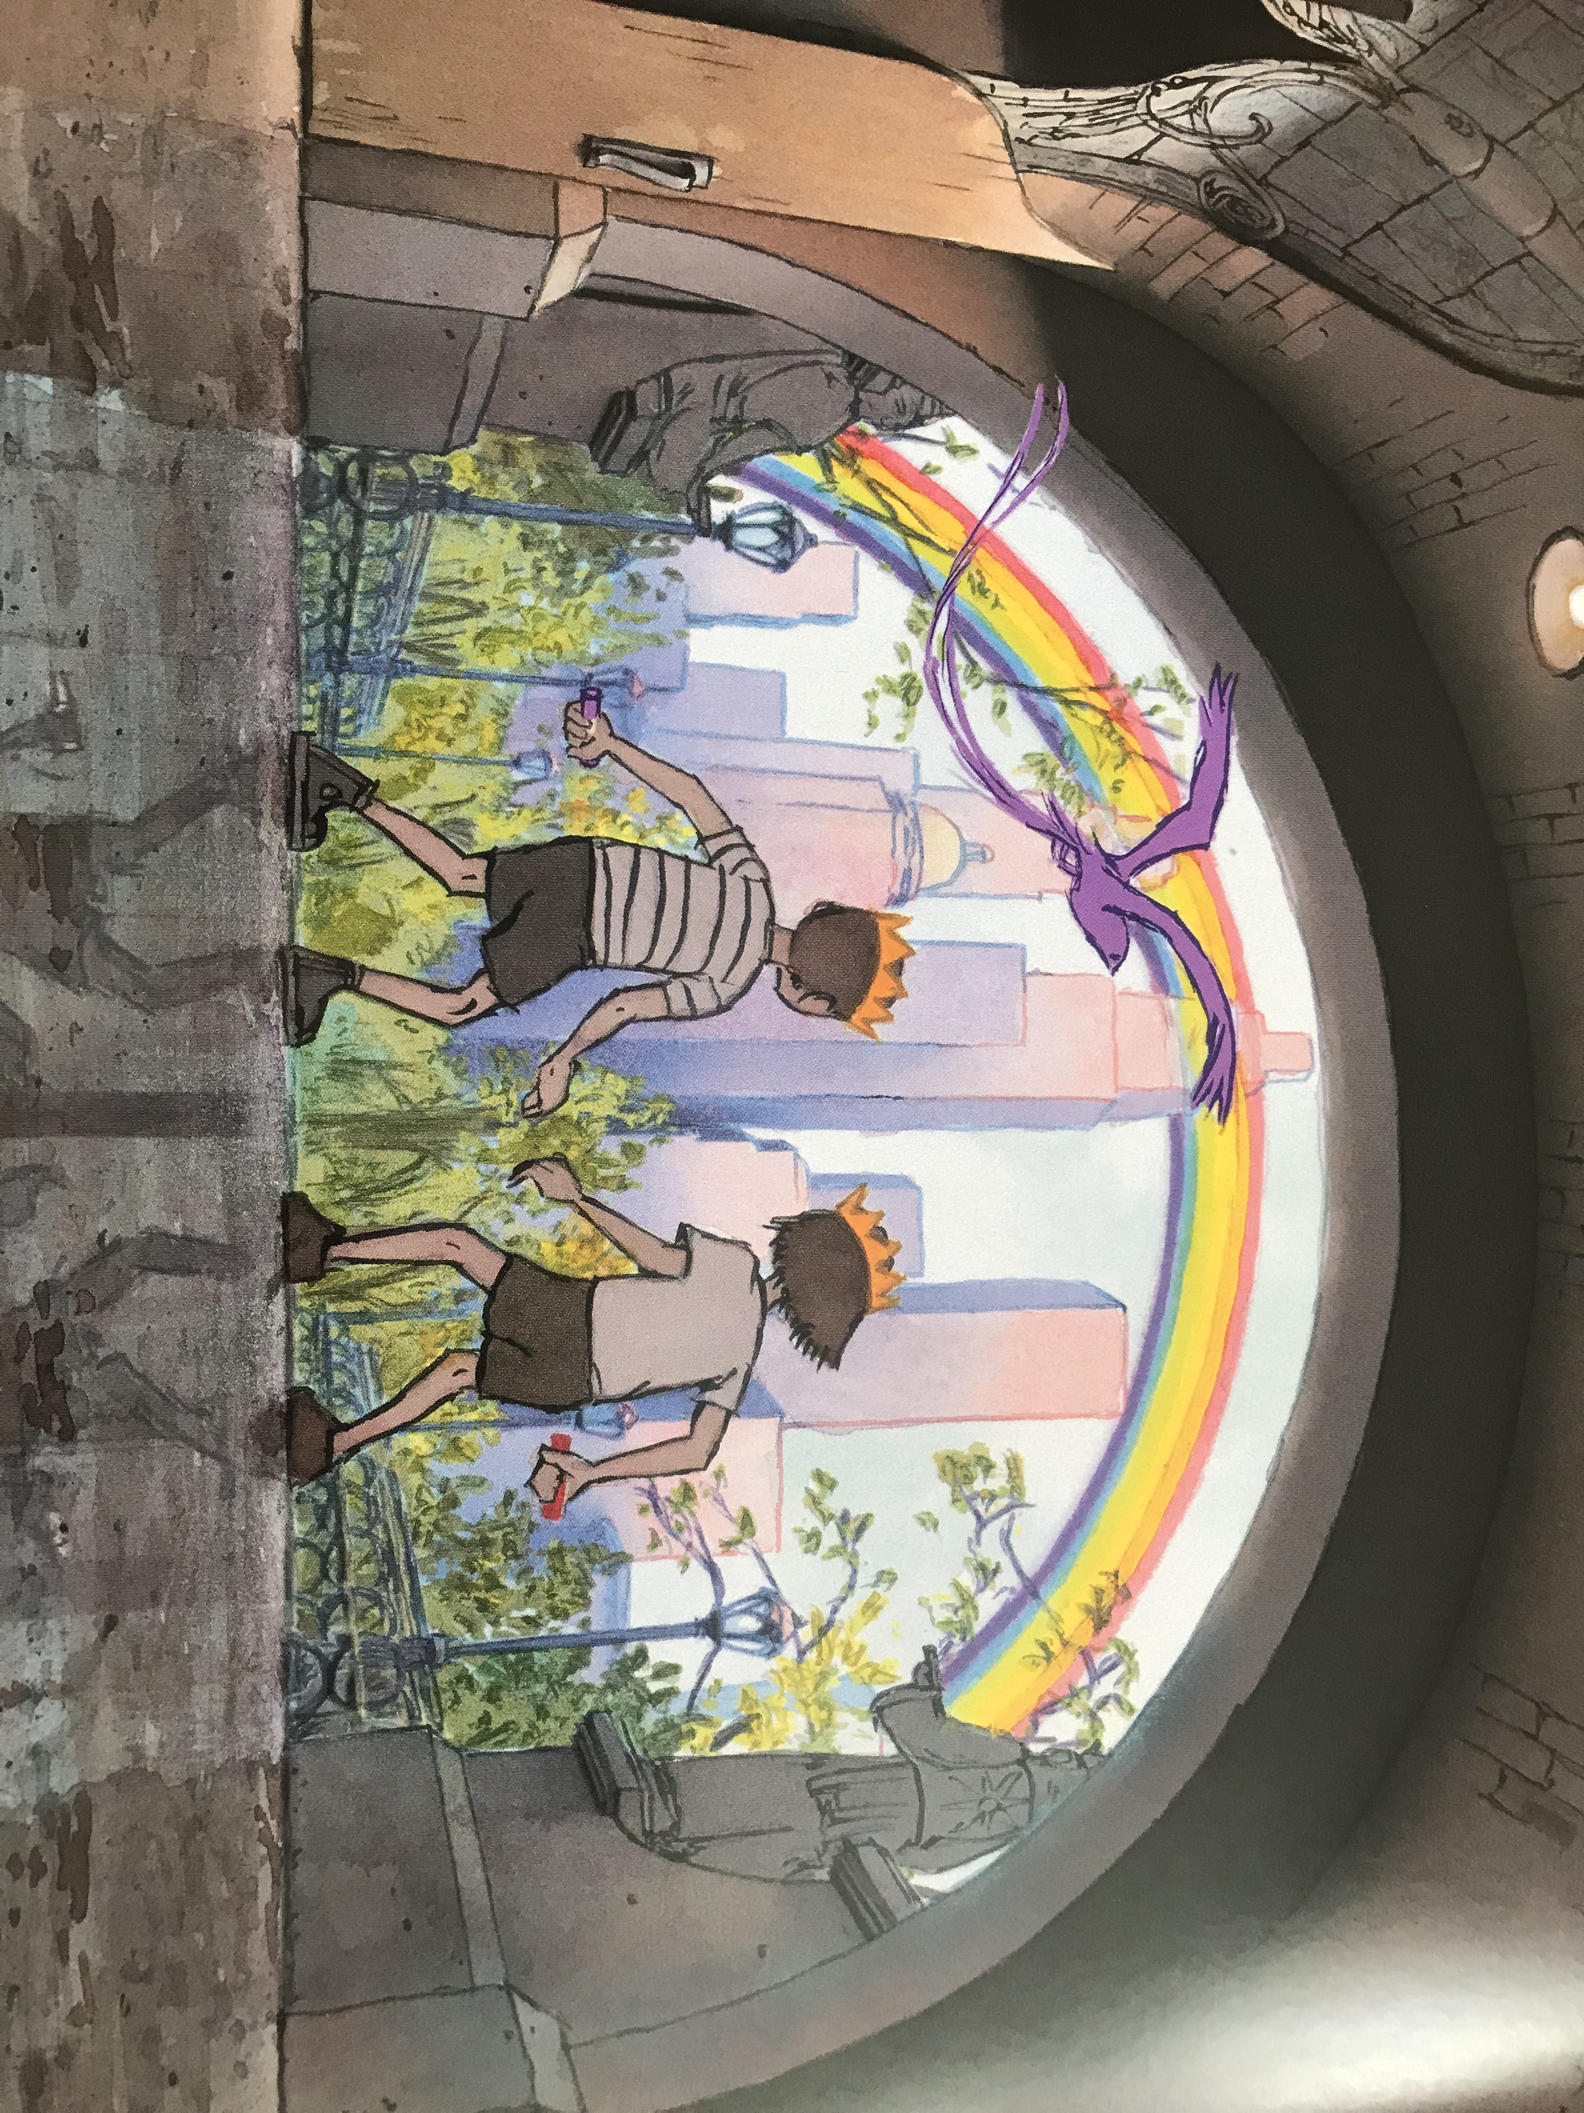
Mind map some of the ideas you could take from the story.

Slide 6
How can you tell different between what the children have created and what is real?
What is the sign of hope within the story?

Slide 7
Create a story path for your adventure.
Things to think about:
Characters
Setting
The problem
How it will be resolved?

Slide 8
Steps in the adventure
The problem
The start and the characters.
Resolution to the problem
The plan

Slide 9
Now you are ready to begin your adventure.

Slide 10
Some of you might feel you are ready to start writing your adventure using your story path to help you – that is great and you can get started!
Just like Aaron Becker, you might prefer to draw your story first. Draw each of the little steps in your story, writing a description underneath.

Slide 11
Here is some vocabulary to help you with your word choices.

Slide 12
Here is some vocabulary to help you with your word choices.

Slide 13
Here is some vocabulary to help you with your word choices.

Slide 14
Here is an adventure story writing toolkit.
Create suspense in the build up
A resolution
A dilemma or problem
Show not tell
Vocabulary choices
Short punchy sentence
Dramatic connectives – in an instant, without warning, out of the blue
Rhetorical questions
Empty words – something, somebody
Powerful verbs – crept, grabbed, smothered

Slide 15
Can you include…
Similes
Cliff hanger questions
Metaphors
Prepositions
Alliteration
Show the setting through the character’s eye’s
Expanded noun phrases to add intriguing details
Describe the change in weather to create atmosphere
Dialogue showing how the character is feeling

Slide 16
Let’s meet the author.
https://www.storybreathing.com/free-virtual-school-visit/

Slide 17
You now have a choice between two activities:
The next two slides will help you with junk modelling a scene from the story.
If you scroll through these slides you will find a line drawing art ideas linked to the story. There are pdf documents on the Year 3 page of the website which you might like to use with this activity.

Slide 18
Just like Aaron Becker we are going to try and create a scene from our story through Junk modelling.
You can create a scene from your story or from return it is up to you, but we would love to see photos of you models.

Slide 19
Here is some ideas to get you started.

Slide 20
Can you use the images on the slides to help you create some artwork for you stories?
You don’t have to use them all, pick the ones that will work with your story or use them to inspire you own artwork.
Who lives in the castle?
Do they keep animals?
Can you draw them so we can see?

Slide 21
You were secretly following someone when they disappeared through this archway. You aren't sure what's on the other side so you tiptoe up the step and peer through.
Draw or paint what you see through the archway.
What do you see through the archway?
Is there anything on the step, draw what you see?
Suddenly, something makes you look up...what do you see above the archway?

Slide 22
You are right at the top of the castle, looking out: what can you see? Clouds, stars, rooftops? What is the weather like?
Who lives in this magical castle floating in the sky?
What is on the flags?
What do you see below the castle? Clouds? S​tars? Rooftops?

Slide 23
You saw a city that you had ​never seen before, with streets full of water and strange wonderful buildings. Draw in as much as possible of what you see. Who is in the boat and where is it going?
What else can you see in this strange wonderful, watery city?
Who is in the boat and where is going?

Slide 24
The castle is on an island, draw in the water and an upside down picture of the castle reflected in it.
Is there anything or anybody in the water? Draw them with their reflections, if you can.

Slide 25
Something extraordinary just happened and you saw it all!
Draw a picture showing the whole story................
What have you seen?
Where is it happening?
Who is involved?

