Slide 1
Writing
This week, we are going to be continuing with the alien theme.
We have 2 creative challenges to complete: designing your own alien, then a planet called, ‘Zargon’.
We will begin to think about specific features of newspapers, e.g. headlines, quotes and the 5 ‘w’ questions before we collate it all together and write our own newspaper report next week.
Have fun!

Slide 2
Writing - Day One

Slide 3
Reading – Day One
https://www.bbc.co.uk/bitesize/articles/z62fvk7
Click on or copy and paste the link above and listen to Ed Petrie reading extract 1 from ‘Dindy and the Elephant’. The extract is also in written form a little lower on the page.
Answer the 3 questions after listening/reading the extract.
1) What is a cobra snake and what does it look like?
2) How do you think Pog is feeling in this extract?
3) Do you think the characters will now go home?

Slide 4
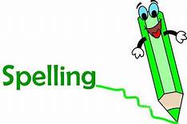
Spellings for week 4 - Homophones & near homophones. Words that sound the same but are spelled differently and have different meanings
Group 1 - new knew, blue blew, sea see, so sew, sun son, meet meat, bye buy
Group 2 - hole whole, vein vain, aloud allowed, father farther, isle aisle, cereal serial, whether weather, pause paws, feet feat

Slide 5
Spelling activities for week 4
Try and learn the words for 5 – 10 minutes each day. Break down the words into syllables and/or use the ‘Look, Say, Cover, Write, Check’ method to help you learn them. Complete one of the activities below during the week: New ones are highlighted in green.
Write your words using one colour for the vowels and another colour for the consonants
Word classes – sort your spelling words into nouns, verbs, adjectives, adverbs etc
Find an antonym (opposite) for each of your spelling words
Write your words, then write them again with the letters mixed up. Can you unscramble them the next day and spell them correctly?
Write your words. Then use a coloured pencil to divide your words into syllables, e.g. sen-tence, re-mem-ber
Use a thesaurus to find some synonyms
X words – write 2 words with 1 letter in common so that they cross over each other, as if they were on a scrabble board
Type out your words on the computer – try to use at least 4 different fonts
Set a timer for 2 minutes. See how many times you can write each word perfectly during that time.
Ask an adult to test you at the end of the week. Good luck!

Slide 6
06.05.20 - Answers

Slide 7
Lesson 24 – WALT: Compare area.
Can you predict who is winning the game just by looking? Which shape is taller, does that mean it will have the greater area?
How can you compare the areas?

Slide 8
Can you tell who is winning just by looking? How can you check which shape has a larger area?
One way to find the number of white squares is to count all the white squares. Is there another way?

Slide 9
What is the only way to compare areas accurately?
Are the squares inside the middle of the shape a part of its area? Why/Why not?

Slide 10
Practice Questions

Slide 14
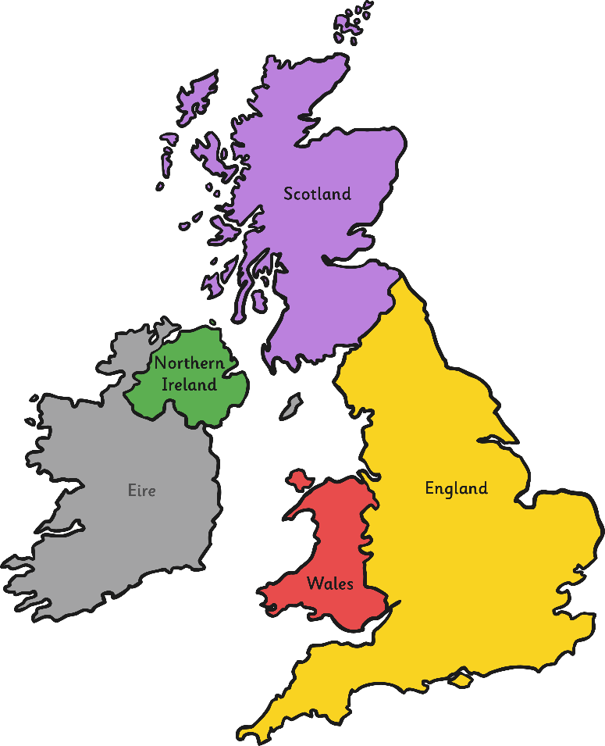
Who Was Charles Darwin?
Charles Darwin was born on 12th February 1809 in Shrewsbury, England.
Shrewsbury

Slide 15
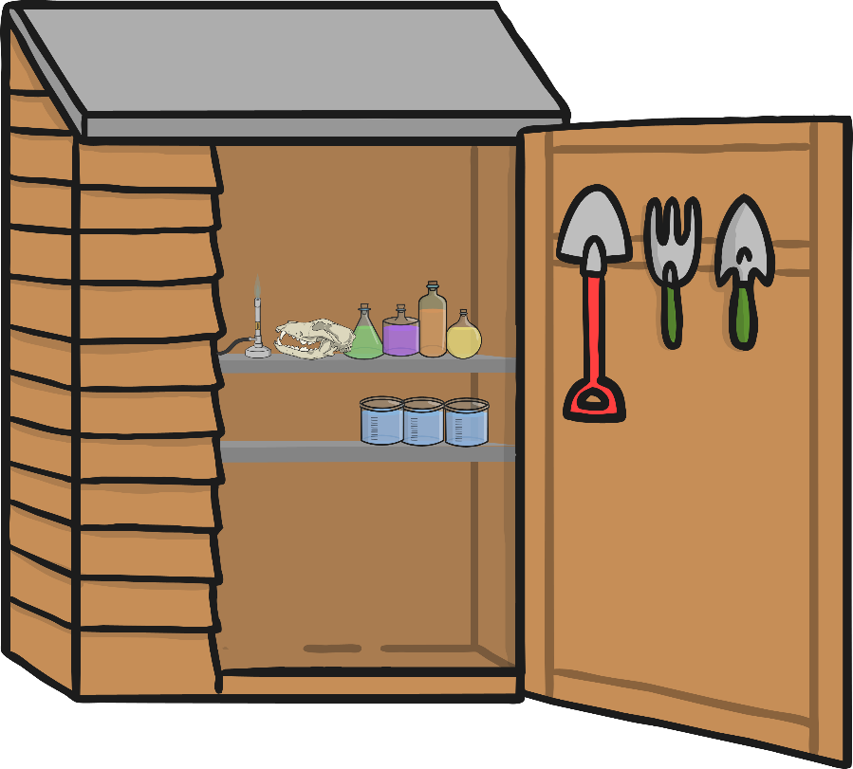
When he was nine years old, Charles Darwin went to Shrewsbury School for boys. Darwin did not particularly enjoy school and found some of the work, like Latin and Greek, hard. He did, however, love science and was always asking questions. When he was 13 years old, he set up a science lab in his garden shed.

Slide 16
When he was 16 years old, Darwin was sent to Edinburgh to train to become a doctor, like his father, grandfather and brother, who were also all doctors.
Edinburgh
Shrewsbury
However, Darwin did not enjoy it and knew he did not want to become a doctor. He didn’t like looking at blood. His father then sent him to Cambridge to become a vicar but he was more interested in learning about nature and animals. He had lots of friends and teachers at university who helped him to learn more about these things.

Slide 17
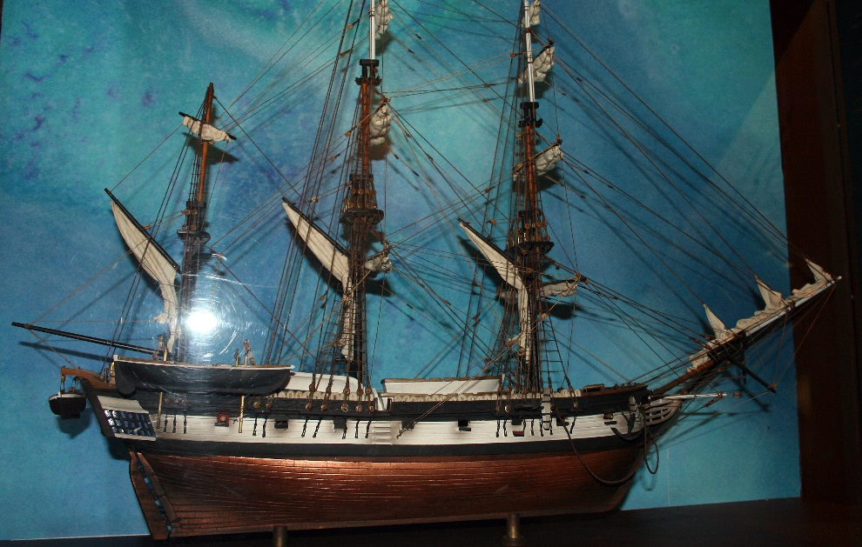
Darwin passed his exams to become a vicar but he did not want this to be his job. John Henslow, a teacher from Cambridge, sent him a letter saying that Robert FitzRoy, the captain of the ship HMS Beagle, was looking for someone to be the ship’s naturalist. The person would have to explore, collect and record information about the rocks, plants and animals that they found on their trip. Darwin knew this was his dream job and so persuaded his father to let him go on the trip.
A model of
HMS Beagle
Photo courtesy ofL2F1 (@Wikipedia.com) granted under creative commons licence; attribution

Slide 18
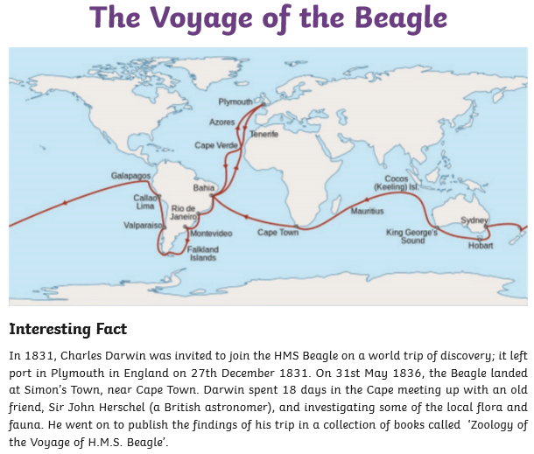
Can you locate these places in an atlas or using google maps?

Slide 19
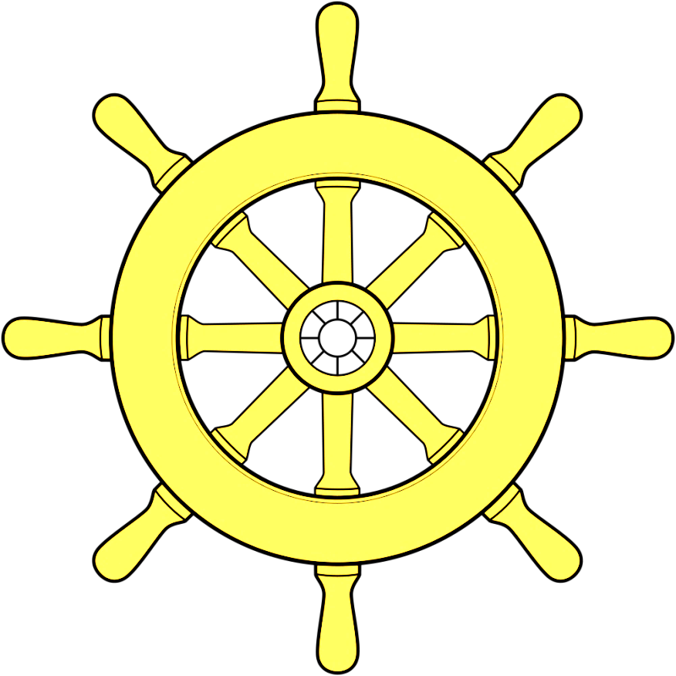
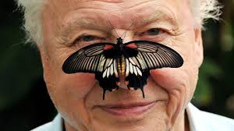
The Beagle: Darwin’s Kit List
Charles was the ship’s naturalist. Each time the ship docked he would explore and investigate the local area. He was probably quite happy to be on dry land for a while, as he got very seasick! As the ship’s naturalist, Charles captured and collected endless species. He was fascinated by what he saw and wrote many detailed descriptions with illustrations. Some he preserved in special liquid in jars to be studied later. Other specimens were stored in barrels and crates that were sent back to the UK.
David Attenborough is a naturalist.

Slide 20
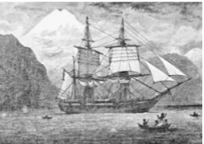
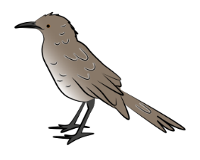
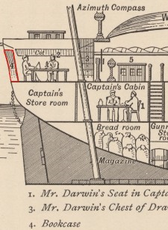
Some specimens even landed up as supper! One story tells how Darwin and his crew were feasting on a particularly tasty bird when half way through the meal he realised it was a new species, and quickly rescued any bits of bone that remained!
Darwin shared the poop deck cabin with two other crew members. It measured only 3 x 3.5 metres and contained a library, instrument stand and a large chart table in the middle. It was here that Darwin studied and preserved specimens, wrote letters and notes and rested in his hammock during the bouts of sea-sickness.

Slide 21
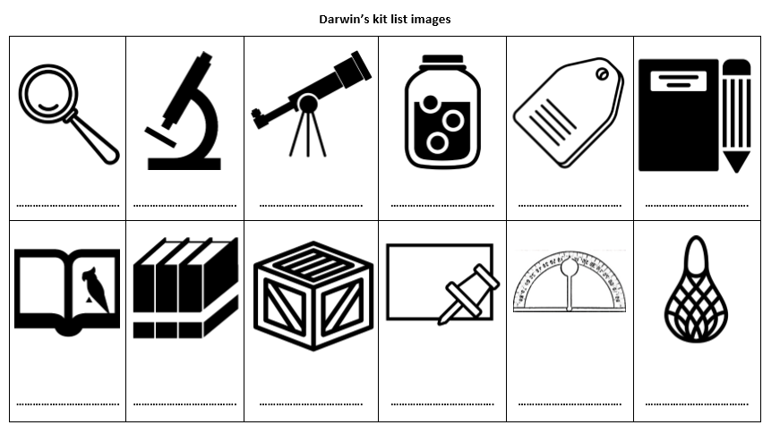
What would a naturalist need on board HMS Beagle? Use the picture
clues below to help you write a kit list for Charles Darwin.
Either print out this sheet and write the name of the kit below or just
write the kit list in your books.
Try yourself first and if you get stuck look at the next slide.

Slide 22
What would Charles Darwin need on board HMS Beagle?
What equipment would he have needed to carry out his research?
Have a look at the images of his ‘kit list’ on your worksheets and decide what each item is and what it would be used for.
hand lens
microscope
telescope
storage jars and preserving liquid
card labels
notebook and pencils / pens
taxidermy book
reference books
storage crates
boards and pins
clinometer
plankton nets
Have a look at the answers. How accurate were your ideas? Are there any you find tricky? Look up the meaning of any you are unsure of.
Which pieces of equipment do you think we still use now?
How do you think these pieces of equipment have changed over time?
A

Slide 23
How new technologies help naturalists and scientists today
Scientists have replaced light microscopes with powerful microscopes that can magnify specimens up to 10,000,000x!
Whilst scientists still make notes in the field using pen and paper, they are able to share thoughts and findings instantly . Darwin would have to wait weeks, sometimes months for his letters to be carried by ship. There were no telephones or internet for rapid communication.
Now information can be found instantly using internet search engines like Google, rather than relying on searching through large reference books such as those that filled Darwin’s shelves.
Digital technology is even used for preserving species. Many plant and seed samples that were preserved and mounted on sheets of paper and card are now being digitised and are accessible online to anyone in the world that wants to see them.
We enjoy these technologies when watching wildlife programmes. Watch David Attenborough in the Galapagos.
https://www.youtube.com/watch?v=czpPbDGHOZA

