Slide 1
Day Two

Slide 6
Day Two
https://www.bbc.co.uk/bitesize/articles/zr93bdm
Follow the link again from yesterday and read the second poem from BBC Bitesize website ‘Excuses’ by Allan Ahlberg.
Follow parts 1 and 2 from activity 2 on the page where the list of excuses from the poem are ordered and where you can create new ones!

Slide 7
Yesterday’s Answers

Slide 8
Lesson 22 – WALT: Find the area of Rectilinear shapes by counting squares.
How will you find the area of these shapes? Do you think squares are a good way to cover a shape? Why?

Slide 9
Last lesson you measured area by placing units of measurement inside a shape? How is this method the same/different?
How can you make sure you count all the squares and not miss any out?

Slide 10
How is the area of these shapes measured? Which shape has the largest area? How do you know?
What if you put small flat squares inside each shape? Would you get the same or different answer?

Slide 11
Practice Questions

Slide 14
So Giants & Griffins, let’s recap life processes…
All living things do certain things to stay alive. These are called life processes.
All animals, including humans, do these things. Plants do too, although they do them in different ways.
We can remember life processes by thinking about Mrs Gren.
Do you remember what her initials stand for?

Slide 15
Life Processes
Movement
Respiration
Sensitivity
Growth
Reproduction
Excretion
Nutrition
MRS GREN

Slide 16
Sorting into Three Groups
Lays eggs
Venn diagrams can be used to sort lots of groups of animals.
Where would a turtle go on this diagram?
Where would a cat go?
snake
penguin
dragonfly
butterfly
duck
kangaroo
parrot
human
bat
Has two legs
Can fly

Slide 17
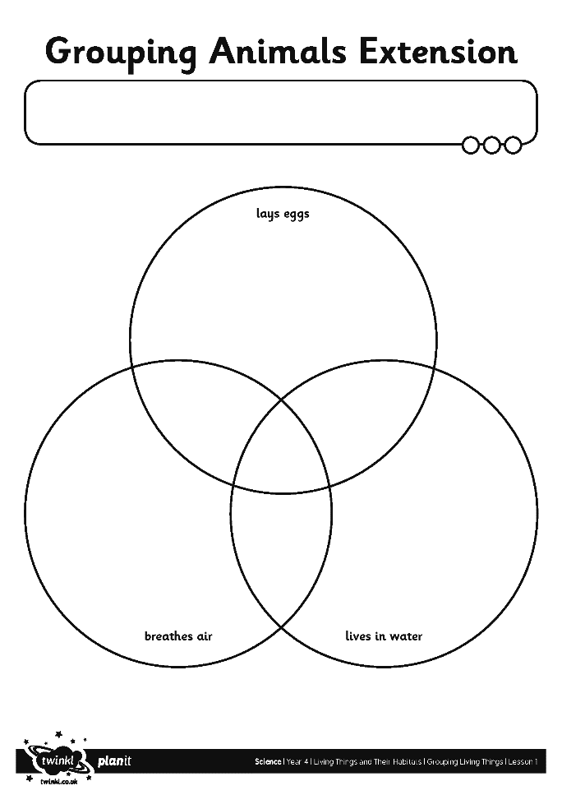
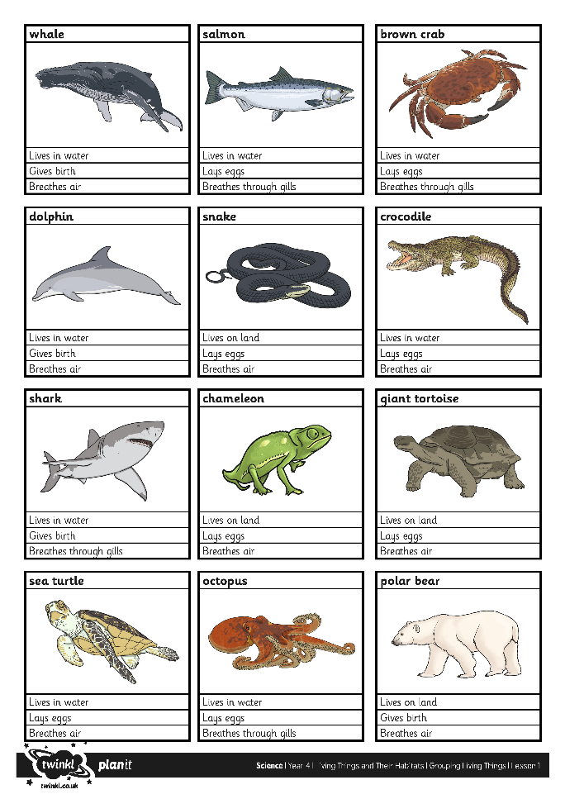
Activity 1. Sort these animals into 3 Groups. Copy into your books or print out the sheets on the next slides.

Slide 18
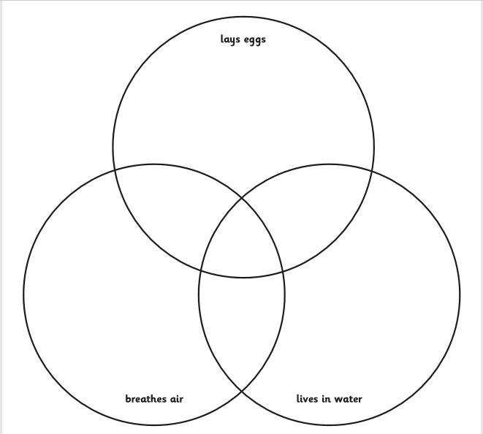

Slide 19
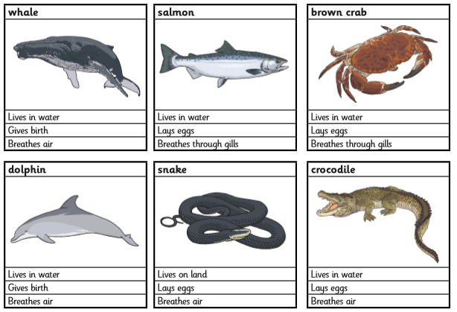

Slide 20
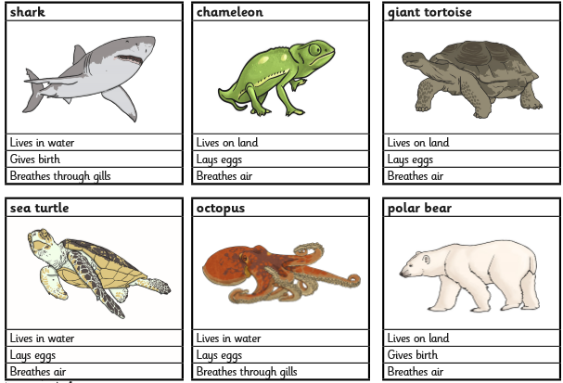

Slide 21
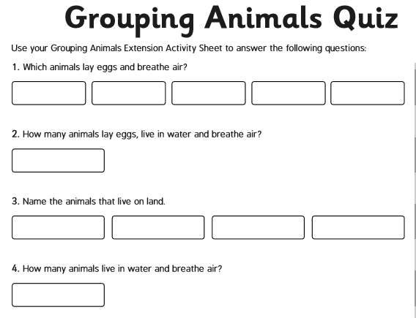
Activity 2:Once you have created your Venn diagram, use it to answer the Grouping Animals Quiz

Slide 22
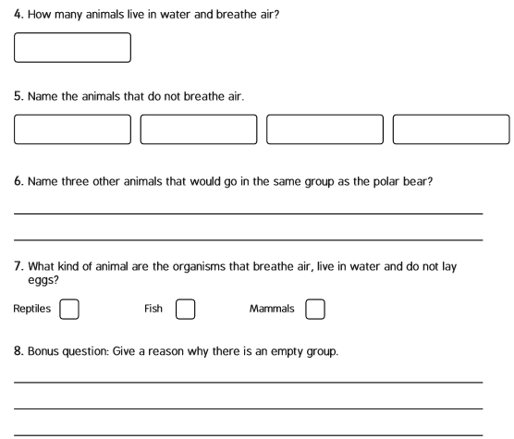

Slide 23
Grouping Animals Quiz
Well Done!
See tomorrow’s slides to see if you are correct!

