Slide 1
Writing - Days Two and Three
You have today and tomorrow’s session to write the log that you have drafted into a written piece with full sentences.
Use the guidance on the next slide to help you.

Slide 3
Maths Investigation – 19.05.20
Cut out and put in order from shortest amount of time to longest.
Creates some great discussion!

Slide 4
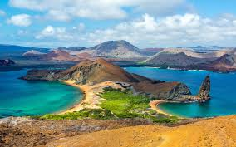
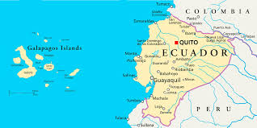
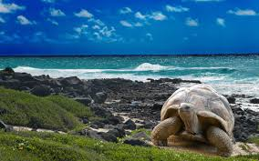
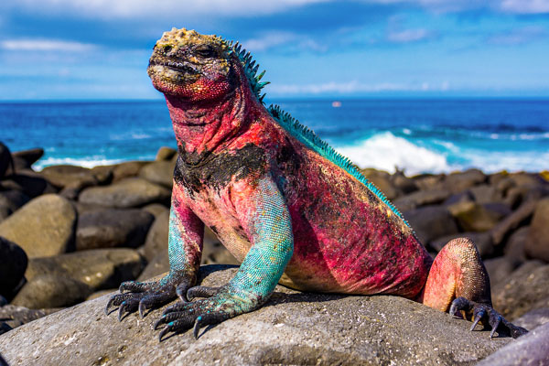
Galapagos What is this place that Darwin visited in 1835 like?

Slide 5
The Galapagos Islands contain many endemic animals and plants (meaning they are only found in Galapagos).
One of the most famous visitors to the Islands was the British naturalist Charles Darwin and the observations he made during his 5 week visit in 1835 were very important for the future of science. Upon returning to England, Charles Darwin worked on his theory of ‘natural selection’ but the full account of his theory, On the Origin of Species, was not published until 1859.
https://www.youtube.com/watch?v=ZbITQ0dqxCQ

Slide 6
https://www.bbc.co.uk/bitesize/topics/z3fycdm/articles/zk9cxyc
Watch the short video on the Galapagos Islands with Sue Venir
Read the information on this page and watch the video to see more of the Galapagos Islands
Complete the short quiz on the Galapagos Islands

Slide 7
Where are the Galapagos Islands located?
What do the Galapagos Islands look like?
GALAPAGOS FACT:
The Galapagos Islands belong to Ecuador, and the official language is Spanish.

Slide 8
Use what you have found out to answer the questions below:
Where are the Galapagos Islands located?
What do the Galapagos Islands look like?
What animals would you find on the Galapagos Islands?
How many people live on the Galapagos Islands?
What is the weather like on the Galapagos Islands?
Look at the next slide to think about how you want to present your research

Slide 9
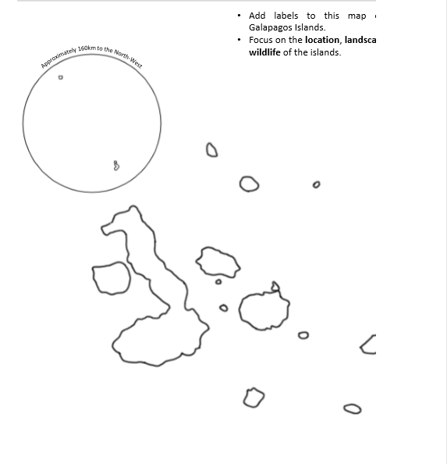
How do you want to present your research?
You could present your ideas as an information poster on the Galapagos showing the location, landscape animals, climate and so on. Make it colourful and attractive, perhaps spread across 2 pages to give space for your information.
Or you could print out the map across and annotate (label)
Or you could write out the answers in full short paragraphs/sentences.
It’s your choice, it’s up to you

