Slide 1
Writing – Day Two

Slide 4
Reading – Day Two
https://www.bbc.co.uk/bitesize/articles/z62fvk7
Click on or copy and paste the link above and listen to Ed Petrie reading extract 2 from ‘Dindy and the Elephant’. The extract is also in written form a little lower on the page.
Answer the 3 questions after listening/reading the extract.
1) Are you surprised about the description of the elephants?
2) Why do you think that the elephants were being kept chained?
3) Is it always rude to shout?

Slide 5
Yesterday’s Answers

Slide 6
Lesson 25– WALT: Make shapes.
How has the patio in the picture been made? What is the area of the patio that is shown?
Do you think there is more than one way to arrange the squares?

Slide 7
Is it true that there can be lots of different shapes that all have the same area?
What mistake has Ash made? How can you check this?
Ash

Slide 9
Practice Questions

Slide 12
Can you create a symmetrical fantasy insect?

Slide 13
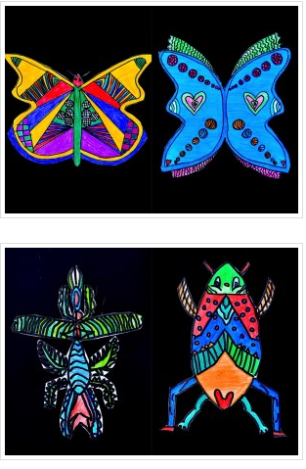
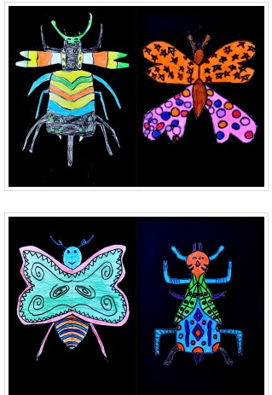
Symmetrical means the same on both sides.

Slide 14
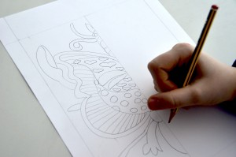
Fold your paper in half and draw one side

Slide 15
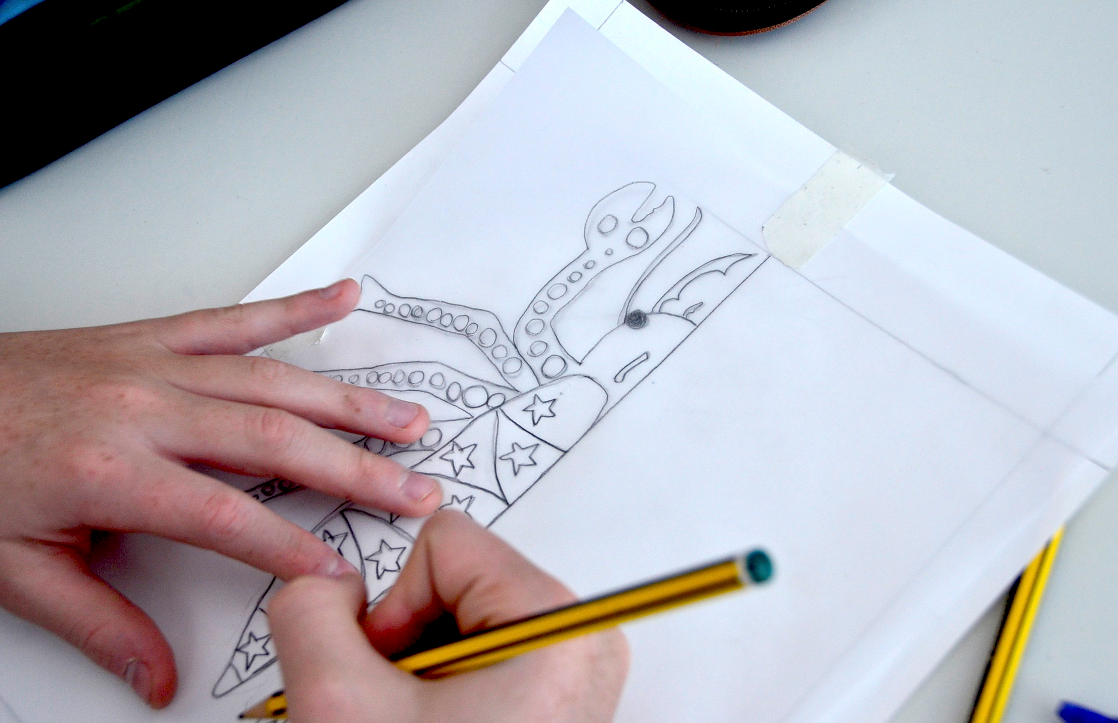

Slide 16
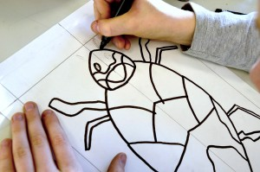
Go over the first half with pen, then you should be able to see through the paper to trace the other side. Then go over the second side with pen too, as you can see in this photo.

Slide 17
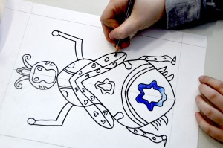
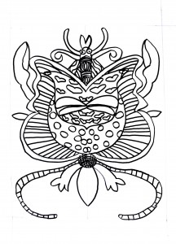
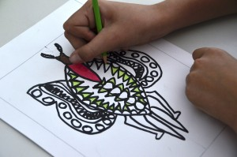
Some examples to get you thinking……….What could you do?

Slide 18
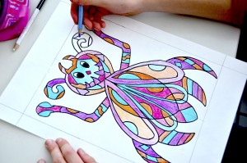
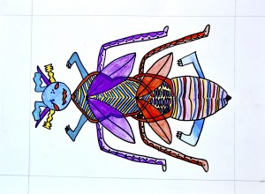
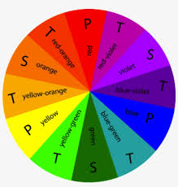
Think about your colour choices, you may want to use colours that go together as in these examples below.
Or you could use contrasting colours (colours that appear opposite each other on the colour wheel) such as blue and orange or red and green.
It’s your choice! Go for it!

Slide 19
It’s a Bug’s life!
You can leave your fantasy insect as it is or you could cut it out carefully and stick on a background of your choice, it’s up to you! Be creative!

Slide 20
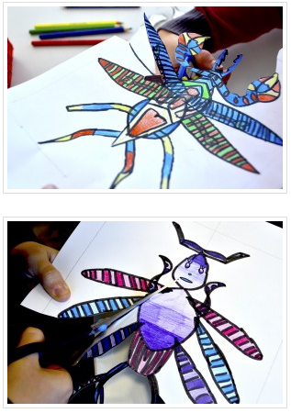
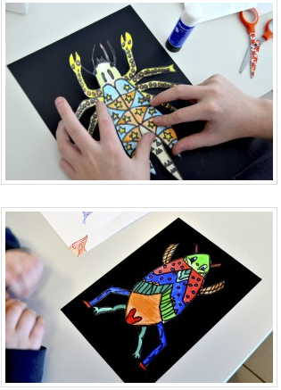

Slide 21
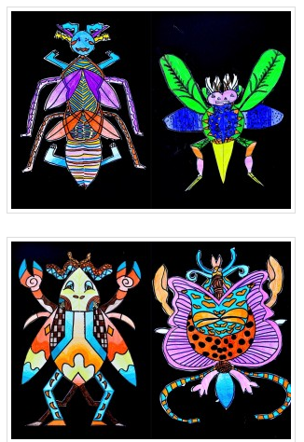
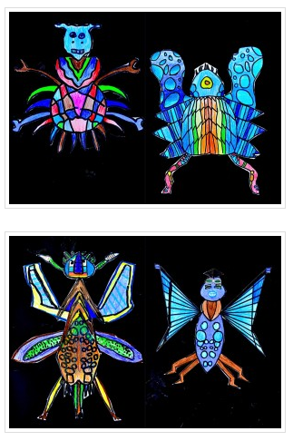

Slide 22
