Slide 1
Hello Unicorns,
I hope that you all had a great Bank Holiday weekend and were able to enjoy the sunshine.
We’ve got another exciting week ahead of us… On Thursday we will be starting ‘Farnborough gets Active’ and Friday is Farnborough’s Film Festival!
It’s been great to hear from some many of you- I’ve really enjoyed seeing your hard work and hearing your news, so keep those emails coming in if you can:
yeartwolearning@farnborough.bromley.sch.uk
Love from,
Mrs Matthews
xxx

Slide 2
Good morning Unicorns!
Here’s your work for today: Monday 11th May

Slide 3
Reading online
Please log on to Bug Club and read for at least 15 minutes
Make sure you answer your bug questions!

Slide 4
Reading online
Here’s a link to the latest issues of ‘The Week Junior’
https://magazine.theweekjunior.co.uk/

Slide 5
Maths answers from last Wednesday:
Pages 53 and 54
3 letters, Tuesday, 14 letters
3 blue flowers
Li got 4 stickers in Sport; Li got 2 fewer stickers in Art than in Music.
Teddy, 12 children, 3 children
Challenge

Slide 6
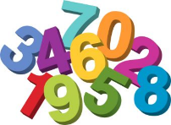
Maths
Today we are going to be focussing on measuring in centimetres.

Slide 7
Click on this link: https://www.youtube.com/watch?v=sSj4Y8tWGEw

Slide 8
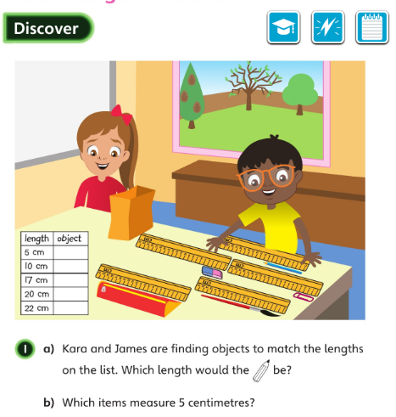
How many objects are the children measuring?
• How are they doing the measuring?
Let’s look at the answers and how you could have worked them out on the next page…

Slide 9
Look at the left end of the pencil. Which number did Ash line it up with? Why didn’t Ash put the end of the pencil at one (the 1 cm mark)?

Slide 10
The pencil case is 20 cm long.

Slide 11
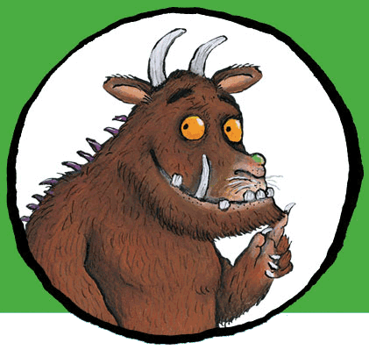
Now I would like you to have a go at completing the questions on the next slides. You can write your answers in your exercise books.
If you would like to try Gruffalo work, complete questions 1 and 2.
If you would like to try Horrid Henry work, complete questions 1, 2, 3 and 4
If you would like to try James and the Giant Peach work, complete questions 1, 2, 3 ,4 and the Challenge question on the following slide.

Slide 12
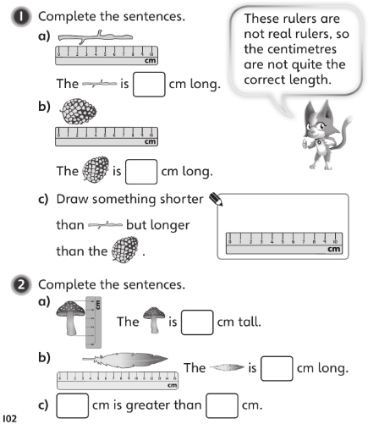

Slide 13
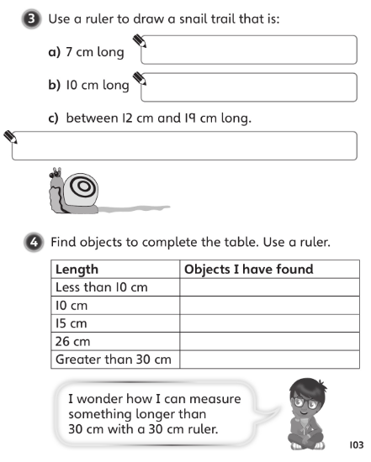

Slide 15
If you’d like an extra challenge, (or have some spare time) I have created a Maths Challenge PowerPoint which has an extra challenge for every day. You can have a go at that now.

Slide 16
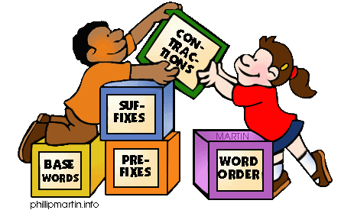
Grammar
Today you will be focussing on:
Joining words
Watch this link and enjoy the video:
https://www.youtube.com/watch?v=_yarxGq1Ens

Slide 17
Grammar
Please complete pages 20 and 21 in your Nelson Grammar workbook.

Slide 18
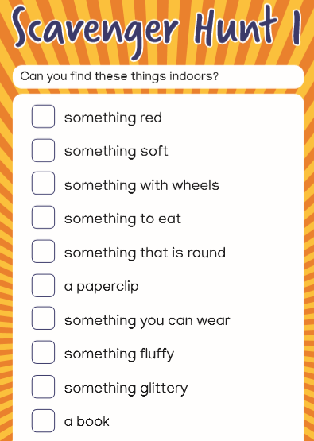
Independent Learning

Slide 19
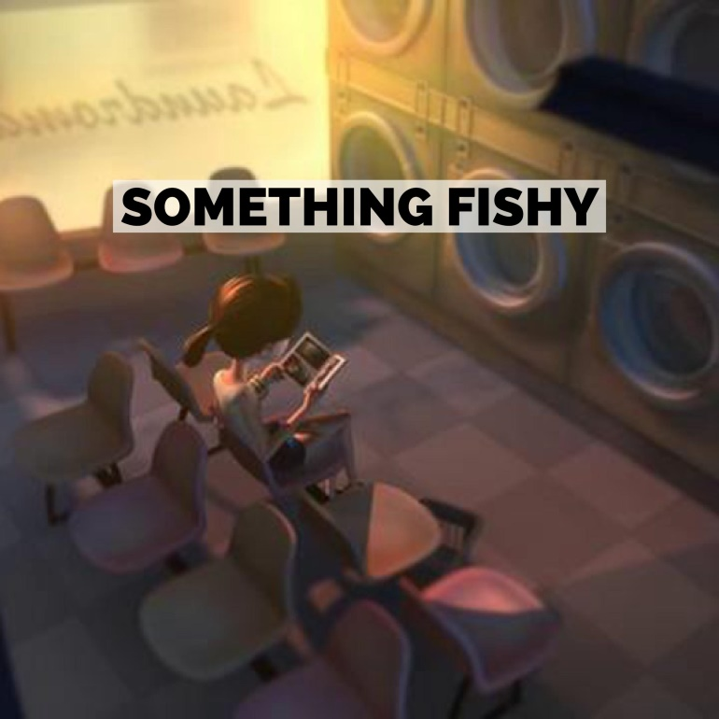
English
This week we are going to be carrying out some work based on a short film called ‘Something Fishy’

Slide 20
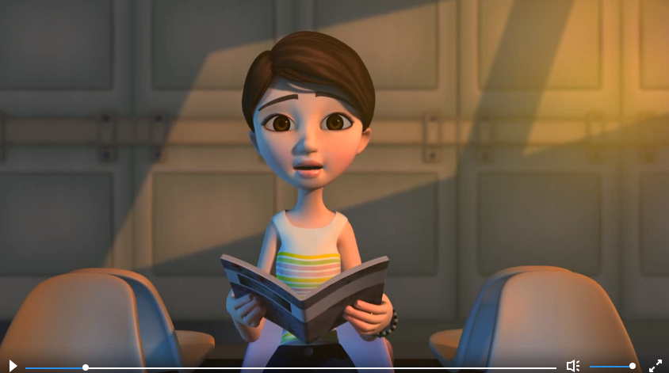
Watch this link:
https://vimeo.com/24962214
Think about these questions:
What do you think about the main character and why is she there?
How is the character feeling?
What does this tell you about the time of day?
What lured her to look at the washing machine?

Slide 21
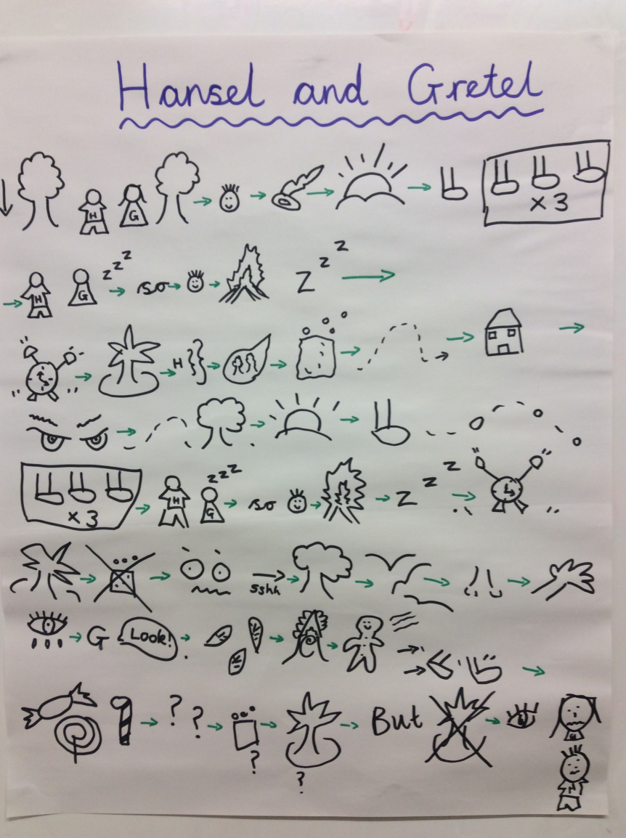
Today you are going to be creating a story map to retell the story.
Do you remember when we created story maps at school? You don’t need to use any words. The pictures that you draw will help you to remember the story.
As a reminder, here is our class story map for ‘Hansel and Gretel’

Slide 22
First, draw a story path

Slide 23
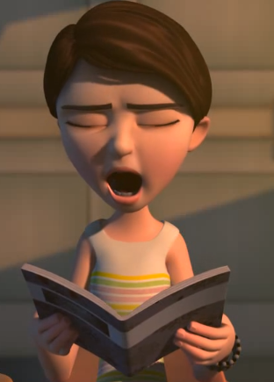
Next, think about what your first picture is going to be.
My first picture is of the tired girl who is sitting in the launderette waiting for her washing to finish.

Slide 24
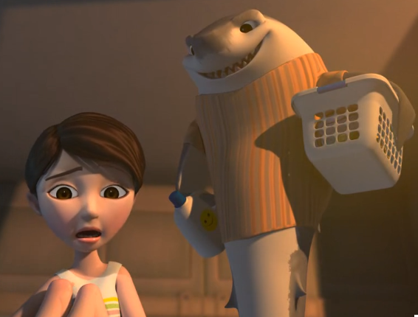
Carry on until you reach the end of the film when your last picture will probably be of the fish picking up his jeans…

Slide 25
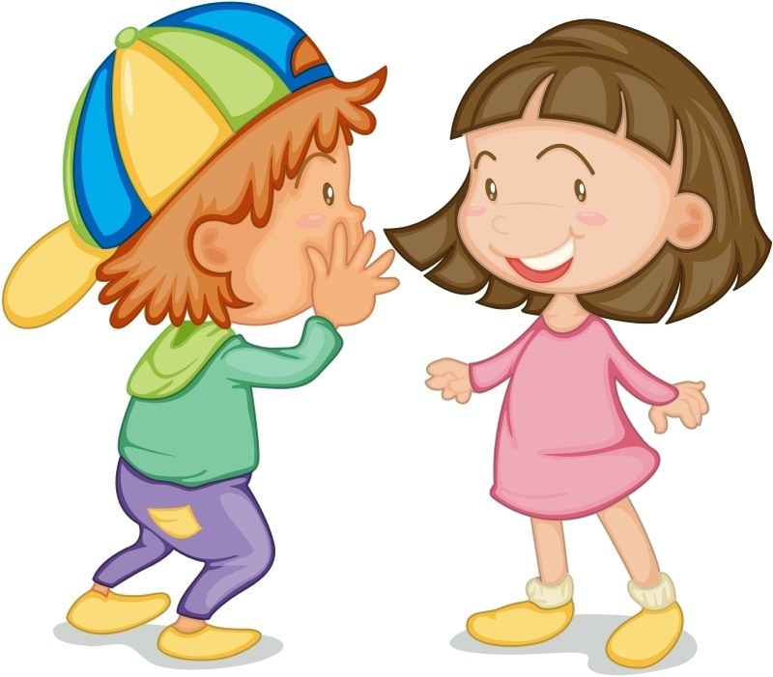
If you have time, you could retell the story from the film to someone else in your house.

Slide 26
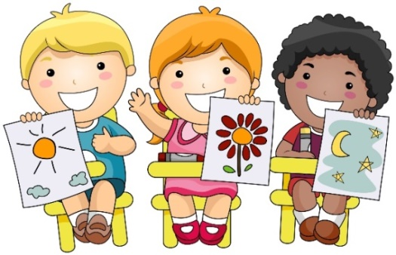
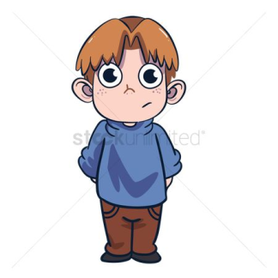
Art Today you are going to have a go at Touch Drawing ● Ask an adult or another person to put a small object into your hand behind your back. Don’t look! ● What does it feel like? Smooth, spiky, hairy? How many surfaces are there? ● Now try drawing the object using your dominant (writing) hand whilst keeping the object in your non-dominant hand behind your back. Keep feeling the object and try to draw what you can feel. There are a few ideas on the next slide…

Slide 27
Enjoy, Unicorns!

