Slide 1
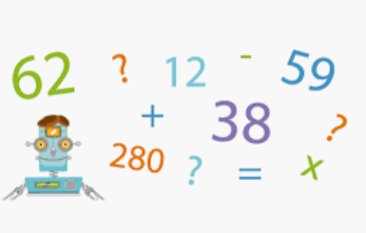
Maths Challenges
Linked to Fractions

Slide 5
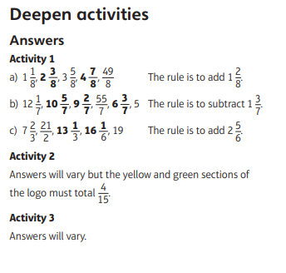
Answers

