Slide 1
Maths Challenges
Week commencing
18th May

Slide 2
Monday

Slide 3
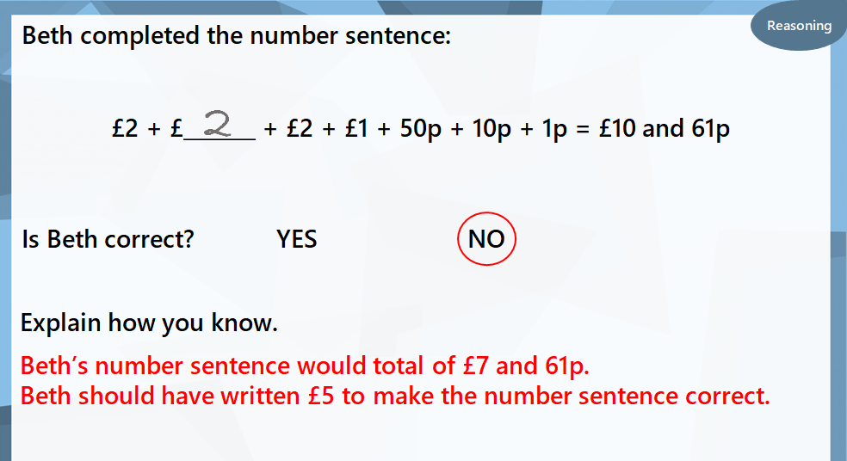
Tuesday
Type text here- you can change the font and font size as needed. You can also add or remove text boxes.

Slide 4
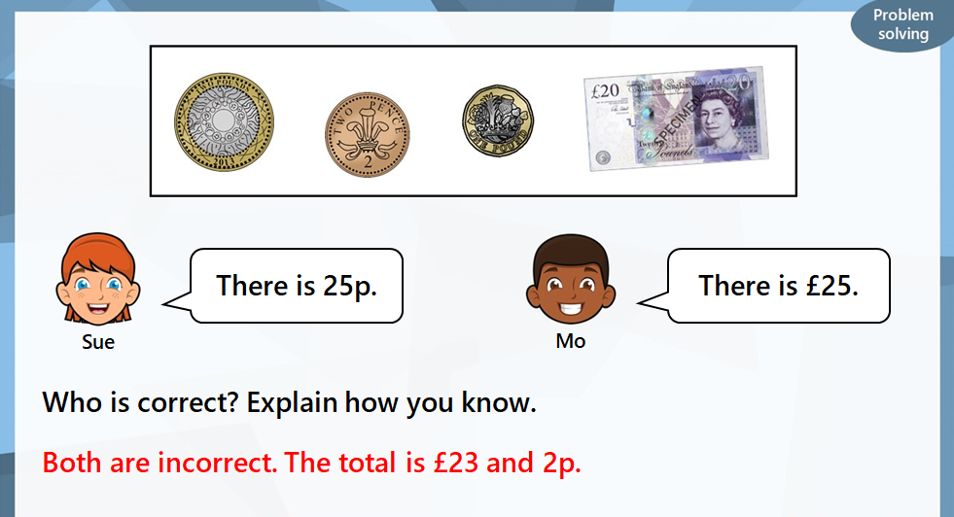
Wednesday

Slide 5
Thursday

Slide 6
Friday
Type text here- you can change the font and font size as needed. You can also add or remove text boxes.

