Slide 1
It’s Friday
Friday 5th June 2020
Here’s your work for today…
.

Slide 2
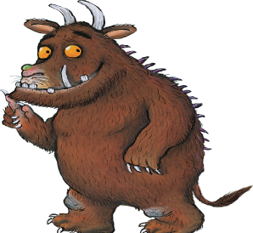

Slide 3
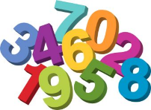
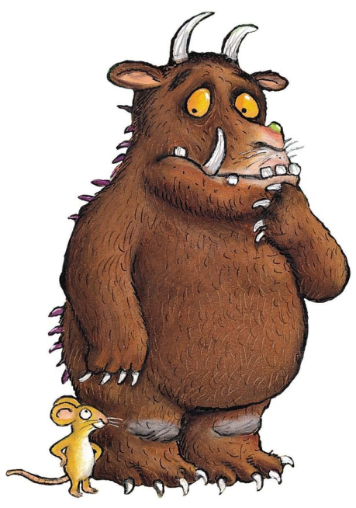
Maths
The Gruffalo is really happy with your maths work this week!
He would really like your help with
the final investigation for the week.

Slide 4
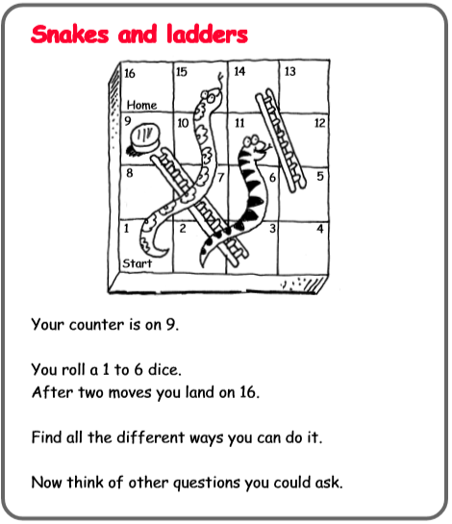
Remember to try and find a systematic way to work out this question.
2.
1.
1.
2.
2.
3.
3.
3.

Slide 5
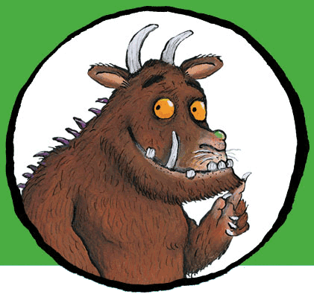
. .
You can write your answers in your exercise books.
If you would like to try Gruffalo work, complete question 1
If you would like to try Horrid Henry work complete question 2
If you would like to try James and the Giant Peach work, complete question 3

Slide 6
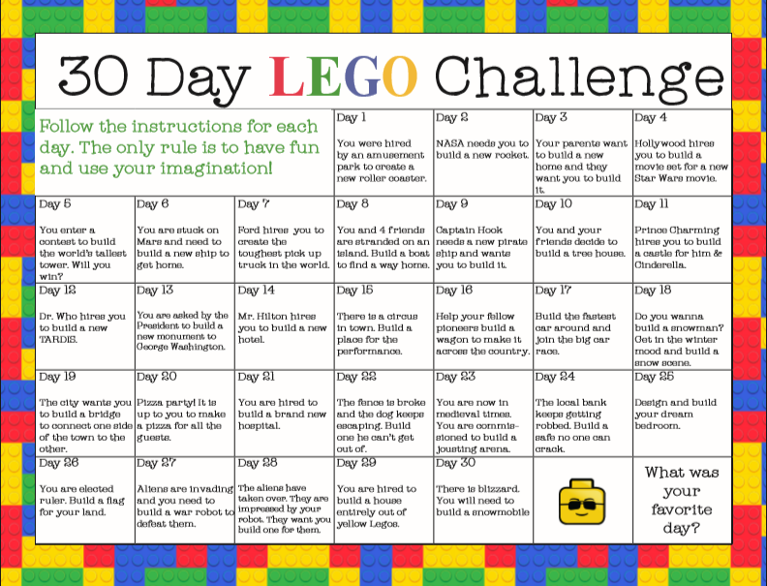
Select one of these activities to complete. If you do not have lego at home, complete the challenge with other materials you find around your house. Happy Building!

Slide 7
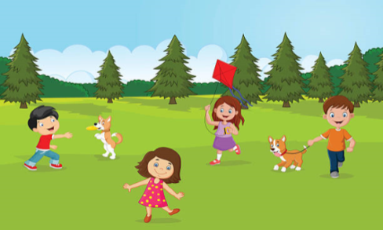
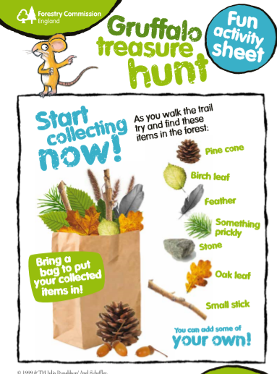

Slide 8
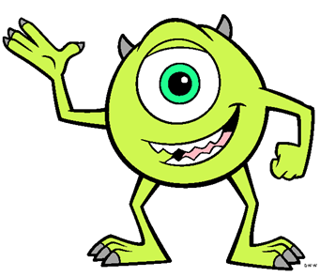
Reading online
I’m so impressed with your reading Elves.
You should be very proud of yourselves!
Please log on to Bug Club
Read for at least 15 minutes.
Please read the key words inside the front cover first.
When you find the bug questions, click and complete them.
Please note down the books you’ve read in your reading
record book.
Your personal login details are on the inside of your reading record book.

Slide 9
Have a lovely weekend with your families Elves.
Keep active and a big WELL DONE for your great work!
.

