Slide 1
Good Morning Elves!
You’ve been amazing this week!

Slide 2
Green group
Thursday’s
Maths Answers
15
16
Izzy has more counters

Slide 3
It’s Friday!
Friday 22nd May 2020
Here’s your work for today…
.

Slide 4
Reading online
I’m so impressed with your reading Elves.
You should be very proud of yourselves!
Please log on to Bug Club
Read for at least 15 minutes.
Please read the key words inside the front cover first.
When you find the bug questions, click and complete them.
Please note down the books you’ve read in your reading
record book.
Your personal login details are on the inside of your reading record book.

Slide 5
Maths
Congratulations! You have learnt all of these new words! Can you explain these words to a grown up.

Slide 6
Maths

Slide 7
Green group
Maths

Slide 9
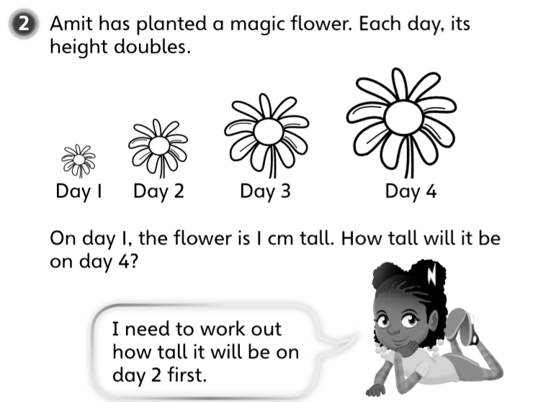
Green group
Maths
Challenge
3

Slide 10
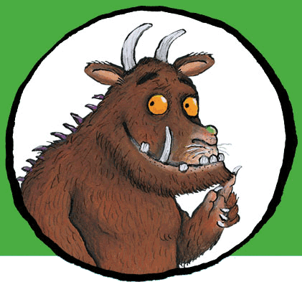
For today’s work, complete the slides which follow.
If you would like to try Gruffalo work, complete challenge 1 on the next page.
If you would like to try Horrid Henry work, complete challenges 1 and 2
If you would like to try James and the Giant Peach work, complete challenges pages 1,2 and 3.

Slide 11
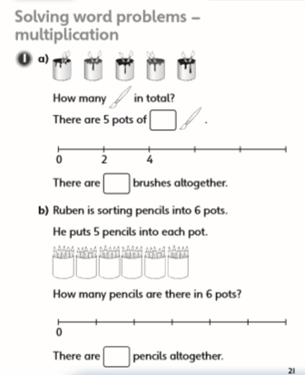
Green group Maths Challenge 1
Green group
Maths
Challenge 1

Slide 12
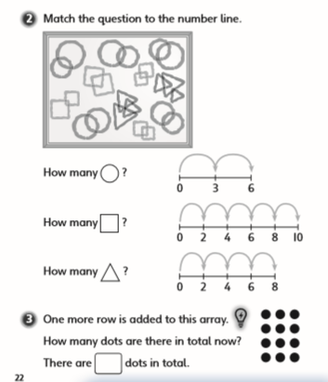
.
Green group
Maths
Challenge 2
.
.
.

Slide 13
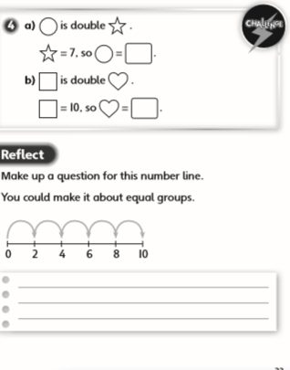
.
Green group
Maths
Challenge 3
.
.
.

Slide 14
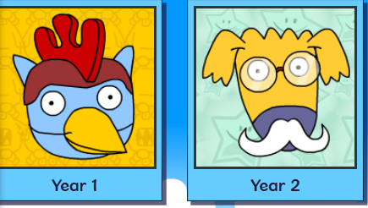
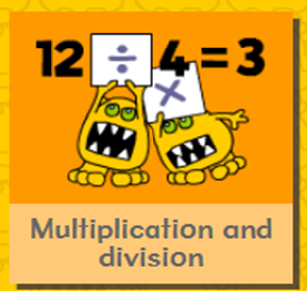
.
.
.
.
Logon on to Busy Things.
Can you score more points today? Are you faster?
Play this game to practise your multiplication skills

Slide 15
If you’ve completed your maths quickly, go to the Maths Challenge
Powerpoint on the learning page for
this week and complete one or more challenges.

Slide 16
Yellow group
Maths
Maths
Today we are learning to
make teen numbes

Slide 17
Yellow group
Maths
Complete the challenge questions in your blue book.
If you would like to try Gruffalo work, complete page challenge 1
If you would like to try Horrid Henry work, complete pages challenge 1 and 2
If you would like to try James and the Giant Peach work, complete challenge 1, 2 and 3

Slide 18
Yellow group
Maths
Challenge 1
How fast can you create this number line?
Ready, steady, go!

Slide 19
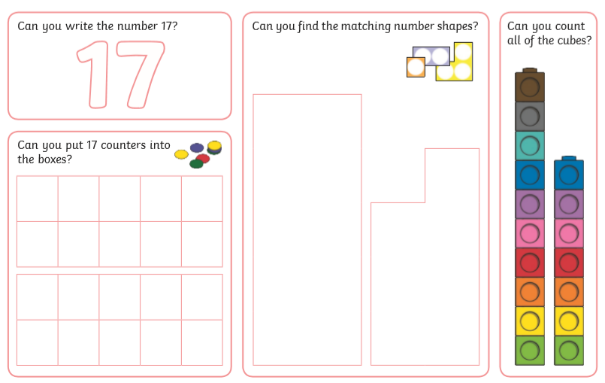
Yellow group
Maths Challenge
2
Use objects from home (lego pieces, bricks, cars and pens) to practise making this number and counting the number of objects

Slide 20
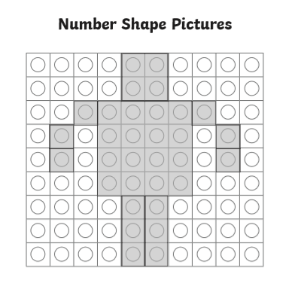
Can you make this picture using Numicon?
What is the picture of?
Yellow group
Maths Challenge
3

Slide 21
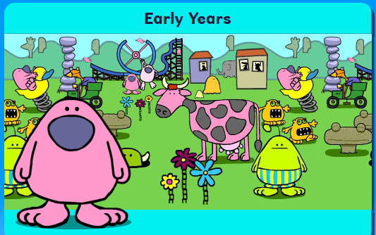
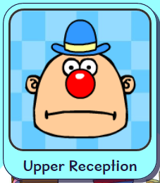
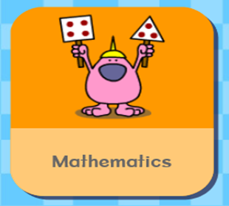
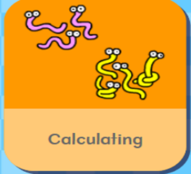
.
Logon on to Busy Things. How did you get on with the games
yesterday.. Play the following game to practise your counting skills.

Slide 22
Handwriting
.

Slide 23
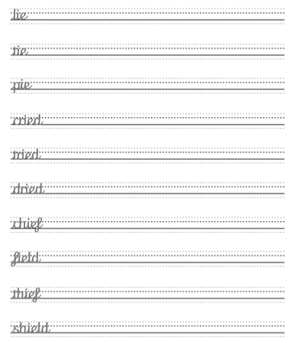
Handwriting
.

Slide 24
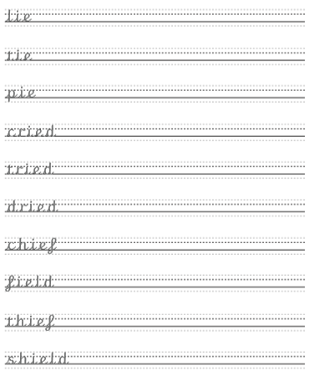
Handwriting
.

Slide 25
English
We are learning to describe a character.

Slide 26
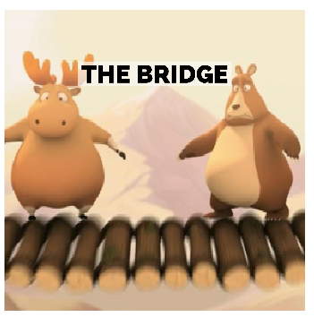
English
Follow the link and watch the above short film
You Tube The Bridge disney

Slide 27
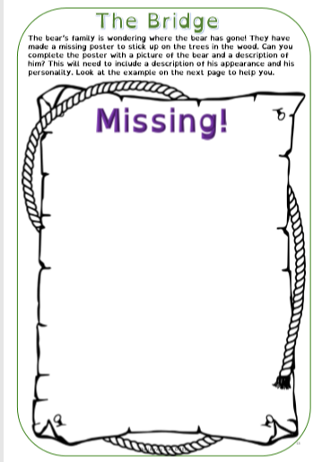
English
.

Slide 28
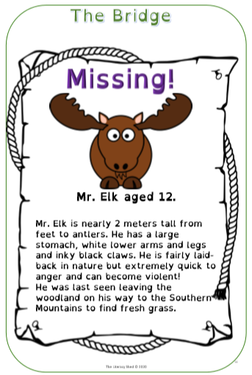
English

Slide 29
English
A solution is on the next page.

Slide 30
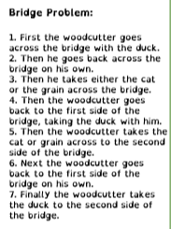
English

Slide 31
Phonics
Green group
Phonics
Today you are learning the alternative i sound.
Complete pages 22 and 23 in your CGP phonics booklet 2.
Click on the existing version. Login for Phonicsplay: Username: march 20 password: home Phase 5
Sneaky squirrels alternative pronunciation game alternative ie
https://www.phonicsplay.co.uk/member-only/Sneaky_Squirrels.html

Slide 32
Phonics
Yellow group
Phonics
I would like you to work through pages 34 and 35 in your Phonics booklet 2.
Login for Phonicsplay:
Username: march 20 password: home
Phase 2
Tricky Word Trucks Game
https://www.phonicsplay.co.uk/member-only/TrickyWordTrucks.html

Slide 33
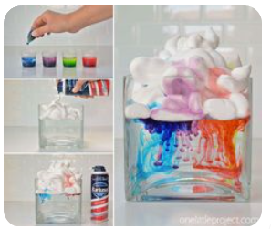
Make a rain cloud in a jar.
What you need:
A jar
A small cup
Shaving foam
Food colouring
.
What to do:
In a small cup, mix the food colouring with some water.
Fill the large jar about ¾ full.
Place the jar and the cups of coloured water on the table.
Spray some shaving foam in the jar.
Drop a few drops of food colouring onto the top of the shaving foam. Watch what happens next.

Slide 34
Active Learning

Slide 35
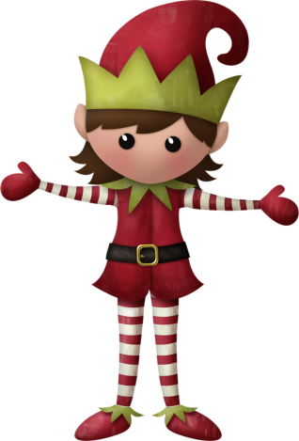
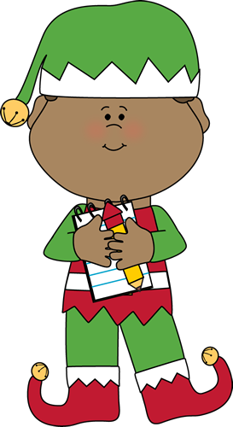
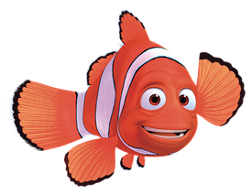
Well done for
your brilliant work today!
If you have any questions or just to let me know what you have been up to email me on admin@farnborough.bromley. sch.uk

Slide 36
Have a lovely half term Elves.
Each of you deserves 10
house points for your amazing efforts this half term!
WELL DONE!!
Stay safe and keep well.
Best Wishes,
Mrs Murray
.

