Slide 1
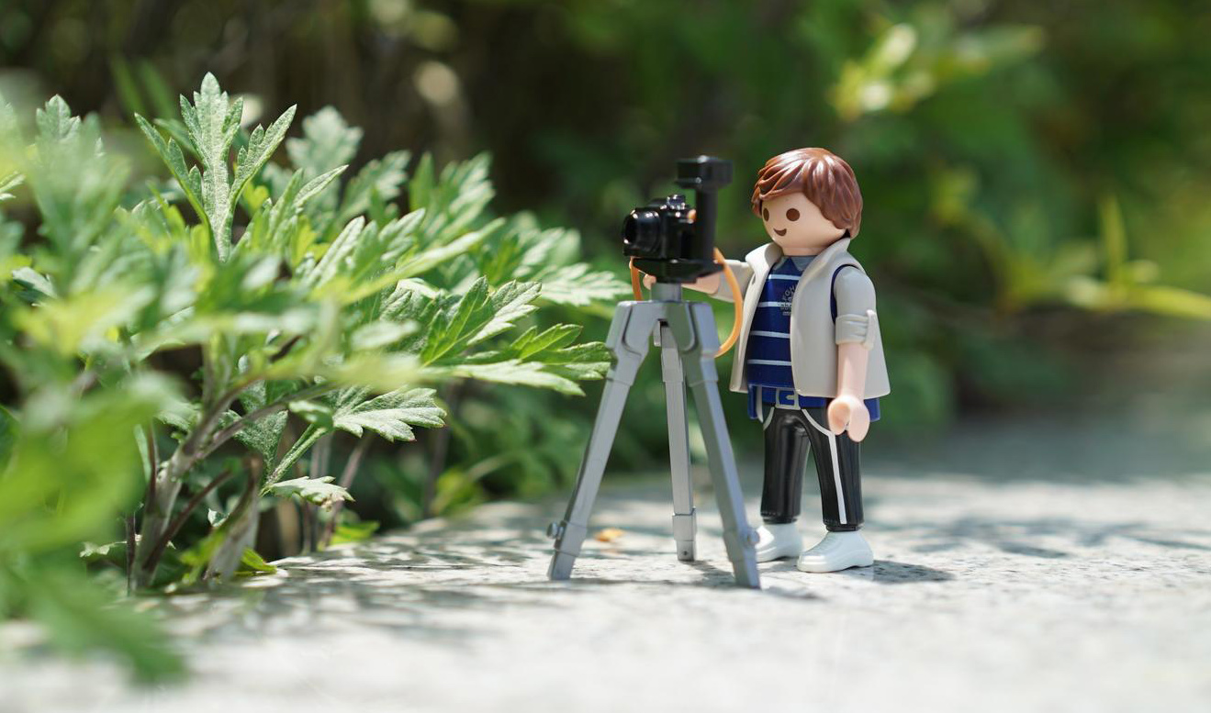
Farnborough Film Festival 2020!

Slide 2
We are going to be creating our own animations to enter into the inaugural ‘Farnborough Film Festival 2020’.

Slide 3
Activity | Time
Investigating animation | 1 hour
Testing out the app | 45 minutes
Planning animation | 45 minutes
Creating animation | 1 hour

Slide 4
I hope you are all excited to get started with today’s project!
First of all, what is animation?

Slide 5
Animation is a way of making a movie from many pictures.

Slide 6
There are 5 different types of animation:
3D computer animation e.g. Frozen, Toy Story 4
Traditional animation (also called hand-drawn animation) e.g. Lion King
2D animation e.g. Bugs Bunny
Motion graphics e.g. Motion graphics examples
Stop motion animation e.g. Wallace and Gromit
Watch the video links to compare the different styles of animation. Make notes about each animation style, then write down which one is your favourite style of animation and why.
This website has more information about each type of animation if you are interested in learning more about the way each type of animation works: https://www.bloopanimation.com/types-of-animation/

Slide 7
We are going to be creating our own stop motion animation films today.
What is stop motion animation? Talk with an adult about what you think it might be.

Slide 8
Watch this video about stop motion animation. Write down a definition for what you think stop motion is after you have watched it.
Click here if video does not play automatically – watch the first 3 minutes of the video only.

Slide 9
Stop Motion Animation is a technique used in animation to bring non-moving objects to life on screen. This is done by moving the object a tiny amount and taking pictures each time (each picture is called a frame). When all the frames are played in sequence it shows movement.

Slide 10
How many frames (pictures) do you think are used in films to make 1 second worth of animation?

Slide 11
Professional stop motion often uses around 24 frames per second (that means, for every second of the film there are 24 pictures taken). Most people use between 12 and 15 frames per second to make animations.

Slide 12
Here is an example of how Aardman studios (makers of many stop motion animation films) make their films, watch out for how many frames they use per second. Click here for video

Slide 13
How do they make sure that the camera is still during the filming?

Slide 14
You might want to think about finding a way to keep your device still while you are filming, either by using a stand/tripod or thinking about how you will keep your hand as still as possible while moving your characters/objects.

Slide 15
In this video (click here), there is an animation created with different frames per second.
Write down what you notice about each different frame rate version of the animation.

Slide 16
The higher the number of frames per second you have, the smoother the movements look.
The smaller the number of frames per second you have the more jolty the movements look.

Slide 17
Watch these examples of stop motion animation films.
Think carefully about which ones look smoothest, and how the animator has created the video.
Which are your favourite examples of stop motion and why?
Paper Stop Motion
'Walkies' animation
Fruit and Vegetable
Animation
Lego Cars Animation
Morph Animation

Slide 18
Write a list of the resources (objects) that were used in the animations you watched. This will help you think of things you might like to use in your own animations.

Slide 19
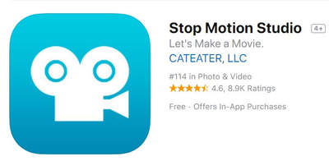
You will need to download the app called Stop Motion Studio onto either a phone or a tablet (it is free, but check with an adult before you do this!)
If you don’t have access to a phone or a tablet, you can use paper to make a flip book animation: click here to practise
Get familiar with how the app works, over the next couple of slides I will show you the main features that you can use.

Slide 20
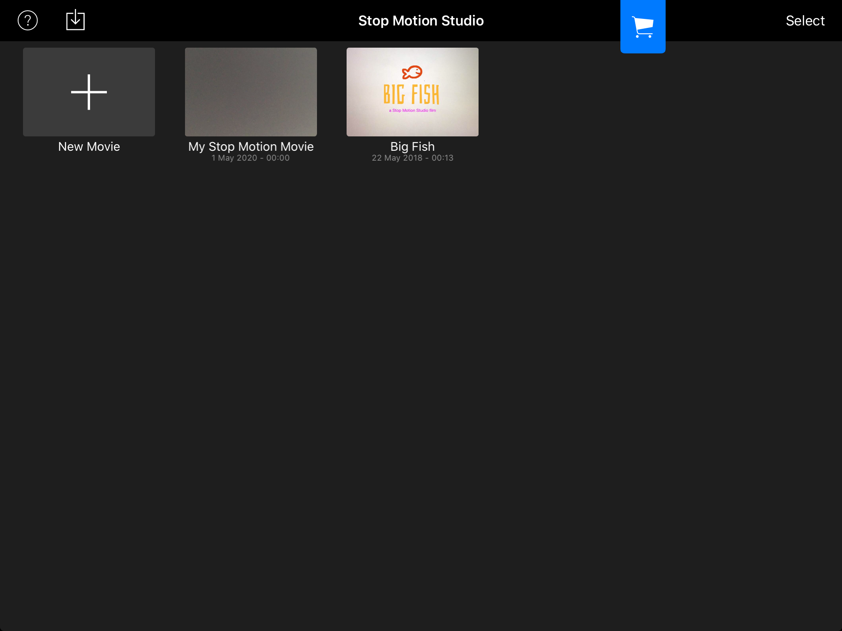
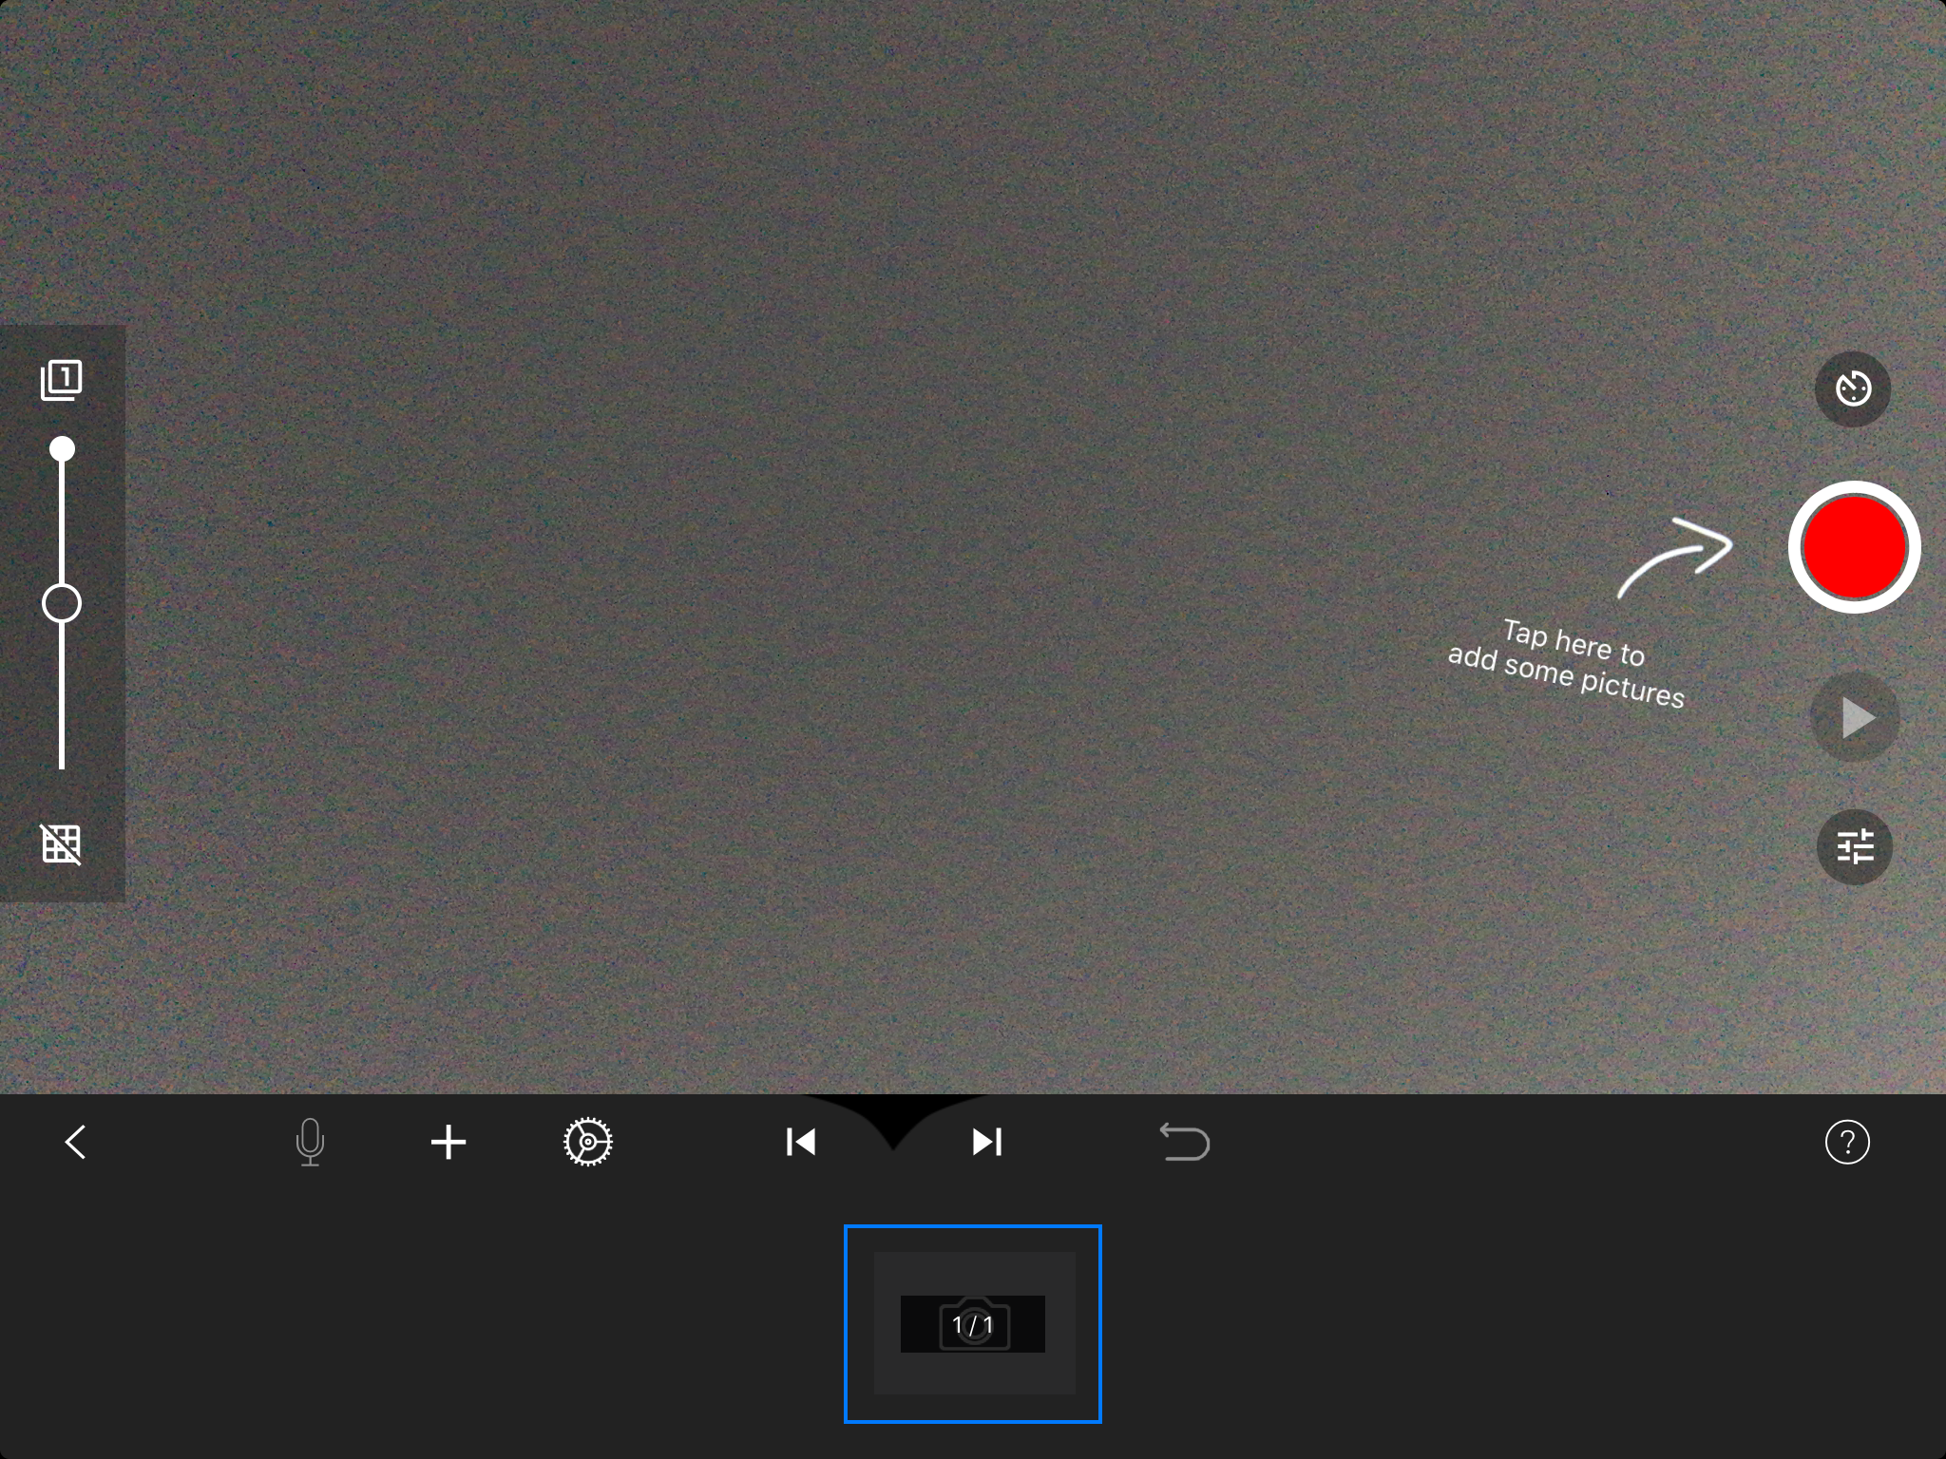
How to take pictures to make your frames for your video
Click the ‘New Movie’ button to start filming
On some devices, this toolbar is on the side of the screen instead of the bottom, but it is the same!
When you tap this button you will take a picture.

Slide 21
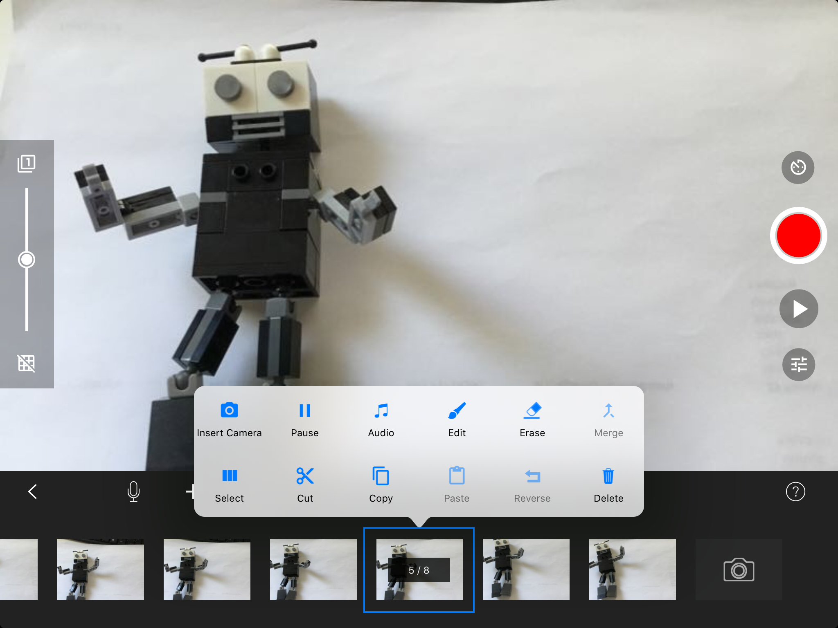
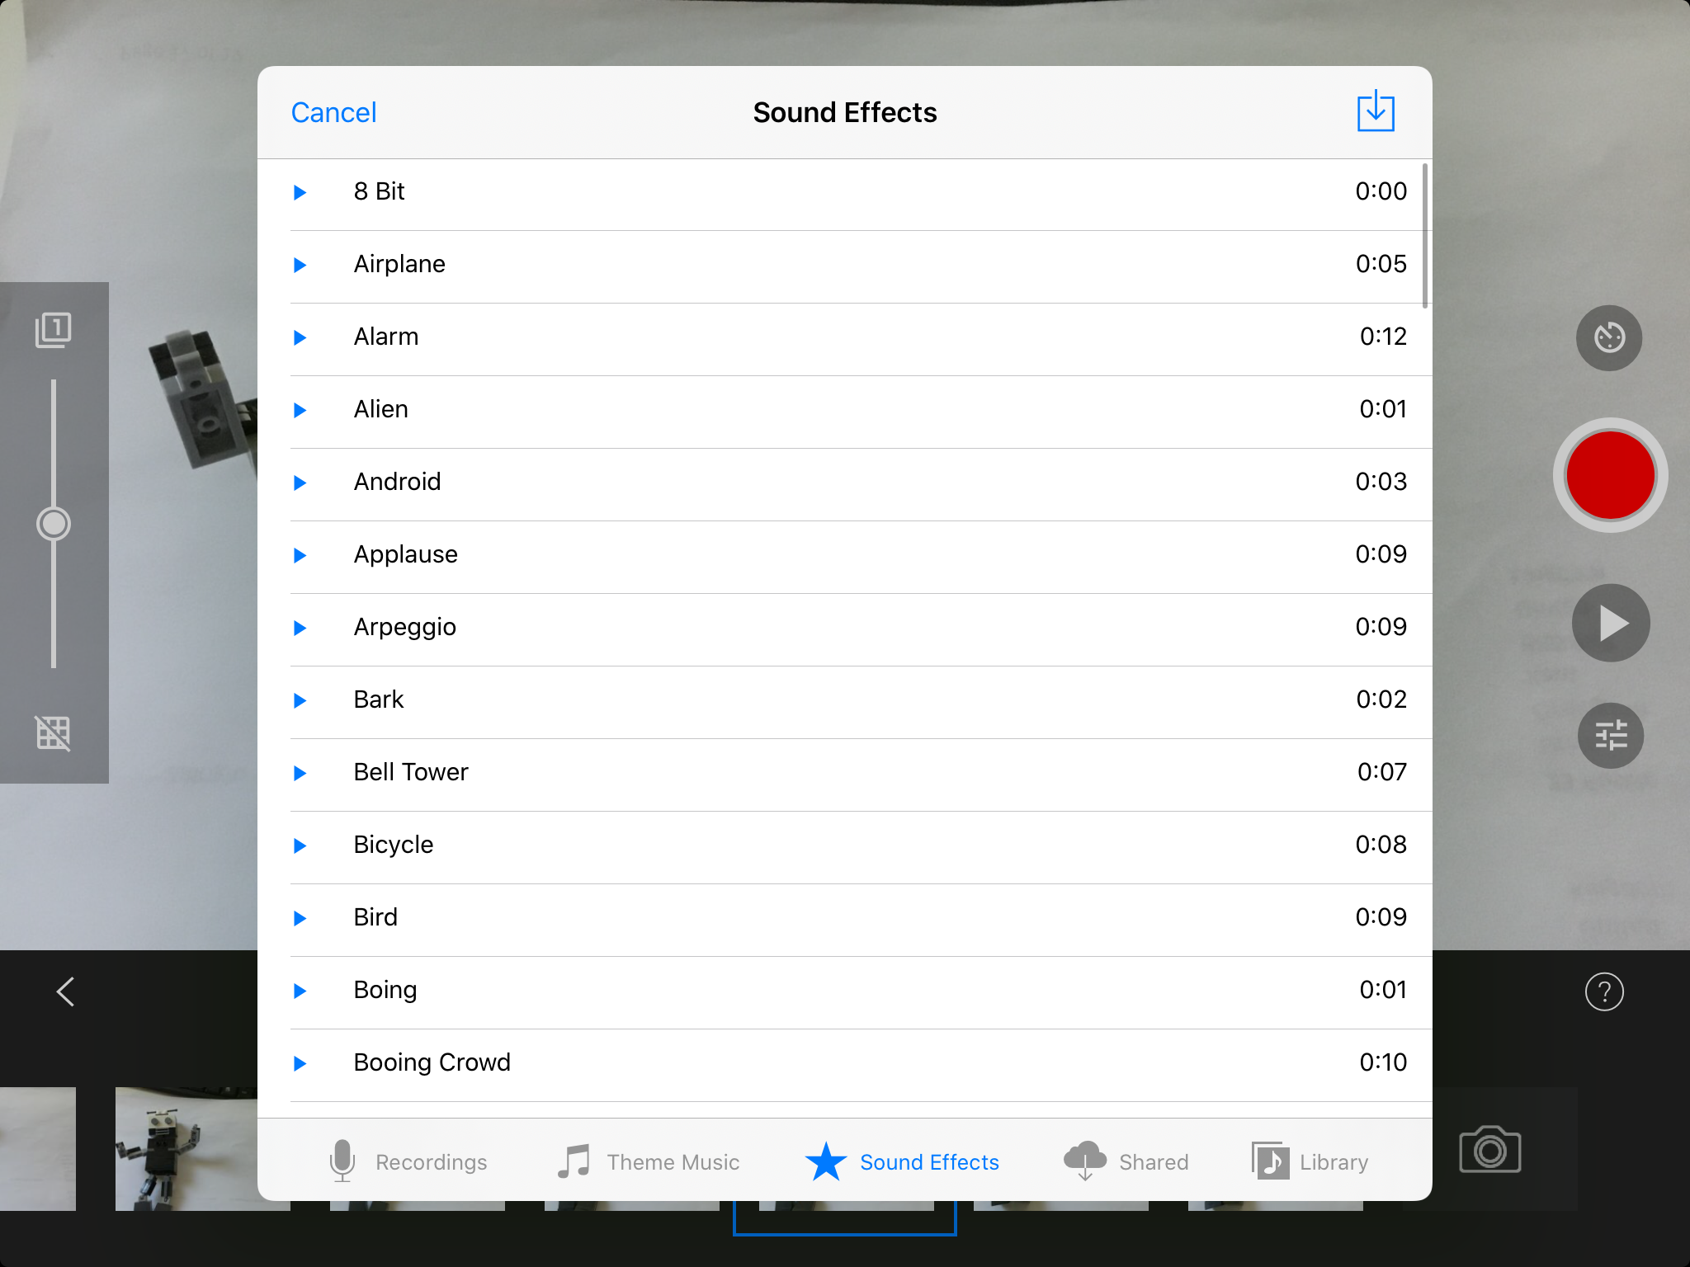
How to take add sound effects and/or music
Click on a frame to edit it. Here is how you add music and sound effects.
As you take pictures, the frames come up at the bottom.
You can add sound effects (which you can see here) or music from your device.

Slide 22
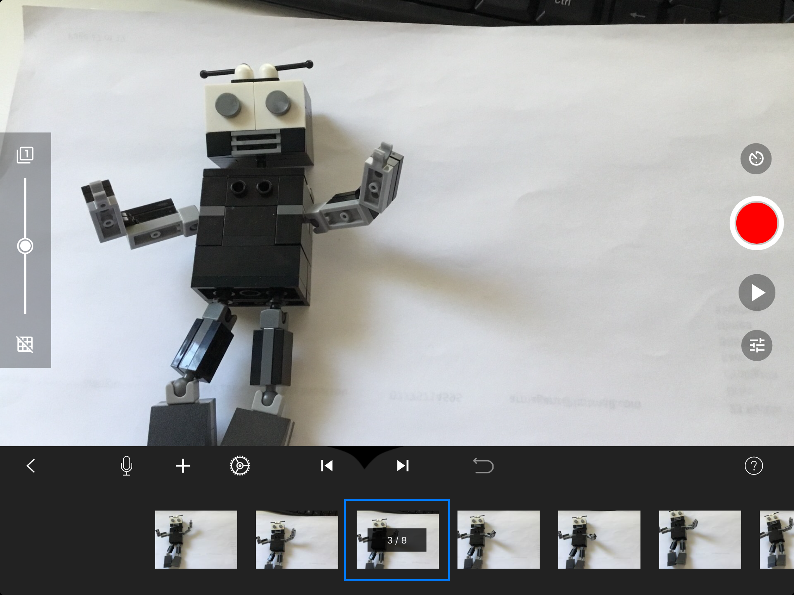
How to add your own voice
If you want to add your own voice to the animation, press the microphone button

Slide 23
When have finished your animation, press this button. Don’t worry if you do this by mistake, you can open your animation again on the home page.
How to watch your animation
When you want to see your animation so far, just press this play button.

Slide 24
How to share your animation
To rename your animation click on it.
If you select your animation you will be able to save your movie and then send your final one to your teacher.

Slide 25
The less you move the object each time, the more realistic your animation will look
Have a go at using the app so you get used to what you will need to do when making your own animation. Perhaps try moving an object across a table, moving it a little bit at a time and see what it looks like when you play your animation back.
You might want to use a stand to keep your camera still.

Slide 26
Now you know how to use the app, it’s time to think about what you want your animation to be made with! Don’t forget you might want to make or draw a background as well to help tell your story.
Look back at what resources the stop motion films we looked at used, and think about what you have in your house to use to make your own. There are some ideas on the next slide, but feel free to use whatever you can think of!

Slide 27
Lego/Playmobil etc
Clay/playdough
Toys
What have you chosen to use? Get all your resources ready!
Food
Paper/cardboard

Slide 28
So now you have thought about what resources you will use, you are now going to think about what will happen in your animation (between 15-30 seconds long). Here are some ideas to get you started:
Make up a new story
Teach about a topic you have covered in class e.g. science, history, geography.
Retell a story you have written as part of your school work
Retell part of your favourite book
Animate a fun event you have taken part in
Make an animation to your favourite song
Retell your favourite part of a film

Slide 29
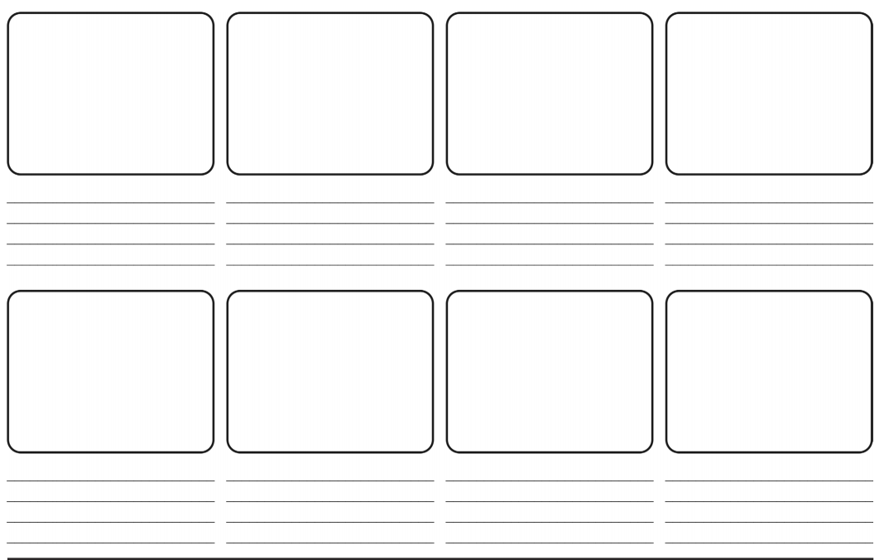
You could plan out your animation on a story path or story board to show the main parts of it.

Slide 30
Now it is time to create your film! Remember, you will need to take lots of photographs and make really tiny movements between each picture.
Use the app (or a pad of paper if you are making a flipbook animation) to create your own animation which is between 15 - 30 seconds.

Slide 31
Congratulations, you are now an animator!
Now, email your teacher your finished animation to enter the film festival (using your year group email address). Please include on the email whether you are happy for the animation to be put onto the school website, as we will upload as many as we can on there!

