Slide 1
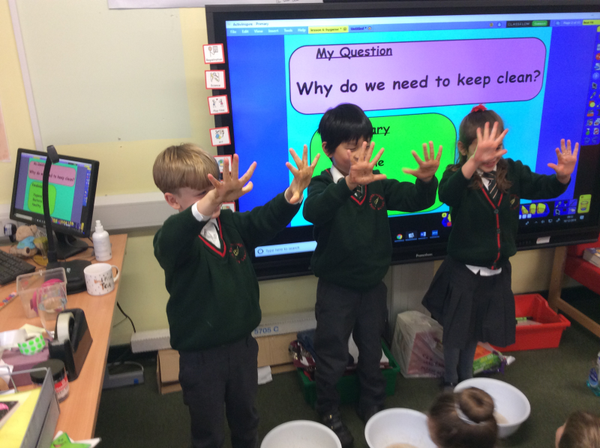
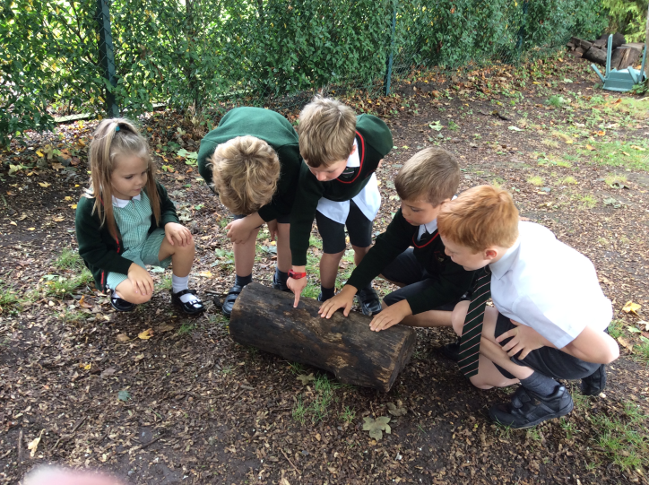
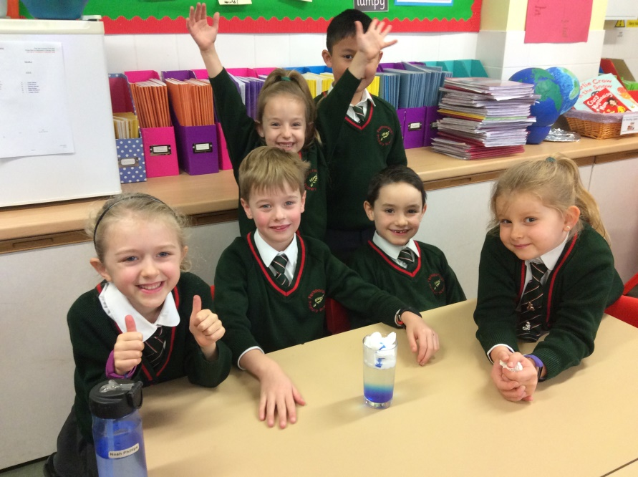
Fun Farnborough Science at Home!

Slide 2
Hello to all you lovely budding scientists at Farnborough - I know that there are lots of you out there!
Here are a few practical science investigations that you could carry out at home to keep those scientific brain cells ticking over.
Some of these are investigations that last year’s Young Science Ambassadors carried out- you can see them on the website by clicking on this link:
http://farnboroughprimary.co.uk/young-science-ambassadors/.
If you think of any of your own experiments that we could do once we’re back in school, or want to send me some photos of your science fun, then please e-mail me at the school admin address.
Enjoy!
Mrs Matthews xx

Slide 3
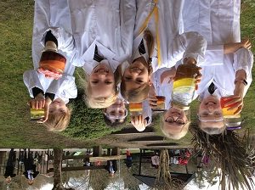
Creating your own lava lamps
You will need:
​A clear jam jar/bottle
​Water
Vegetable oil
Effervescent tablets (fizzy)
Food colouring
1. Pour the water into the jam jar/bottle until it is approximately one third full.
2. Add the oil. You may have to wait a few minutes for the oil and water to separate.
3. Add a few drops of food colouring. The drops will pass through the oil and then mix with the water below.
4. Drop the tablet into the bottle. Watch it sink to the bottom and the lava lamp begin to work!

Slide 4
What’s the science behind it?
At first the oil sits above the water because it is less dense. When you add the fizzy tablet, it sinks down to the bottom and starts dissolving and creating a gas. As the gas bubbles rise, they take some of the coloured water with them. When the blob of water reaches the top, the gas escapes and down goes the water!​
You could try to answer these questions:
Does the temperature of the water affect the reaction?
Does the size of the jar/bottle affect how many blobs are made?
Does the size of the tablet affect the number of blobs created?​

Slide 5
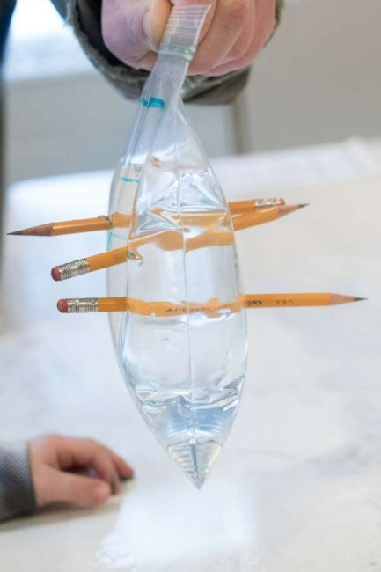
Creating a magical leak-proof bag!
You will need:
Sharp pencils
Water
A sandwich bag that can be sealed.
Fill your bag three quarters of the way full with water.
Hold the top of the bag with one hand and use the other hand to push the pencil all the way through to the other side of the bag.
Repeat with as many pencils as you like!

Slide 6
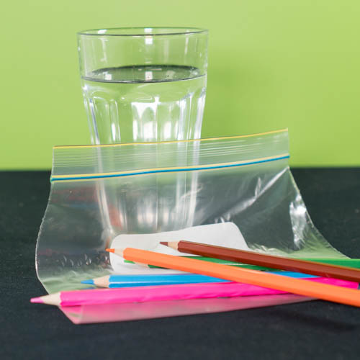
What’s the science behind it?
Your sandwich bag is made up of lots of molecules which are attached to each other in long chains. When you push the pencil through the bag it can push apart the flexible parts of the chains but because the chain is flexible, it forms a temporary seal against the edge of the pencil.
When the pencil is removed, the hole stays there because the molecules were pushed aside permanently and that is when the water will leak out- watch out!
You could try to answer these questions:
Do different types of pencils achieve better results?
Can your bag hold more or less pencils than someone else in your household’s?

Slide 7
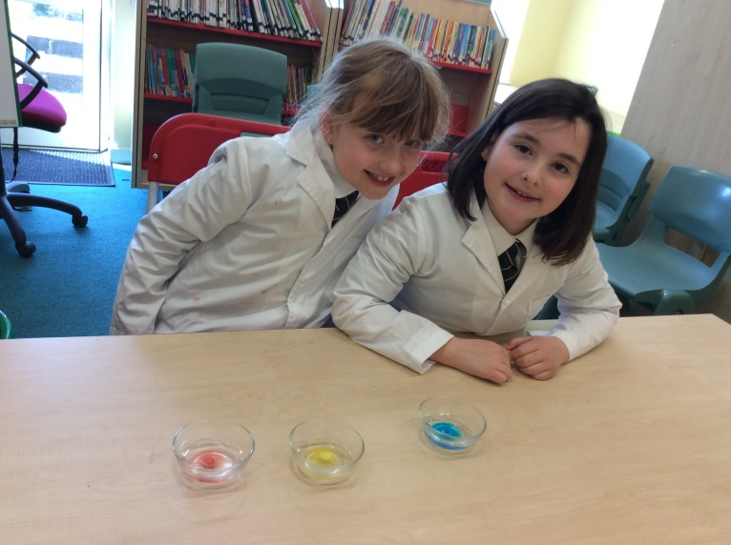
Floating Letters
Can you manage to dissolve the ‘M’ off an M & M?
You will need:
M and M’s
Glass bowls/containers
Water
1.Place M and M’s of different colours in glass bowls making sure that the ‘M’ is facing up.
2.Pour room temperature water into the bowls so that the chocolates are completely covered.
3.Observe what happens! The colour begins to dissolve and sinks to the bottom. The ‘M’ floats to the surface of the water.

Slide 8
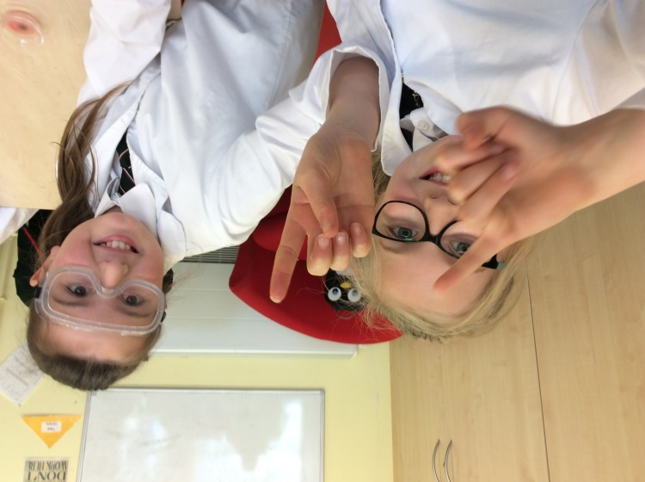
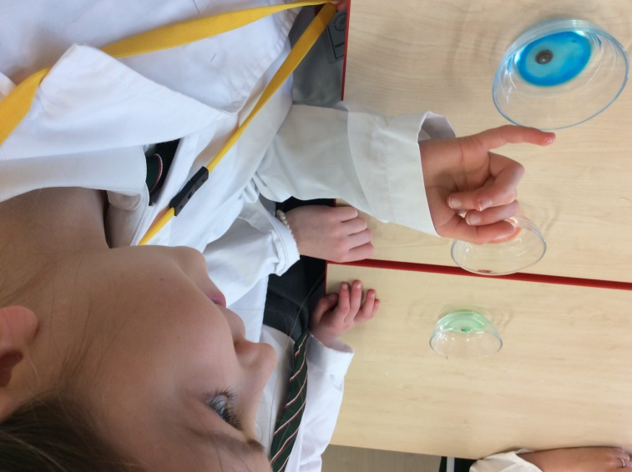
What’s the science behind it?
The ‘M’ doesn’t dissolve in water (it’s insoluble) and is attached to the chocolate with an edible glue that dissolves in warm water. Since the letter is less dense than water, the letter peels off and floats as the rest of the chocolate shell dissolves.
You could try to answer these questions:
Does using hot/cold water instead of room temperature water make a difference?
Does using other liquids such as vinegar or vegetable oil change things?

Slide 9
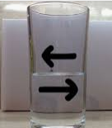
Reversing Arrows
You will need:
A glass
Paper
Pen
Water
Draw an arrow on a piece of paper and prop it up. Look carefully at the direction in which the arrow is pointing.
Put an empty glass in front of the arrow.
Fill the glass with water and watch what happens to the direction of the arrow!

Slide 10
What’s the science behind it?
This is called refraction. Refraction is the bending of light. During this experiment, light travelled from the image, through the air, into the glass and water, then out of the glass and into the air once more before it reached our eyes.
This means that the light bends once when it travelled out of the glass into the water and then it bends again when it travelled out of the glass and into the air.
The light paths cross and the image appears to be flipped from left to right.
You could try to answer these questions:
Does this change if you use a different shaped glass?
Can you write messages backwards so that they will reveal when you fill the glass?

Slide 11
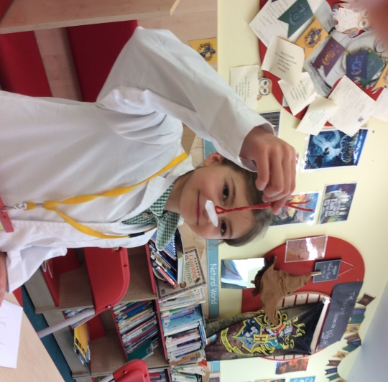
Sewing ice-cubes!
You will need:
​Salt
​A cup of cold water
​20 cm of thread
​An ice cube
1. Float the ice cube in the cup of water.
2. Make a loop out of the thread and carefully place it on top of the ice cube.
3. Sprinkle a little salt over the top of the thread.
4. Wait one minute and then gently lift the thread.

Slide 12
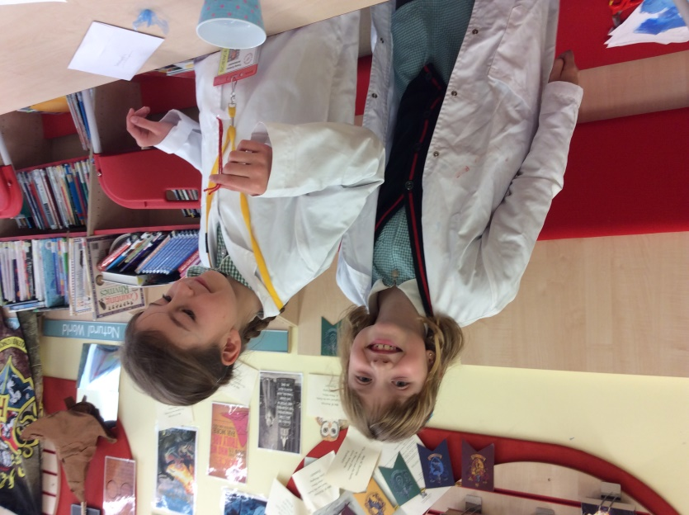
What’s the science behind it?
Salt lowers the melting point of water so the ice melts. But the water quickly refreezes, trapping the thread in place.
You could try to answer these questions:
Does changing the size of the ice cube make a difference?
What difference does adding more salt make?

Slide 13
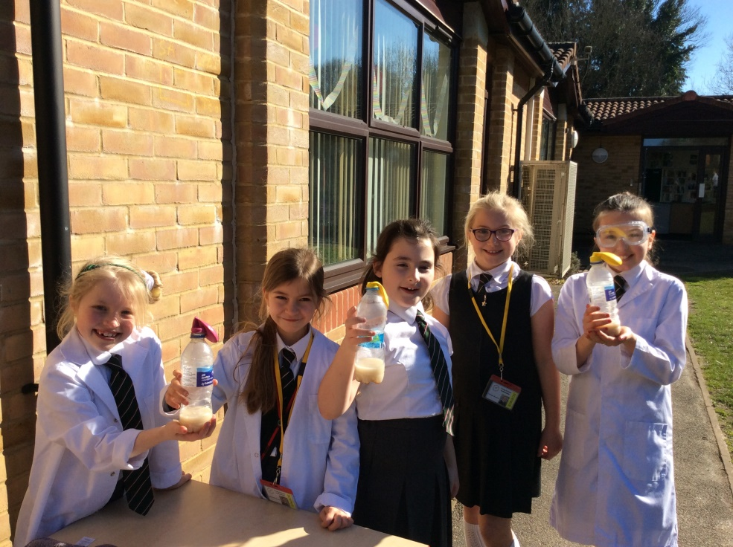
Yeast Balloons
* You will need to be outside where making a mess doesn’t matter and this is best carried out on a sunny day!*
You will need:
An empty water bottle
​One teaspoon of yeast
One teaspoon of ​sugar
​Warm water
​A balloon.
First, to activate the yeast you need to warm it up- fill the bottle up with 3cm of warm water.
Next, add a teaspoon of yeast and gently swirl the bottle for a few seconds.
After that, you will need to give it energy by feeding it- add a teaspoon of sugar and swirl the bottle again.
Finally, place the neck of the balloon over the neck of the bottle and leave it in the sunshine for about 20 minutes.
Your balloons should start to inflate!

Slide 14
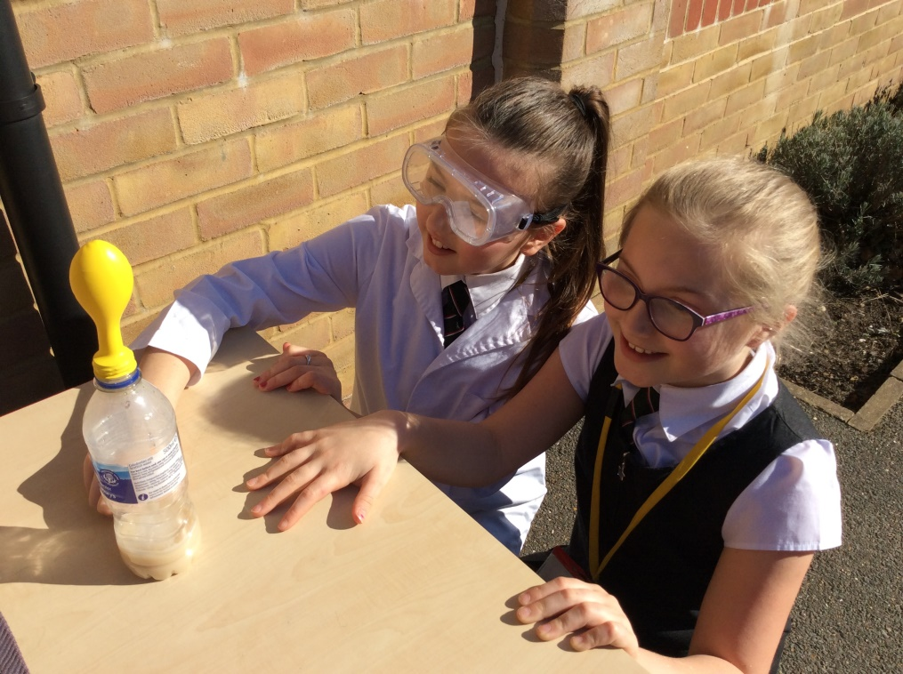
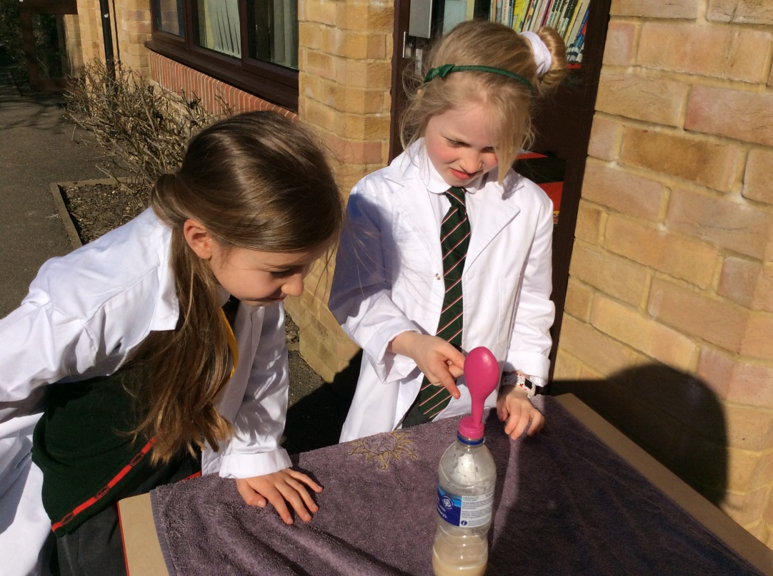
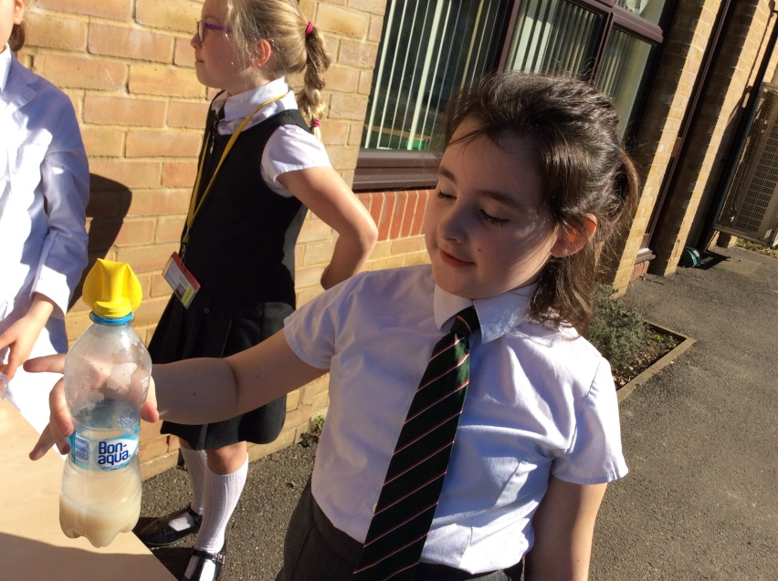
What’s the science behind it?
As the yeast eats the sugar it releases a gas called carbon dioxide. The gas fills the bottle and then fills the balloon as more gas is created.
You could try to answer these questions:
Does changing the size of the water bottle make a difference?
Does changing the ‘food’ that we give the yeast e.g. honey or syrup make a difference?

Slide 15
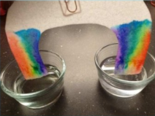
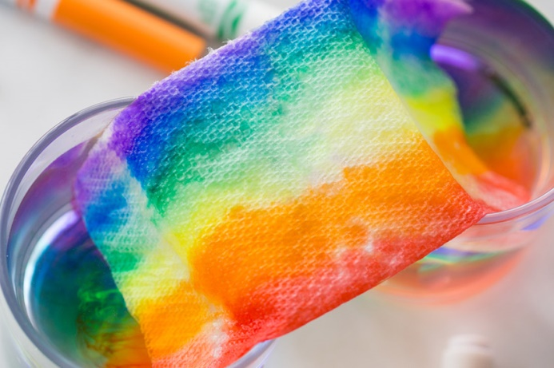
Growing a rainbow!
You will need:
Kitchen roll
Felt tip pens
Two small bowls of water
A paper clip
Thread
Cut your kitchen roll into the shape of a rainbow.
Start to colour your rainbow using the felt tips up to approximately 2cm on both sides.
Attach your paper clip to the top and tie a piece of thread to it. This will give you something to hold your rainbow with.
Fill each bowl with water.
Hold your rainbow with each end slightly submerged in the water and watch your rainbow grow!

Slide 16
What’s the science behind it?
The water is absorbed through the fibres in the kitchen roll and the ink follows.
You could try to answer this question:
Will the rainbow keep growing if you leave it in the water for a long time?

Slide 17
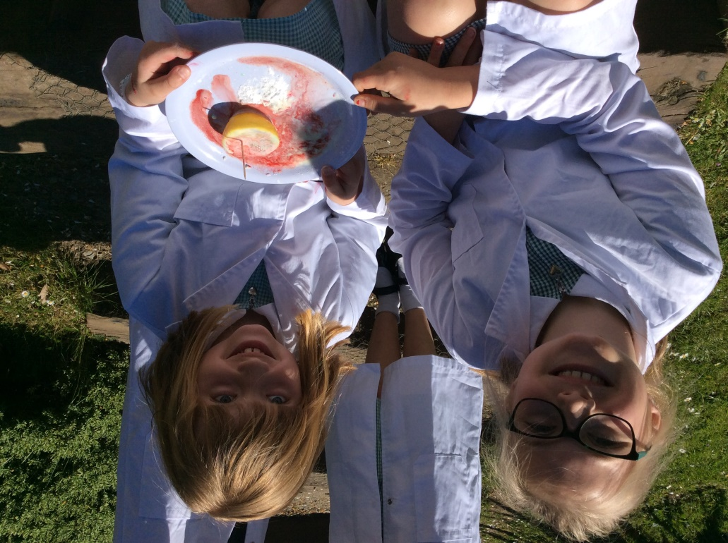
Erupting Lemon Volcanoes
*A final messy experiment that is best carried out where making a mess doesn’t matter*
You will need:
A Lemon
A toothpick
Food colouring
Washing up liquid
Bicarbonate of soda
A plate
1. Cut your lemon in half and then use a toothpick to poke into the flesh of the lemon to release the juice.
2. Put your lemon on a plate (ready to catch the eruption!)
3. Add a few drops of food colouring.
4. Next, add a little washing up liquid to the lemon.
5. Sprinkle the top of the lemon with a generous layer of bicarbonate of soda.
6. Stand back and watch!

Slide 18
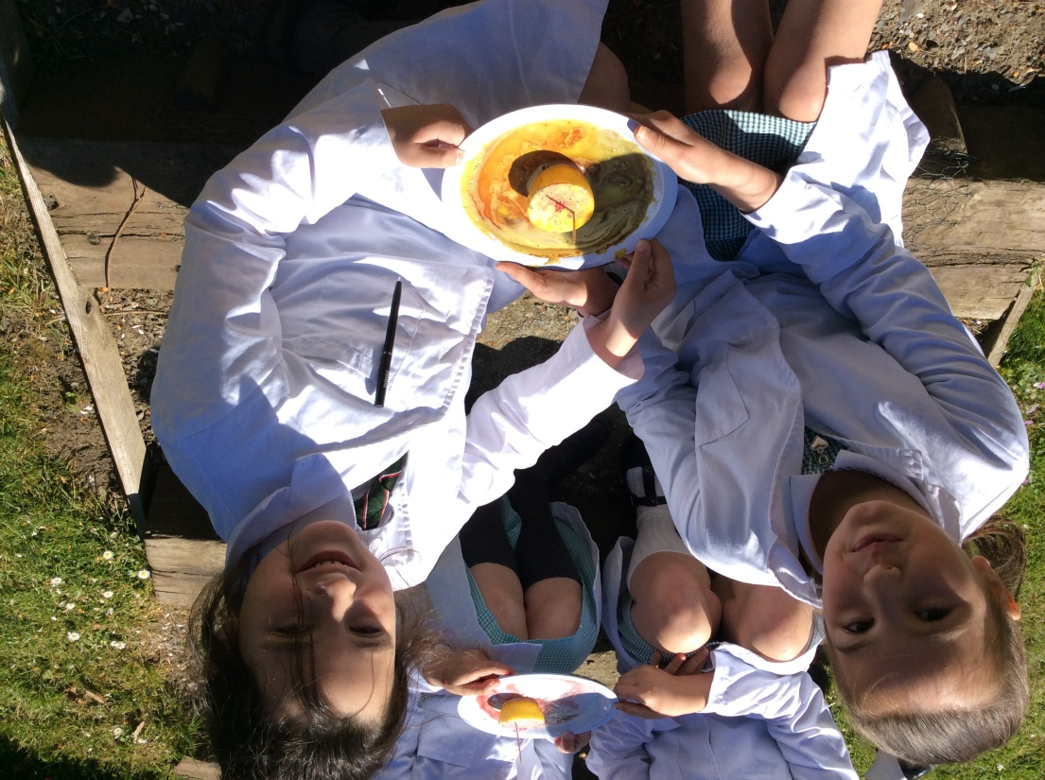
What’s the science behind it?
This is all because of a chemical reaction: The citric acid from the lemon juice is reacting to the bicarbonate of soda creating carbon dioxide gas. The washing up liquid helps capture the gas so we can see it as bubbles during the reaction.
You could try to answer these questions:
Would this work as well with limes?
Would else could you use?

Slide 19
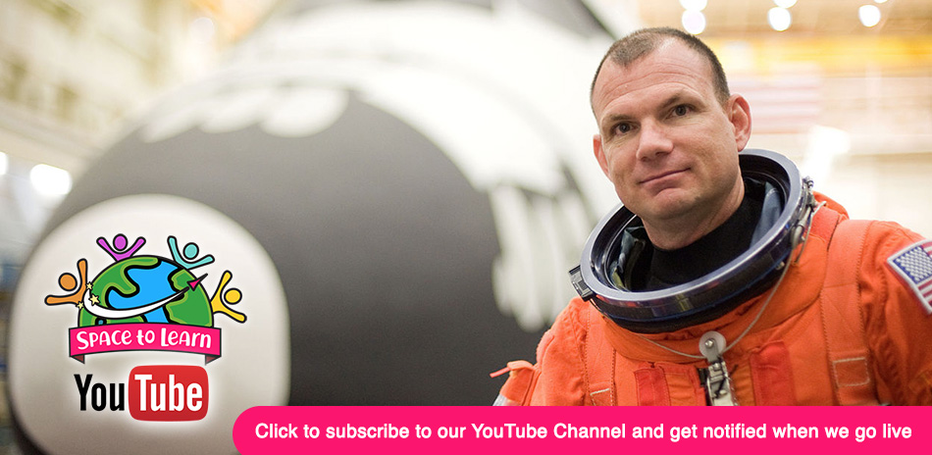
Space to Learn A free Astronaut Talk with LIVE Q&A
Have you ever wanted to have a chat with an astronaut?
Then tune into https://isset.org/live/spacetolearn.php
each Tuesday at 2pm.

