Slide 1
Subject / Lesson | Time
Maths | 1 hour
Grammar | 20 minutes
Comprehension | 20 minutes
English | 40 minutes
Physical Activity | 30 minutes
Art | 30 minutes

Slide 2

I would like you to try out a new maths programme today: Power Maths.
Instructions
Click on-
http://go.pardot.com/e/749453/PowerMathsYear6/51zwx/107010261?h=9zEkYm9Vv36T0kIK2mGoBlvXYizjLxGA8JPqztzRvMQ
(You might need to copy and paste this link into your web browser)
Agree to the terms and conditions and click ‘Continue’.
Click on ‘Power Maths Year 6’
Click on ‘Power Maths Year 6 Practice Book Summer Home Edition’
Read and complete from page 1 to page 11. (Answers start from page 164)

Slide 3
Grammar Task | Time
Complete the task about relative clauses. http://farnboroughprimary.co.uk/wp-content/uploads/2020/04/Grammar-Relative.pdf Answers http://farnboroughprimary.co.uk/wp-content/uploads/2020/04/Grammar-Answers.pdf | 20 minutes

Slide 4
Comprehension Task | Time
Complete the task about the history of the internet. Choose your option: http://farnboroughprimary.co.uk/wp-content/uploads/2020/04/Comprehension-25-Years-of-the-Internet-Expert.pdf http://farnboroughprimary.co.uk/wp-content/uploads/2020/04/Comprehension-25-Years-of-the-Internet-Genius.pdf | 20 minutes

Slide 5

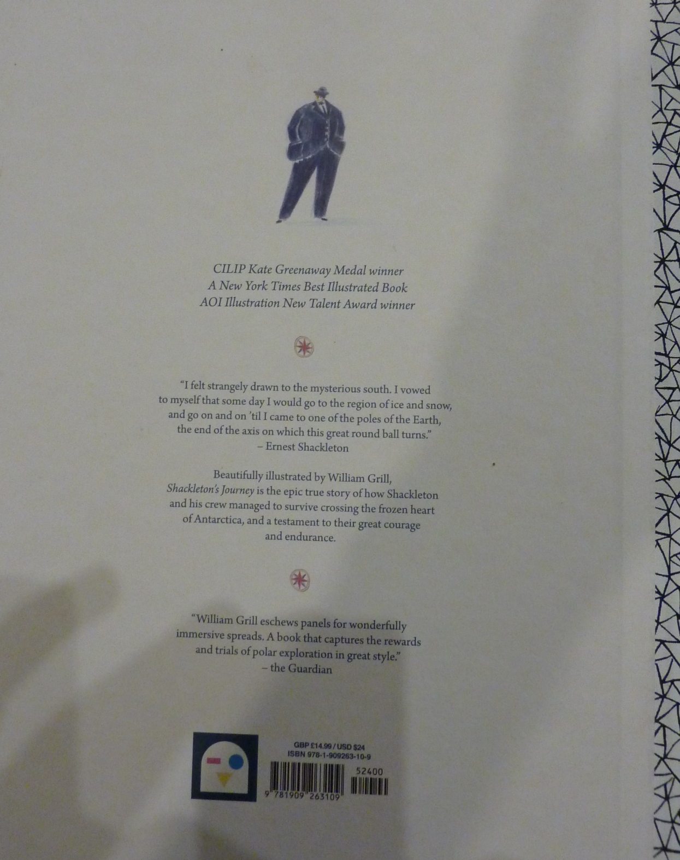

Slide 6
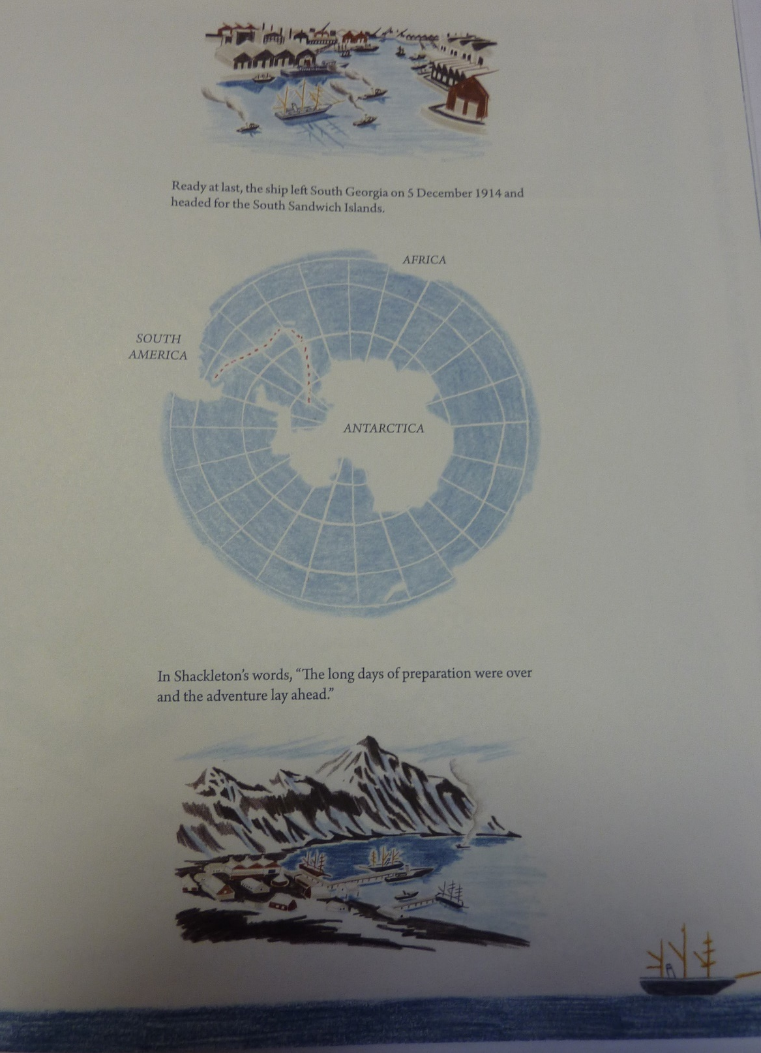
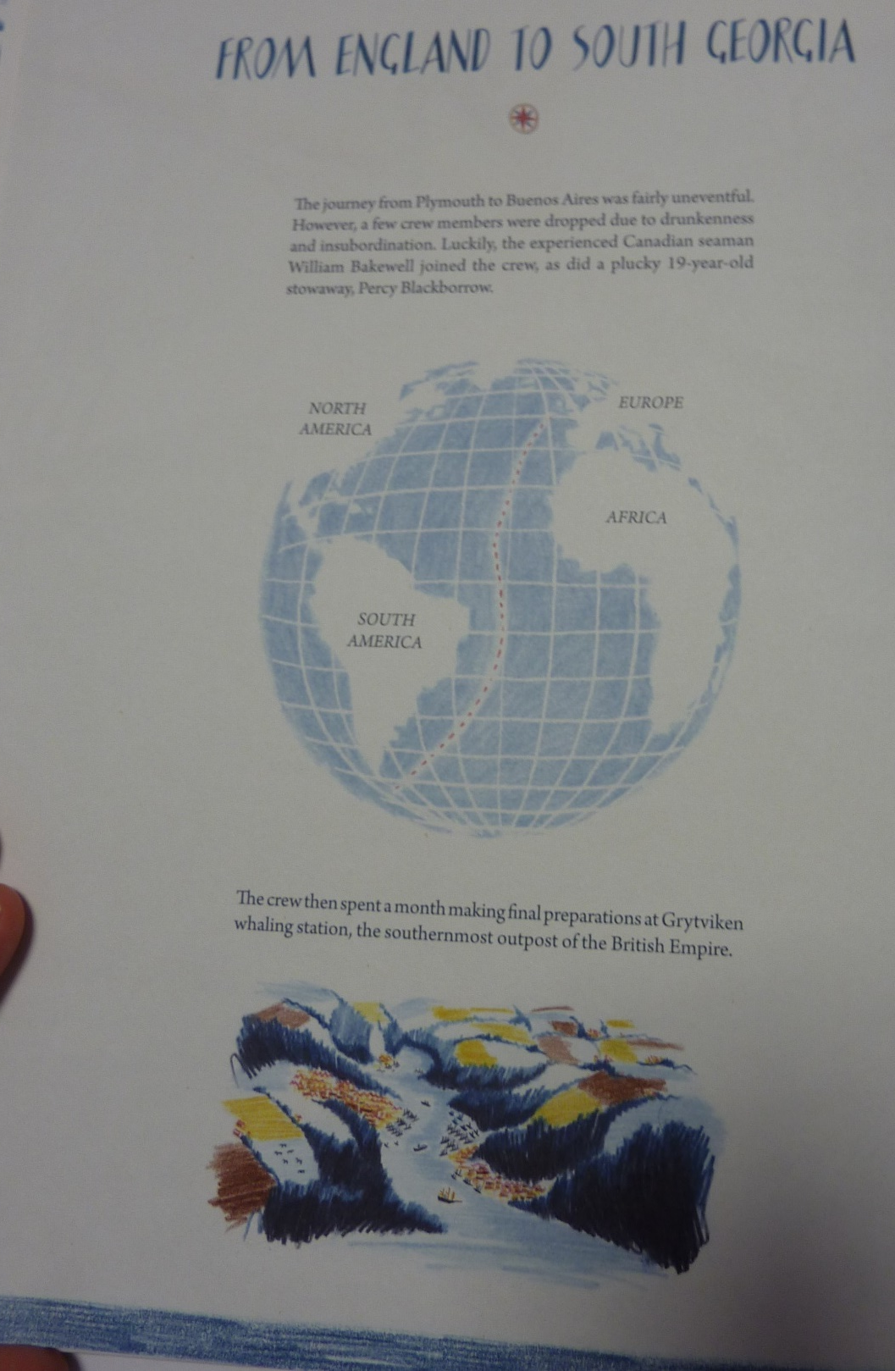

Slide 7
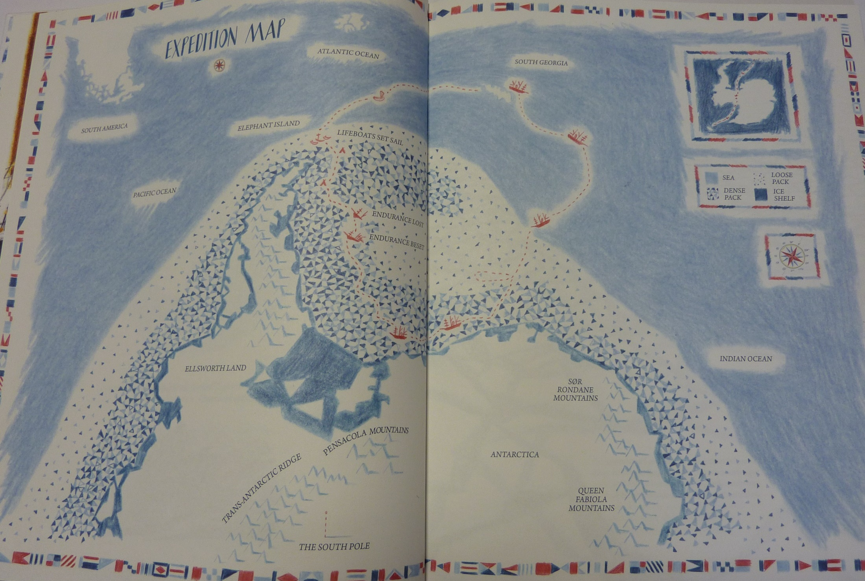

Slide 8
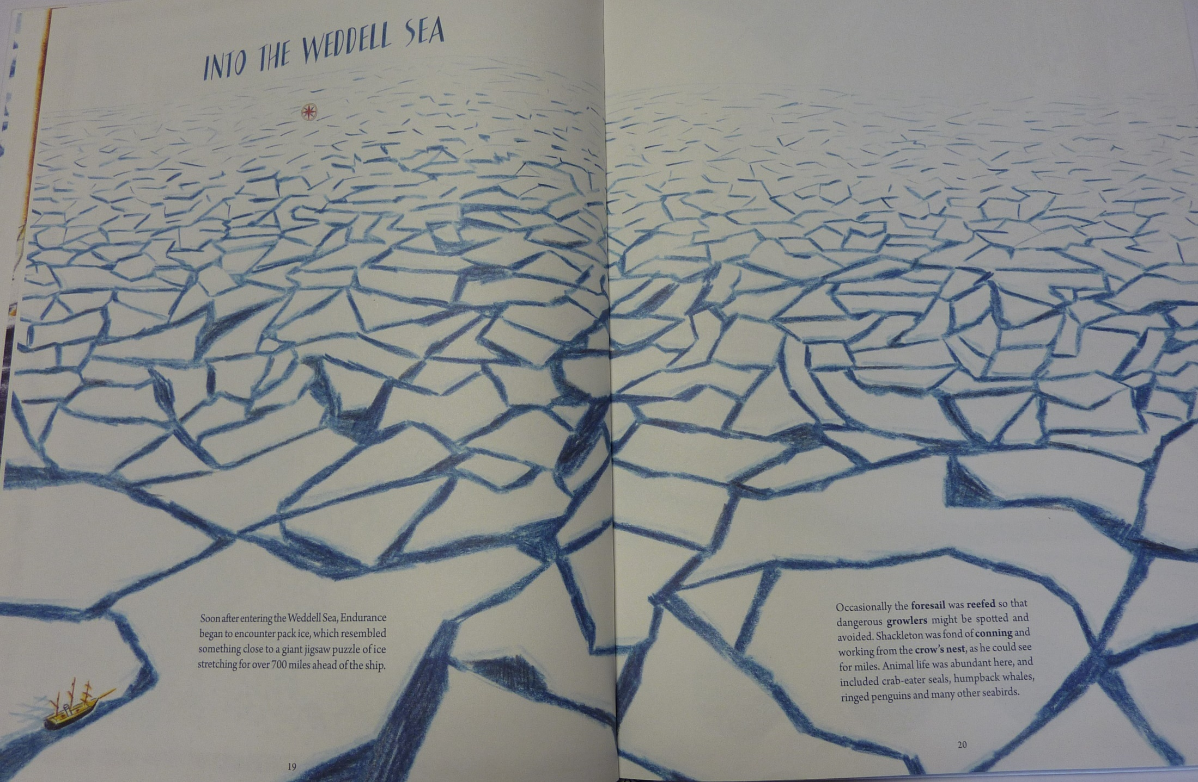

Slide 9
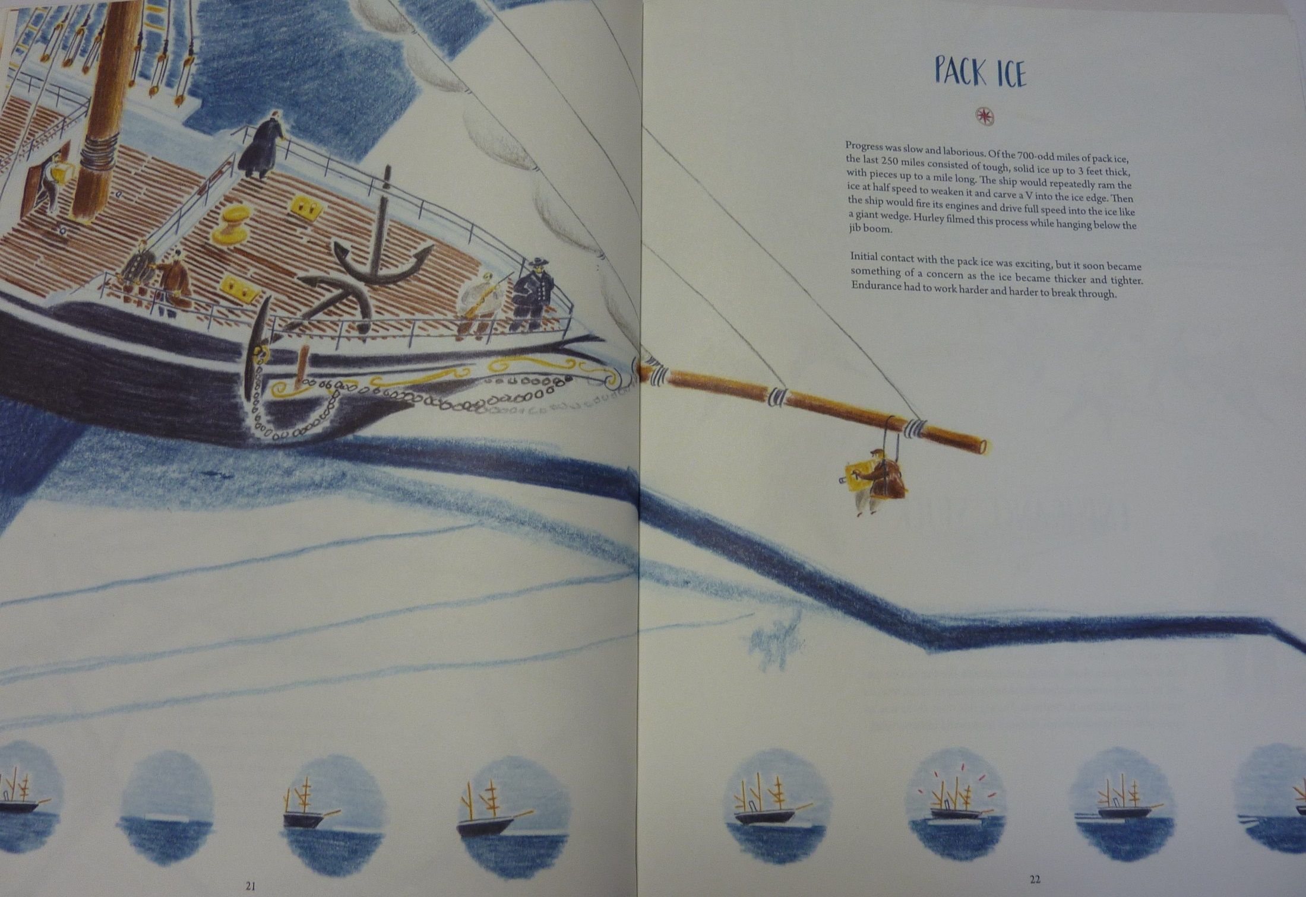

Slide 10
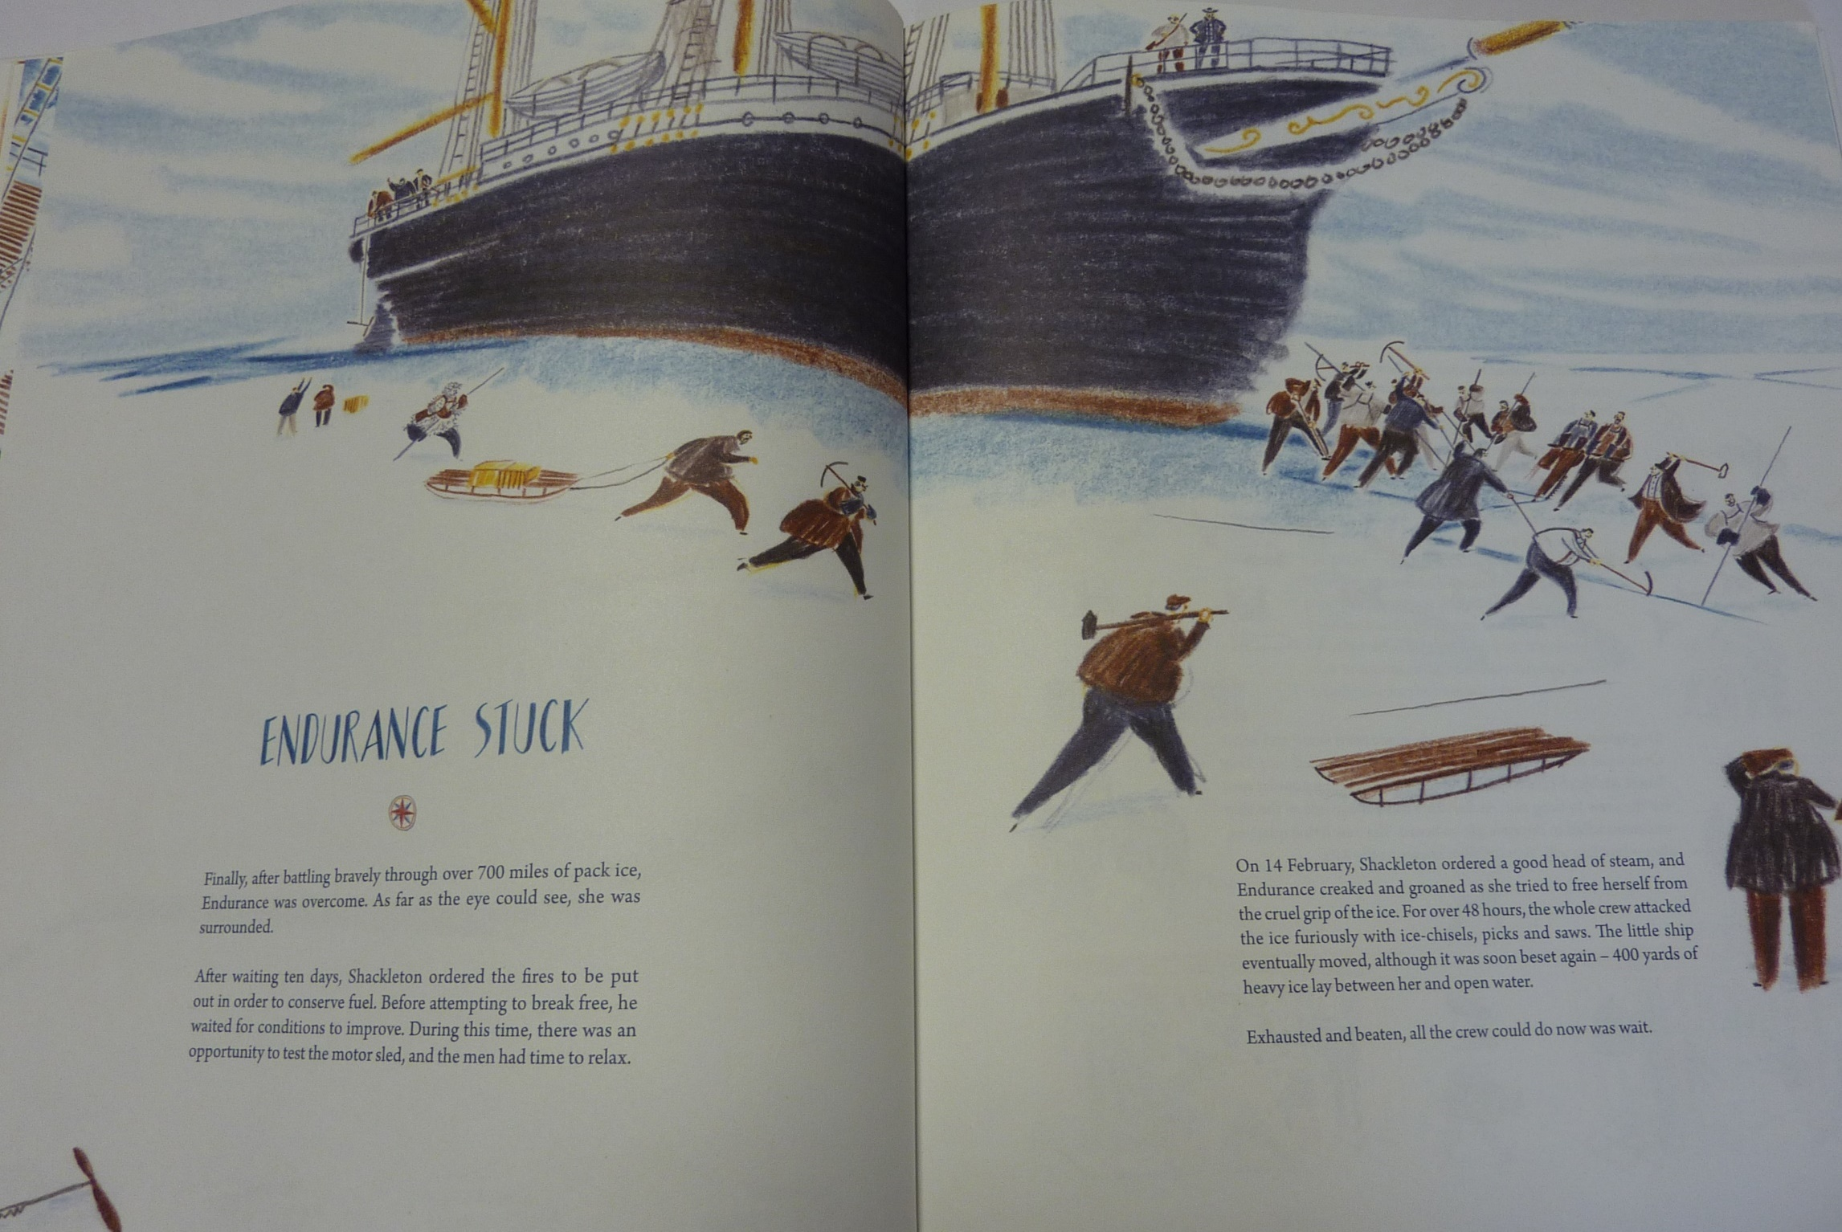

Slide 11
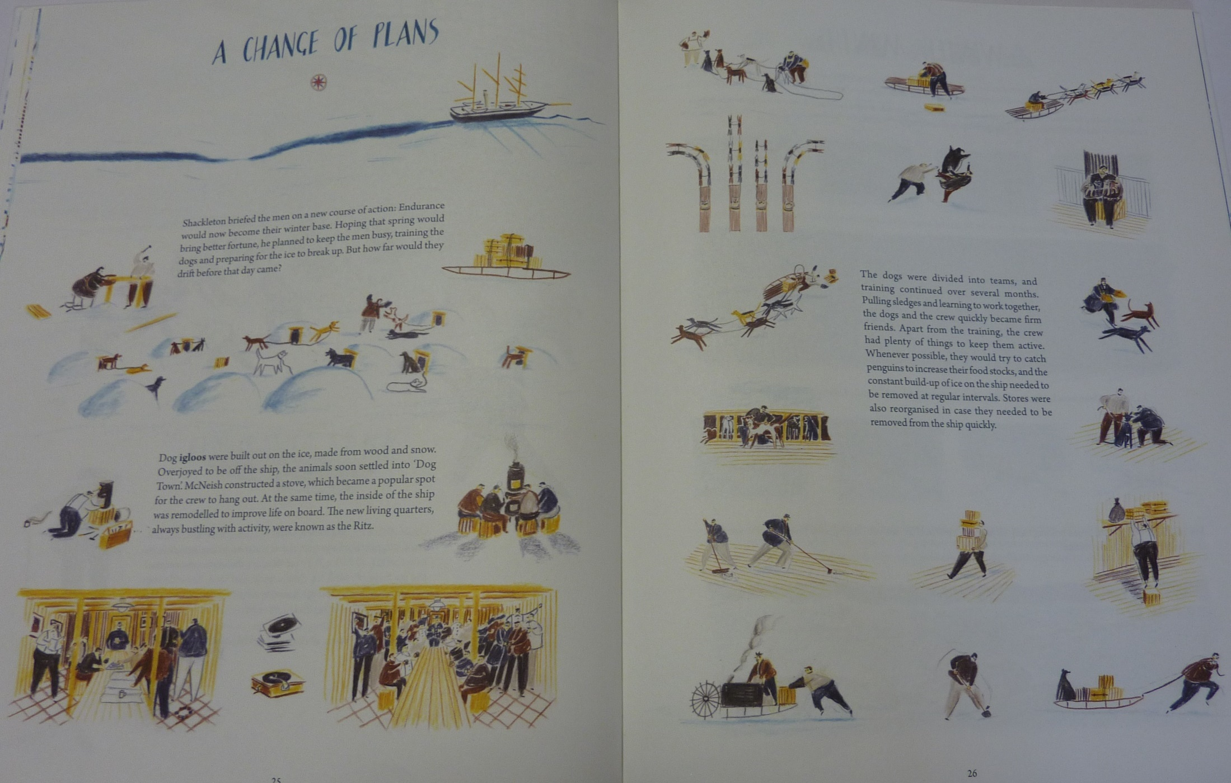

Slide 12

Today I would like you to write the second part of the diary.
1st part – describe the excitement of approaching and reaching Antarctica
2nd part – getting stuck but still optimistic about your chances
3rd part – struggling to stay positive as winter sets in

Slide 13
I will include an example for each part to give you some ideas but feel free to include whatever you want to!
Second Part
http://farnboroughprimary.co.uk/wp-content/uploads/2020/04/diary-part-2.docx
Some useful vocabulary
http://farnboroughprimary.co.uk/wp-content/uploads/2020/04/diary-vocabulary.docx

Slide 14
Physical activity – minimum 30 minutes each day | Link to resource
5 a day User Name: FPS53 / Password: JFz4XqG7 | https://player.5-a-day.tv/
Joe Wicks – PE sessions | https://www.youtube.com/channel/UCAxW1XT0iEJo0TYlRfn6rYQ
Cosmic Kids Yoga | https://www.youtube.com/user/CosmicKidsYoga
PE Hub Parents Portal | https://pehubportal.co.uk/
Go Noodle | https://www.gonoodle.com/good-energy-at-home-kids-games-and-videos/
Go for a walk/run. You must go with an adult from your home and make sure you stay 2 metres away from other people.

Slide 15

Try drawing a self-portrait or a portrait of someone you know. Below is a link with some tips.
If you can, email a picture in to admin.office@Farnborough.Bromley.sch.uk and I will put them on the website for us all to enjoy.
https://www.bbc.co.uk/teach/class-clips-video/how-to-draw-a-portrait/zk28qp3

