Slide 1
Subject / Lesson | Time
Maths | 1 hour
Grammar | 20 minutes
Comprehension | 20 minutes
English | 40 minutes
Physical Activity | 30 minutes
Topic | 30 minutes

Slide 2
Maths Task | Time
Maths Frame Interactive Quiz Username: Farnborough / Password: Farnborough https://mathsframe.co.uk/en/resources/resource/366/interactive-maths-quiz | 10 minutes
Complete the Consolidation Pack about the 4 Operations http://farnboroughprimary.co.uk/wp-content/uploads/2020/04/4-Operations-Consolidation.pdf | 45 minutes

Slide 3
Grammar Task | Time
Complete the task about adverbs and modal verbs. http://farnboroughprimary.co.uk/wp-content/uploads/2020/04/Grammar-Adverbs-Modal.pdf Answers http://farnboroughprimary.co.uk/wp-content/uploads/2020/04/Grammar-Answers.pdf | 20 minutes

Slide 4
Comprehension Task | Time
Continue working through the Nelson Comprehension book or the CGP Poetry or Non-fiction books. | 20 minutes

Slide 5

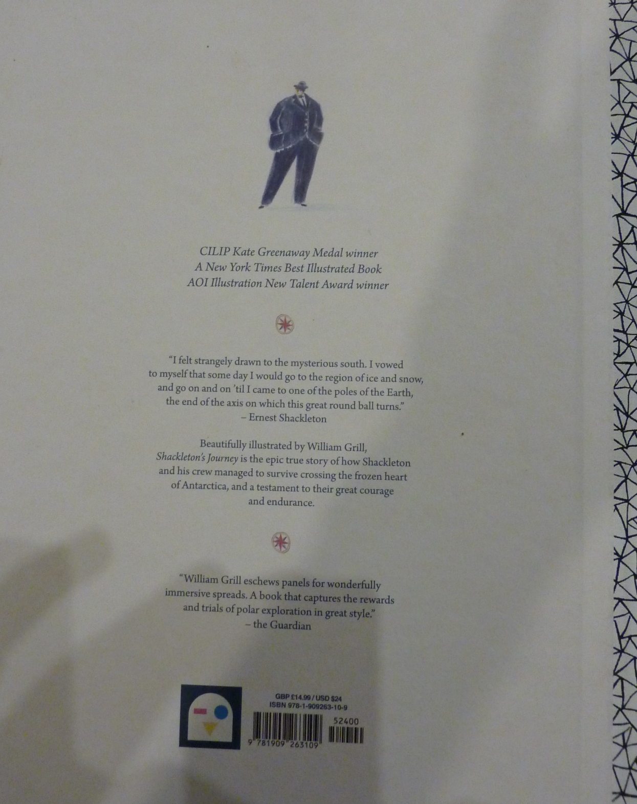

Slide 6
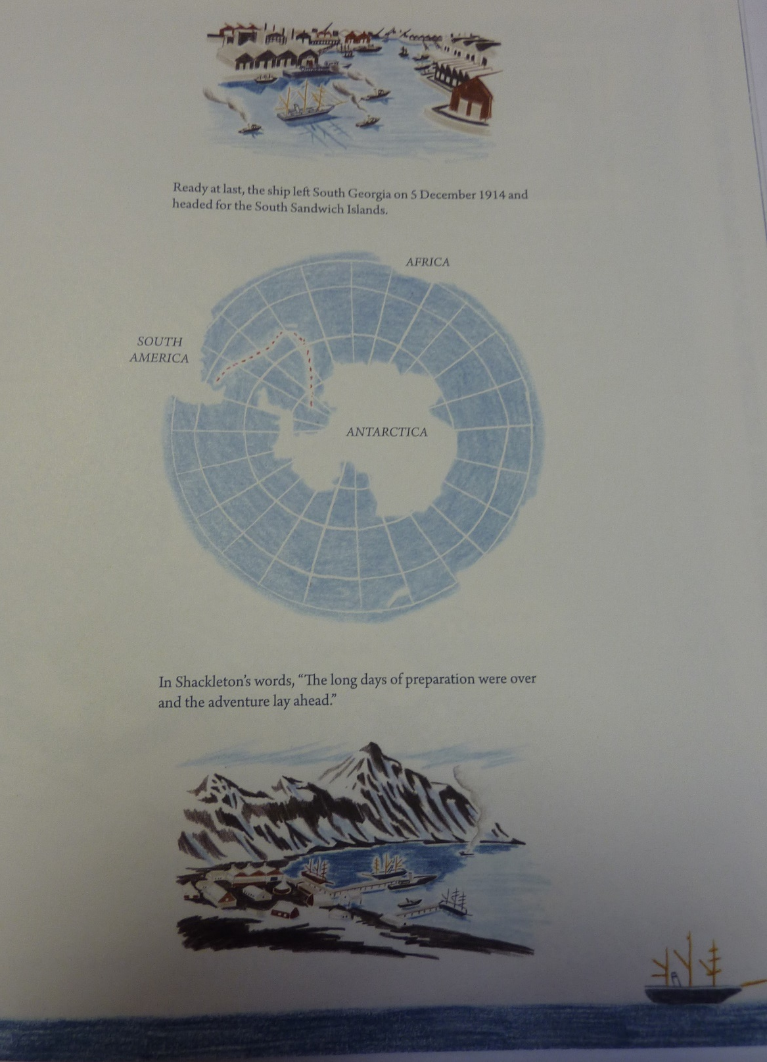
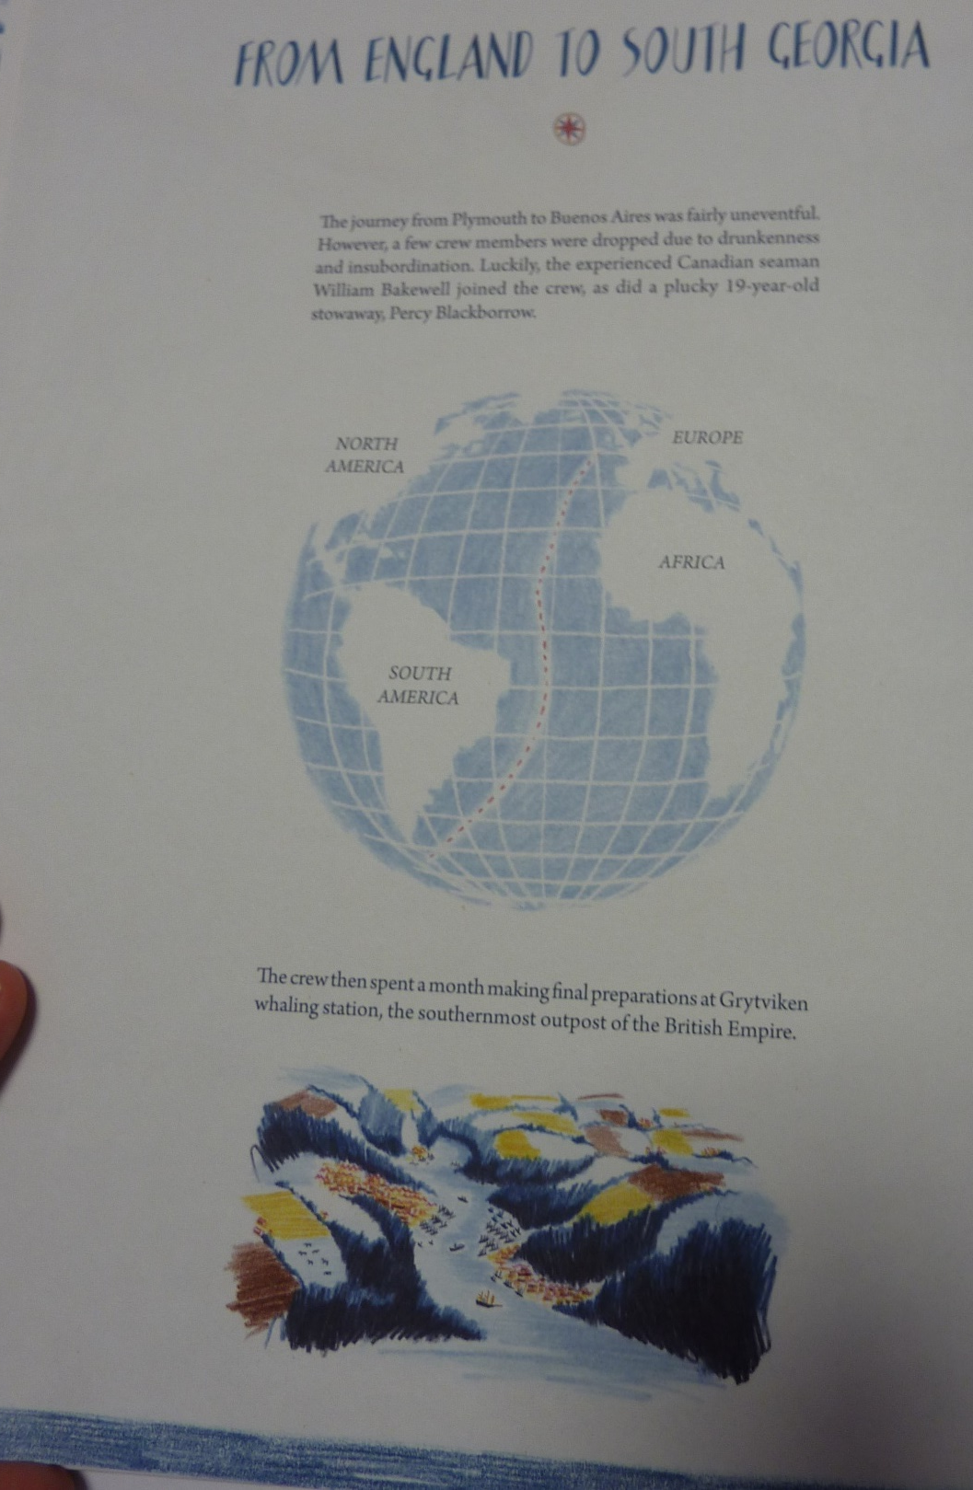

Slide 7
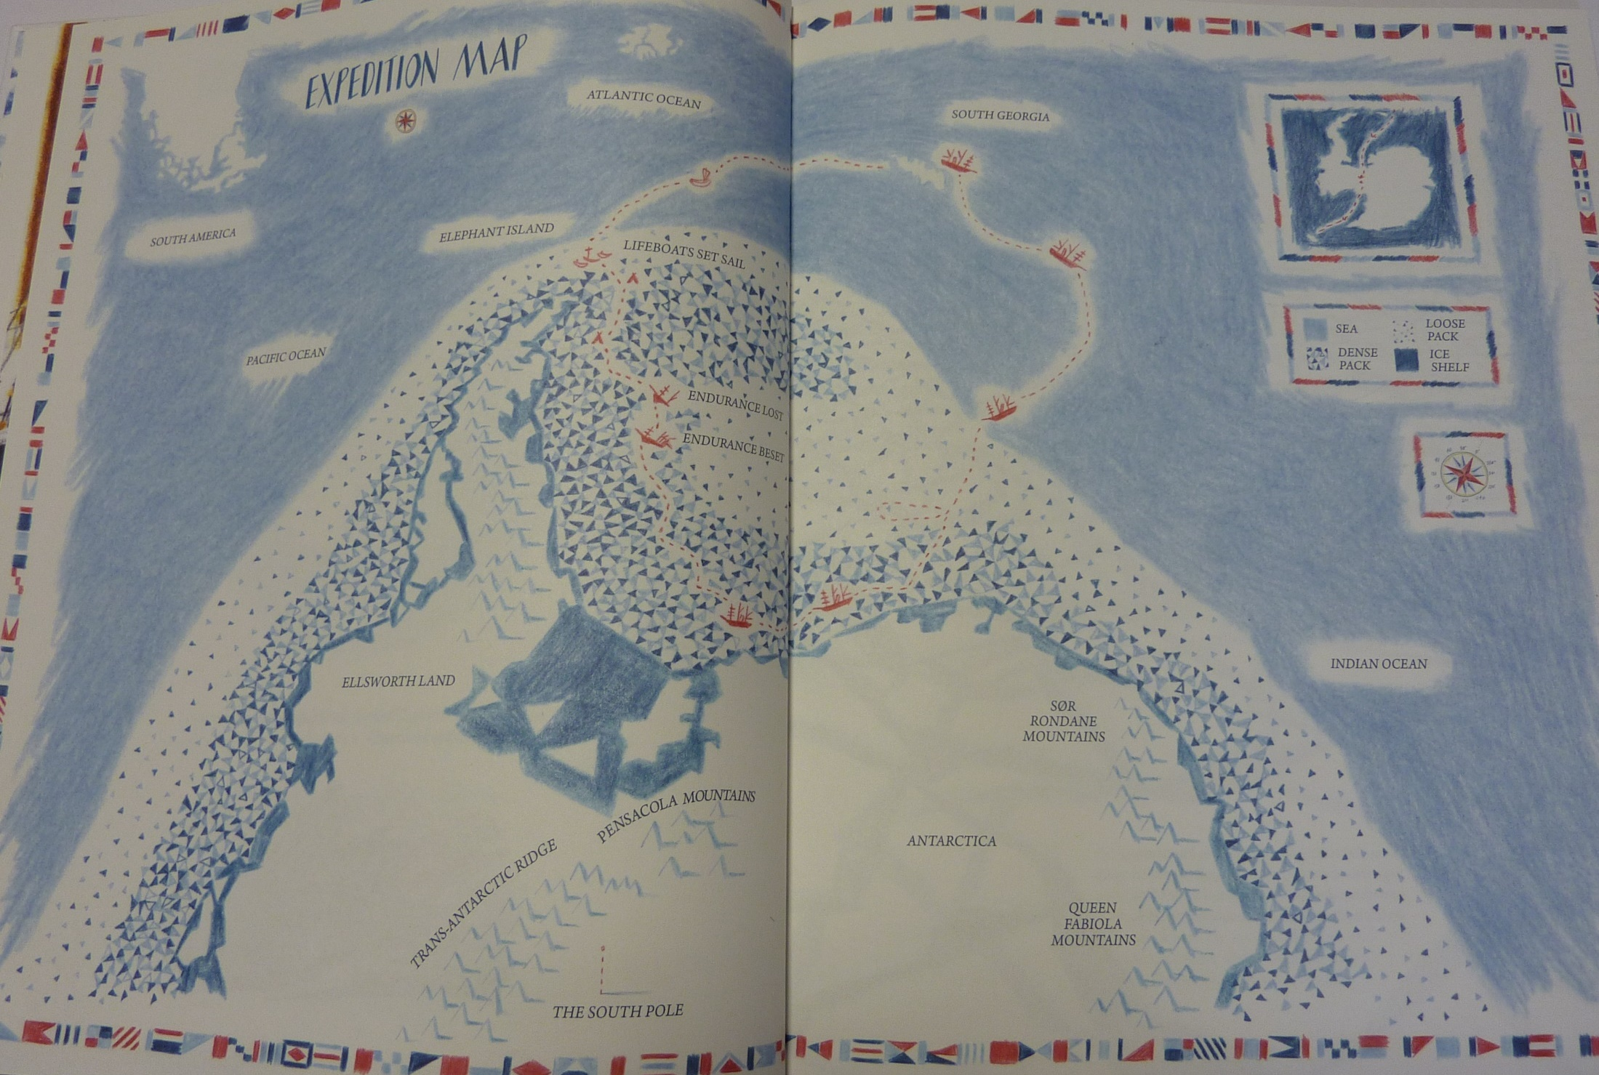

Slide 8
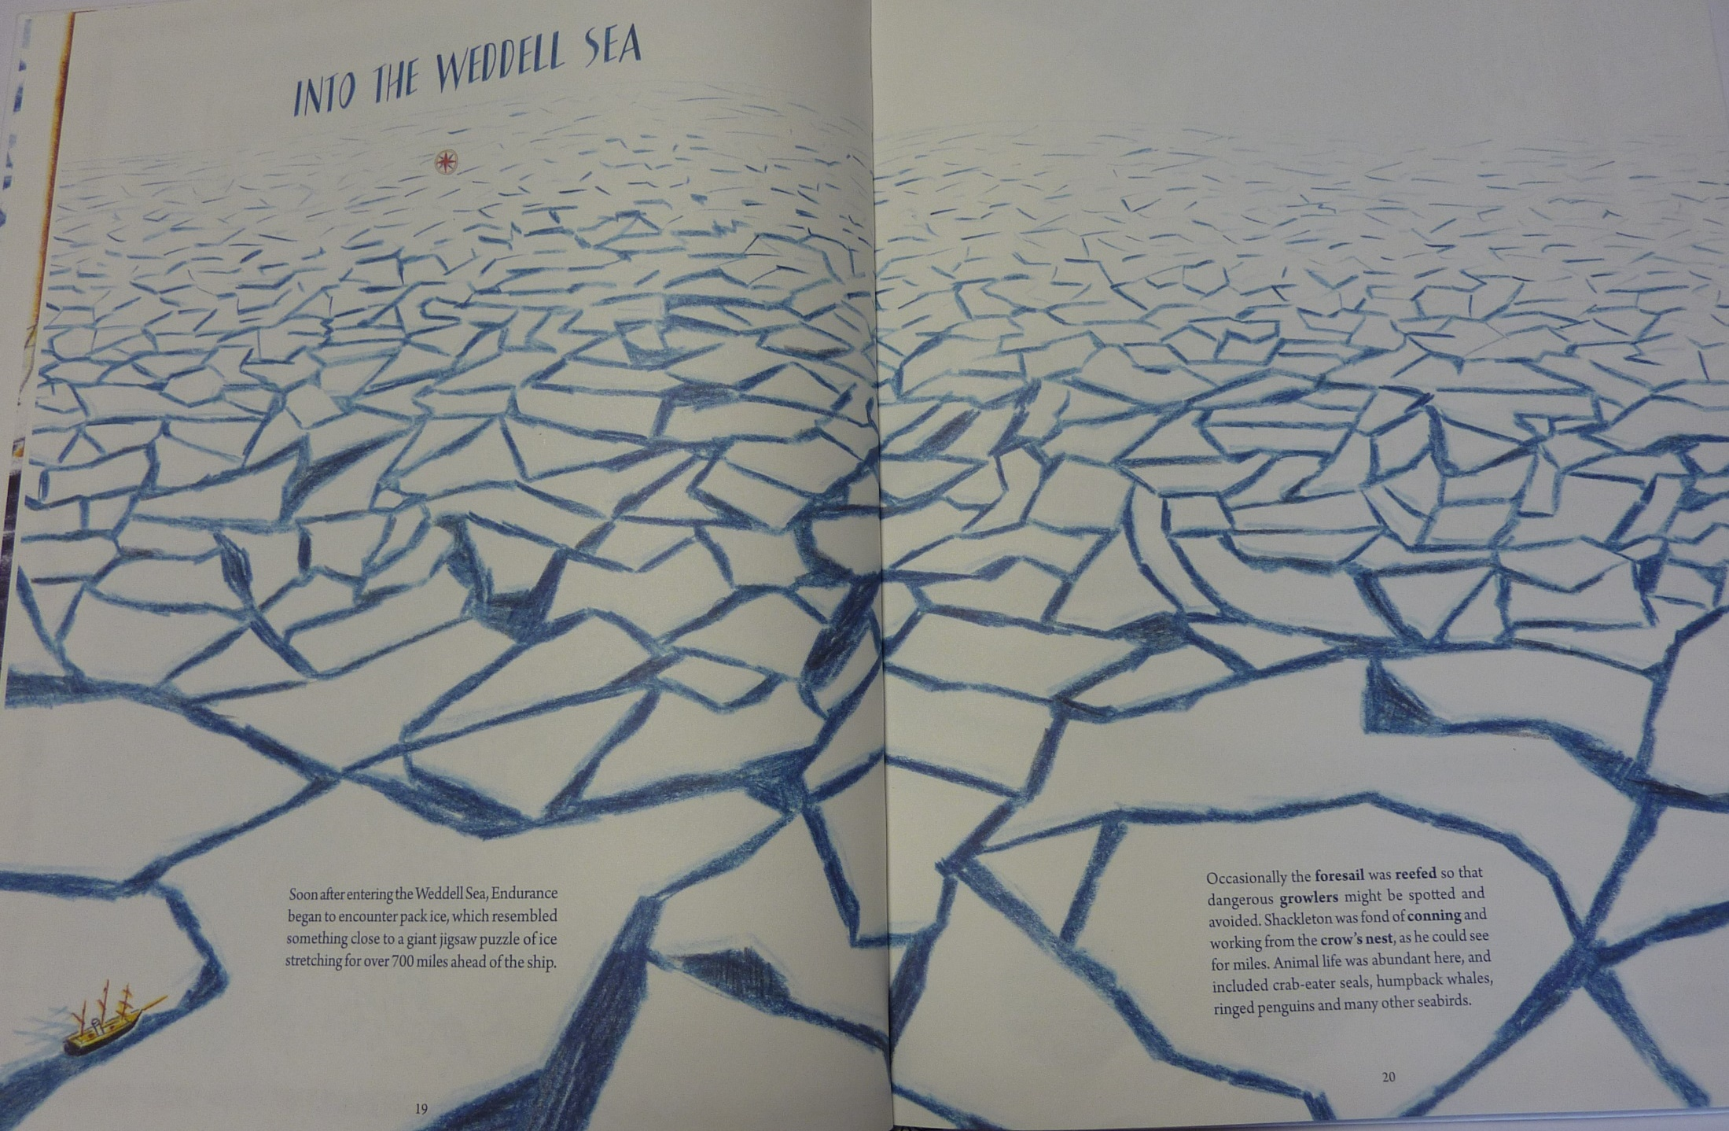

Slide 9
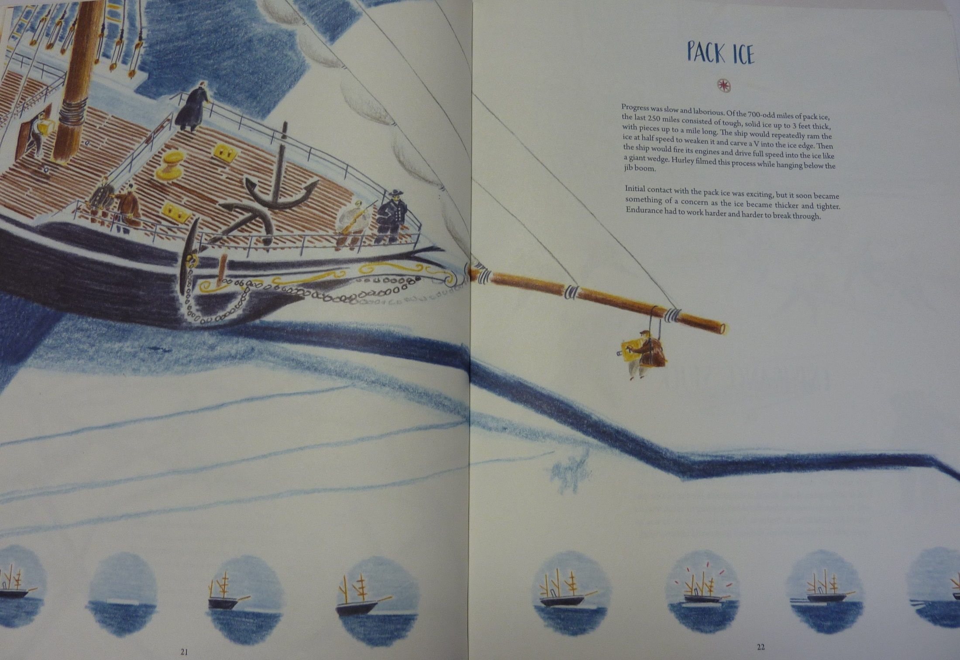

Slide 10
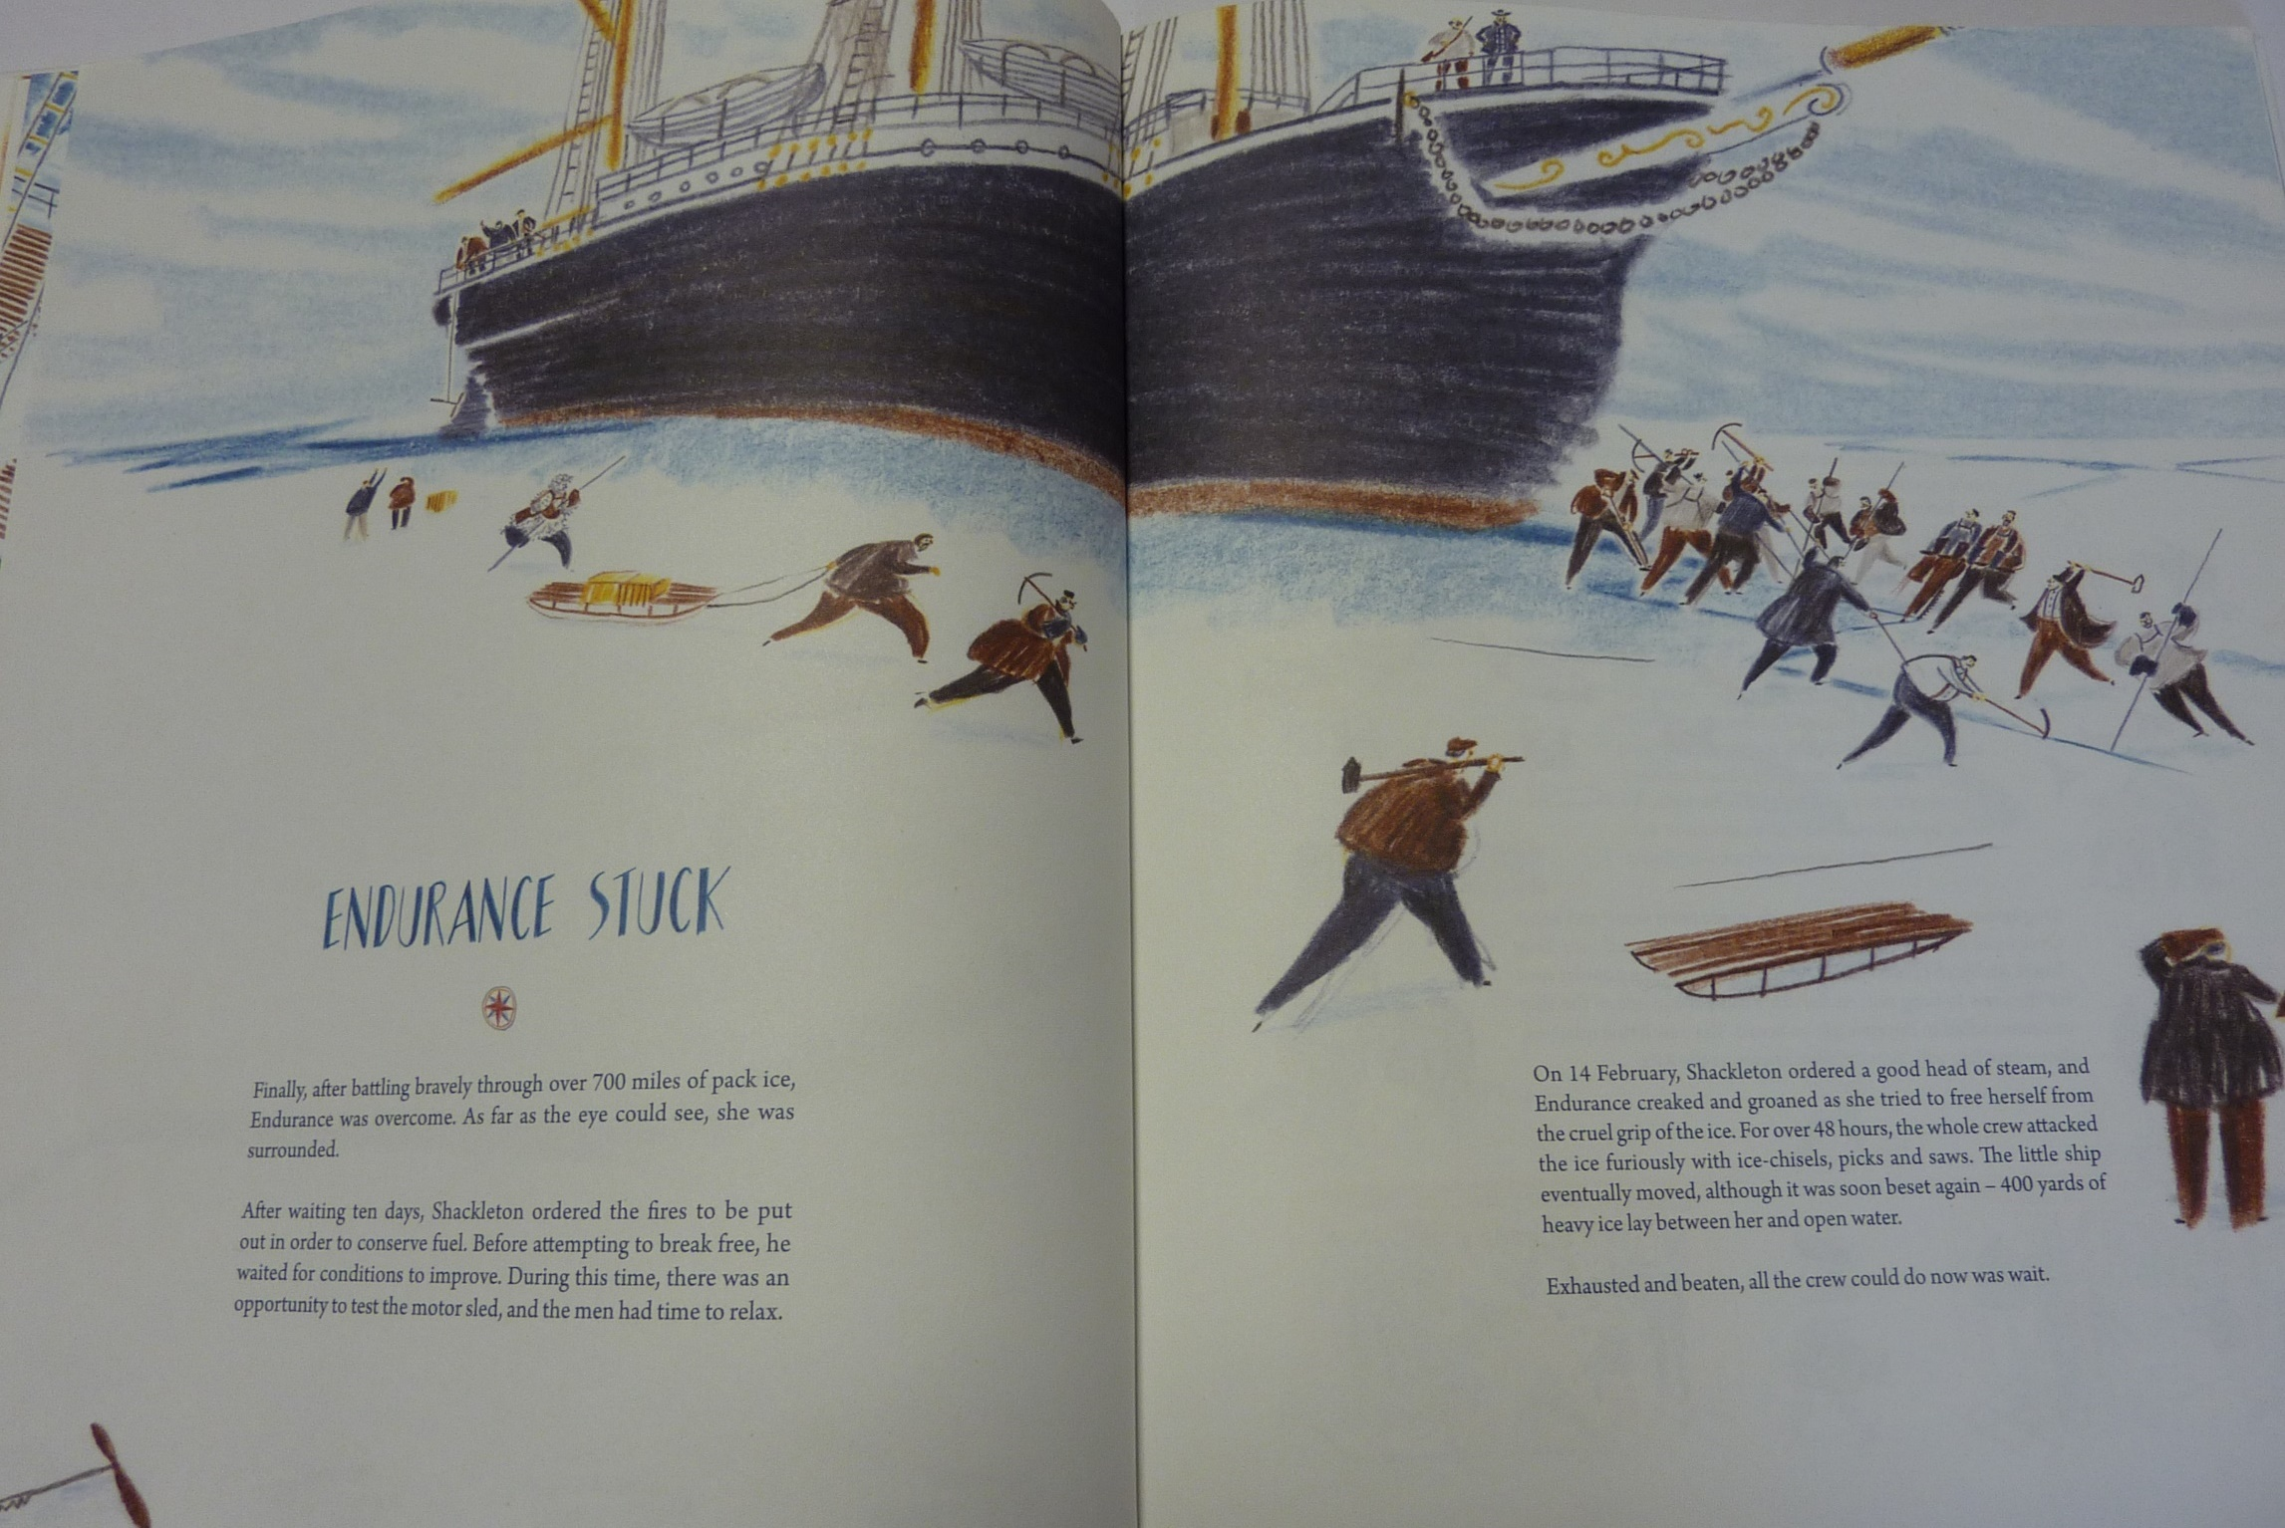

Slide 11
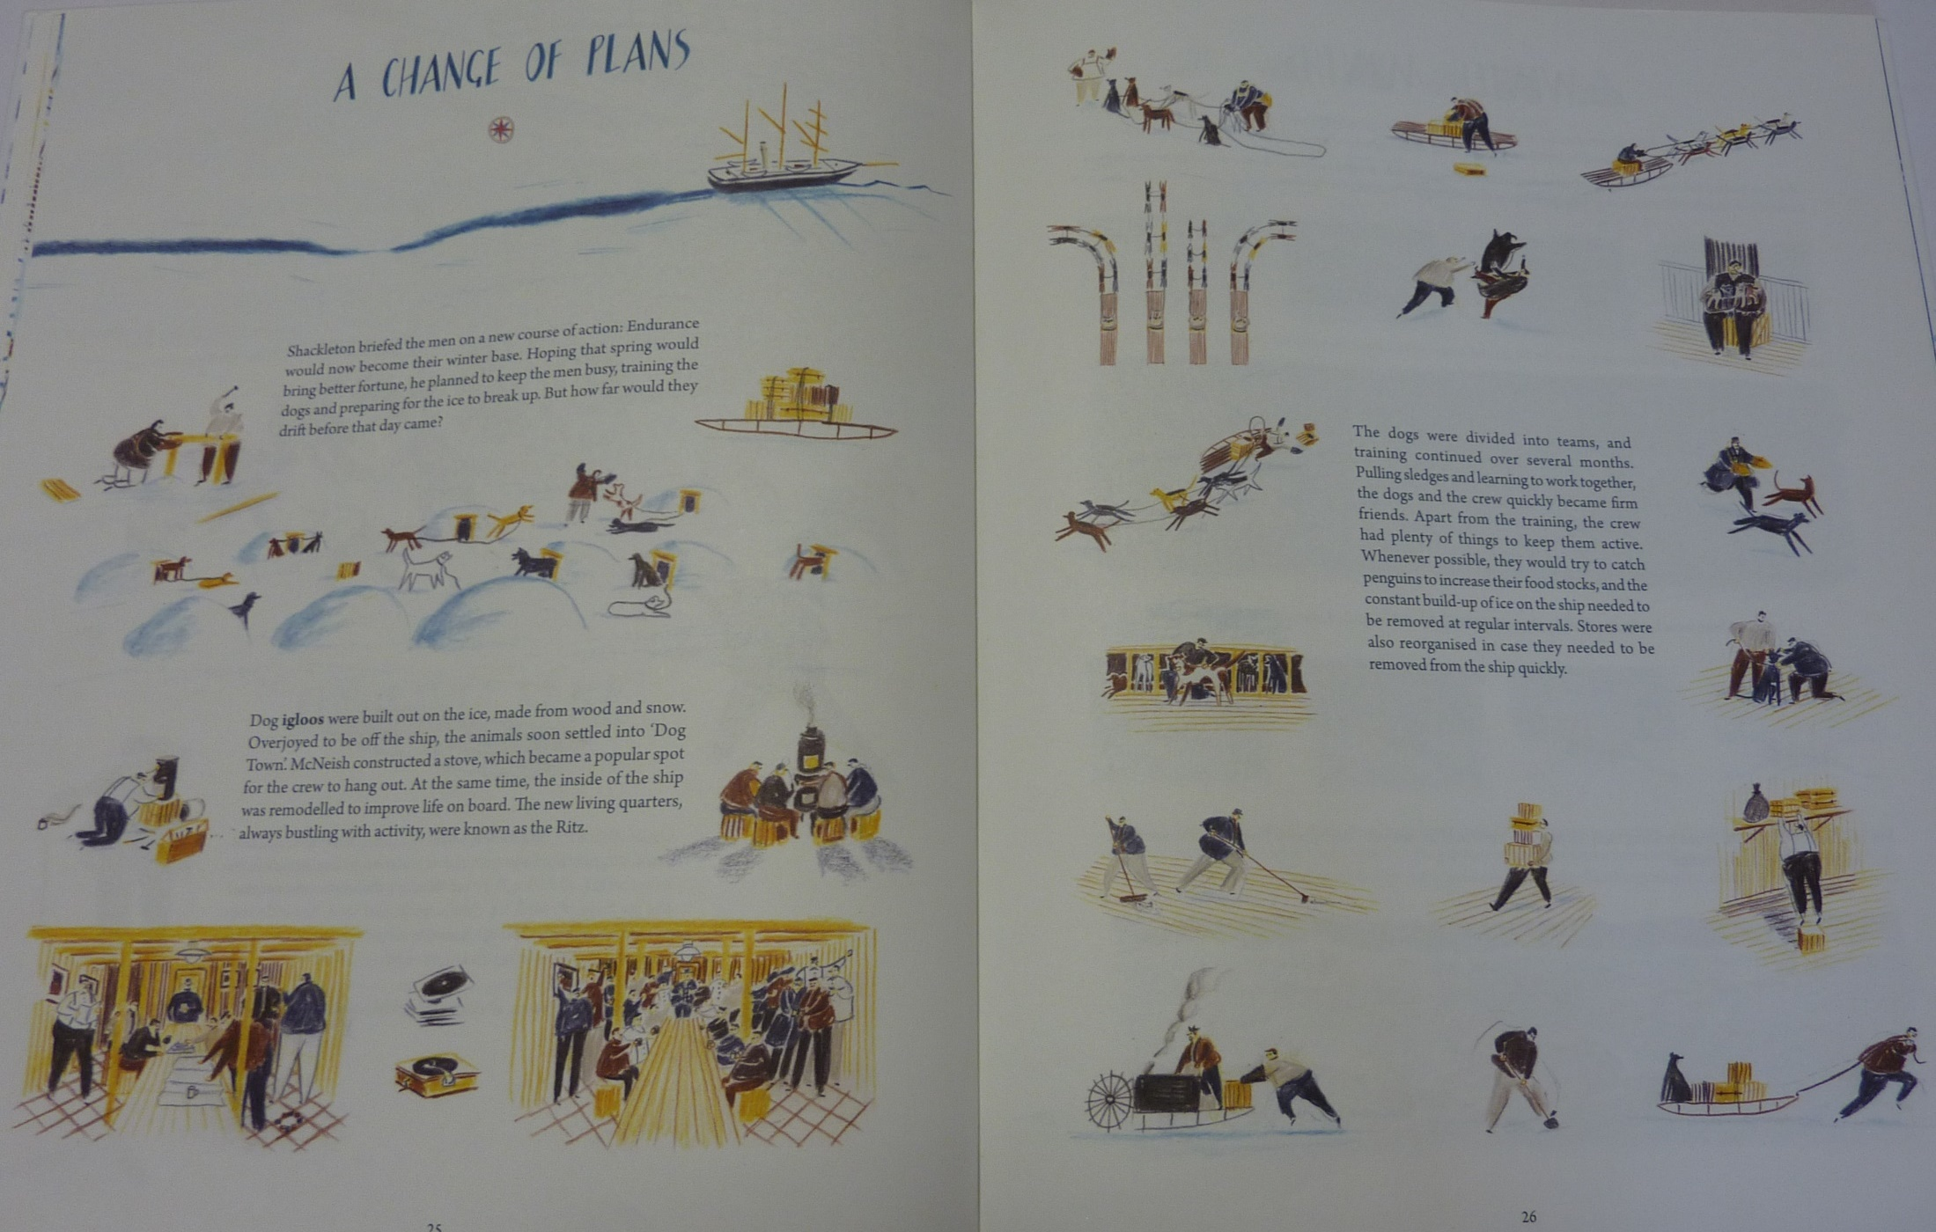

Slide 12

Today I would like you to start the diary. We are going to divide the diary into 3 parts and write it over 3 days (Tuesday, Wednesday and Friday).
1st part – describe the excitement of approaching and reaching Antarctica
2nd part – getting stuck but still optimistic about your chances
3rd part – struggling to stay positive as winter sets in

Slide 13
I will include an example for each part to give you some ideas but feel free to include whatever you want to!
First Part
http://farnboroughprimary.co.uk/wp-content/uploads/2020/04/diary-part-1.docx
Some useful vocabulary
http://farnboroughprimary.co.uk/wp-content/uploads/2020/04/diary-vocabulary.docx

Slide 14
Physical activity – minimum 30 minutes each day | Link to resource
5 a day User Name: FPS53 / Password: JFz4XqG7 | https://player.5-a-day.tv/
Joe Wicks – PE sessions | https://www.youtube.com/channel/UCAxW1XT0iEJo0TYlRfn6rYQ
Cosmic Kids Yoga | https://www.youtube.com/user/CosmicKidsYoga
PE Hub Parents Portal | https://pehubportal.co.uk/
Go Noodle | https://www.gonoodle.com/good-energy-at-home-kids-games-and-videos/
Go for a walk/run. You must go with an adult from your home and make sure you stay 2 metres away from other people.

Slide 15

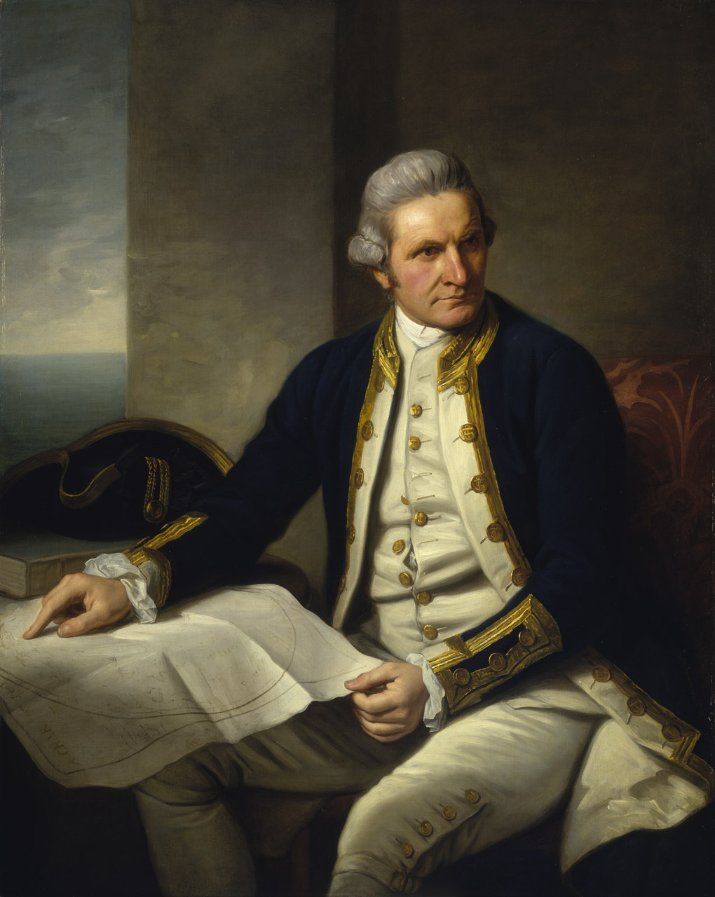
Captain James Cook
Can you finish your poster with the 5 most interesting facts about Captain Cook.

Slide 16
PowerPoints
http://farnboroughprimary.co.uk/wp-content/uploads/2020/04/Captain-Cook-Facts.pptx
http://farnboroughprimary.co.uk/wp-content/uploads/2020/04/Captain-James-Cook.pptx
Web pages
https://www.dkfindout.com/uk/history/explorers/captain-cook/
https://www.ducksters.com/biography/explorers/captain_james_cook.php
YouTube video
https://www.youtube.com/watch?v=UqSREQY-7sE

Slide 17
Thinking Question
James Cook’s voyages were remarkable and he achieved amazing things. Historians, however, struggle with some aspects of his exploration. Think about the question below. What do you think?
Was it right for Captain Cook to claim Australia as British when people already lived there?

