Slide 1
Subject / Lesson | Time
Maths | 1 hour
Grammar | 20 minutes
Comprehension | 20 minutes
English | 40 minutes
Physical Activity | 30 minutes
Topic | 30 minutes

Slide 2
Maths Task | Time
Times Table Rock Stars | 10 minutes
Complete the Consolidation Pack about Place Value http://farnboroughprimary.co.uk/wp-content/uploads/2020/04/Place-Value-Consolidation.pdf | 45 minutes

Slide 3
Grammar Task | Time
Complete a task from the selection on the website: http://farnboroughprimary.co.uk/wp-content/uploads/2020/03/Year-6-SPAG.zip | 20 minutes

Slide 4
Comprehension Task | Time
Complete Alice in Wonderland text http://farnboroughprimary.co.uk/wp-content/uploads/2020/04/Alice-in-Wonderland.pdf | 20 minutes

Slide 5

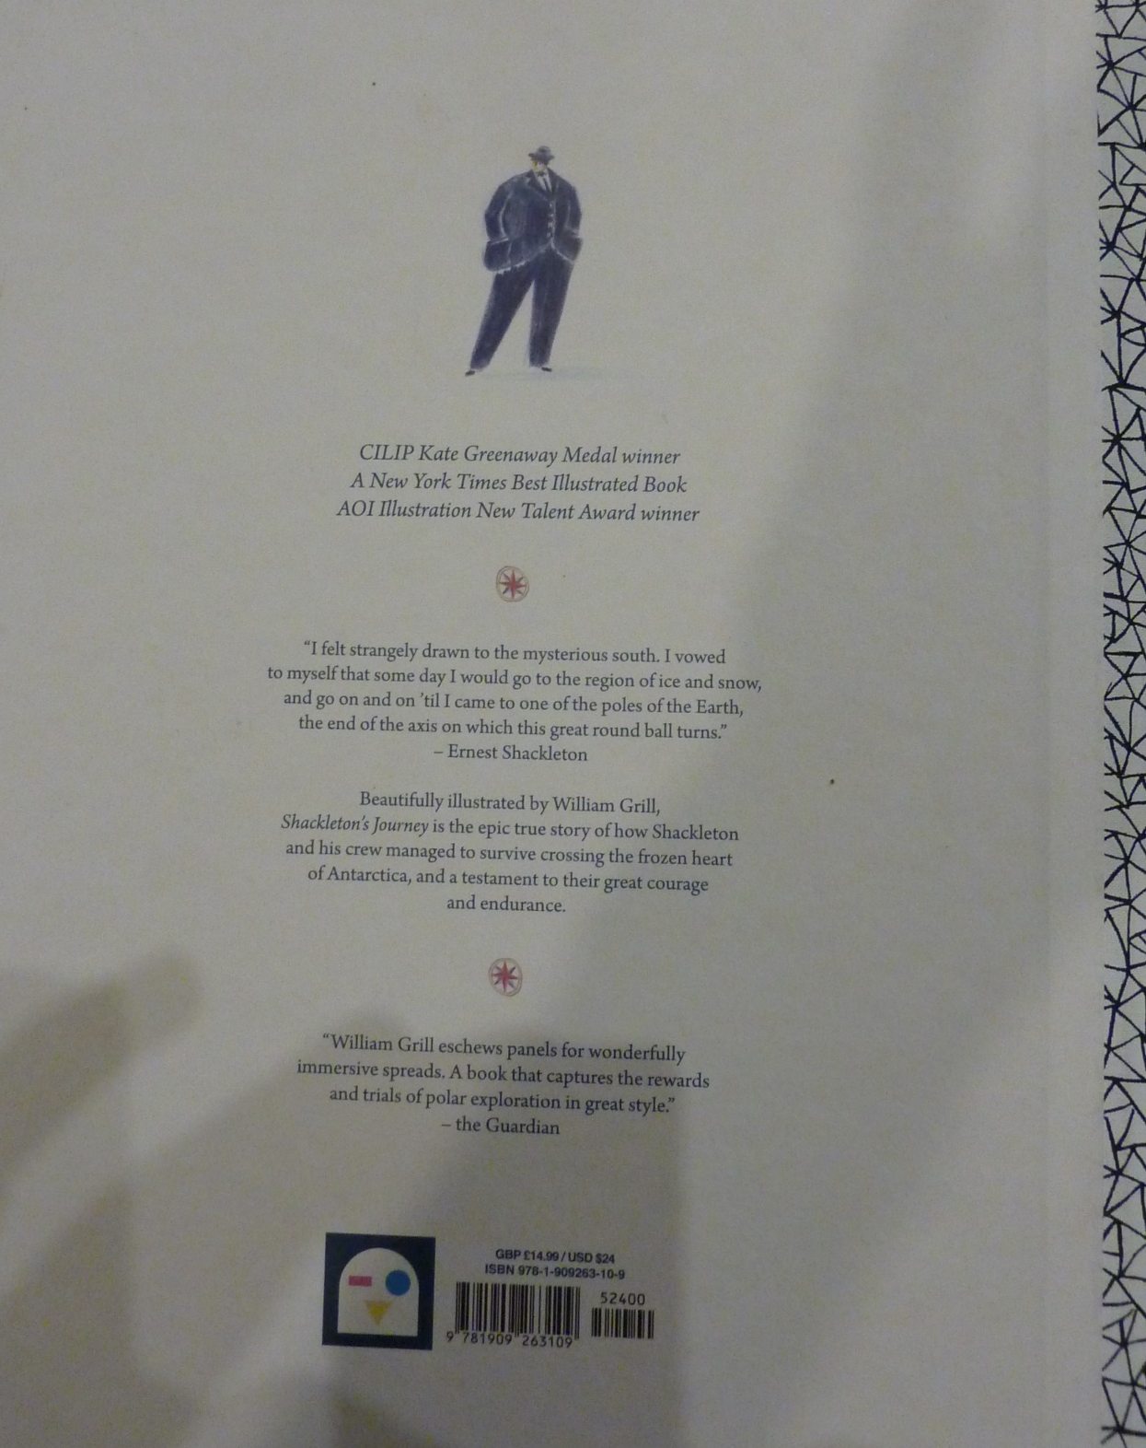

Slide 6
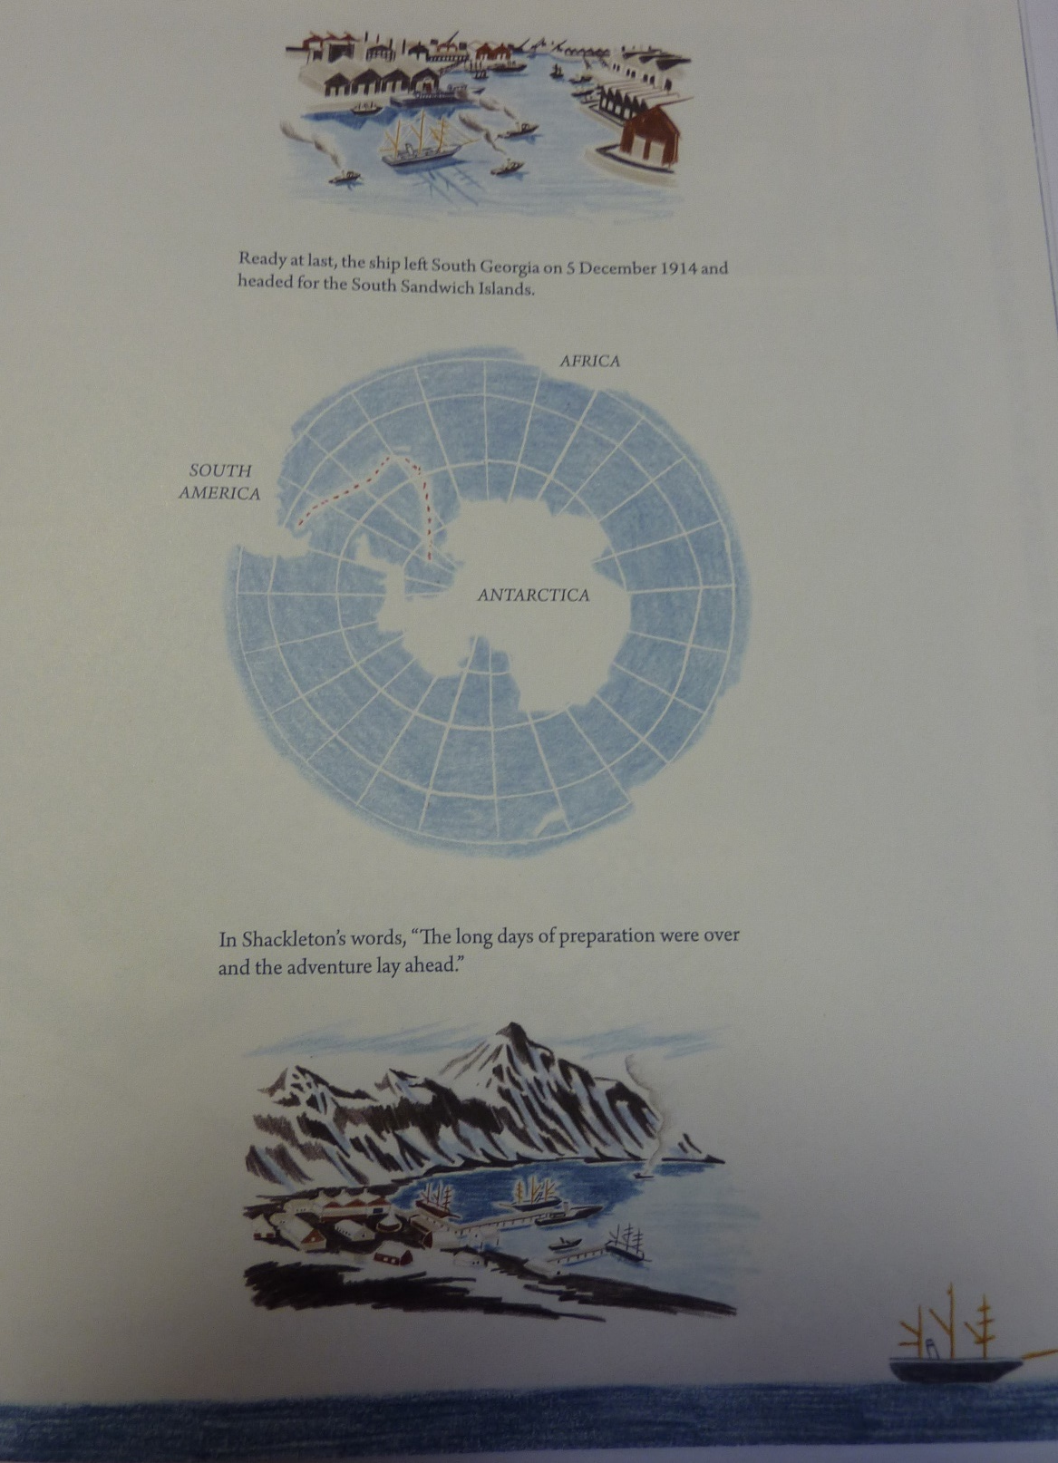
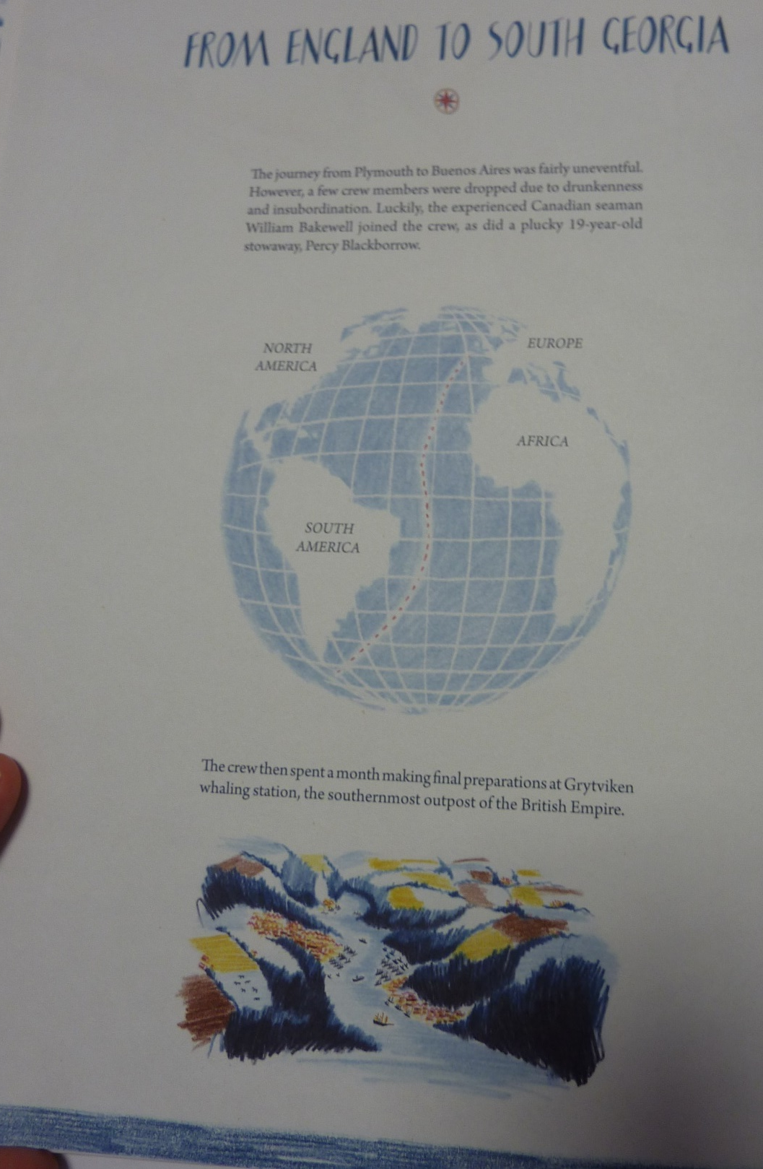

Slide 7
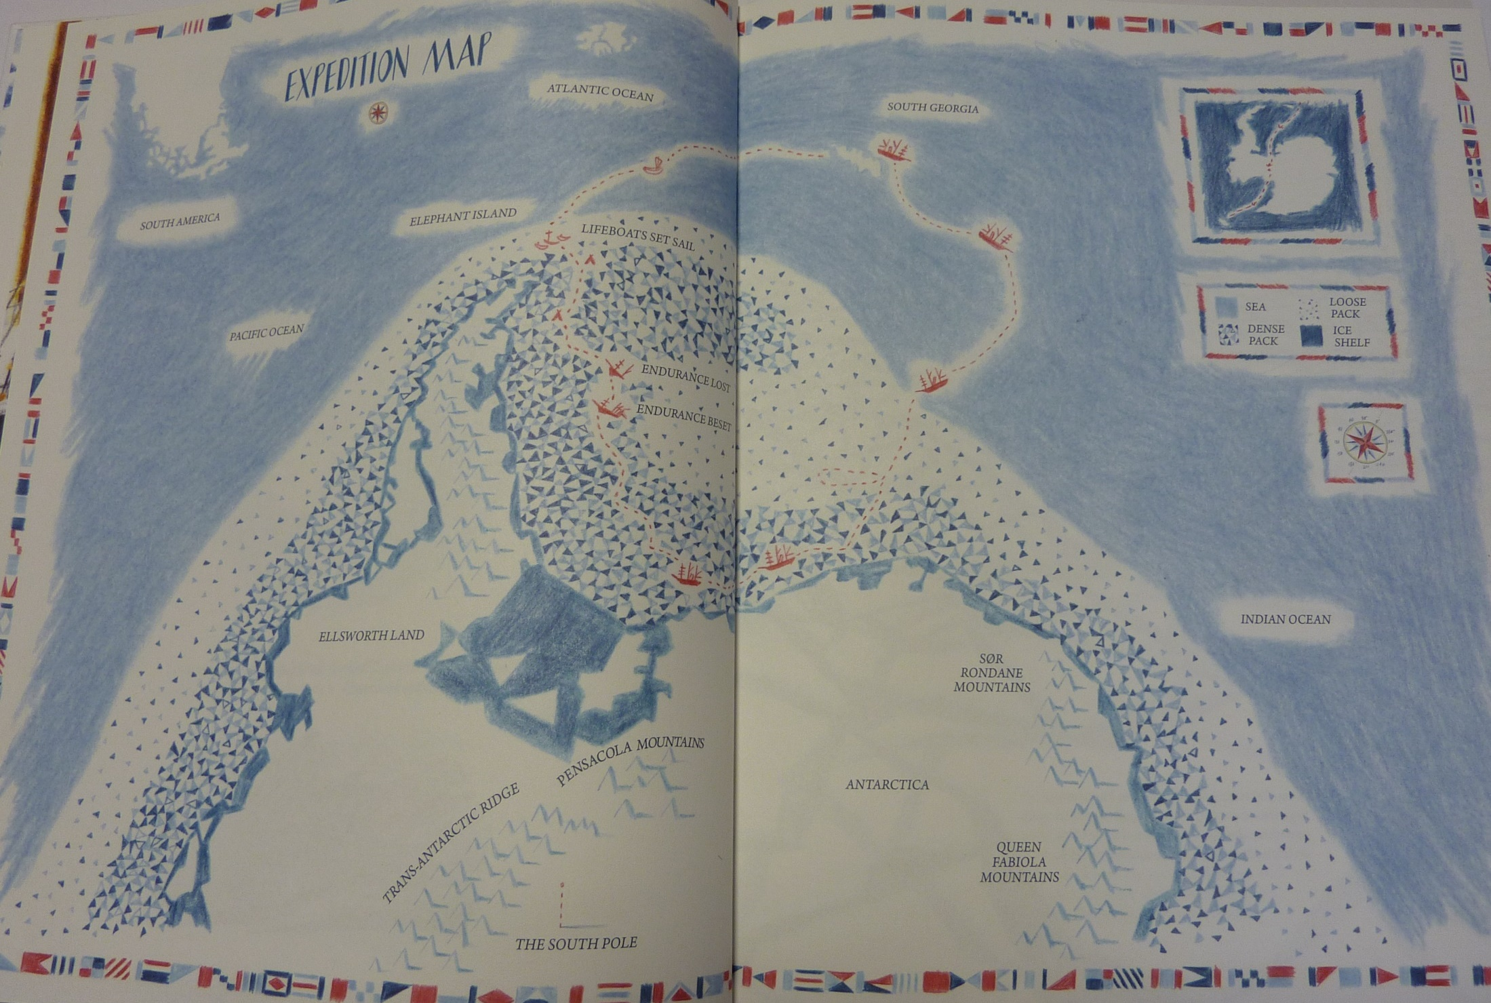

Slide 8
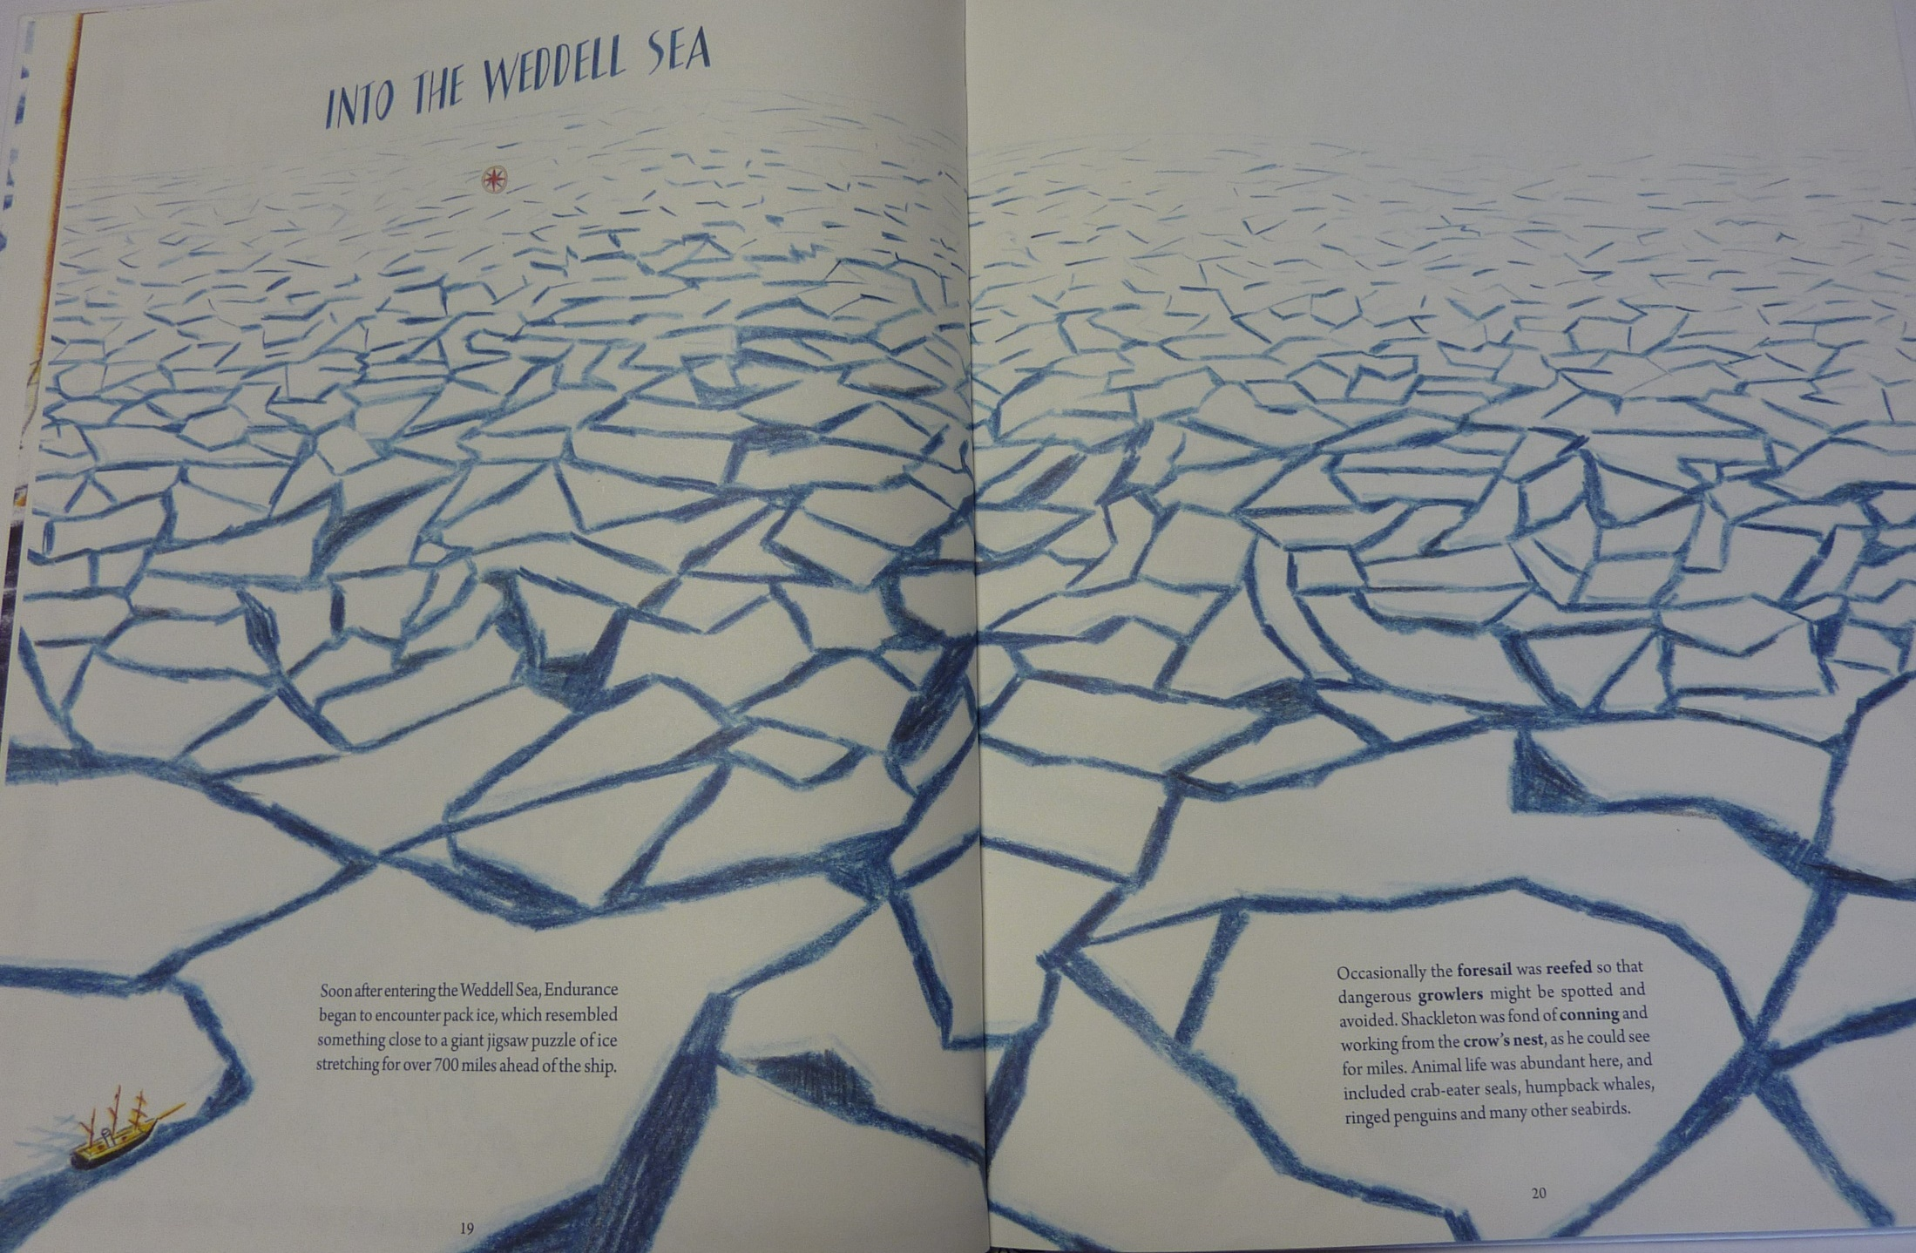

Slide 9
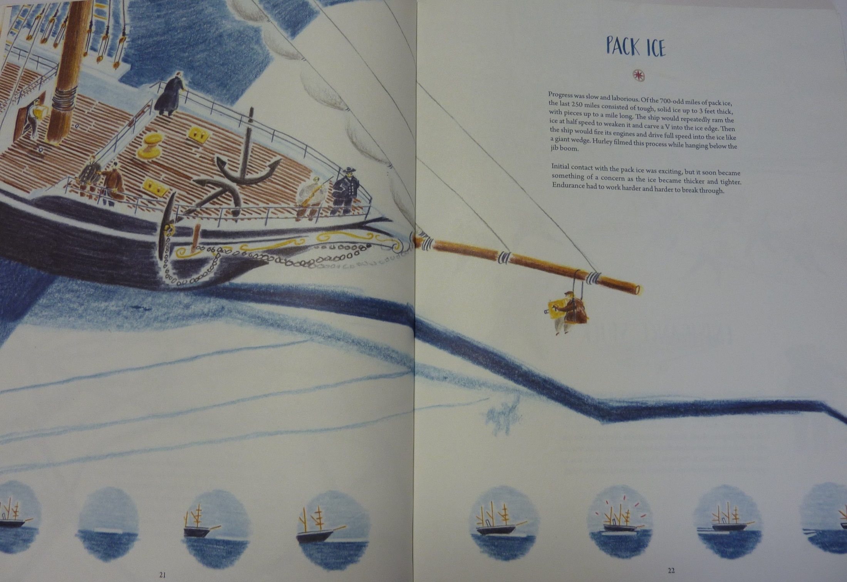

Slide 10
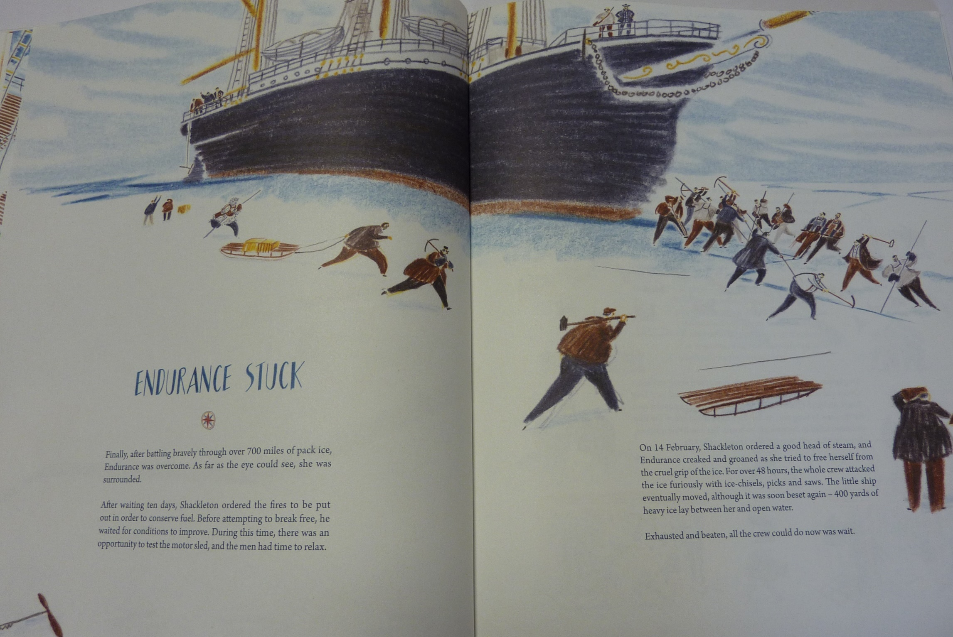

Slide 11
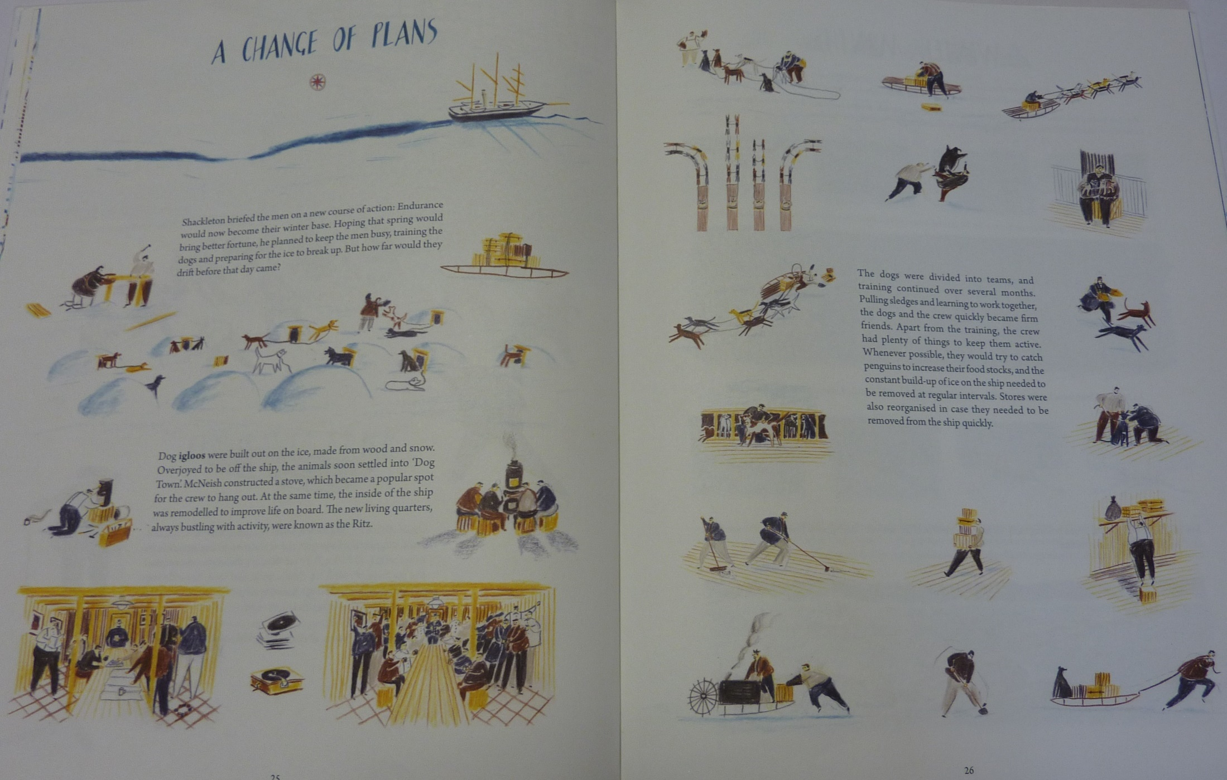

Slide 12

Today I would like to read through the previous slides.
You can see that Shackleton got into trouble with the ice very quickly. We will be writing a diary as one of the sailors. So it can sound realistic, we need to make sure that we know what the sailors did.
Make a list of some of the jobs that the sailors did. Can you think of any other things they would have too do to survive?

Slide 13
Physical activity – minimum 30 minutes each day | Link to resource
5 a day User Name: FPS53 / Password: JFz4XqG7 | https://player.5-a-day.tv/
Joe Wicks – PE sessions | https://www.youtube.com/channel/UCAxW1XT0iEJo0TYlRfn6rYQ
Cosmic Kids Yoga | https://www.youtube.com/user/CosmicKidsYoga
PE Hub Parents Portal | https://pehubportal.co.uk/
Go Noodle | https://www.gonoodle.com/good-energy-at-home-kids-games-and-videos/
Go for a walk/run. You must go with an adult from your home and make sure you stay 2 metres away from other people.

Slide 14

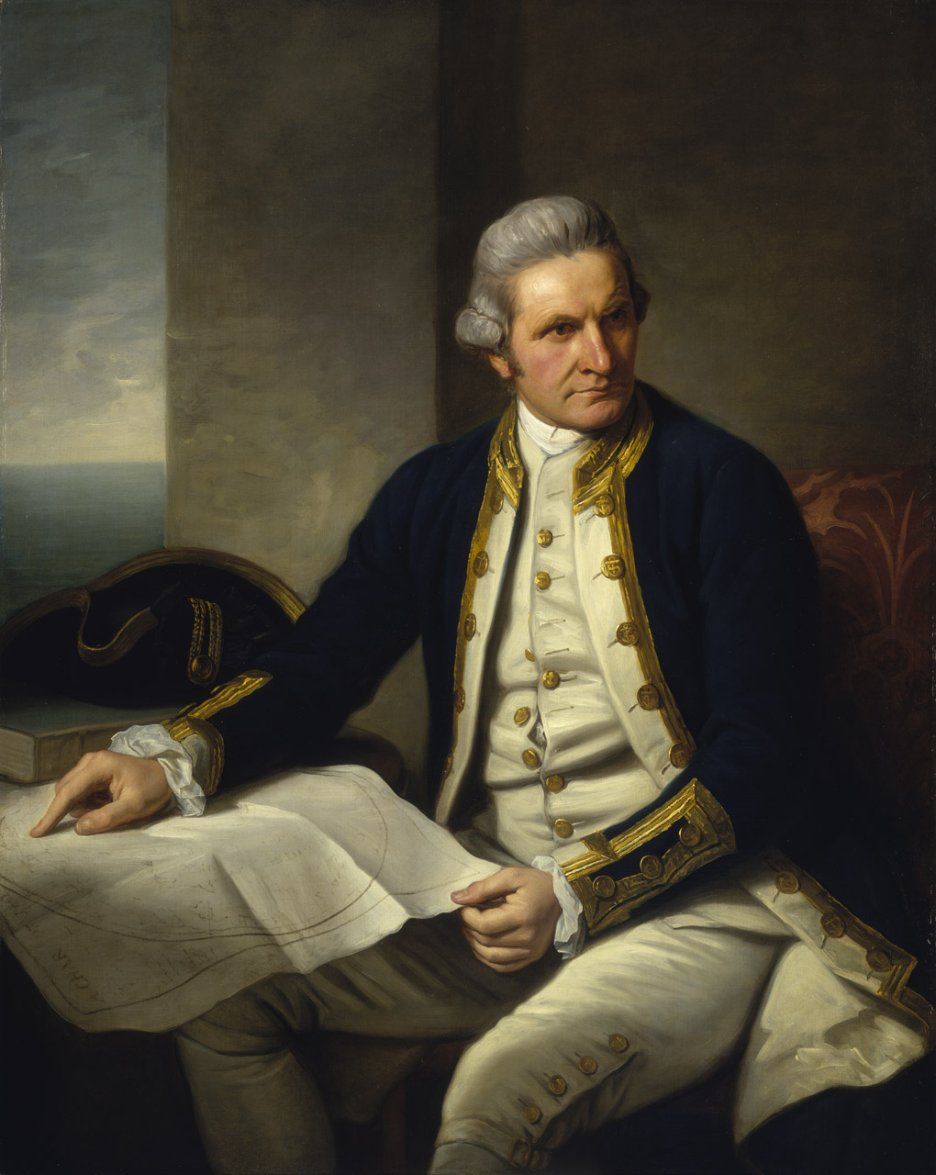
Captain James Cook
I would like you to research Captain James Cook. On the next slide I have included some links to different information sources.
We will be creating a poster with the 5 most interesting facts about Captain Cook over the next 2 days.

Slide 15
PowerPoints
http://farnboroughprimary.co.uk/wp-content/uploads/2020/04/Captain-Cook-Facts.pptx
http://farnboroughprimary.co.uk/wp-content/uploads/2020/04/Captain-James-Cook.pptx
Web pages
https://www.dkfindout.com/uk/history/explorers/captain-cook/
https://www.ducksters.com/biography/explorers/captain_james_cook.php
YouTube video
https://www.youtube.com/watch?v=UqSREQY-7sE

