Slide 1
Subject / Lesson | Time
Maths | 1 hour
Grammar | 20 minutes
Comprehension | 20 minutes
English | 40 minutes
Physical Activity | 30 minutes
French | 30 minutes

Slide 2
Maths Task | Time
Maths Frame Interactive Quiz Username: Farnborough / Password: Farnborough https://mathsframe.co.uk/en/resources/resource/366/interactive-maths-quiz | 10 minutes
Complete the Consolidation Pack about Fractions http://farnboroughprimary.co.uk/wp-content/uploads/2020/04/Fractions-Consolidation.pdf | 45 minutes

Slide 3
Grammar Task | Time
Complete the task about synonyms and antonyms. http://farnboroughprimary.co.uk/wp-content/uploads/2020/04/Grammar-Synonyms.pdf | 20 minutes

Slide 4
Comprehension Task | Time
Complete the Dracula text. Be careful: he does bite! http://farnboroughprimary.co.uk/wp-content/uploads/2020/04/Dracula.pdf | 20 minutes

Slide 5

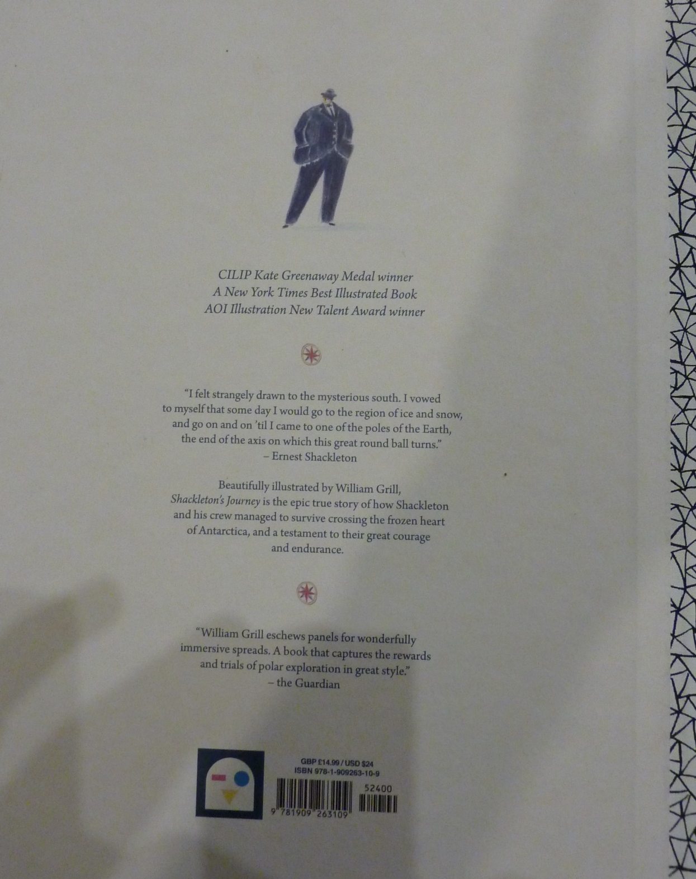

Slide 6
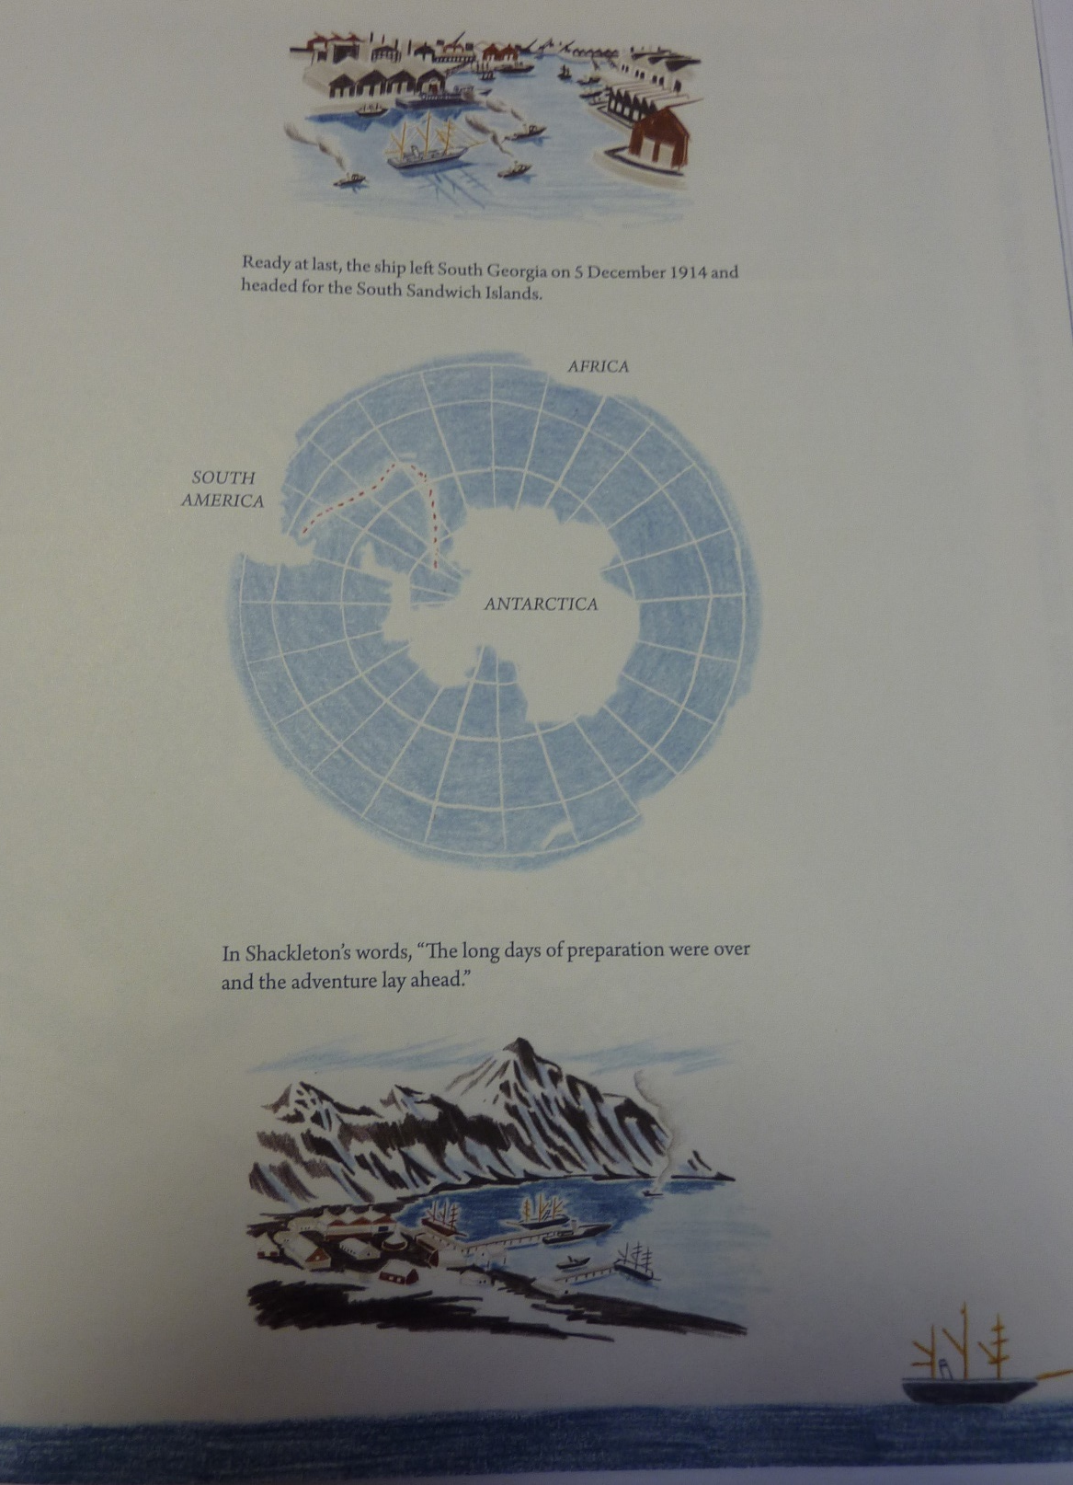
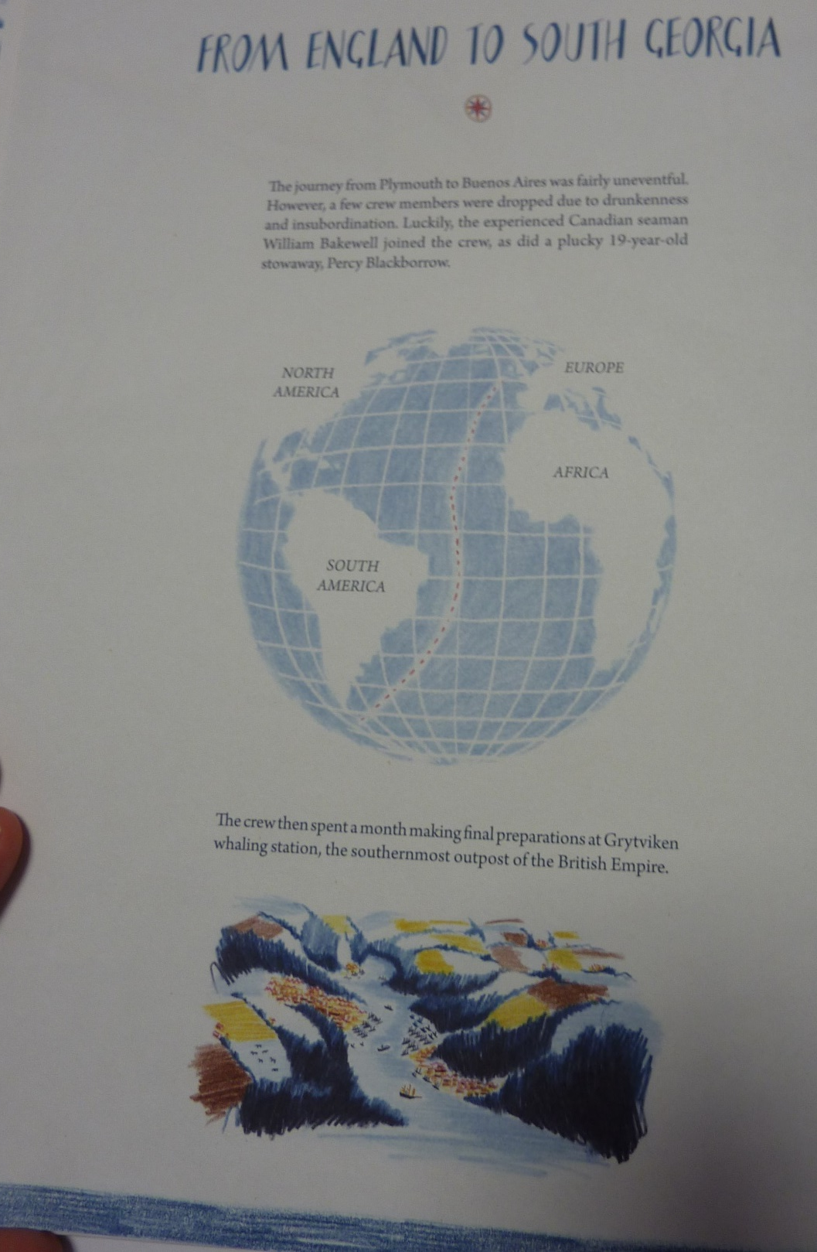

Slide 7
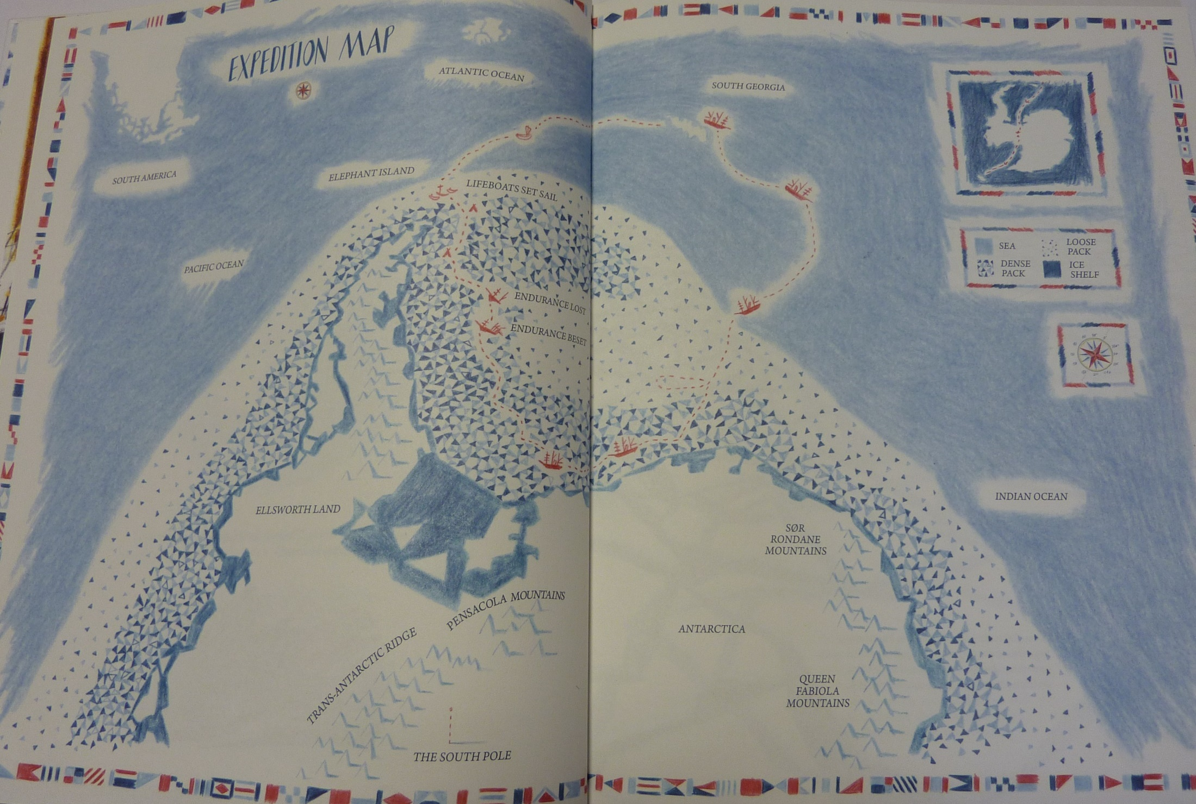

Slide 8
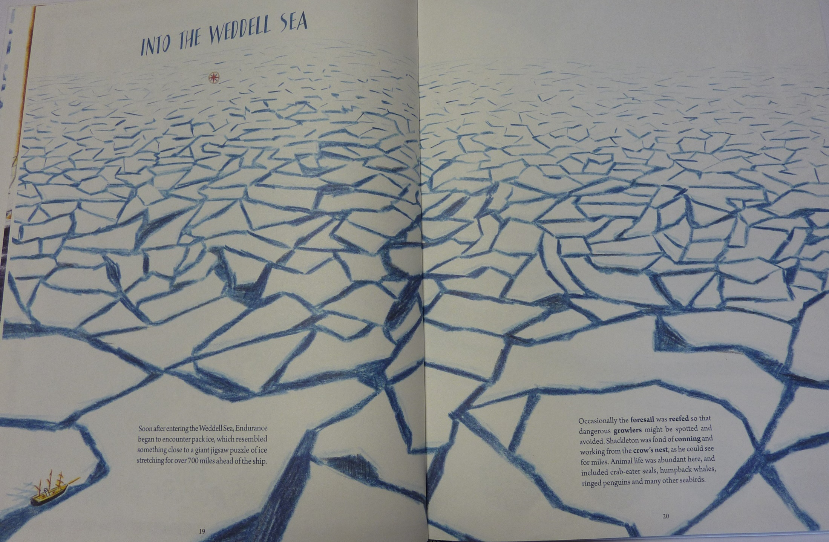

Slide 9
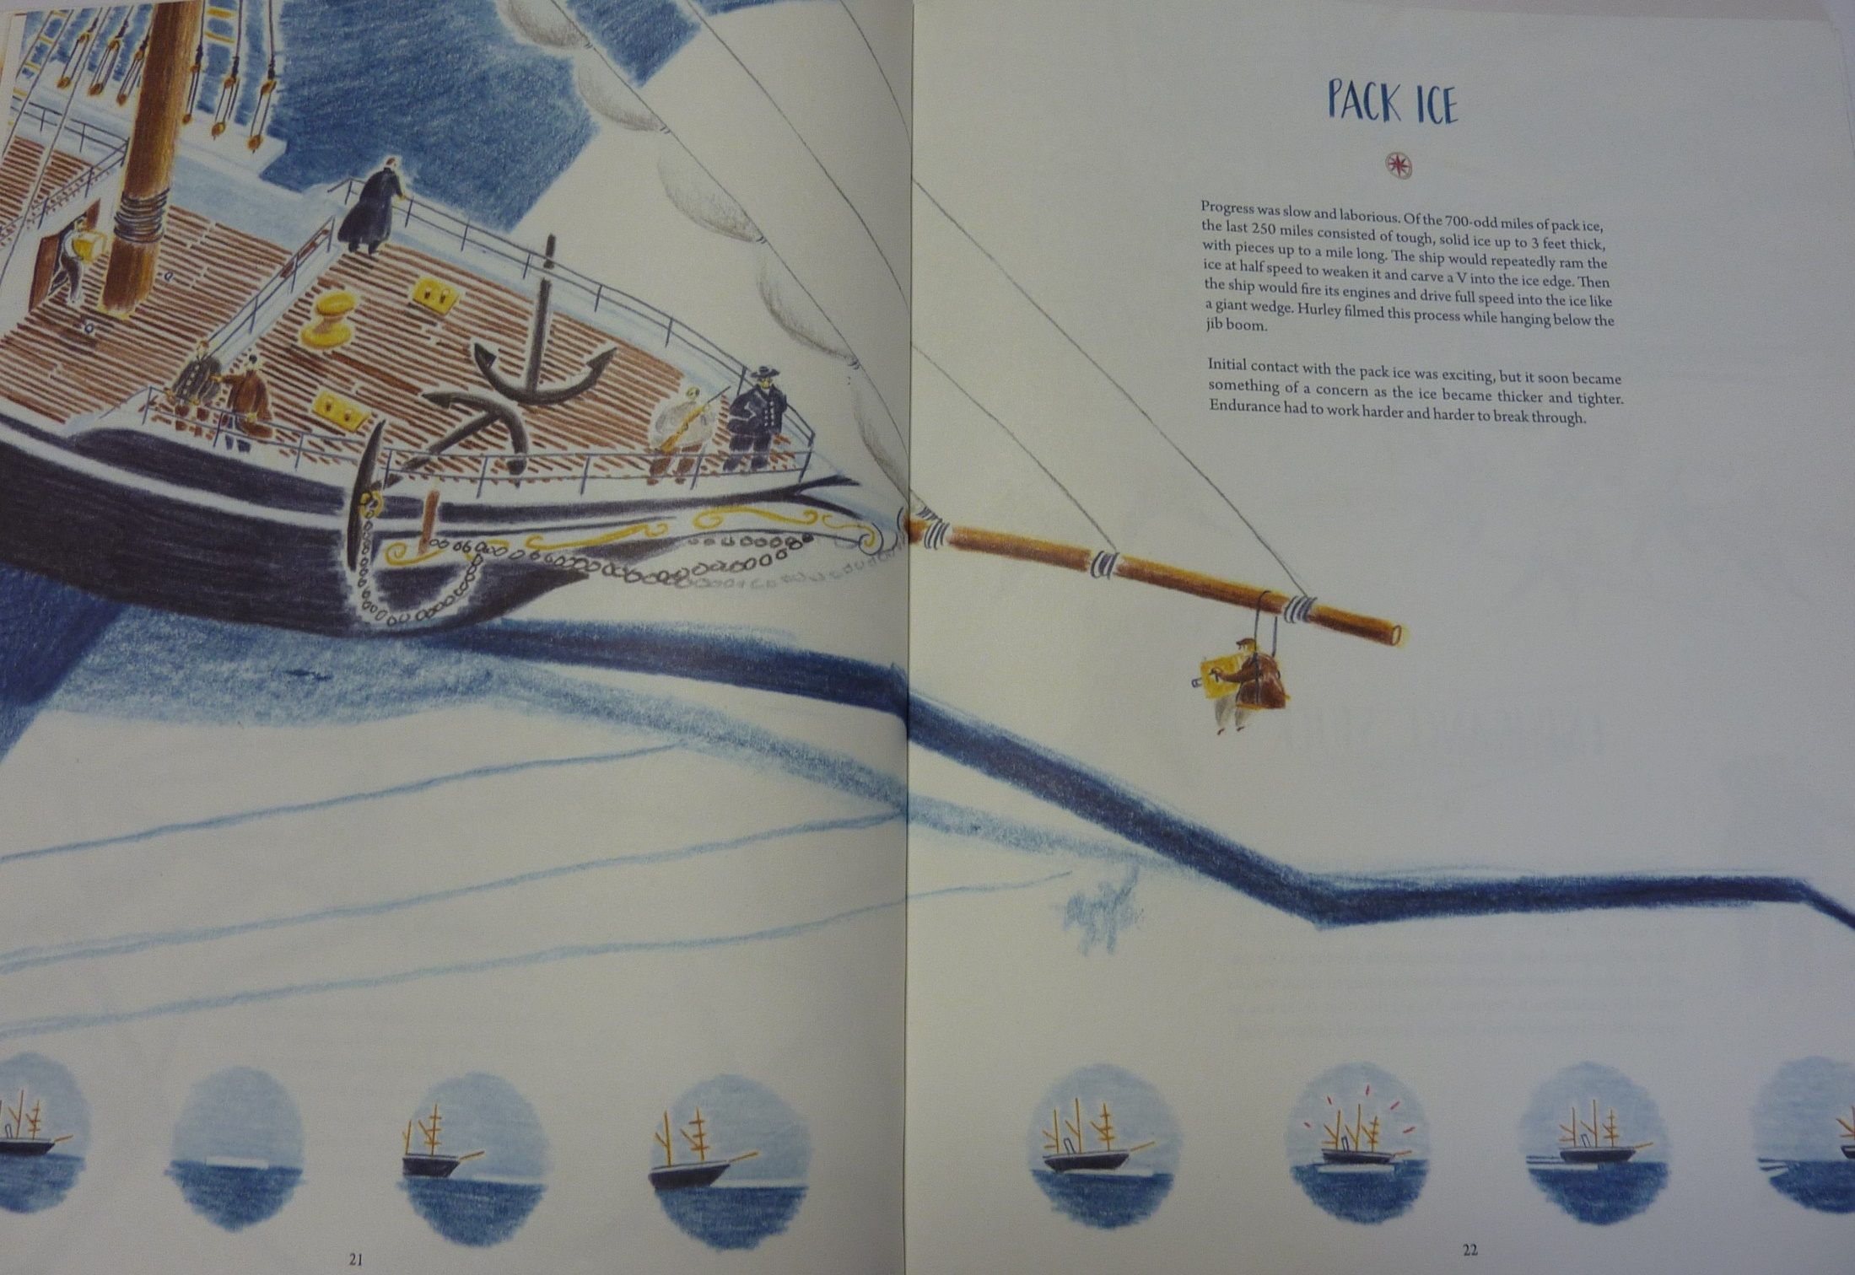

Slide 10
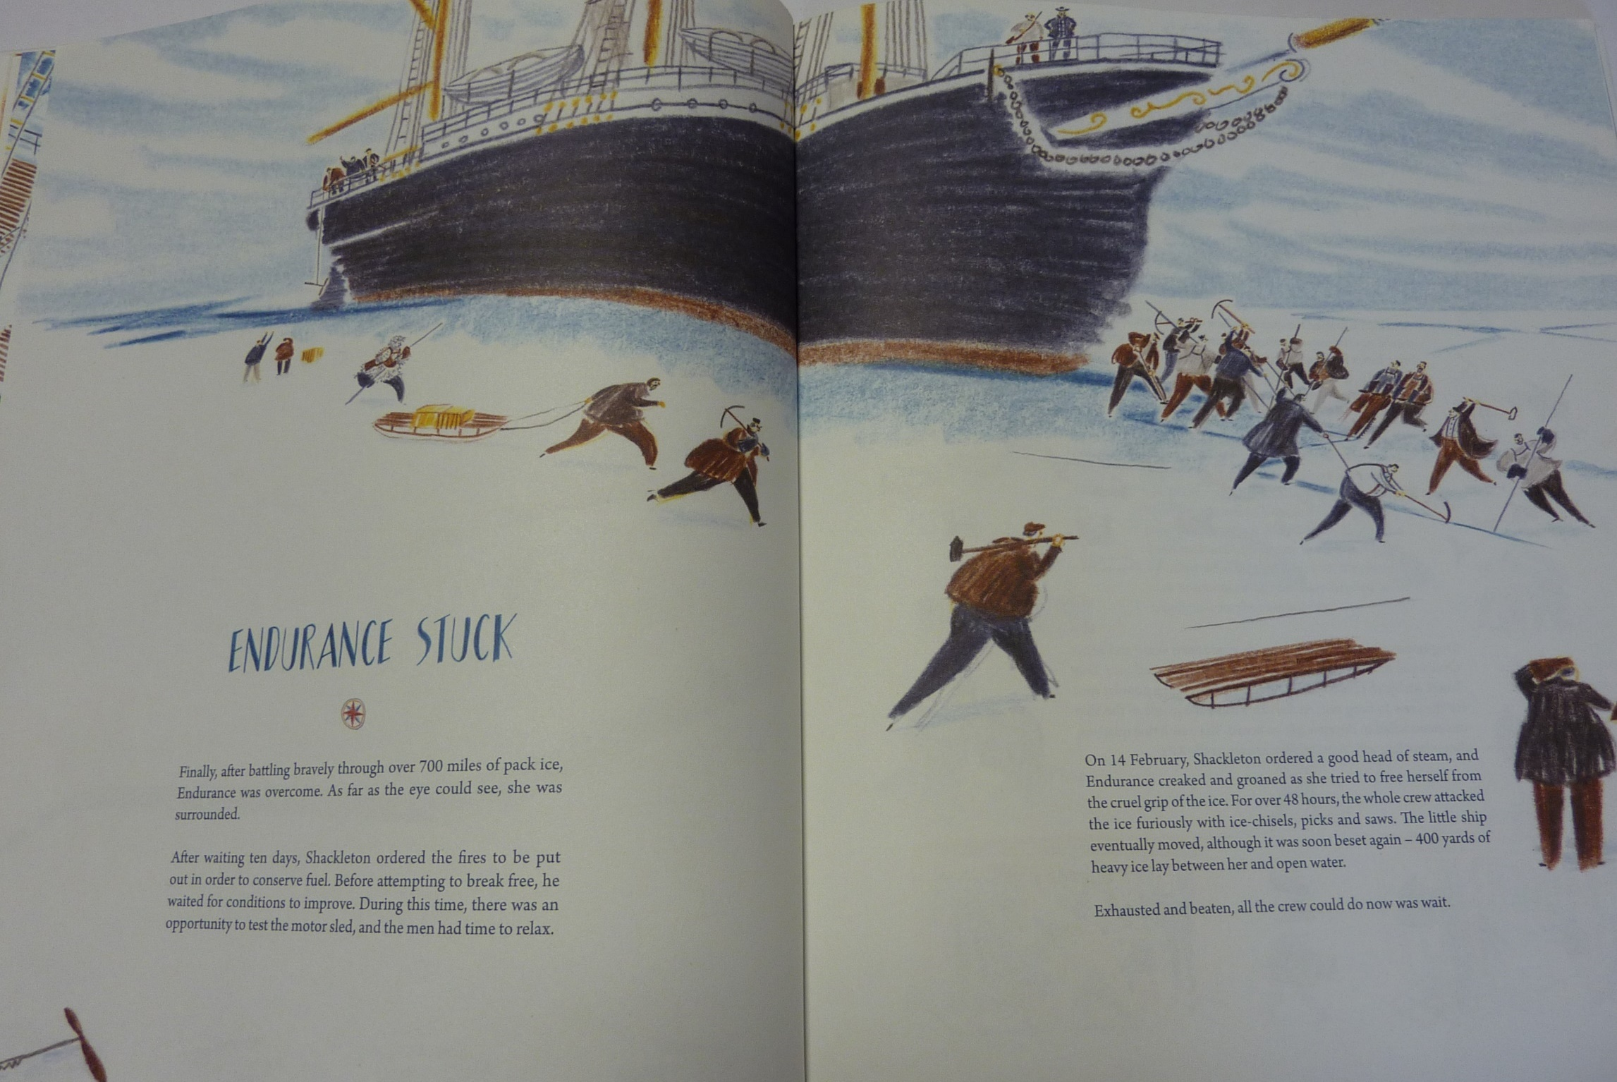

Slide 11
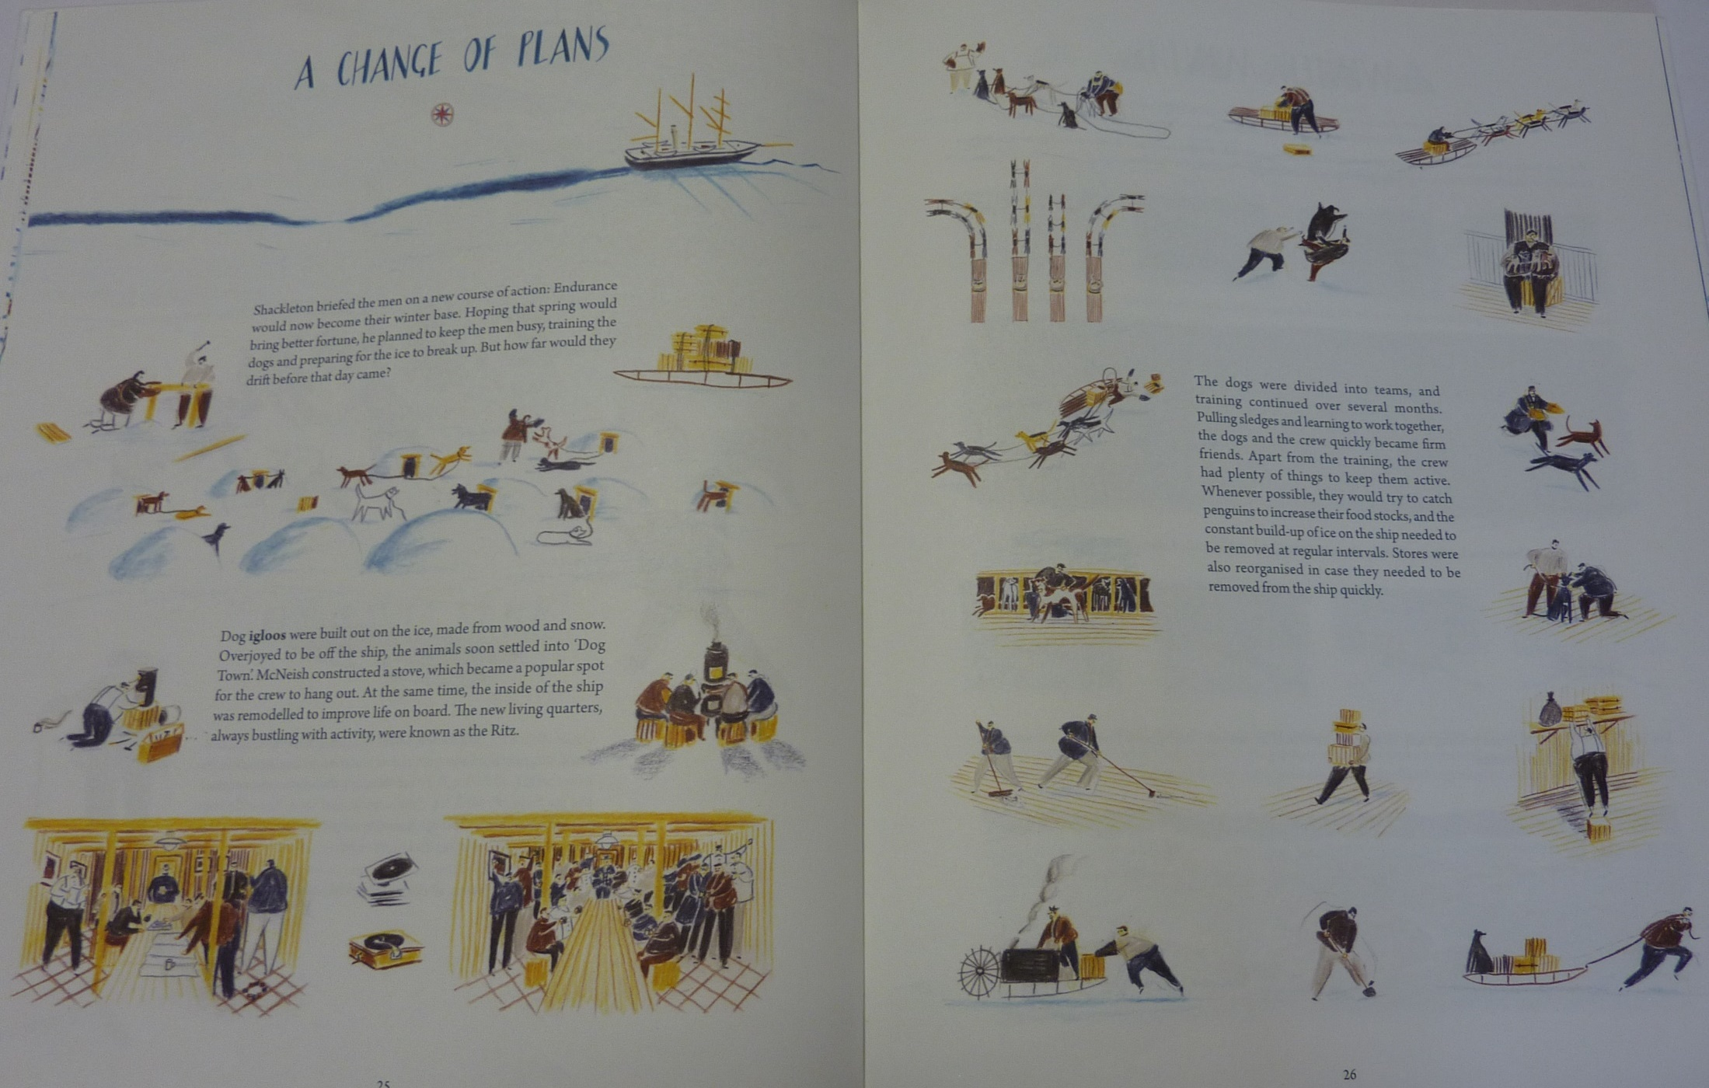

Slide 12

Today I would like you to complete part 3.
1st part – describe the excitement of approaching and reaching Antarctica
2nd part – getting stuck but still optimistic about your chances
3rd part – struggling to stay positive as winter sets in

Slide 13
I will include an example for each part to give you some ideas but feel free to include whatever you want to!
Third Part
http://farnboroughprimary.co.uk/wp-content/uploads/2020/04/diary-part-3.docx
Some useful vocabulary
http://farnboroughprimary.co.uk/wp-content/uploads/2020/04/diary-vocabulary.docx

Slide 14
Physical activity – minimum 30 minutes each day | Link to resource
5 a day User Name: FPS53 / Password: JFz4XqG7 | https://player.5-a-day.tv/
Joe Wicks – PE sessions | https://www.youtube.com/channel/UCAxW1XT0iEJo0TYlRfn6rYQ
Cosmic Kids Yoga | https://www.youtube.com/user/CosmicKidsYoga
PE Hub Parents Portal | https://pehubportal.co.uk/
Go Noodle | https://www.gonoodle.com/good-energy-at-home-kids-games-and-videos/
Go for a walk/run. You must go with an adult from your home and make sure you stay 2 metres away from other people.

Slide 15

Look at these videos about French schools. What words can you remember?
https://www.bbc.co.uk/bitesize/topics/ztfkjxs/resources/1
Check with your parents and see if they are happy for you to sign up to Rosetta Stone:
https://www.rosettastone.co.uk/lp/freeforkids/

