Slide 1
Subject / Lesson | Time
Maths | 1 hour
Grammar | 20 minutes
Comprehension | 20 minutes
English | 40 minutes
Physical Activity | 30 minutes
Art | 30 minutes

Slide 2
Maths Task | Time
SATs style question – try a reasoning set of questions http://farnboroughprimary.co.uk/wp-content/uploads/2020/03/Maths-SATs-questions-links.docx | 40 minutes
Maths Frame Interactive Quiz Username: Farnborough / Password: Farnborough https://mathsframe.co.uk/en/resources/resource/366/interactive-maths-quiz | 10 minutes
Times Table Rock Stars | 10 minutes

Slide 3
Grammar Task | Time
Complete a task from the selection on the website: http://farnboroughprimary.co.uk/wp-content/uploads/2020/03/Year-6-SPAG.zip | 20 minutes

Slide 4
Comprehension Task | Time
Classroom secrets comprehension about Edmund Hillary – http://farnboroughprimary.co.uk/wp-content/uploads/2020/04/Comprehension-Edmund-Hillary-Genius.pdf | 20 minutes
A short documentary about Edmund Hillary
https://www.youtube.com/watch?v=iIqV_JaRnqQ

Slide 5

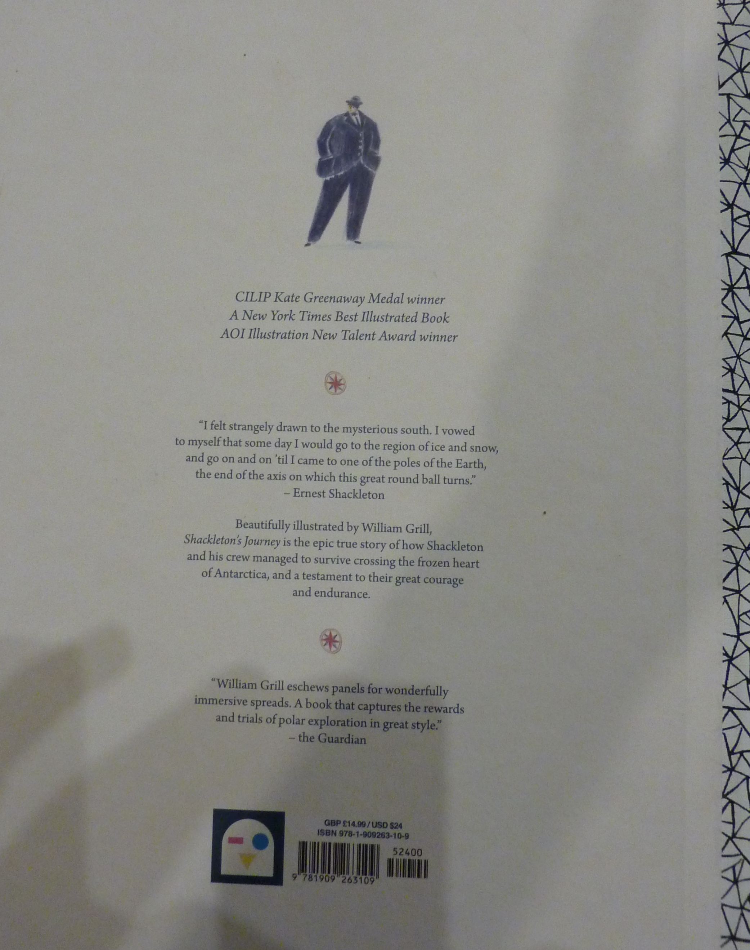

Slide 6
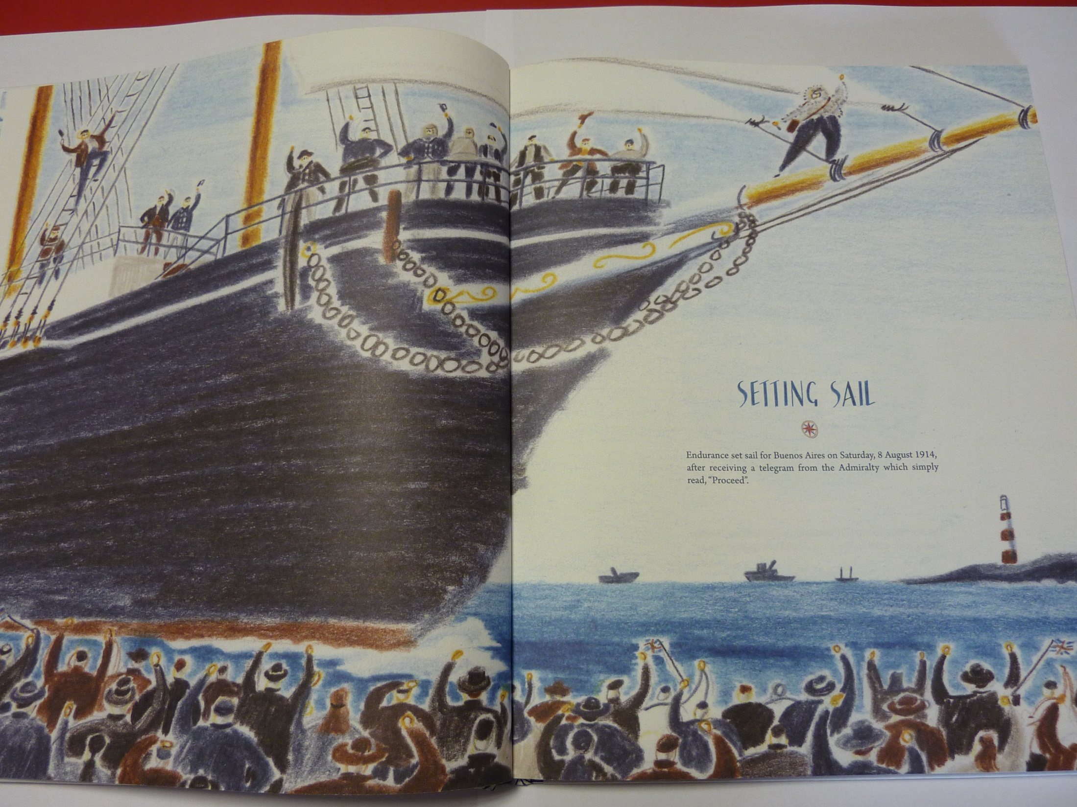

Slide 7

Today I would like to start writing your article.
Remember to include the 5 Ws – Who, When, Where, What, Why
The first paragraph should summarise the whole story.
Make sure you use the quotes you created yesterday.

Slide 8
If you become stuck, read through the Greta Thunberg article for ideas and check the plan.
http://farnboroughprimary.co.uk/wp-content/uploads/2020/04/Shackleton-Newspaper-outline.docx
Report about Greta Thunberg Setting off across Atlantic
https://www.bbc.co.uk/news/uk-england-devon-49330423

Slide 9
Physical activity – minimum 30 minutes each day | Link to resource
5 a day User Name: FPS53 / Password: JFz4XqG7 | https://player.5-a-day.tv/
Joe Wicks – PE sessions | https://www.youtube.com/channel/UCAxW1XT0iEJo0TYlRfn6rYQ
Cosmic Kids Yoga | https://www.youtube.com/user/CosmicKidsYoga
PE Hub Parents Portal | https://pehubportal.co.uk/
Go Noodle | https://www.gonoodle.com/good-energy-at-home-kids-games-and-videos/
Go for a walk/run. You must go with an adult from your home and make sure you stay 2 metres away from other people.

Slide 10

Pick a character from the link below and have a go at drawing it. If you can, email a picture in to admin.office@Farnborough.Bromley.sch.uk and I will put them on the website for us all to enjoy.
http://www.robbiddulph.com/draw-with-rob

