Slide 1
Subject / Lesson | Time
Maths | 1 hour
Grammar | 20 minutes
Comprehension | 20 minutes
English | 40 minutes
Physical Activity | 30 minutes
Science | 30 minutes

Slide 2

Maths Task | Time
Work from CGP book | 30 minutes
Maths Frame Username: Farnborough / Password: Farnborough https://mathsframe.co.uk/en/resources/resource/366/interactive-maths-quiz Find some Shape games to play to practice your knowledge about shape. | 30 minutes

Slide 3
Grammar Task | Time
Continue working through the CGP Grammar and Punctuation books | 20 minutes

Slide 4
Comprehension Task | Time
Continue working through the Nelson Comprehension book | 20 minutes

Slide 5

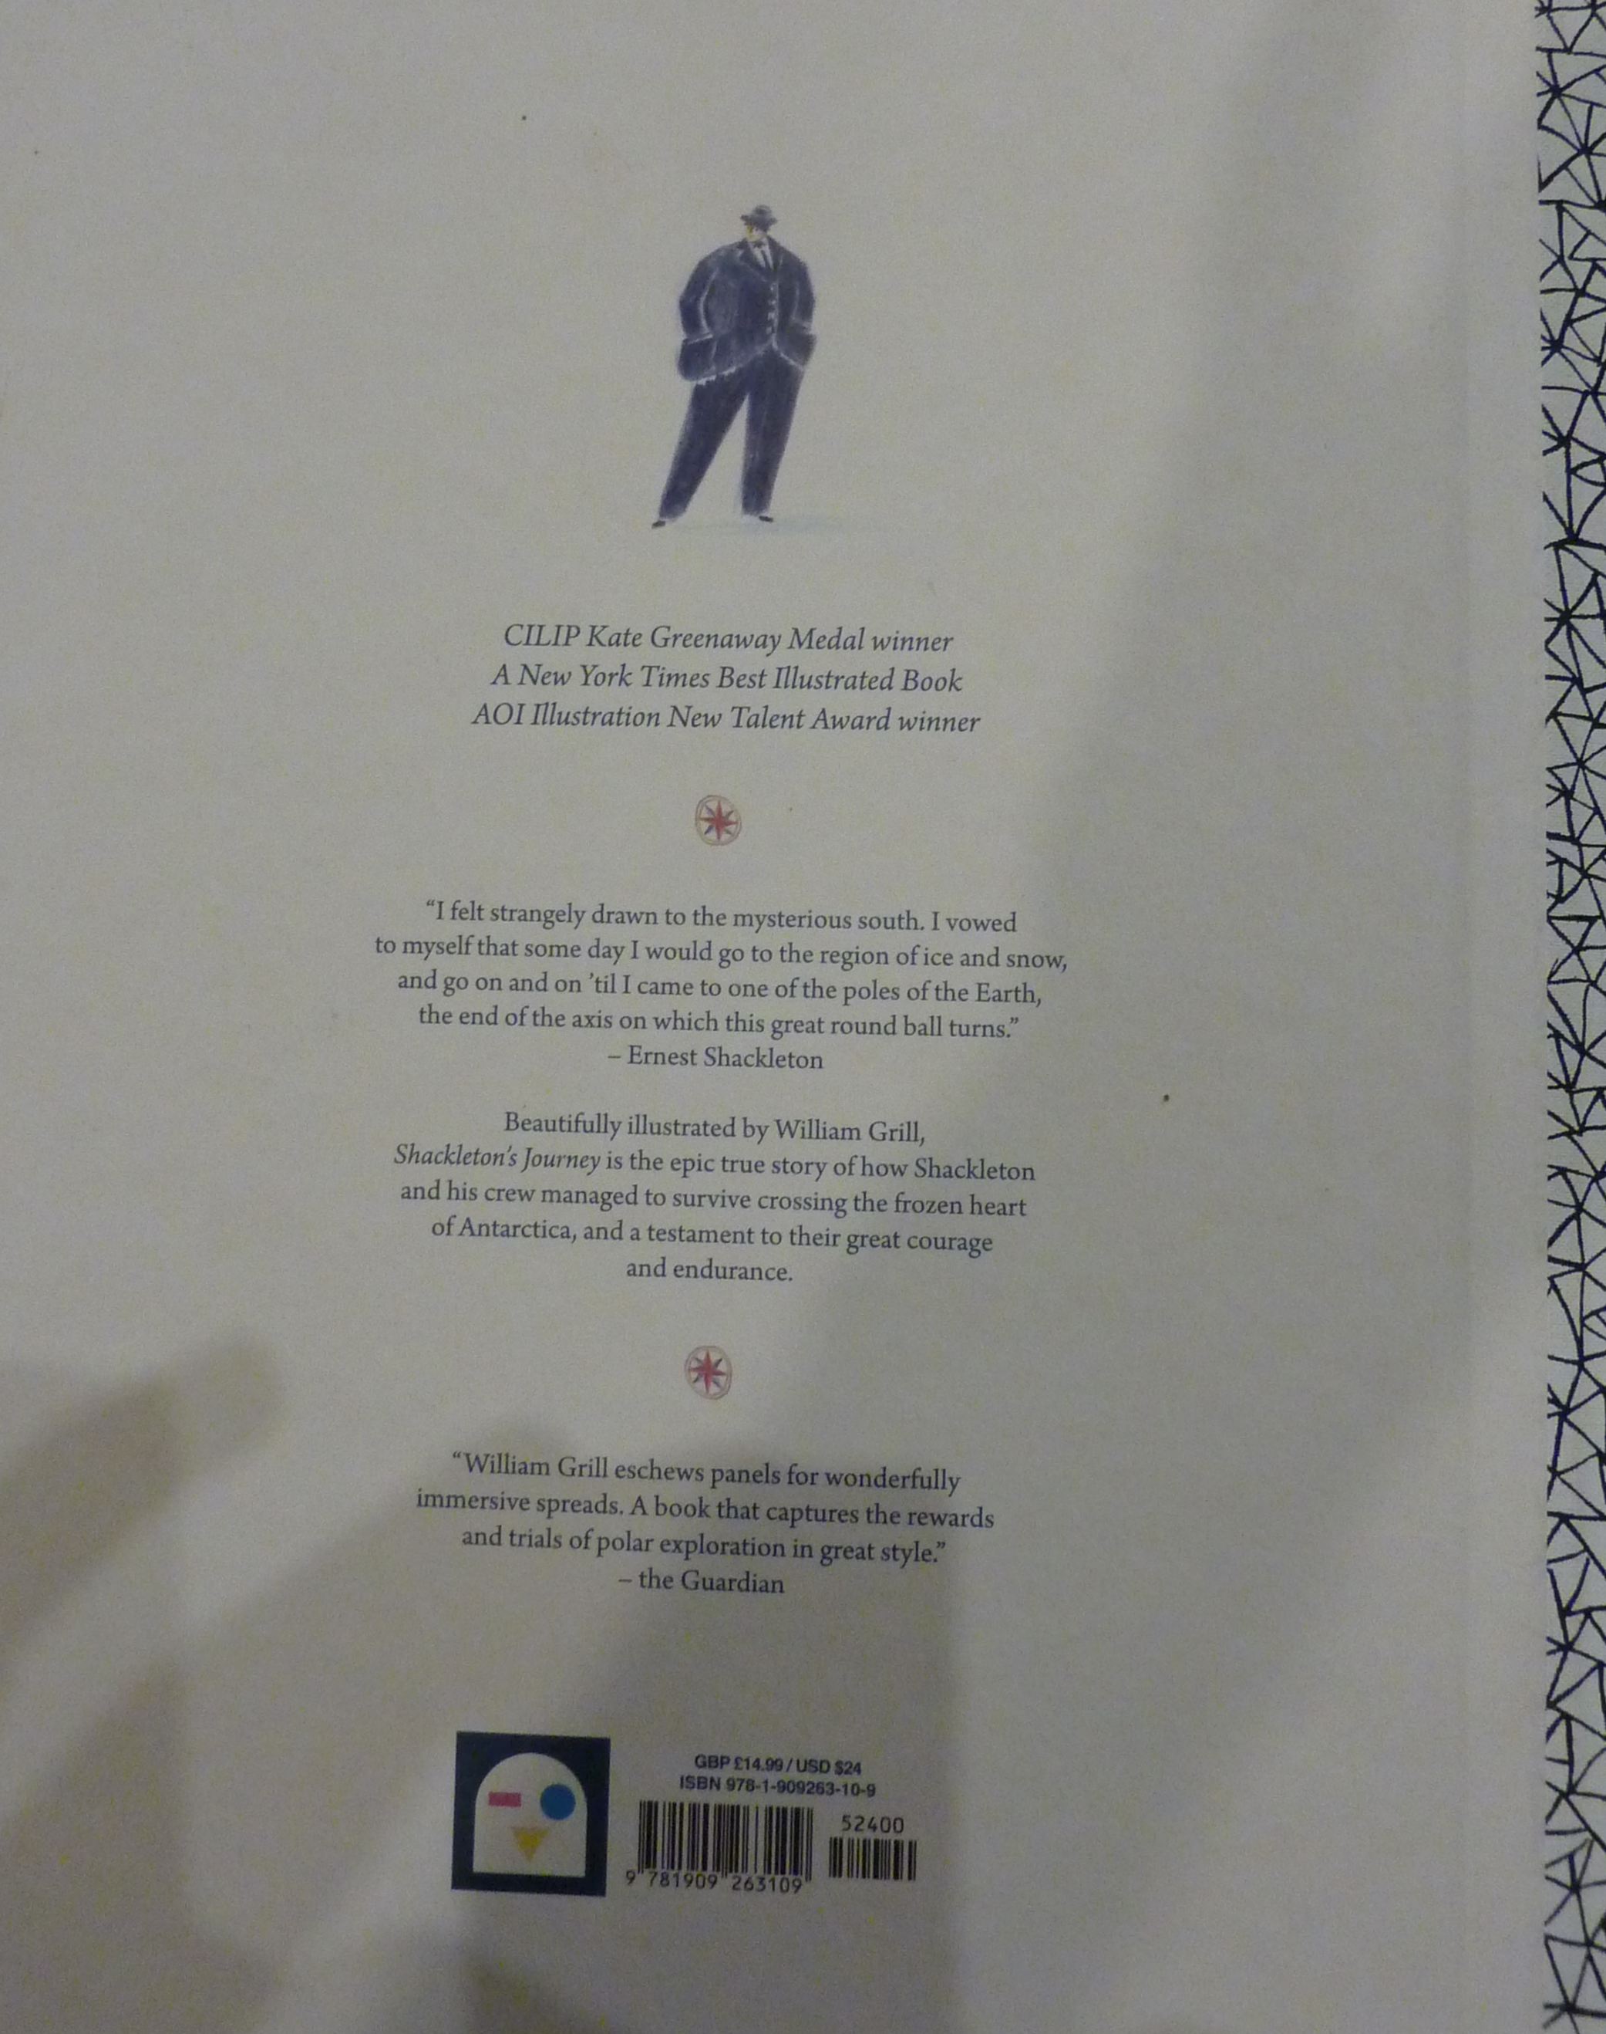

Slide 6
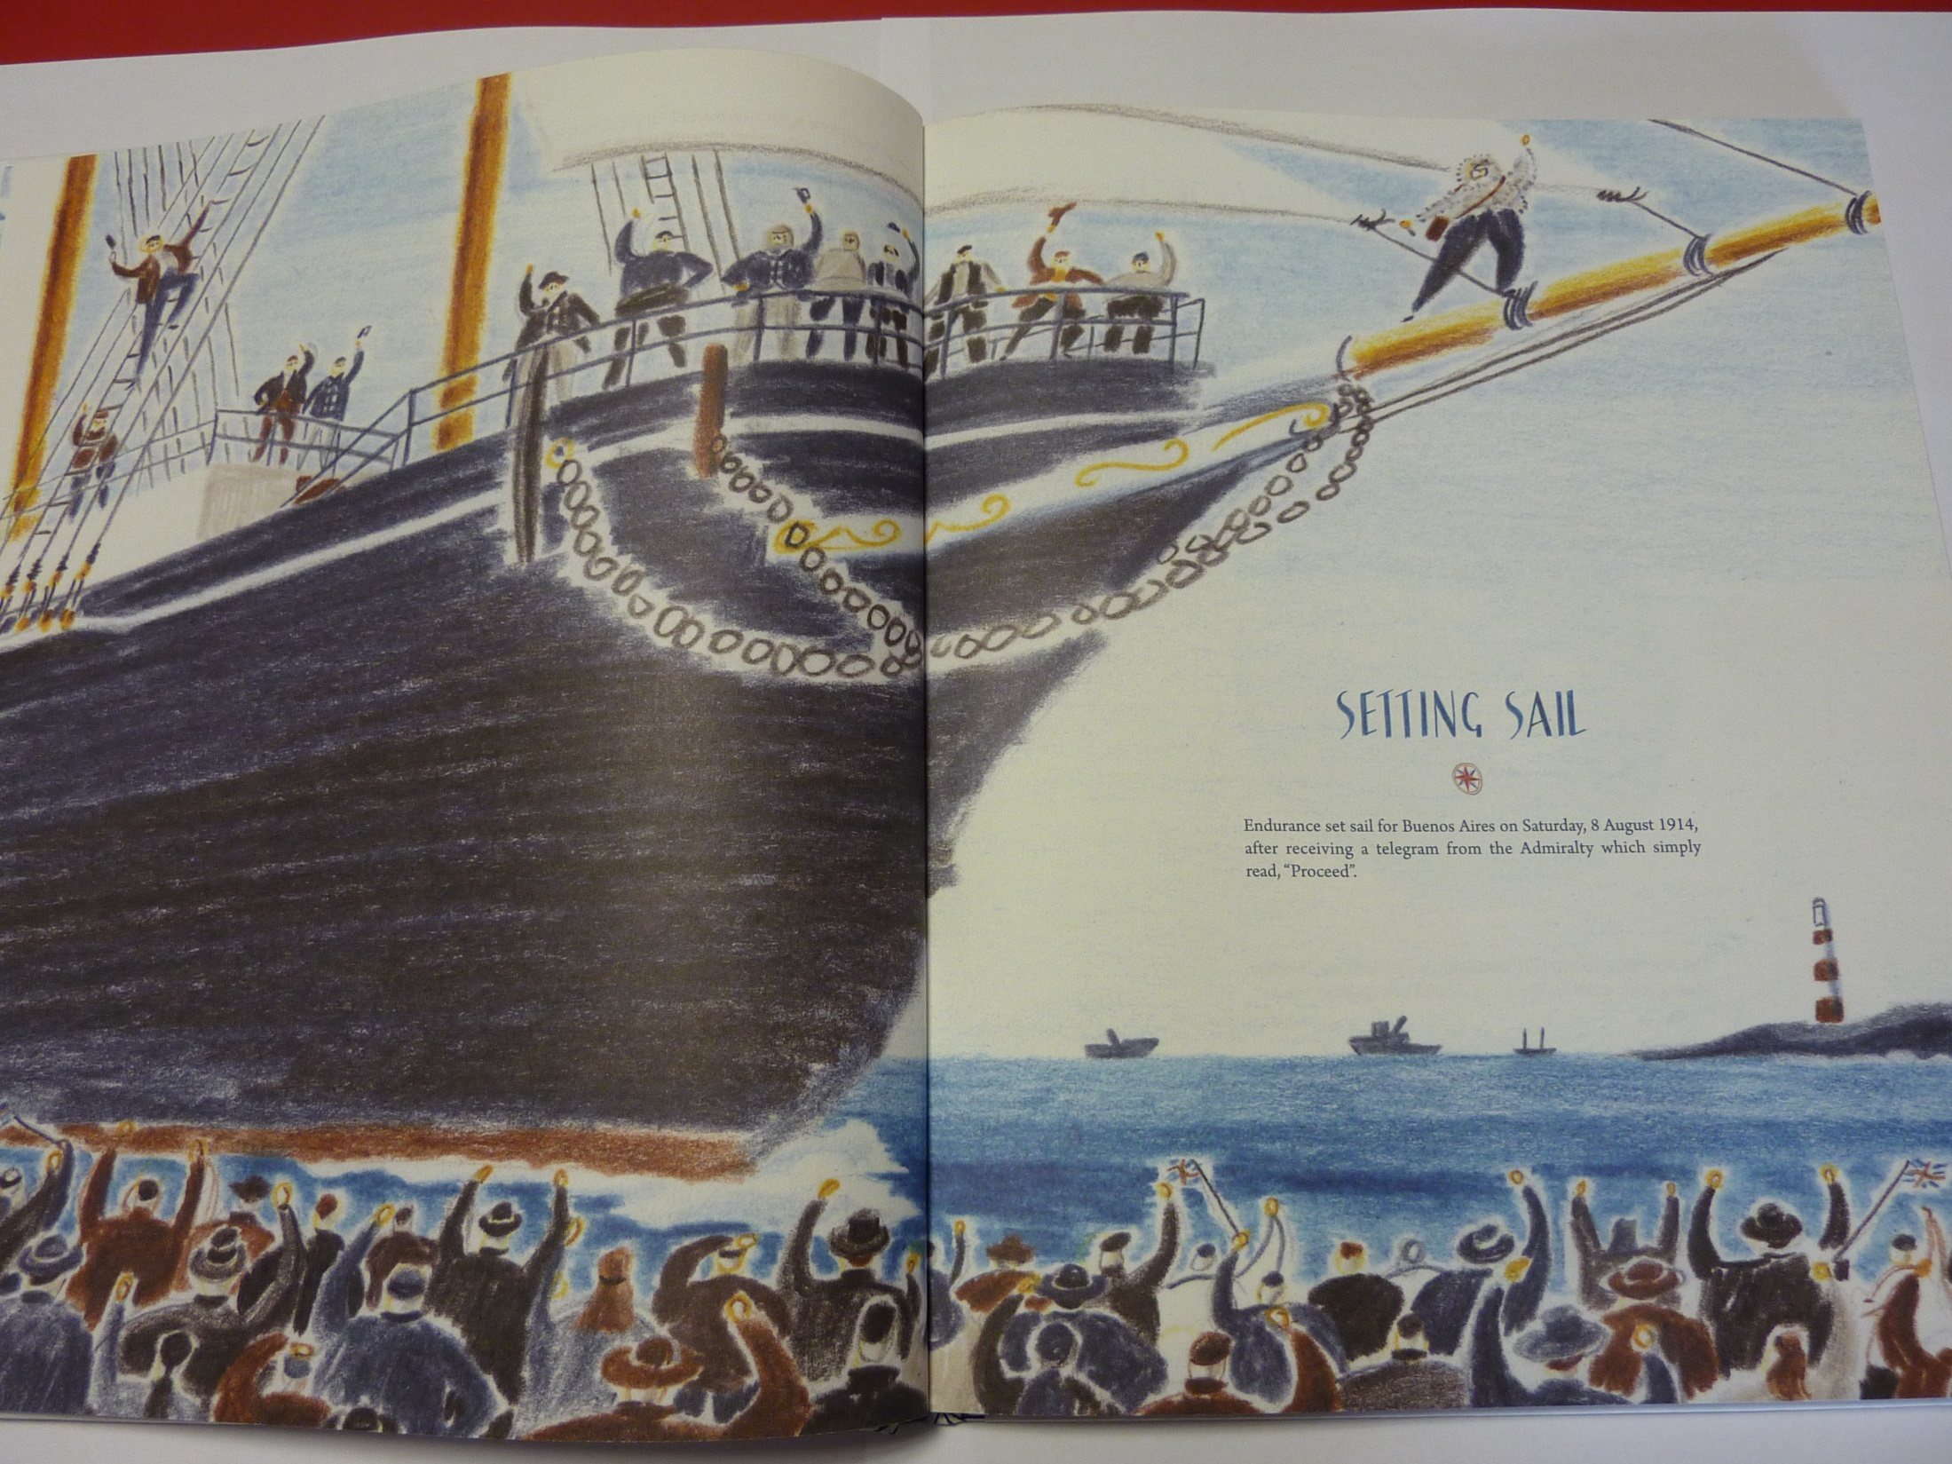

Slide 7

I would like you to write a newspaper article about Shackleton setting off on his adventure. We will write this over 3 days.
Today I would like to create some quotes to use in your article and plan the sections you will write.
On the next page, I have provided some ideas for people you could create quotes for.

Slide 8
Ideas for people you could create quotes for:
Shackleton – he will say what a great honour it is
Young boy on quay – will want to grow up to explore
An old man – proud
Member of crew’s family – worried about danger
Soldier – thinks they should be going to war
Who else can you create a quote for?
Can you write a quote showing an accent? E.g. What’s ‘e up ta? We is mighty concerned about ‘is chances.

Slide 9
Plan what you will write about
You can the ideas from the link below to help you.
Remember, you can add ideas or remove ideas. Make the article interesting for you.
http://farnboroughprimary.co.uk/wp-content/uploads/2020/04/Shackleton-Newspaper-outline.docx
Report about Greta Thunberg Setting off across Atlantic
https://www.bbc.co.uk/news/uk-england-devon-49330423

Slide 10
Physical activity – minimum 30 minutes each day | Link to resource
5 a day User Name: FPS53 / Password: JFz4XqG7 | https://player.5-a-day.tv/
Joe Wicks – PE sessions | https://www.youtube.com/channel/UCAxW1XT0iEJo0TYlRfn6rYQ
Cosmic Kids Yoga | https://www.youtube.com/user/CosmicKidsYoga
PE Hub Parents Portal | https://pehubportal.co.uk/
Go Noodle | https://www.gonoodle.com/good-energy-at-home-kids-games-and-videos/
Go for a walk/run. You must go with an adult from your home and make sure you stay 2 metres away from other people.

Slide 11

Design a new animal
Draw a picture of the animal
Draw a picture of the habitat it lives in
Label the features of the animal that makes it well suited to its habitat
(On the next page are things to consider about your animal)

Slide 12
Questions to consider
What covers the skin – fur, scales, shell?
How tall/small is the animal?
How many arms or legs?
How big are the eyes, ears, nose?
How do the animals communicate?
Do they live alone, in pairs or in packs?
Do they need to adapt to changing seasons?

