Slide 1
Subject / Lesson | Time
Maths | 1 hour
Grammar | 20 minutes
Comprehension | 20 minutes
English | 40 minutes
Physical Activity | 30 minutes
Science | 30 minutes

Slide 2
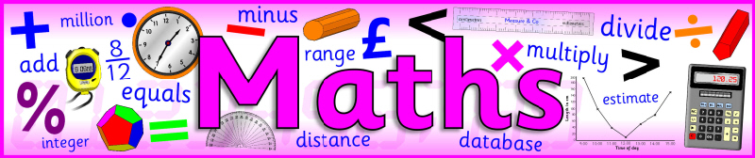
Maths Task | Time
SATs style question – try an arithmetic set of questions http://farnboroughprimary.co.uk/wp-content/uploads/2020/03/Maths-SATs-questions-links.docx | 30 minutes
Maths Frame Interactive Quiz Username: Farnborough / Password: Farnborough https://mathsframe.co.uk/en/resources/resource/366/interactive-maths-quiz | 15 minutes
Times Table Rock Stars | 15 minutes

Slide 3
Grammar Task | Time
Continue working through the Nelson Grammar book | 20 minutes

Slide 4
Comprehension Task | Time
Continue working through the CGP Poetry and Non-fiction books | 20 minutes

Slide 5

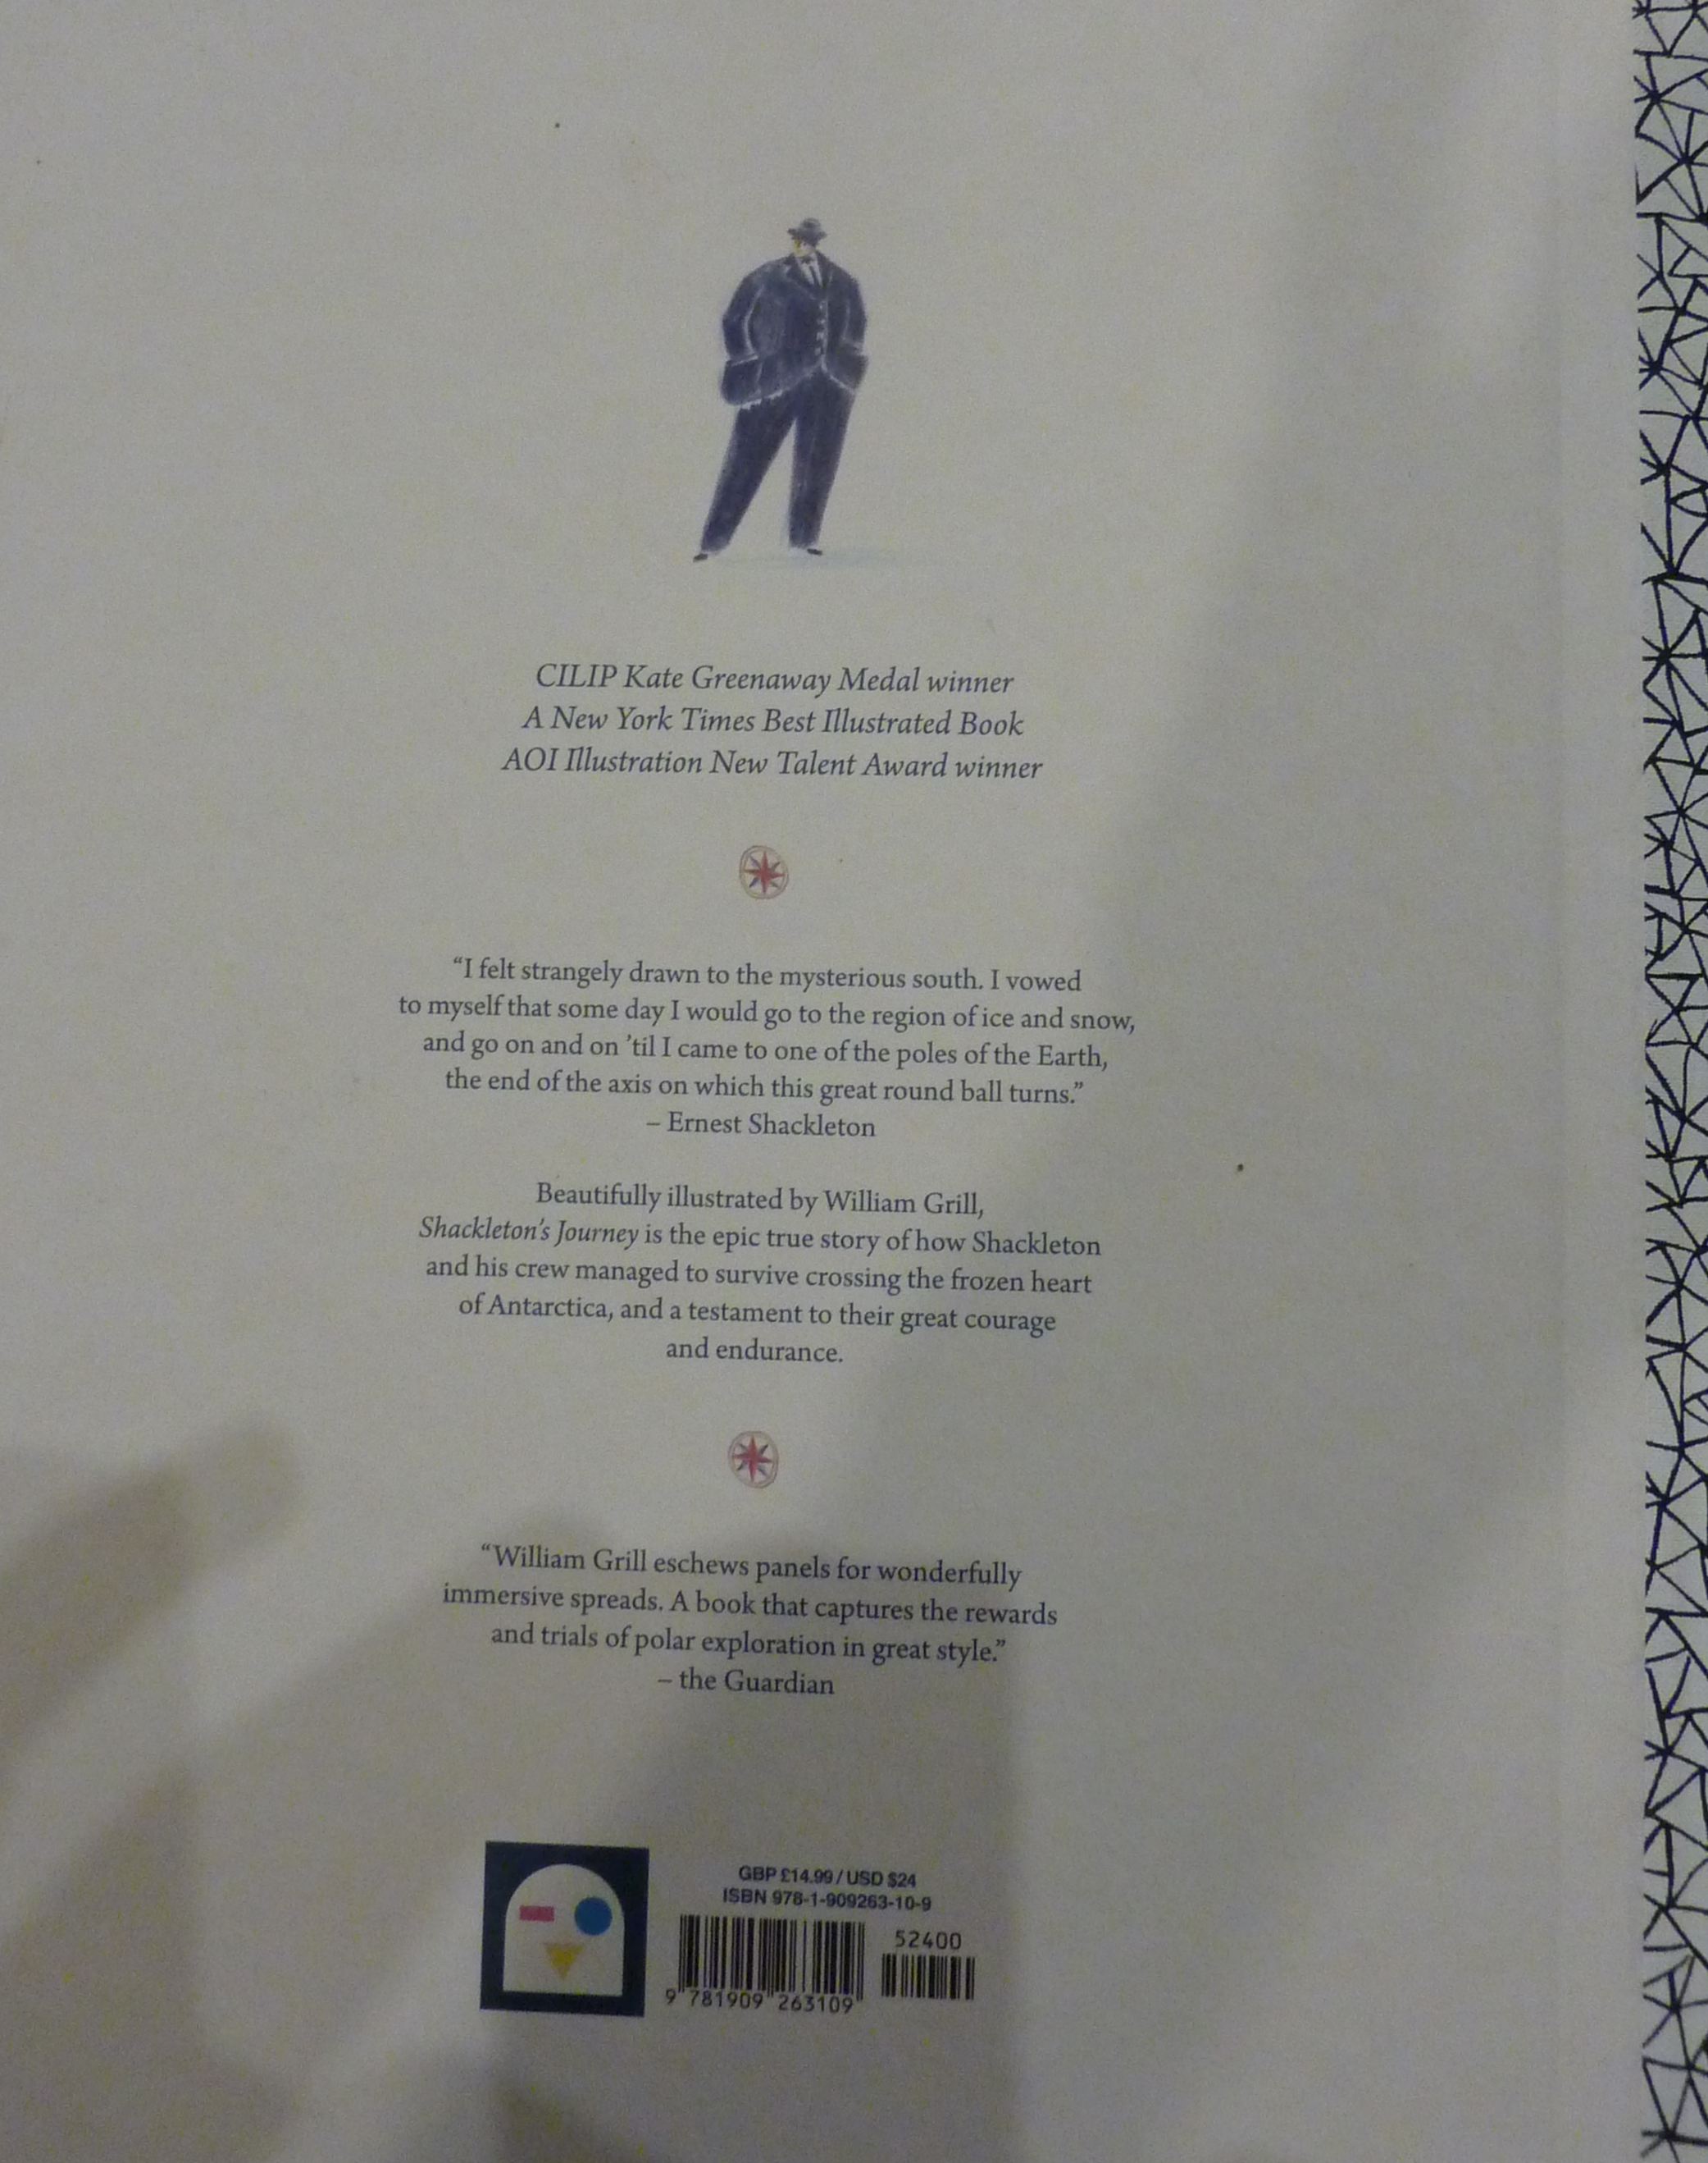

Slide 6
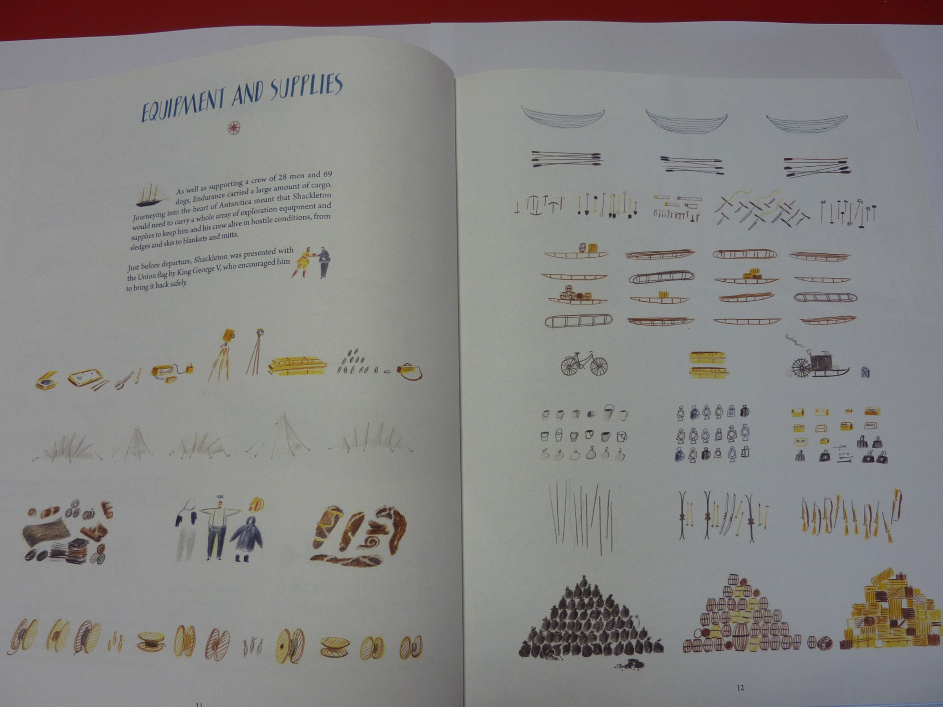

Slide 7
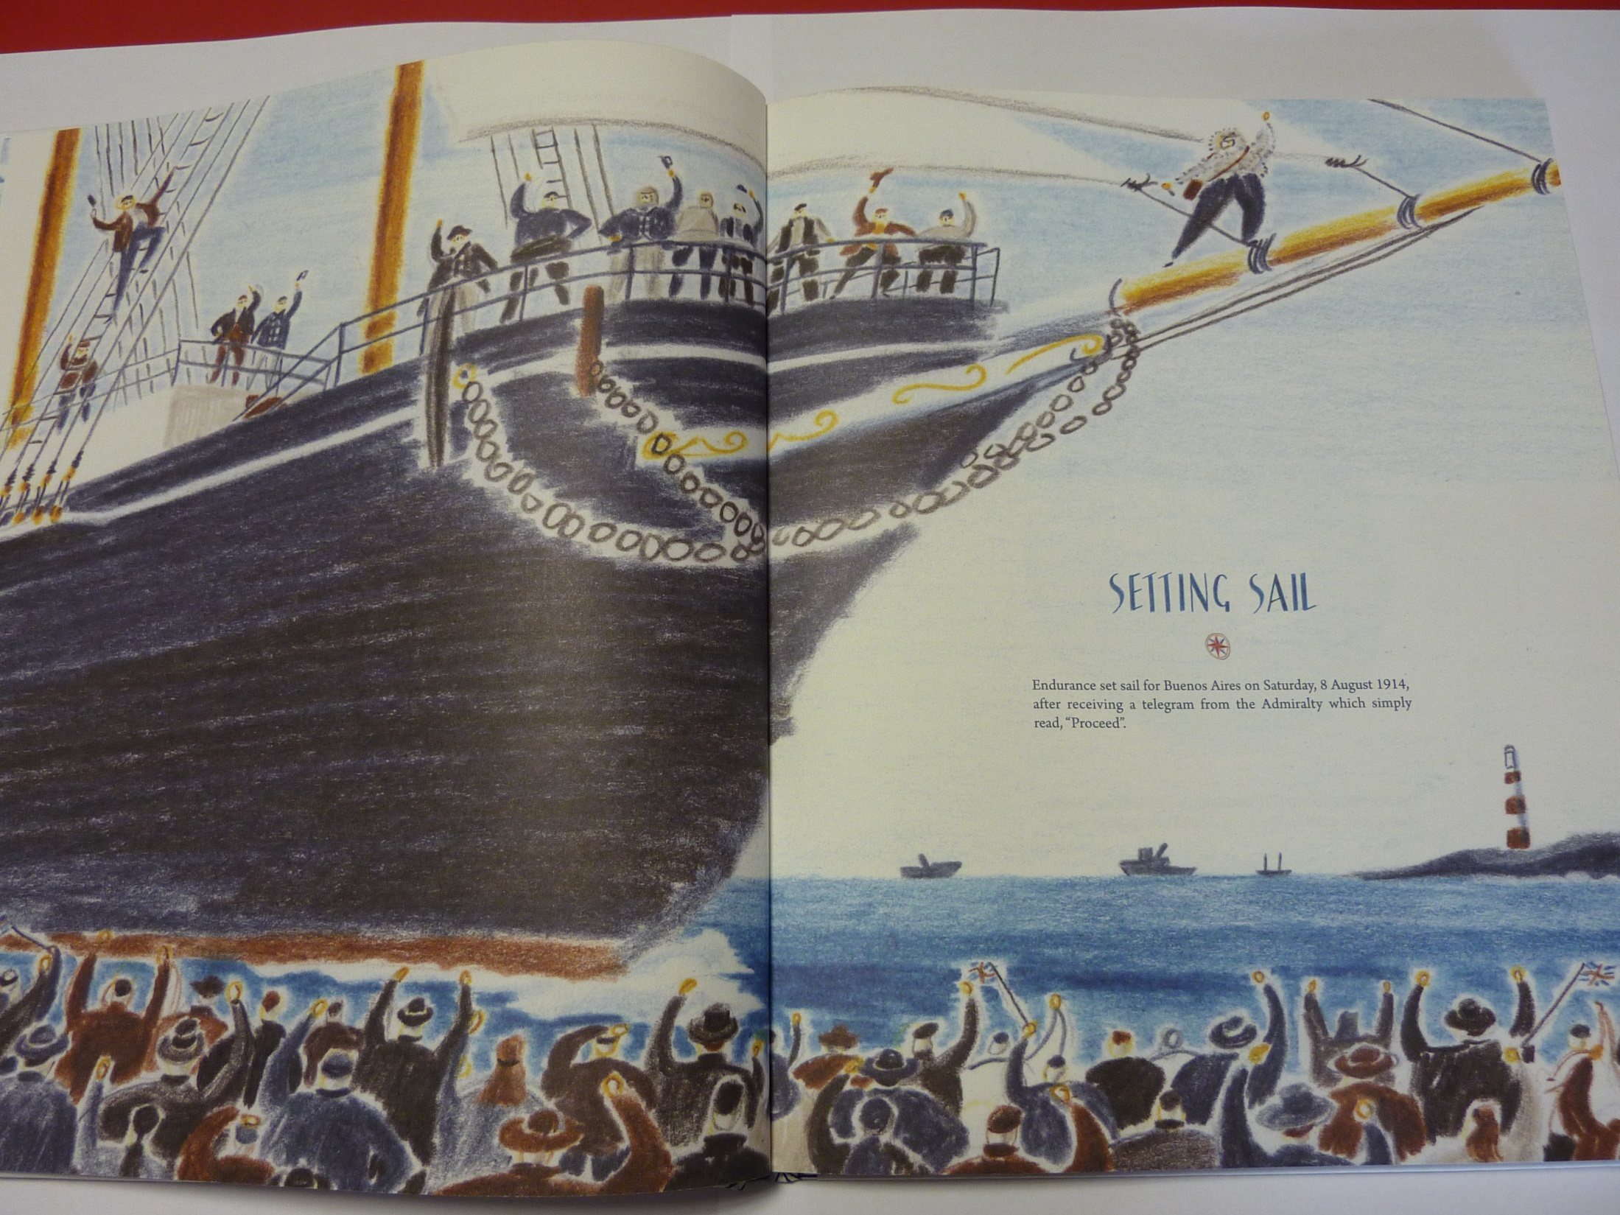

Slide 8

As people lined the docks, they were filled with excitement, pride and wonder.
Why are people fascinated by explorers and adventurers?

Slide 9
Read the report below:
Report about Greta Thunberg Setting off across Atlantic
https://www.bbc.co.uk/news/uk-england-devon-49330423

Slide 10
Physical activity – minimum 30 minutes each day | Link to resource
5 a day User Name: FPS53 / Password: JFz4XqG7 | https://player.5-a-day.tv/
Joe Wicks – PE sessions | https://www.youtube.com/channel/UCAxW1XT0iEJo0TYlRfn6rYQ
Cosmic Kids Yoga | https://www.youtube.com/user/CosmicKidsYoga
PE Hub Parents Portal | https://pehubportal.co.uk/
Go Noodle | https://www.gonoodle.com/good-energy-at-home-kids-games-and-videos/
Go for a walk/run. You must go with an adult from your home and make sure you stay 2 metres away from other people.

Slide 11
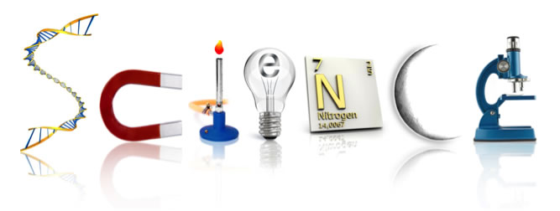
Sign up for a BBC account (ask your parent to do so)
Listen to this explanation by David Attenborough of evolution: https://www.bbc.co.uk/sounds/play/p07f45xx
Whilst listening, think and sketch some ideas for a new animal. You will be creating an information sheet tomorrow.

