Slide 1
Good morning Unicorns!
Here’s your work for today: Wednesday 22nd April

Slide 2
Reading answers from yesterday:
Pages 22-23
Hair
Six
A buzz
Purple, yellow, blue
A sugary liquid
The waggle dance
Page 24
Afraid
To keep the honey and save it for later
Hard

Slide 3
Reading answers from yesterday:
Pages 25-26
Stay still
They are bright colours
They are hairy
How far away the food is
There will be more food for them to eat.
Page 26- Sequence of Events Question
2, 4, 1, 3

Slide 4
Reading online
Please log on to Bug Club and read for at least 15 minutes.
Make sure you answer your bug questions!

Slide 5
Maths answers from yesterday:
Pages 30 and 31
Second see-saw ticked.
12g < 22g, 16m > 10m, 13 °C < 31 °C , 10ml = 10ml
Volume of bucket < Volume of vase
1m, 2m, 10m, 20m, 120m
3kg, 4kg parcels
Rectangle B, Rectangle C
Challenge

Slide 6
Maths answers from yesterday:
End of Unit Check
D
C
A
B
C
Think!
You could have sorted the fractions in various ways, E.g.:
All of the denominators are the same/different…
These fractions all make the same/a different amount…

Slide 7
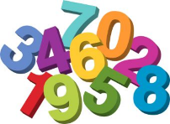
Maths
Today we are going to look at money.

Slide 8
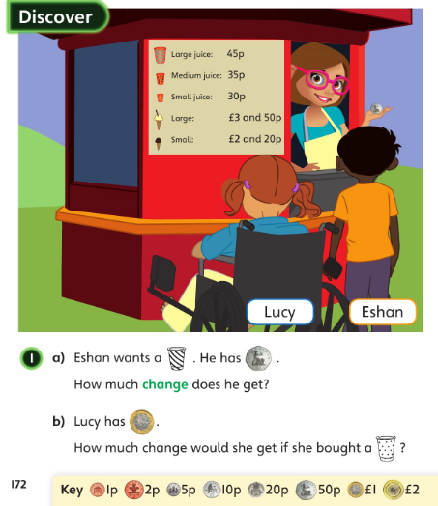
Let’s look at the answers and how you could have worked them out on the next page…

Slide 9
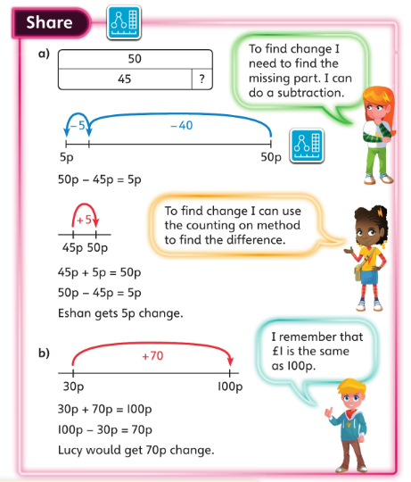
a). Which is the best method to use? Subtraction or counting on to find the difference?
b). How can your number bonds to 10 help you with this question?

Slide 10
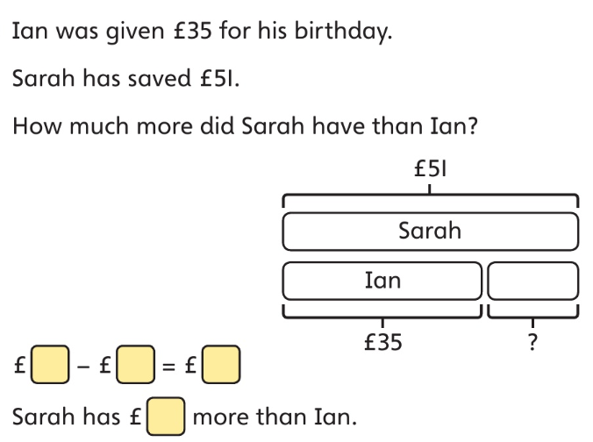
£51 – £35 = £16.
Sarah has £16 more than Ian.

Slide 11
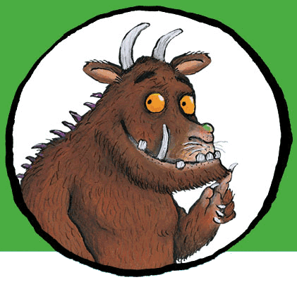
Now I would like you to have a go at completing work in your CGP Maths Reasoning workbook.
If you would like to try Gruffalo work, complete pages 32 and 33.
If you would like to try Horrid Henry work, complete pages 32, 33 and 34.
If you would like to try James and the Giant Peach work, complete pages 32, 33, 34 and my Challenge question on the next slide.

Slide 12
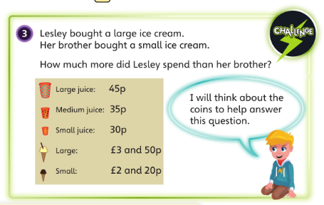

Slide 13
Handwriting
Please complete pages 16 and 17 in your CGP Handwriting Book

Slide 14
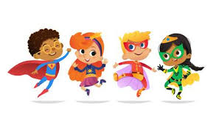
English
Today you are going to write your second subheading.
Have a think about these things:
What superpowers do they have?
What is their special superpower? How do their superpowers work? What do they use their superpowers for? Why do they use their powers? Who do they help?
Look on the next slide for an example of what your second subheading may look like …

Slide 15
What superpowers do they have?
The Super Tutor’s superpowers include flying and having a bulging brain full of knowledge to share with friends. How can she fly? Well, she designed her own beautiful blue cape which can transport her to anyone needing help with their learning. When she puts the cape on, clicks her heels together and then pulls the activation chord, then whoosh, she can fly. To share her braininess with people she simply closes her eyes tight and the knowledge floats from her brain into her student’s brain. How astonishing!

Slide 16
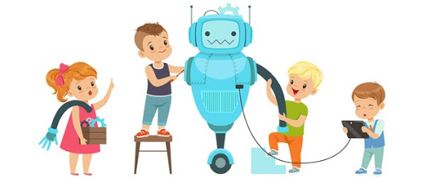
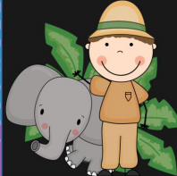
D.T Today I would like you to make an origami zoo or farm…
Become a miniature zookeeper!

Slide 17
How many different animals can you create? Click on this link for animal ideas: https://zoo.sandiegozoo.org/live-cams Here are some instructions on how to make different types of animals: https://www.origamiway.com/easy-origami-animals-for-kids.shtml

Slide 18
Enjoy, Unicorns!

