Slide 1
Good Morning Elves!
Well done for your
super work yesterday.

Slide 2
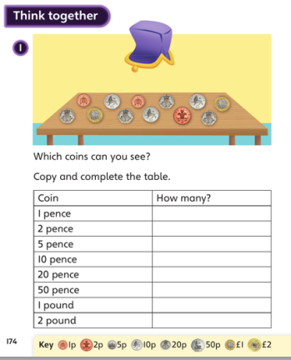
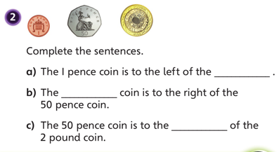
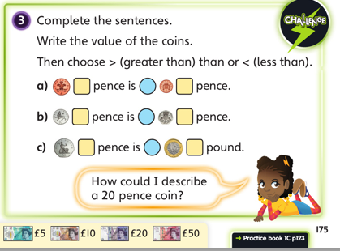
Green group
Maths Challenge
Monday Answers
1. 1p = 2
2p = 1
5p =0
10p=3
20p=3
50p =0
£1 = 0
£2 = 2
2. a)50 pence coin
b) £2 pound coin
c) left
3. 2pence > 1pence
b)5pence<20pence
c)50pence<1 pound
A 20 pence coin is silver and has 7 seven sides (a heptagon) Find a 20 pence coin at home and have a look.

Slide 3
It’s Tuesday!
Tuesday 21st April 2020
Here’s your work for today…
.

Slide 4
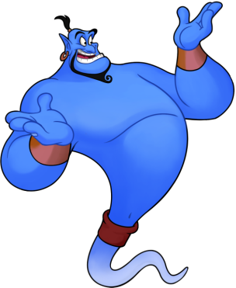
Reading online
I’m so impressed with your reading Elves.
You should be very proud of yourselves!
Please log on to Bug Club
Read for at least 15 minutes.
Please read the key words inside the front cover first.
When you find the bug questions, click and complete them.
Please note down the books you’ve read in your reading
record book.
Your personal login details are on the inside of your reading record book.

Slide 5
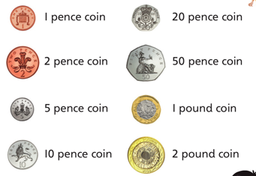
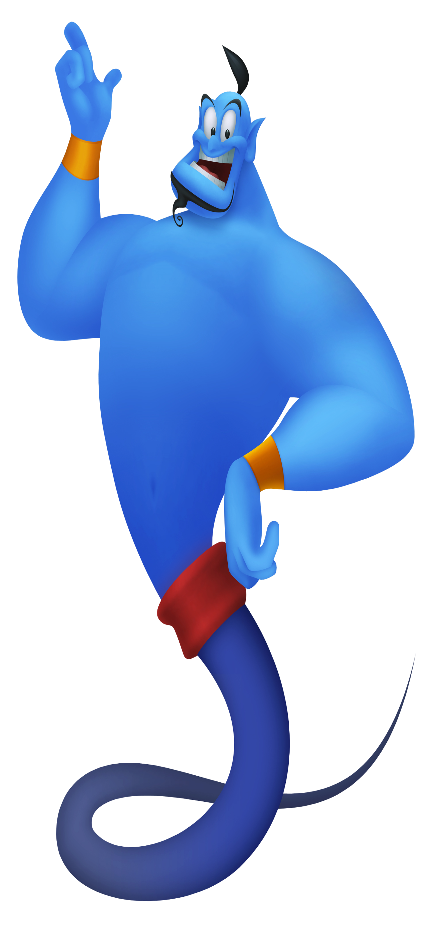
Maths
Today we are going to continue to look at money.

Slide 6
Maths
Have a go at reading these words with your grown up. Can you remember some of these from yesterday?

Slide 7
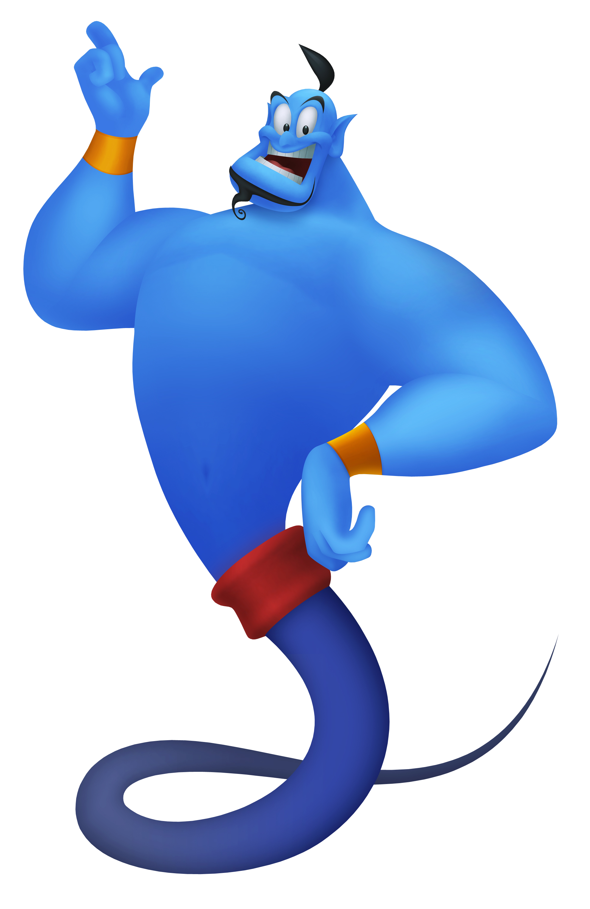
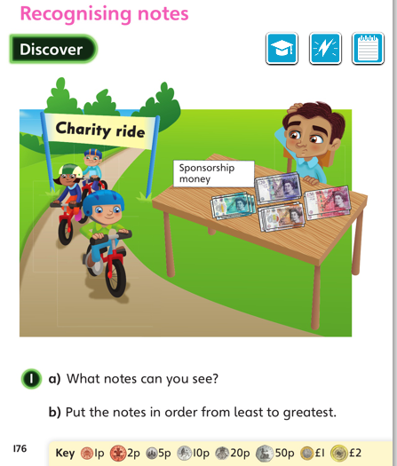
Green group
Maths
Let’s look at the next page to find out the answers and how you could have worked them out.

Slide 8
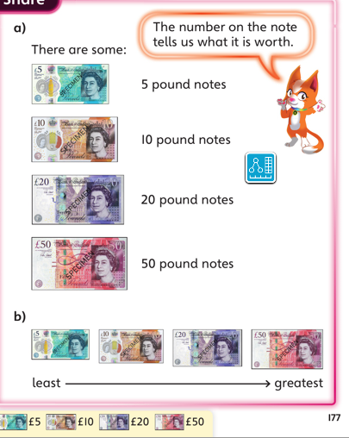
Green group
Maths
a) Which notes can you see?
b)How do you know the notes are in order?

Slide 9
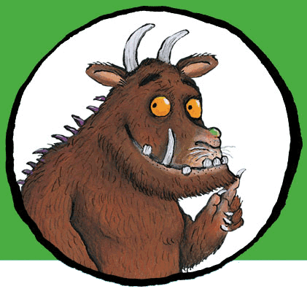
For today’s work, complete the slides which follow in your blue books. .
If you would like to try Gruffalo work, complete challenge 1 on the next page.
If you would like to try Horrid Henry work, complete challenges 1 and 2
If you would like to try James and the Giant Peach work, complete challenges pages 1,2 and 3.

Slide 10
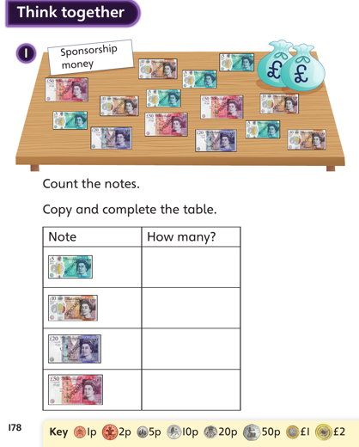
Green group
Maths
Challenge 1

Slide 11
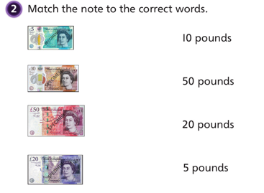
Green group
Maths
Challenge
2

Slide 12
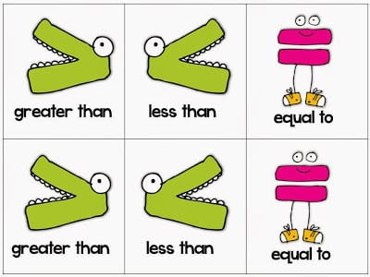
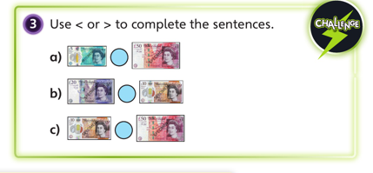
Green group
Maths
Challenge
3

Slide 13
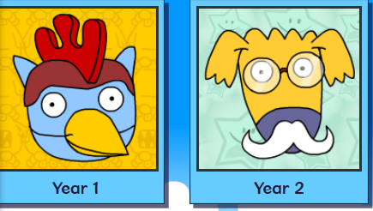
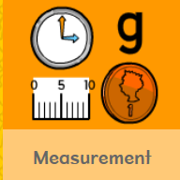
.
.
.
.
Logon on to Busy Things.
Can you score more points today? Are you faster?
Play one or all the games to practise money skills.

Slide 14
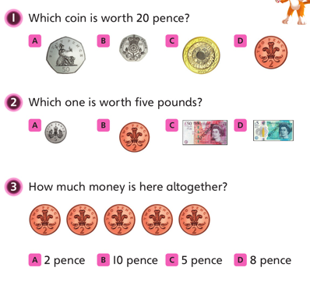
If you’ve completed your Maths and have time for another Maths Challenge. Have a
go at the following question.
Write the answers in your blue book.
Green group
Maths

Slide 15
Yellow group
Maths
Maths
Today we are going to look at patterns.

Slide 16
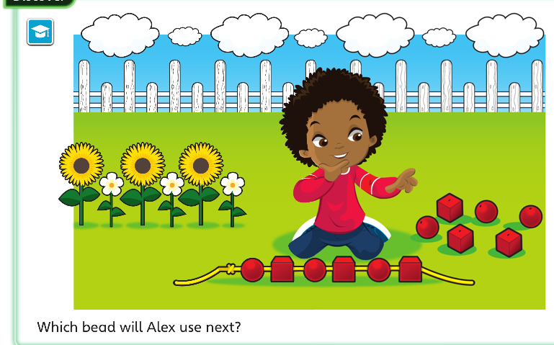
Yellow group
Maths
Let’s look at the next page to find out the answers and how you could have worked them out.

Slide 17
Yellow group
Maths

Slide 18
Yellow group
Maths
Can you complete the tasks below from you CGP book. If you
Complete the challenge questions, draw pictures in your
blue book.
If you would like to try Gruffalo work, complete page 34
If you would like to try Horrid Henry work, complete pages 34 and challenge 1.
If you would like to try James and the Giant Peach work, complete page 34 and challenge 1 and 2.

Slide 19
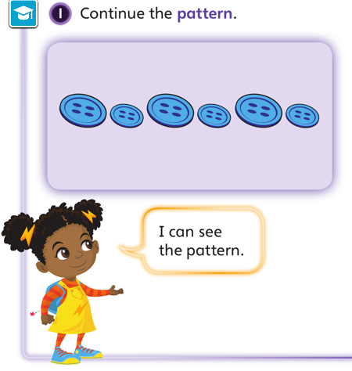
Yellow group
Maths
Challenge 1

Slide 20
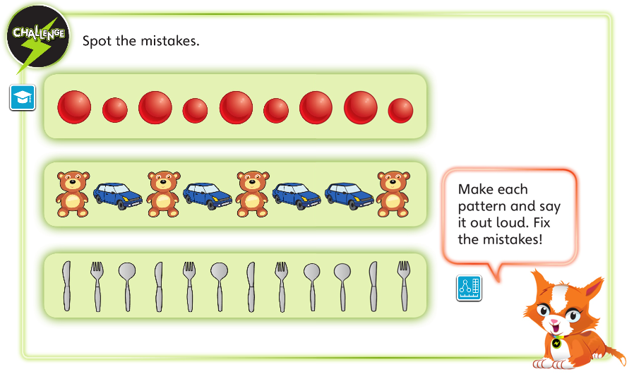
Yellow group
Maths
Challenge 2

Slide 21
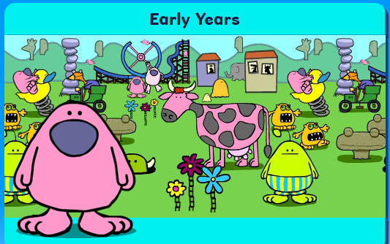
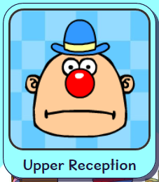
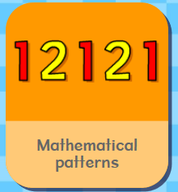
.
Logon on to Busy Things. How did you get on with the games
yesterday. Play one or all the games to practise your pattern skills.

Slide 22
Handwriting
Are you impressing your grown ups with your handwriting?
Please complete pages 23 in
your CGP Handwriting Book
.

Slide 23
English
Read through the poem from yesterday.
What do you notice about the last word at the end of each
line?

Slide 24
English
What do you notice about the last word at the end of each
line?
Yes the words rhyme.
Follow the link in orange to find out more about rhyming words. The
web address is in red in case you are unable to follow the link.
What are rhyming words? - BBC Bitesize
https://www.bbc.co.uk/bitesize/topics/zjhhvcw/articles/zqjgrdm
Can you find the rhyming words in the poem?

Slide 25
English
Can you find the rhyming words in the poem?
They are
Stan plan race place cheat feet
What do you notice about the rhyming words you found?
Stan plan race place cheat feet

Slide 26
English
What do you notice about the rhyming words you found?
That’s right. The middle and end sounds sound the same
but they are not always spelt the same.
Stan plan race place cheat feet

Slide 27
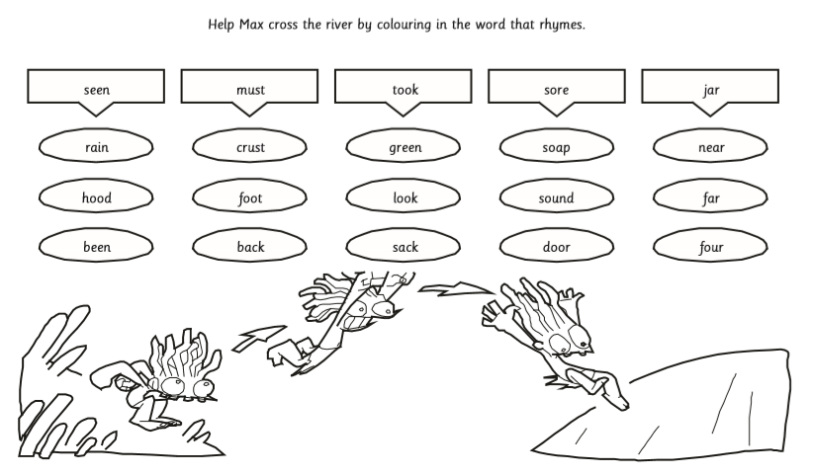
English
Max needs to cross the river. Can you help him by finding the words that rhyme with the word which appear at the top of each column? Write these words
in your blue book.

Slide 28
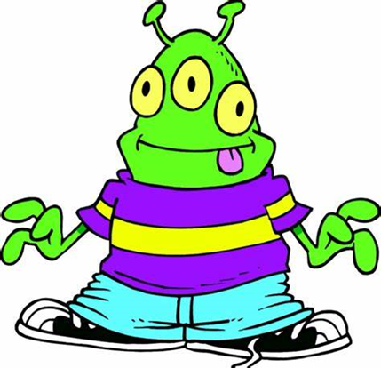
Phonics
Green group
Phonics
Today you are practising the oe sound.
Complete pages 28 and 29 in your CGP phonics booklet.
Follow the orange link to phonics play to practise the oe sound. The web address is in red in case you are unable to access the link. Click on the existing version.
Buried Treasure phonics game oe sound
https://www.phonicsplay.co.uk/BuriedTreasure2.html

Slide 29
Phonics
Green group
Phonics
Challenge
Alternative sounds for a
As in hat or acorn or was
Follow the orange link to phonics play to practise the a sound. The web address is in red in case you are unable to access the link. Click on the existing version.
Cheeky Chimps Game Phase 5 a sound
https://www.phonicsplay.co.uk/member-only/CheekyChimps.html

Slide 30
Phonics
Yellow group
Phonics
I would like you to work through pages 40 and 41 in your Phonics booklet 1.
Follow the orange link to phonics play to practise blending single
sounds. The web address is in red in case you are unable to access the link.
Click on the existing version.
Buried Treasure phonics game Phase 2
https://www.phonicsplay.co.uk/BuriedTreasure2.html

Slide 31
Which birds did you spot yesterday?

Slide 32
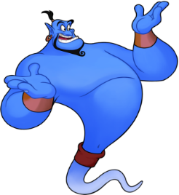
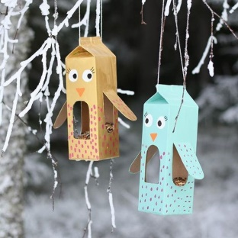
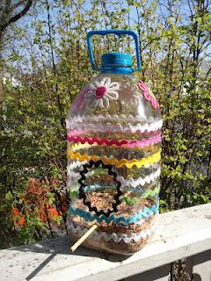
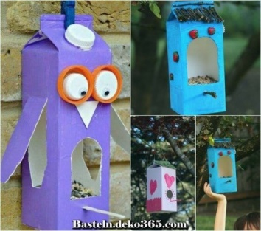
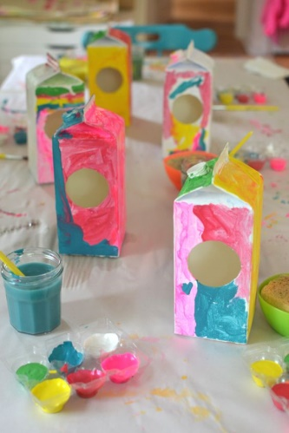
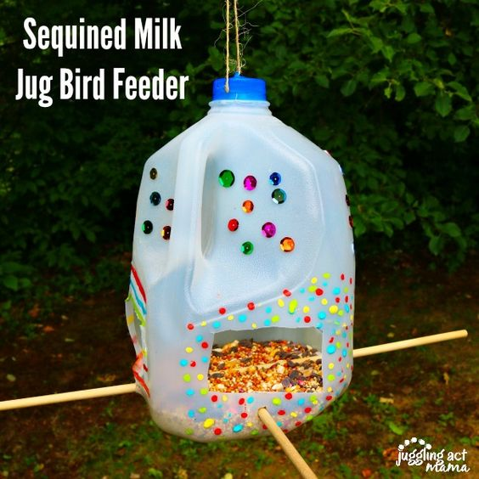
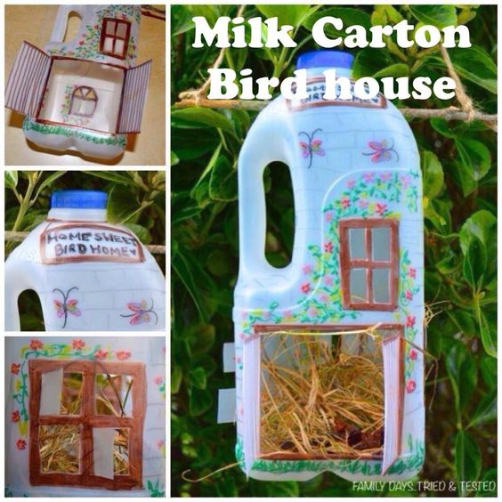
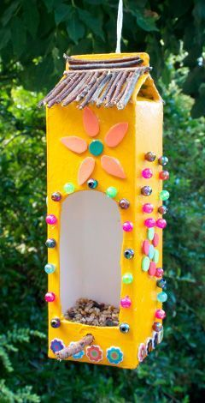
Today we are going to make a bird house out
of things you have at home. Here are a few
ideas…

Slide 33
Active Learning

Slide 34
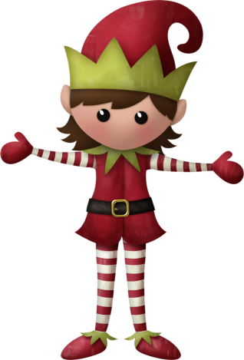
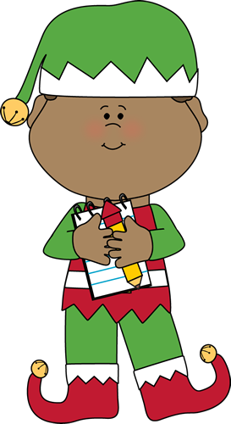
Well done for
your super work today!
If you can, please send me a photo or message via admin@farnborough.bromley. sch.uk and let me know how you are getting on!

