Slide 1
Day Two

Slide 4
Lesson 17 – WALT: Estimate using addition and subtraction.
What method could you use to solve 1a?
How can you tell the ring mistress has not made a good estimate?
How can you show you are correct?
What strategy could you use to check?

Slide 5
How do the number lines help you round?
What would the estimate be if the ring mistress rounded to the nearest hundred?

Slide 6
What is the next 1,000 after 9,000?

Slide 7
Practice Questions

Slide 10
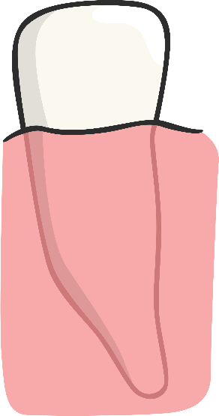
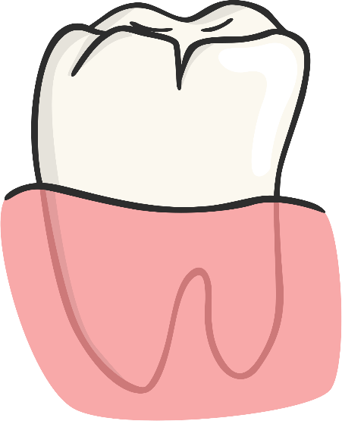
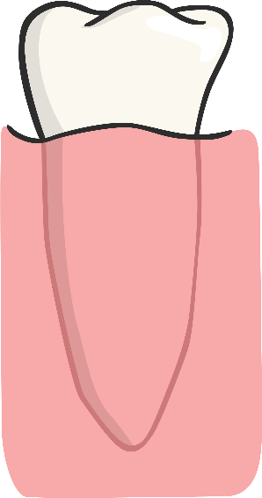
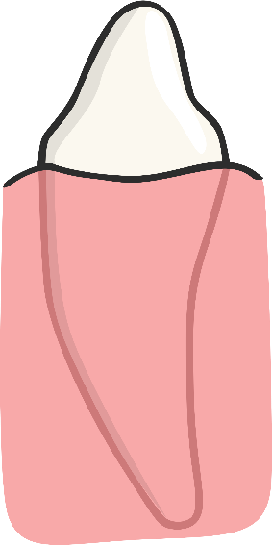
Types Of Teeth
Can you match the types of teeth with their names?
https://www.bbc.co.uk/bitesize/topics/z27kng8/articles/zsp76yc
Molar
Canine
Incisor
Premolar

Slide 11
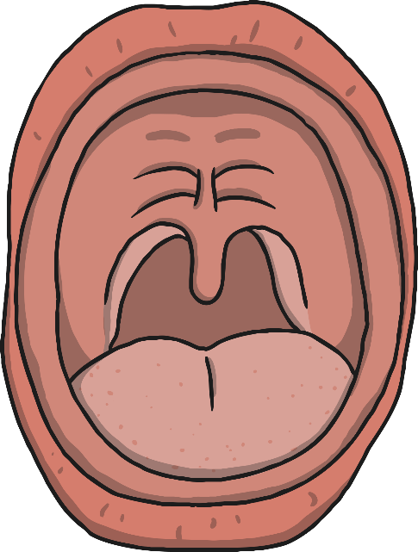
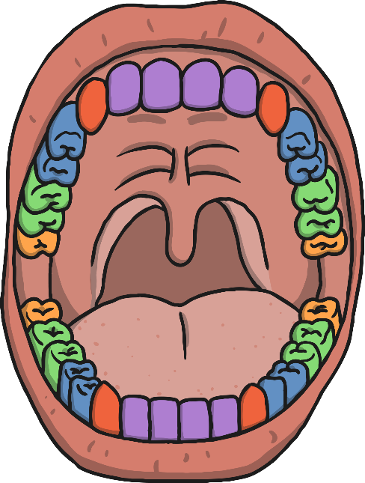
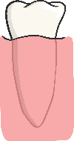
Where Are They?
Were you correct?
Click here
for answers!
Canine
Molars
Premolars
Incisors
Wisdom Teeth

Slide 12
Functions of Teeth
:
Why do we have different types of teeth?
What is their purpose?
Canine
Molars
Premolars
Incisors
Wisdom Teeth

Slide 13
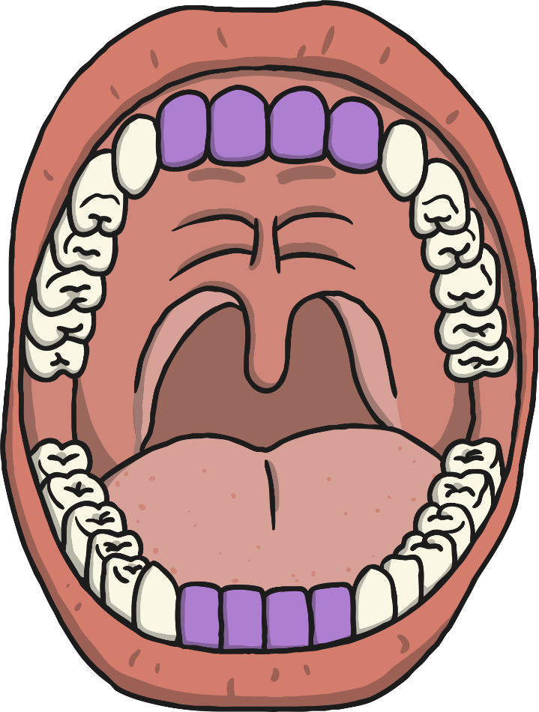
Incisors
How many?
Humans have 8 incisors altogether; 4 in the upper jaw and 4 in the lower jaw.
Shape
Incisors are shovel-shaped.
Function:
Used for biting and cutting food.

Slide 14
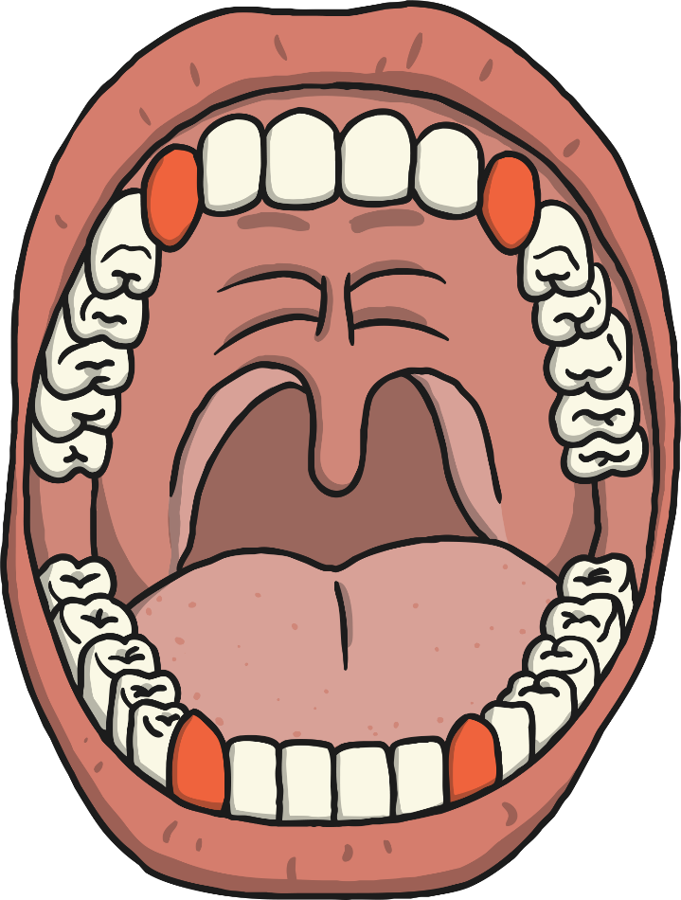
Canines
How many?
Humans have 4 canine teeth, one in each quarter of the mouth, on either side of the incisors.
Shape
Canines are pointy.
Function:
Used for tearing and ripping food.

Slide 15
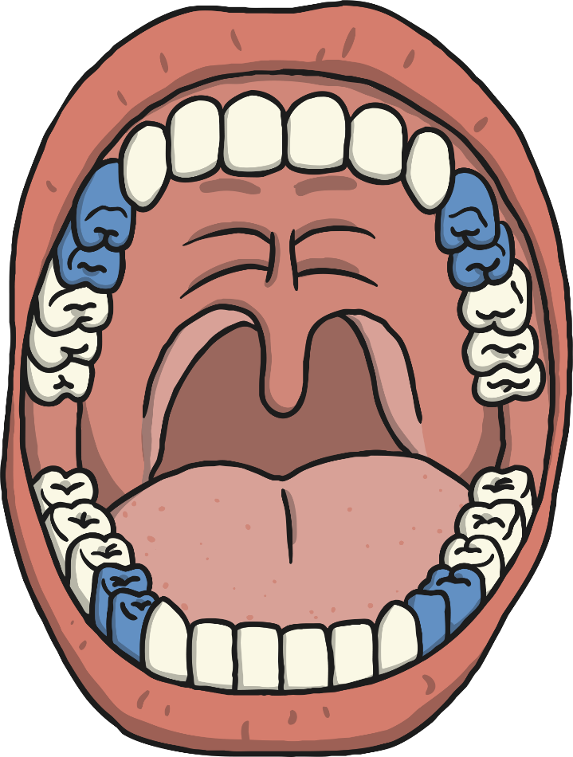
Premolars
How many?
Humans have 8 premolars, two in each quarter of the mouth. They are between the canine tooth and the molars.
Shape
Small and flat
Function:
Holding and crushing food.

Slide 16
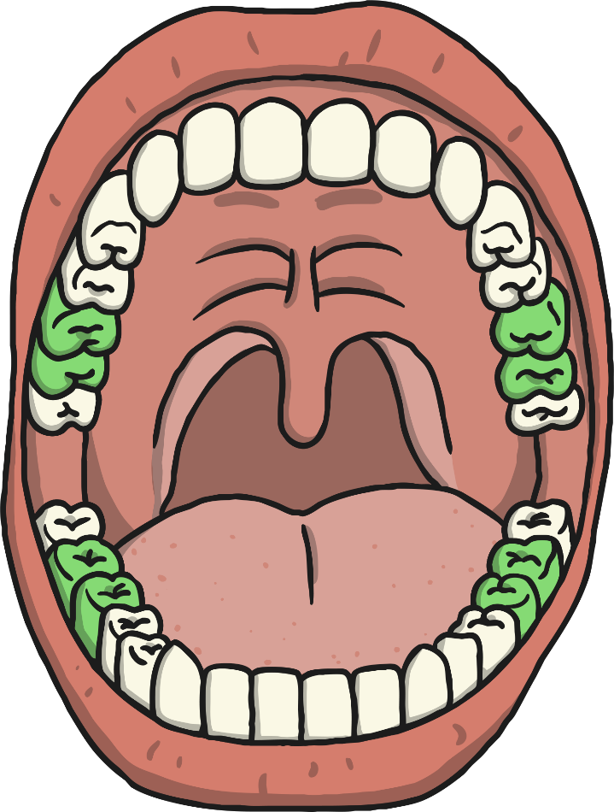
Molars
How many?
Humans have 8 molars, two in each quarter of the mouth. They are at the back of the mouth behind the premolars.
Shape
Large and flat
Function:
Grinding food

Slide 17
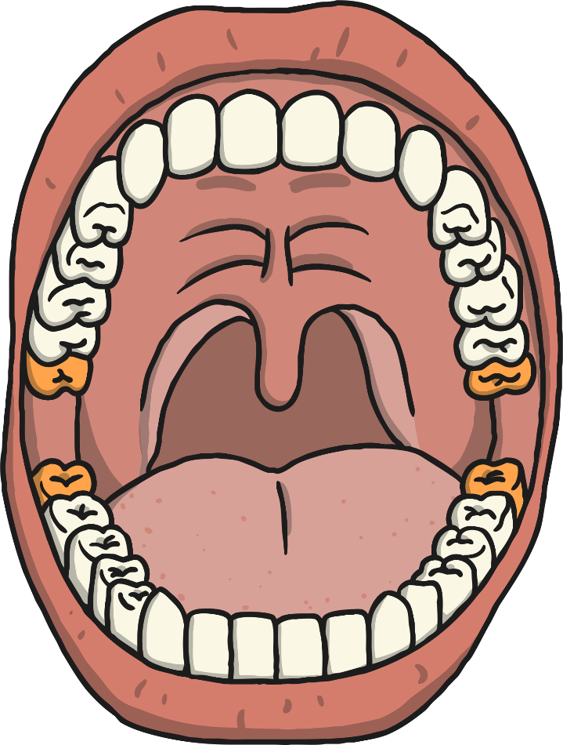
Wisdom Teeth
How many?
Humans can have up to 4 wisdom teeth, although not everyone has them. There is 1 in each quarter of the mouth behind the molars.
Shape
Large and flat (they are just a third molar)
Function:
Does not have one now! Some scientists think that human ancestors needed a third molar to help grind down plant tissue from thicker leaves when humans still ate them. Since the diet of humans has changed we don’t need them.
As the human diet changed our mouths have become smaller. This is the reason why many people have their wisdom teeth extracted – taken out – as there is no real room for a wisdom tooth so it tends to grow inward and can become a problem.

Slide 18
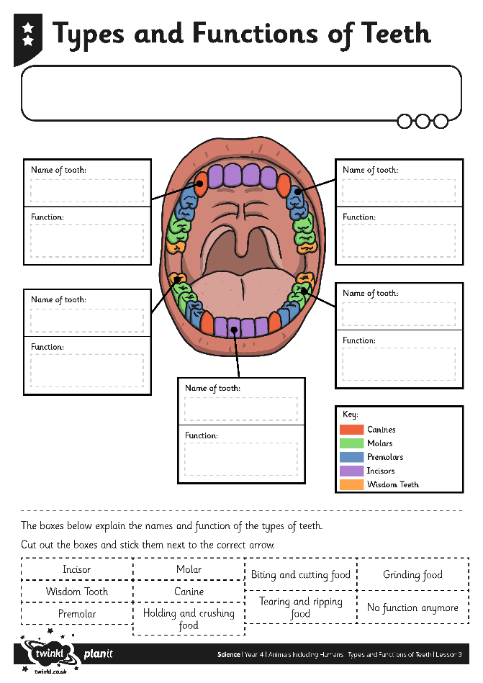
Can you name the type of teeth and label the functions? See how scientists improve toothpaste https://www.bbc.co.uk/programmes/p0119pcl

Slide 19
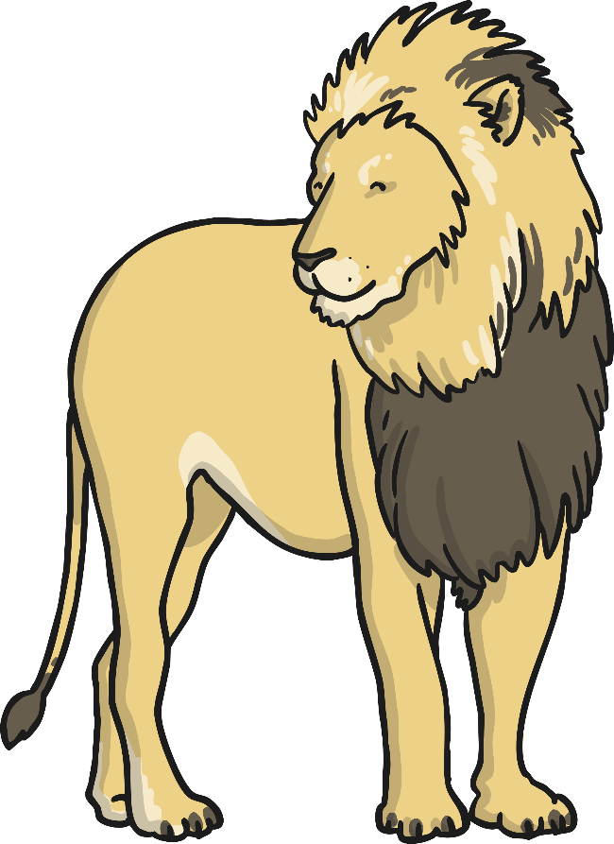
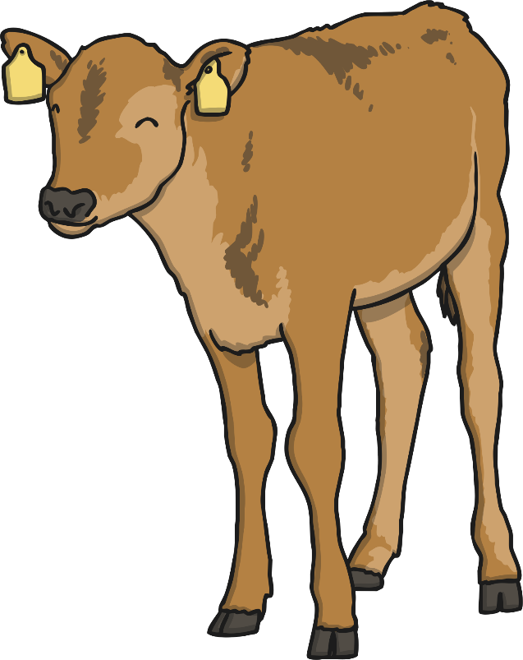
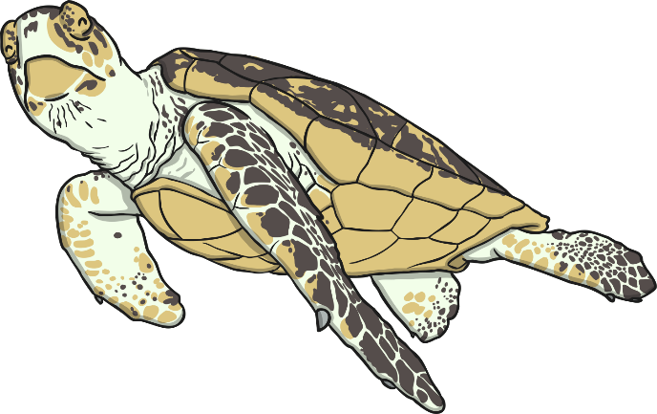
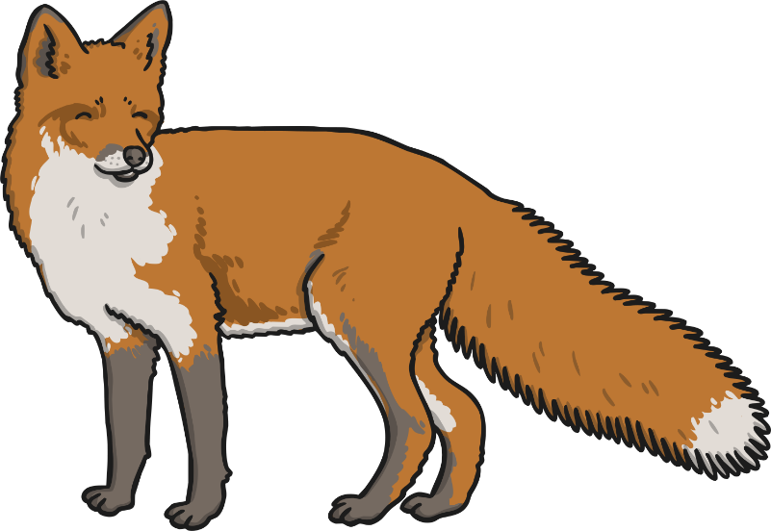
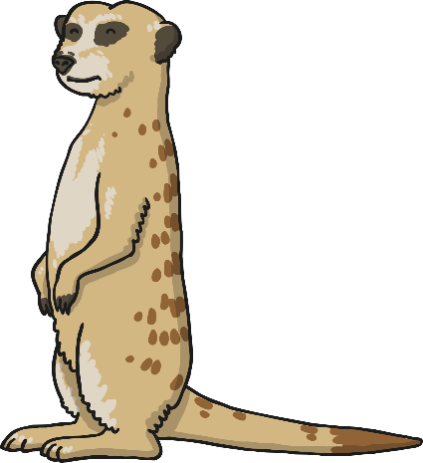
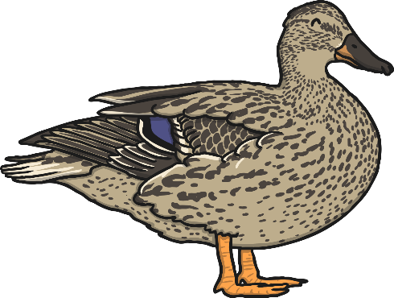
Animal Teeth
Do other animals have the same type of teeth as humans?
Why? Why not?

Slide 20
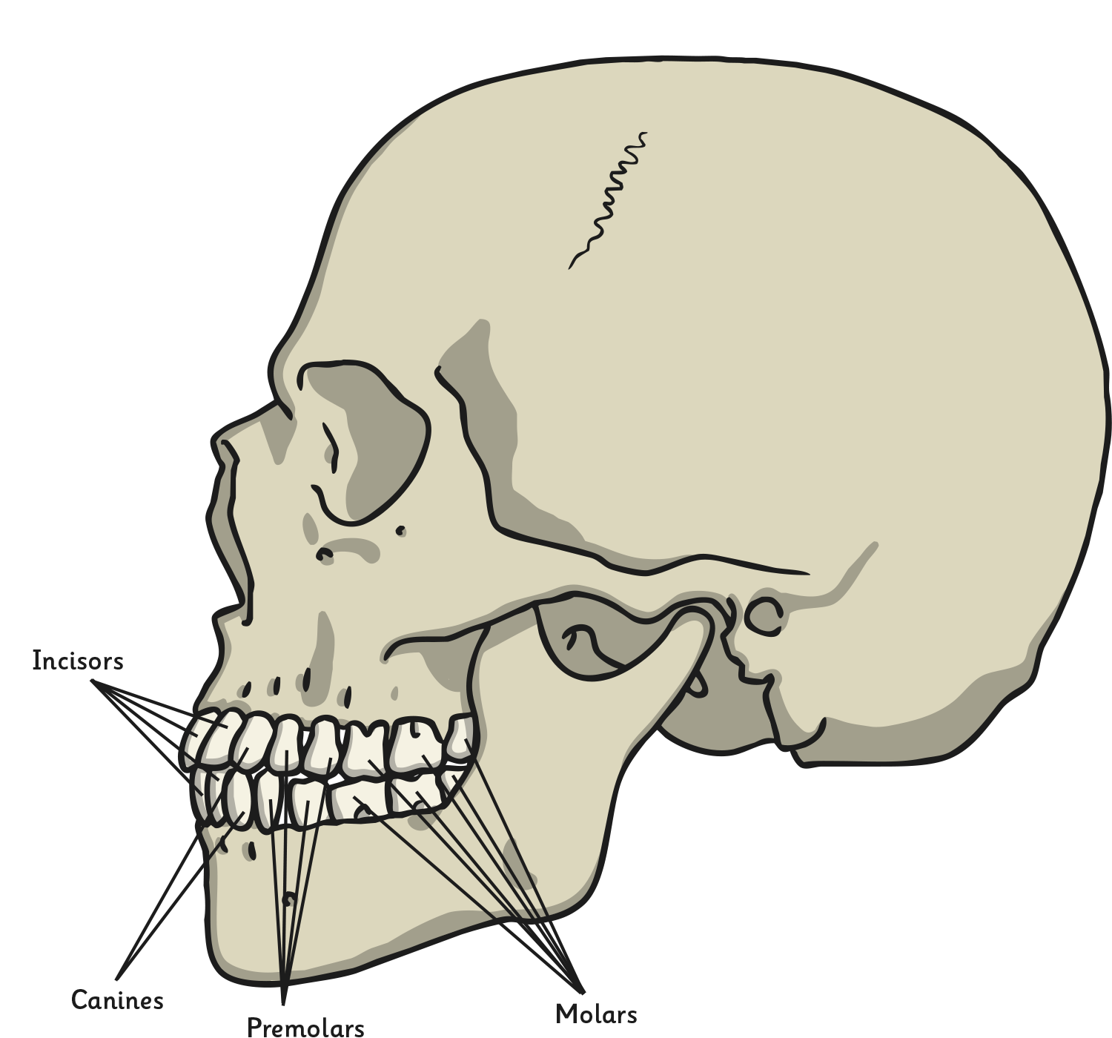
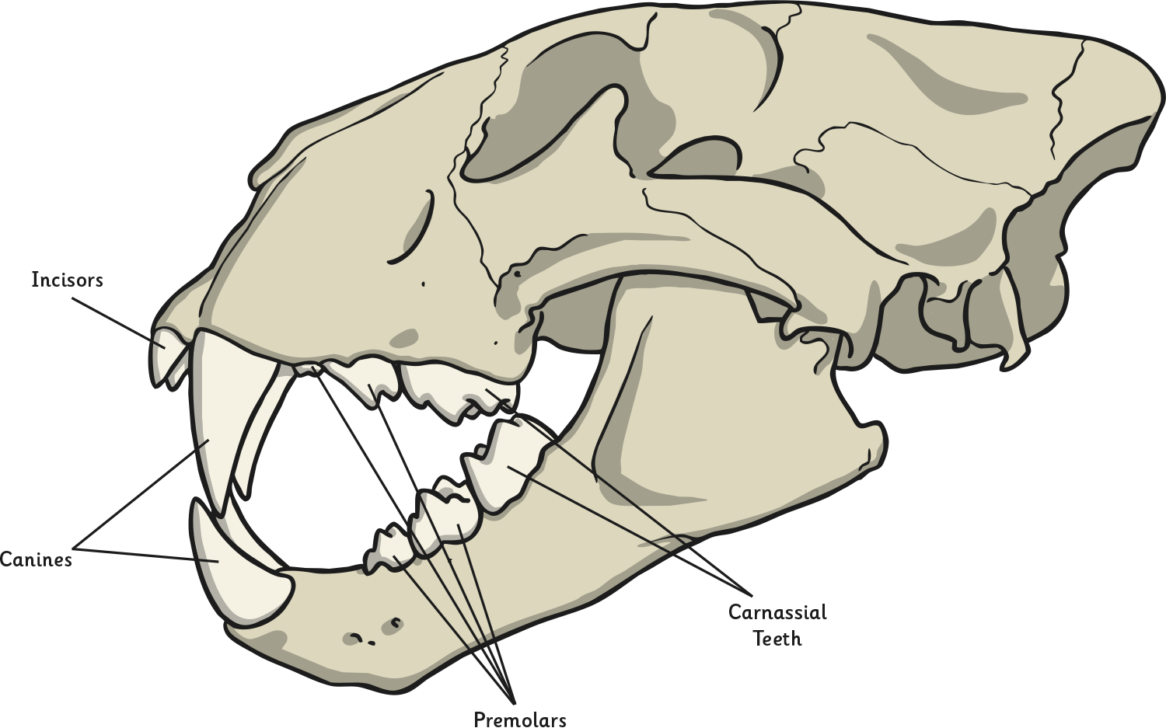
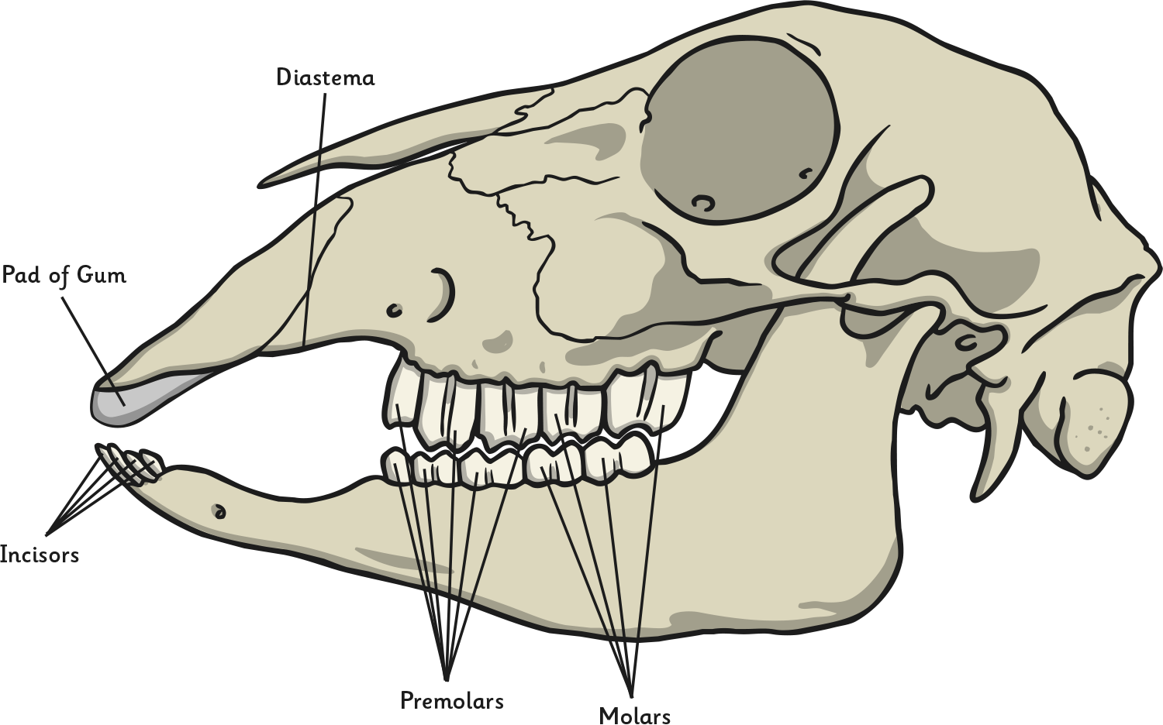
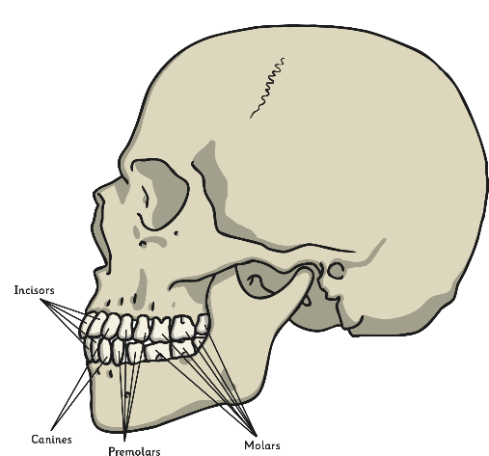
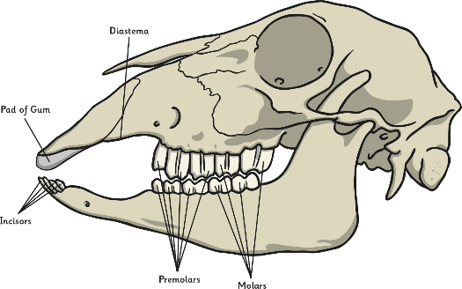
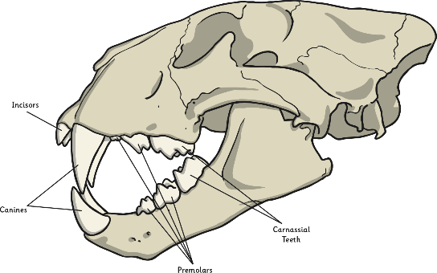
Food and Teeth
Herbivores eat plants
Carnivores eat only meat
Omnivores eat plants and meat
Discuss with a talk partner:
How does the food the animal eats affect the teeth it will have?
What similarities and differences do you notice?
Lion skull. Click again to go back.
Sheep skull. Click again to go back.
Human skull. Click again to go back.
Click a skull for a larger version!

Slide 21
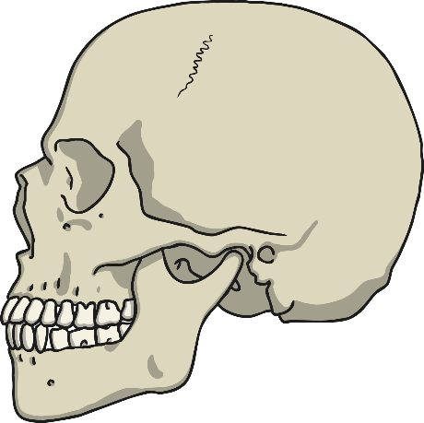
Comparing Teeth
Follow the link to the worksheet where you look at a range of different animals skulls on which you will need to compare and contrast.
Read the questions carefully and write down answers.
Choose which sheet you think is right for you then you can check the answers afterwards. Good luck!

Slide 22
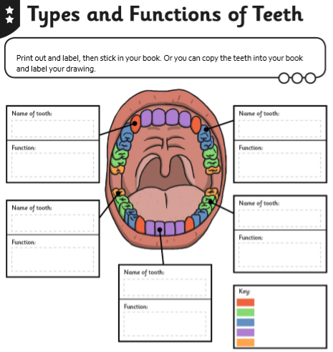

Slide 23
Write out or cut the labels for your teeth.

