Slide 1
Welcome to the writing tasks for week 3
Over the next two weeks, you will have a virtual teacher, Jo, who will guide you through the activities.
The focus is on a story called, ‘The King of Fishes’, which is a wishing tale.
Read the instructions carefully to help you complete the tasks.

Slide 2
Day 5

Slide 7
Notes for Maths
Discovery – Children to work independently.
Share – This page shows you different ways the discovery question could have been answered.
Think Together – Complete and then discuss with an adult to consolidate and deepen understanding.
Practice – children practice the skills they have learnt. Please complete 2 of the 3 slides of practice. (Pick the 2 pages you think will challenge you the most!)

Slide 8
Lesson 15 – WALT: Subtract 2 4-digit numbers continued.
How should the subtraction be laid out if Aki has made a mistake?

Slide 9
How can you tell when an exchange is needed?
Can you explain the method in steps?

Slide 10
What is the number sentence in number 1?

Slide 11
Practice Questions

Slide 14
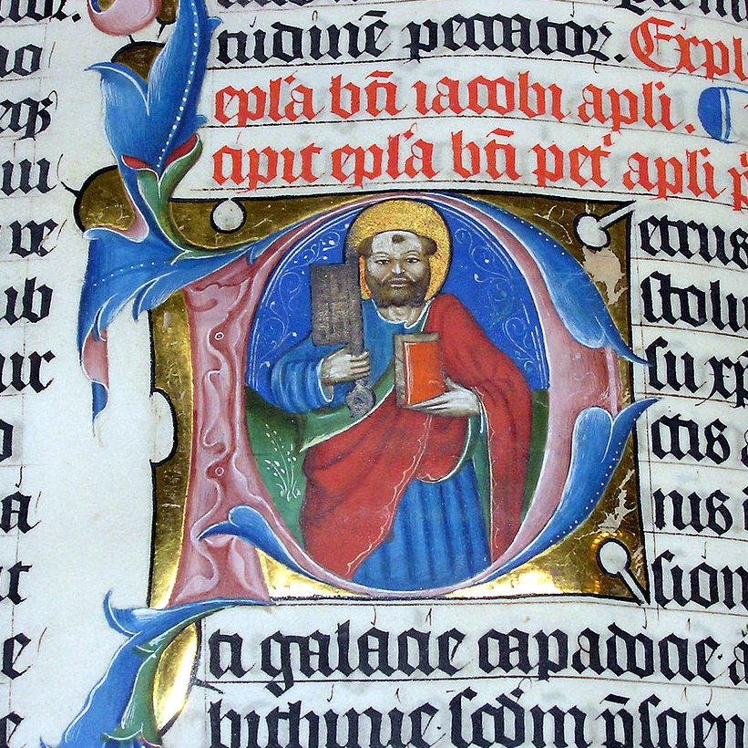
Illuminated Letters
In Medieval times, all books were hand written and decorated by hand, usually by priests and monks. They were seen as very precious works of art, and you had to be very skilled to produce them.
These manuscripts were called ‘illuminated’ because the letters and pictures were often decorated with gold and silver leaf.
The word ‘illuminated’ comes from the Latin word illuminare, meaning “light up.”
Photo courtesy of (@wikimedia.org) - granted under creative commons licence – attribution

Slide 15
Illuminated Letters
An illuminated letter was usually the first letter of a page or paragraph. It was enlarged and in colour, with gold or silver added in areas, while the rest of the text was in black. Images of people, animals, plants or mythological creatures were sometimes added to enhance the letter.
The Anglo-Saxons borrowed from the art styles of several different countries (Irish, Italian and Germanic) to create their own distinctive style of illuminated letters.
Because not many people could read at this time, illuminated letters were a way of communicating a story or message without using words.
The Medieval alphabet didn’t have all of the letters that we use today.
As you look through, see if you can spot which ones are missing!

Slide 16
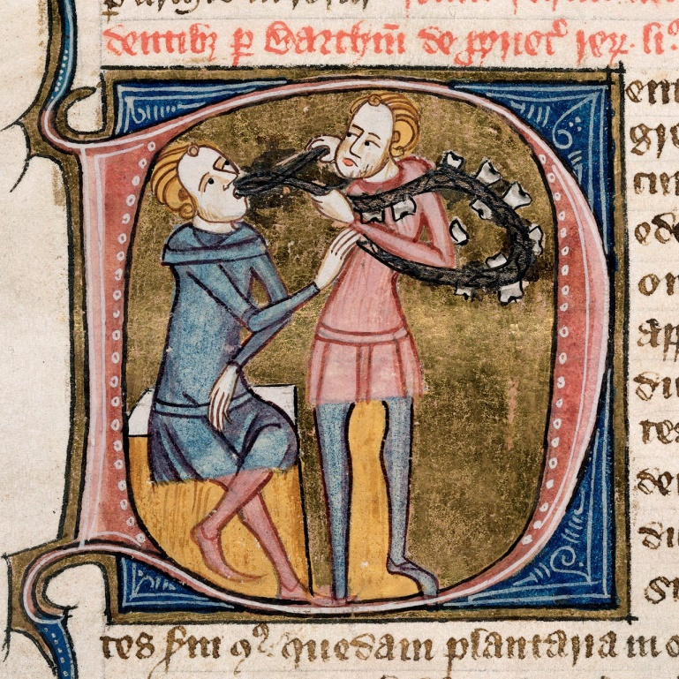
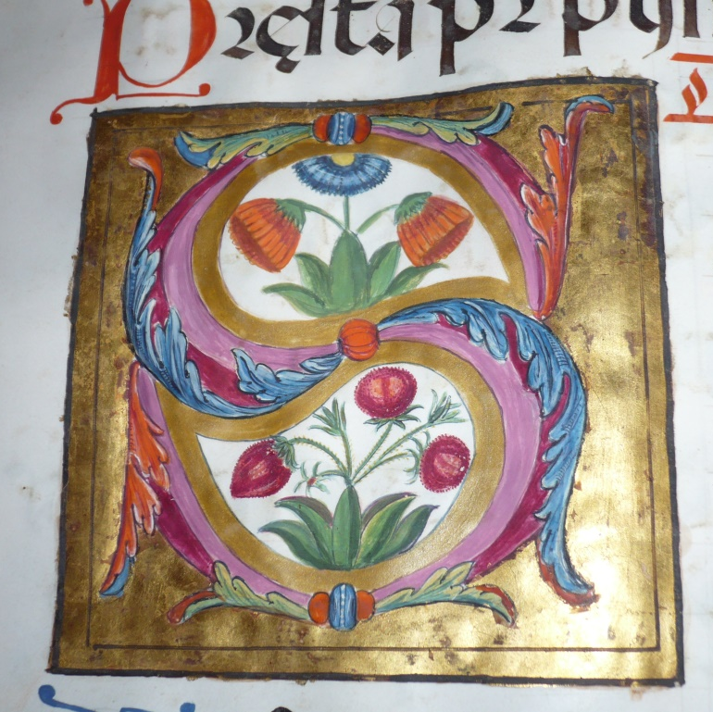
Illuminated Letters
Here are some examples of medieval illuminated letters.
Can you see what the letter is? Can you guess what the text was about from clues in the illuminated letter?
Photo courtesy of (@wikimedia.org) - granted under creative commons licence – attribution
Photo courtesy of (@wikimedia.org) - granted under creative commons licence – attribution

Slide 26
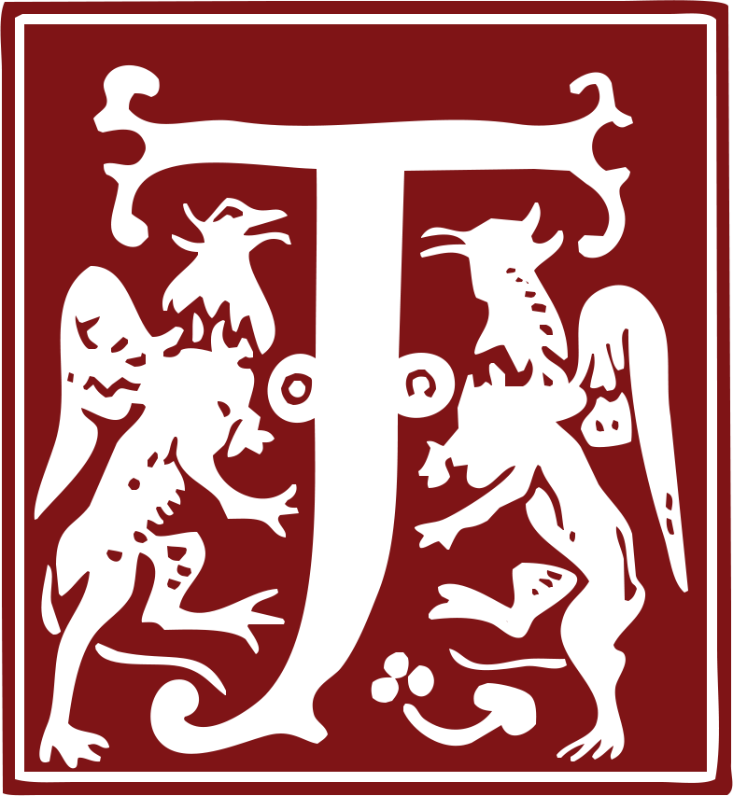

Slide 31
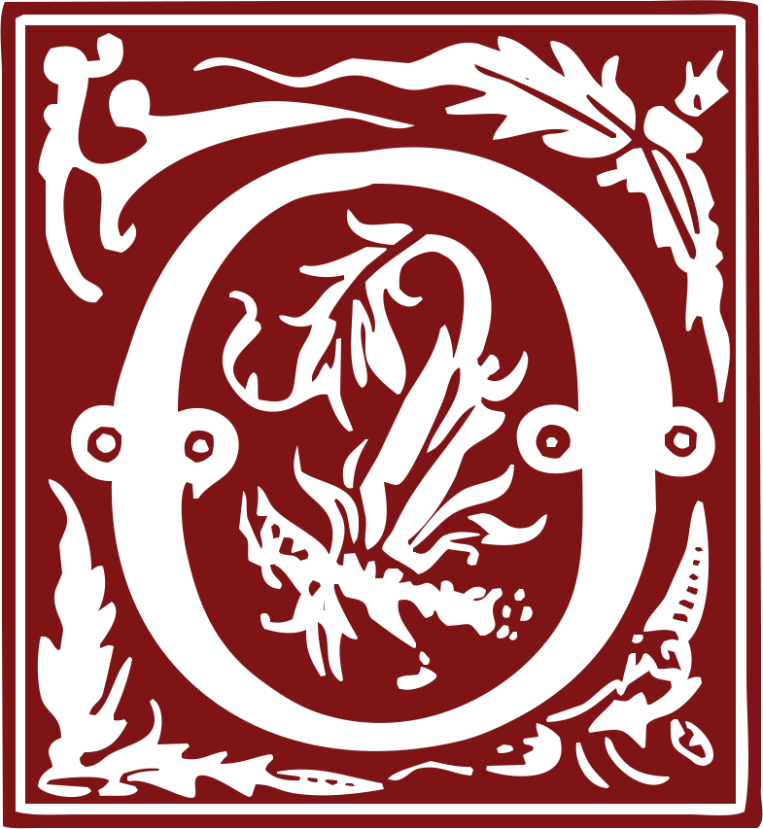

Slide 43
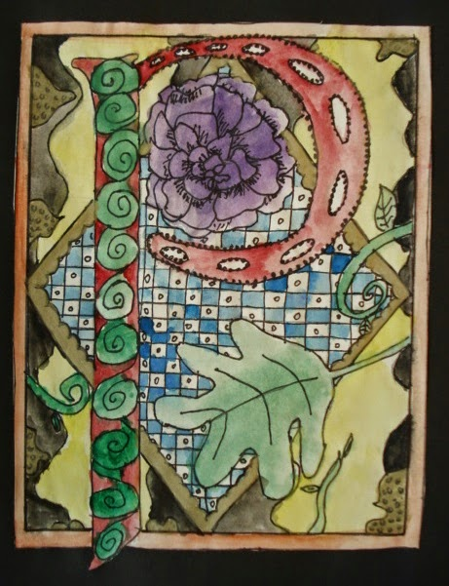
Can you design your own illuminated letter?
Start by drawing a border using a ruler.
Next choose whichever letter you like; maybe choose a letter representing someone special to you?
Next 'illuminate' the letter.
You can either decorate it in a traditional style or create a contemporary (style of today)design.

Slide 44
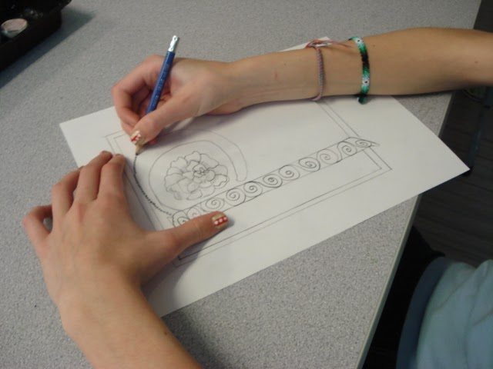
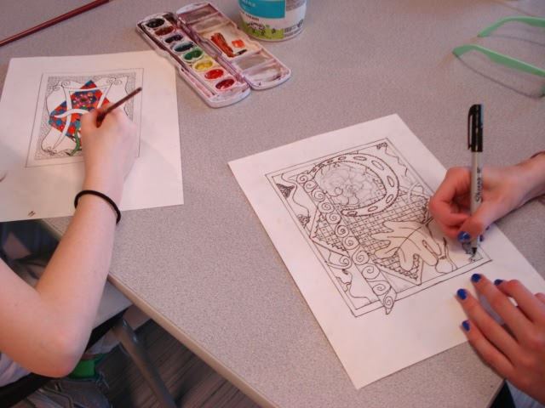
These children have drawn their design and then outlined everything using a fine Sharpie, then they used small brushes and watercolours to paint the illuminations.
Once dry, gold markers could be used to add some metallic accents (to mimic traditional gold leaf).
Or be creative and colour it in any way you choose, using what you have at home.
The designs could make a nice card to give to someone if you wish.

Slide 45
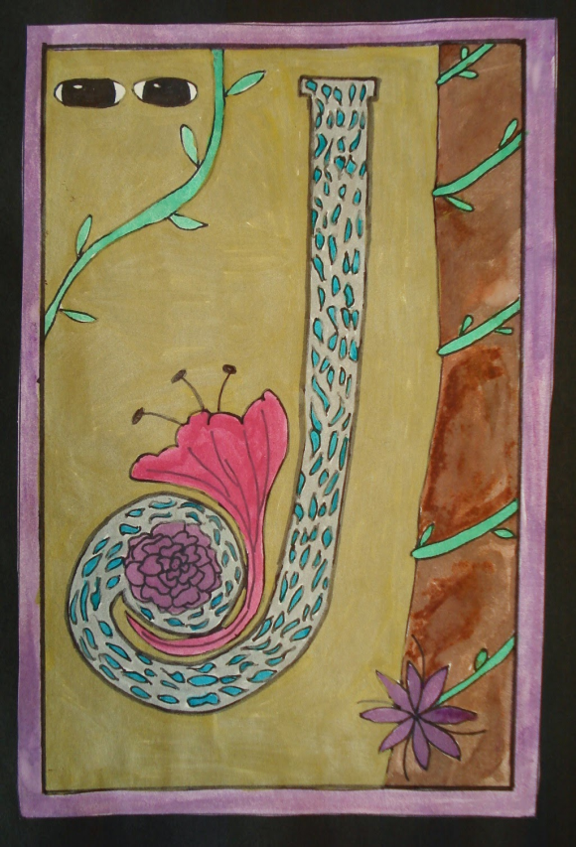
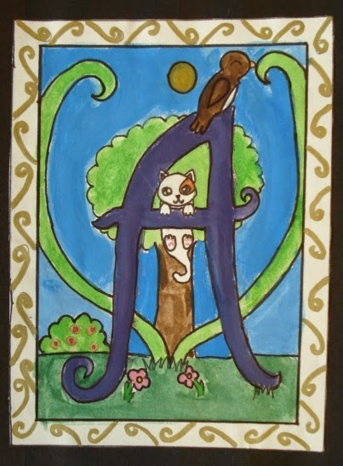
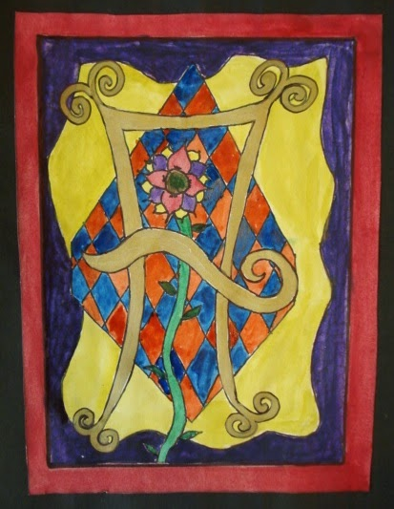
Some ideas to help get you started!

Slide 46
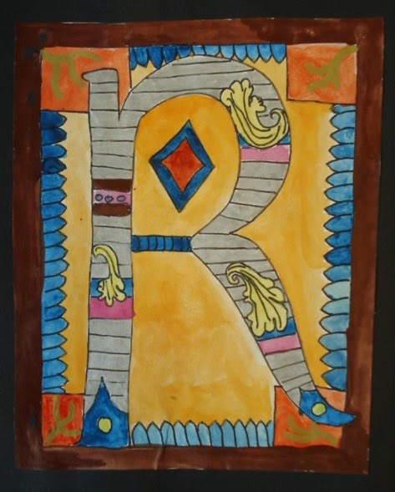
Remember you can look back at the letters in these slides to help you get started.
Good luck!

