Slide 1
Welcome to the writing tasks for week 3
Over the next two weeks, you will have a virtual teacher, Jo, who will guide you through the activities.
The focus is on a story called, ‘The King of Fishes’, which is a wishing tale.
Read the instructions carefully to help you complete the tasks.

Slide 2
Day 4

Slide 7
Notes for Maths
Discovery – Children to work independently.
Share – This page shows you different ways the discovery question could have been answered.
Think Together – Complete and then discuss with an adult to consolidate and deepen understanding.
Practice – children practice the skills they have learnt. Please complete 2 of the 3 slides of practice. (Pick the 2 pages you think will challenge you the most!)

Slide 8
Lesson 14 – WALT: Subtract 2 4-digit numbers.
How can you draw the bar model for this question?
How can you use the bar model to help you work out the answer?

Slide 9
How does the column method of subtraction work?
What do the place value counters tell you about the digits in the calculation?

Slide 10
What is the question asking you to do?
How do you know the question wants you to subtract?

Slide 11
How do you work out a subtraction with a missing number?

Slide 12
Practice Questions

Slide 17
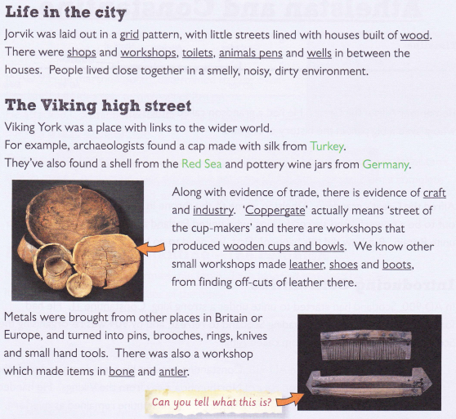

Slide 18
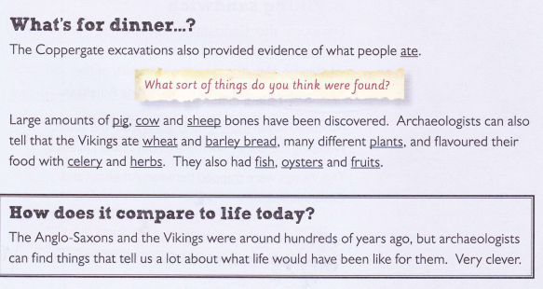
In the next slides you can use the information you have read to answer the questions and complete the activities.

Slide 20
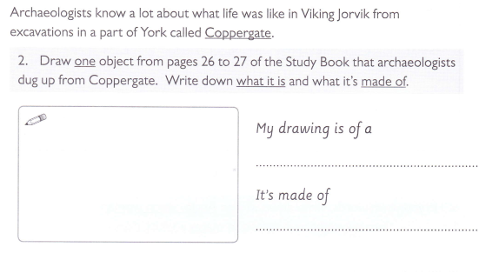

Slide 21
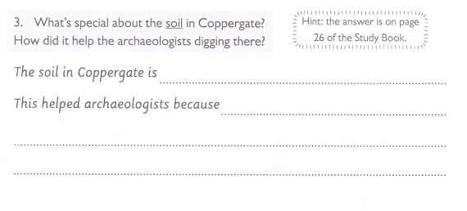

Slide 22
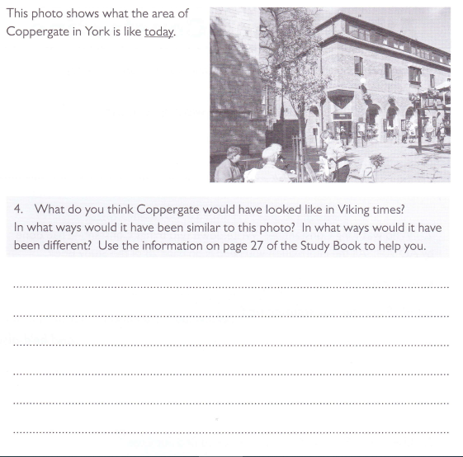

Slide 23
