Slide 1
Welcome to the writing tasks for week 3
Over the next two weeks, you will have a virtual teacher, Jo, who will guide you through the activities.
The focus is on a story called, ‘The King of Fishes’, which is a wishing tale.
Read the instructions carefully to help you complete the tasks.

Slide 2
Day 3

Slide 6
Notes for Maths
Discovery – Children to work independently.
Share – This page shows you different ways the discovery question could have been answered.
Think Together – Complete and then discuss with an adult to consolidate and deepen understanding.
Practice – children practice the skills they have learnt. Please complete 2 of the 3 slides of practice. (Pick the 2 pages you think will challenge you the most!)

Slide 7
Lesson 13 – WALT: Add 2 4-digit numbers continued.
What are the key words in this question?
What is the question asking you to do?
Can you write down the number sentence?
What methods could you use?

Slide 8
Why can you not have 11 counters in the ones column?
What does exchange mean?

Slide 10
Practice Questions

Slide 13
Enjoy reading these funny facts on Viking beliefs from the Horrible Histories team.

Slide 14
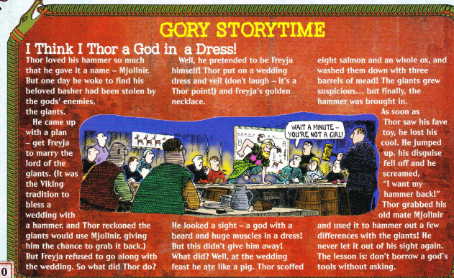

Slide 15
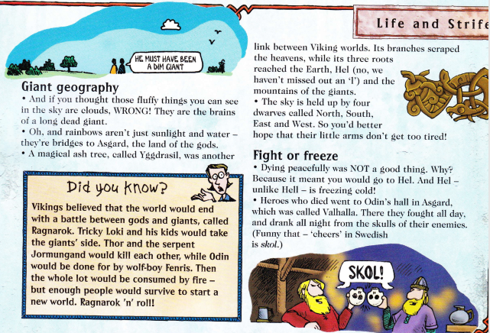

Slide 16
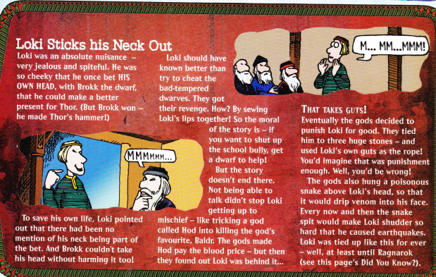

Slide 17
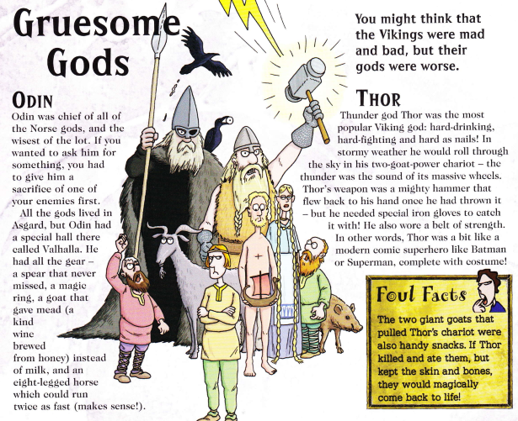

Slide 18
