Slide 1
Day Five

Slide 5
Lesson 20 – WALT: Problem solve continued.
How will you show that Luis has more?
Will you use column subtraction or is there another way?

Slide 6
How does the comparison bar model show who has more?
Did you use the column method to calculate the answer?

Slide 7
Is this problem addition or subtraction?
What can you fill in first on the model?

Slide 8
Practice Questions

Slide 11
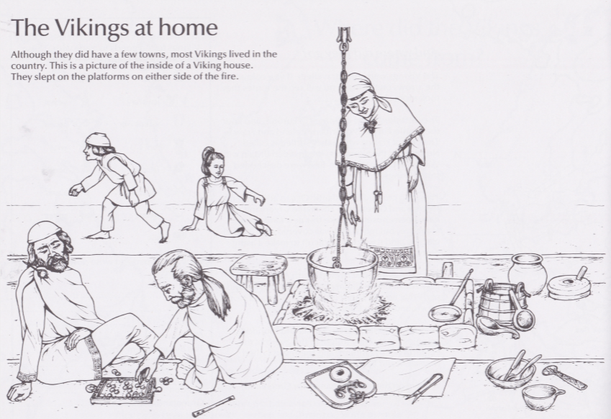
Use the Horrible Histories document on the Year 4 page to help.

Slide 13
Interpreting Food Chains - Answers
Write out the words with their meanings. Extra Challenge: Three new words on this list, can you write a meaning for each one?
Words | Meanings
Herbivores | An animal that eats plants.
Carnivores | An animal that eats other animals.
Omnivores | An animal that eats plants and animals.
Detritivores | An animal that eats decomposing plants and animals.
Producers/Autotrophs | Plants that produced their own food.
Consumers | Animals that eat plant or other animals.
Primary Consumer | An animal that eats plants.
Secondary Consumer | An animal that eats the primary consumer.
Tertiary Consumer | An animal that eats the secondary consumer.
Prey | An animal that is hunted for food.
Scavenger | An animal that eats dead animals.
Predators | An animal that kills for food.
Decomposer | An organism or bacteria that breaks down dead plants and animals into liquid for food.

Slide 14
Food Chain Cards Possible Answers

