Slide 1
Good morning Unicorns!
I hope you’ve all had a lovely weekend.
Here’s your work for today: Monday 27th April

Slide 2
Reading online
Please log on to Bug Club and read for at least 15 minutes
Make sure you answer your bug questions!

Slide 3
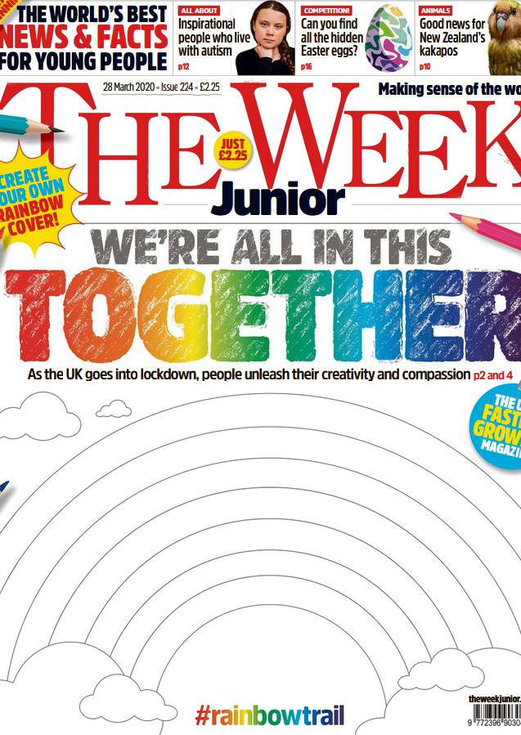
Reading online
You can also read ‘The Week Junior’ newspaper if you would like to:
https://www.yumpu.com/en/document/read/63174530/theweekjunior-224-2703-schools

Slide 4
Maths answers from last Friday:
Pages 37 -38
The third clock
Half past four, Ten to one
Five o’clock- Big hand on the 12, small hand on the 5; Quarter to ten- Big hand on the 9, little hand on the 10 Twenty-five to eleven- Big hand on the 7, little hand in-between the 10 and the 11.
24, 60
Picture 1: Adam was slower; picture 2: Adam was slower; Picture 3: Ben was slower
Tyronne was slower than Aya. Aya finished the jigsaw first.
Omar
15 minutes

Slide 5
Maths answers from last Friday:
Pages 39
9. 2nd: Nia; 1st: Finn; 3rd: Charlie
10. Big hand on the 4, small hand just gone past the 5.
11. The second cyclist has a tick ( 52 minutes, 55 seconds)
The third cyclist has a cross ( 1 hour, 4 seconds)

Slide 6
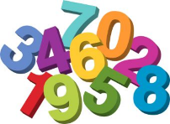
Maths
Today we are going to look at 2D shapes.

Slide 7
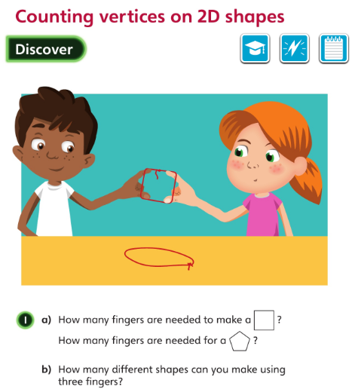
What do you notice about the part of the shape where the fingers are?
• What shapes can you make using four fingers?
Let’s look at the answers and how you could have worked them out on the next page…

Slide 8
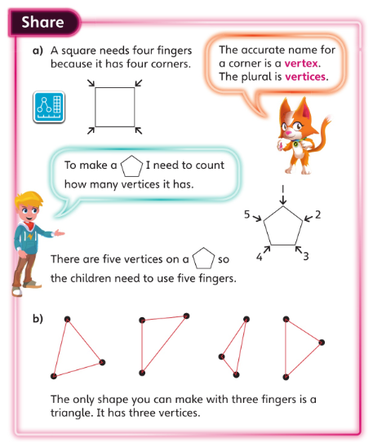
• How can you make sure that you count all the vertices only once?

Slide 9
Try carrying this out practically.
What do you notice about the number of sides and the number of vertices of a shape? Is this always true? Why do you think that is?

Slide 10
Now I would like you to have a go at completing work in your CGP Maths Reasoning workbook.
If you would like to try Gruffalo work, complete page 40
If you would like to try Horrid Henry work, complete pages 40 and 41
If you would like to try James and the Giant Peach work, complete pages 40, 41 and my Challenge question on the next slide.

Slide 12
Handwriting
Please complete pages 20 and 21 in your CGP Handwriting Book.

Slide 13
English
This week we are going to look at poetry.
Which poems have you ever enjoyed reading?

Slide 14
A shape poem is written in the shape of an object. Look on the next slides for some examples…
What is a shape poem?

Slide 17
Today you are going to create your own shape poem.
Your first job is to decide on the theme of your poem. You might decide to use one of the examples such as riding a bike. Or you might about something else e.g. your favourite food or your favourite animal.
I have been enjoying gardening in the sunshine, but my garden now needs some water so I can going to write a poem about a raindrop.

Slide 18
Your next job is to create a word bank of words or phrases that describe your theme.
My words are:
splash,
fast,
small,
not silent,
window,
splatters

Slide 19
Now you need to put your words into sentences:
Whether the raindrop is moving fast or slow, or is big or small, it always gets everyone’s attention.
The raindrop is never silent.

Slide 20
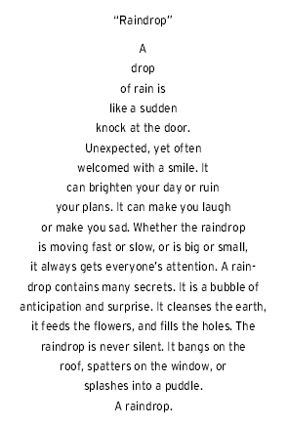
Now for the best part!
Draw an outline of your object and write the poem inside like this:

Slide 21
Art A messy but fun activity for you today! I’d like you to paint one or both of your hands and then use your handprint as a basis for a picture. There are a few ideas on the next slide…

Slide 22
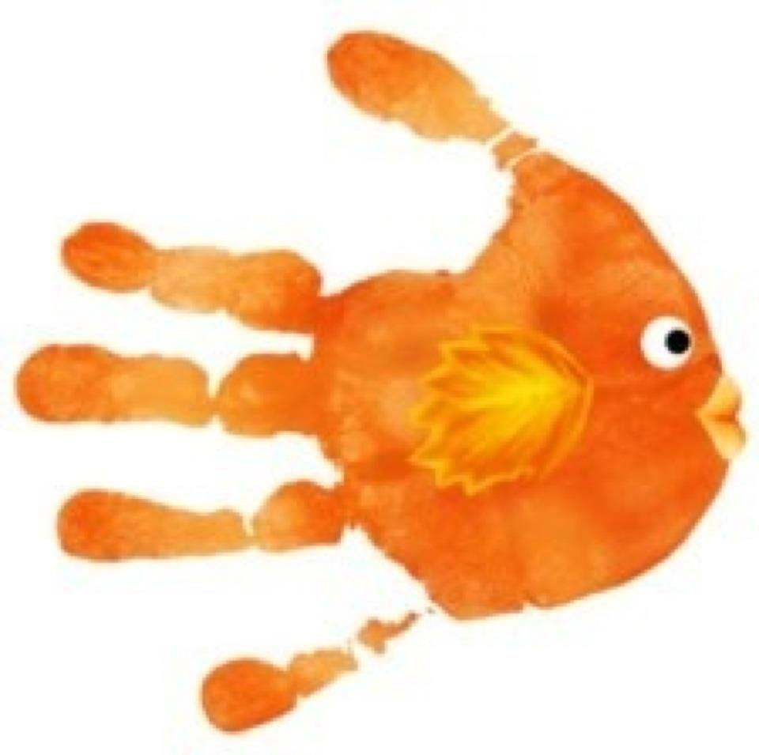
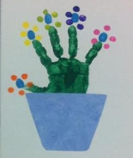
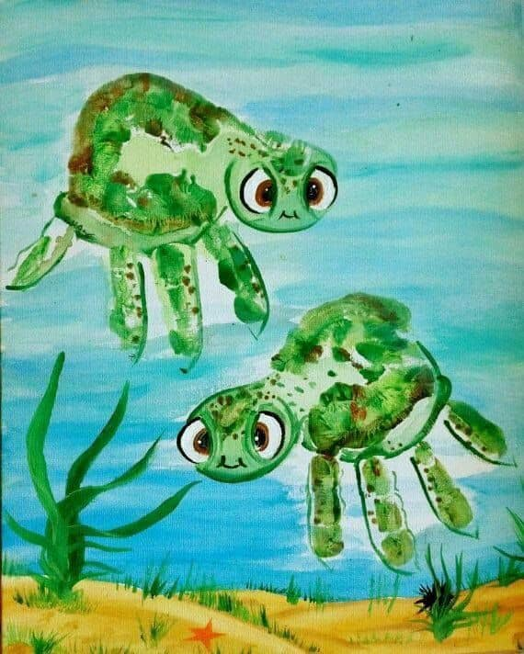
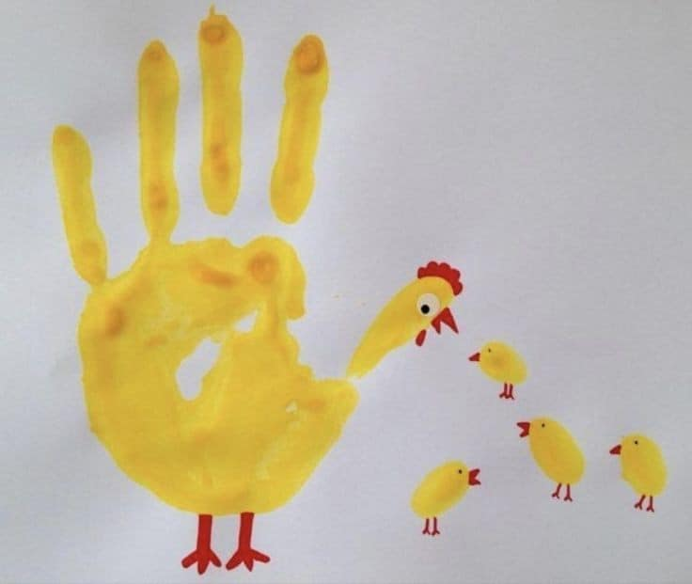

Slide 23
Enjoy, Unicorns!

