Slide 1
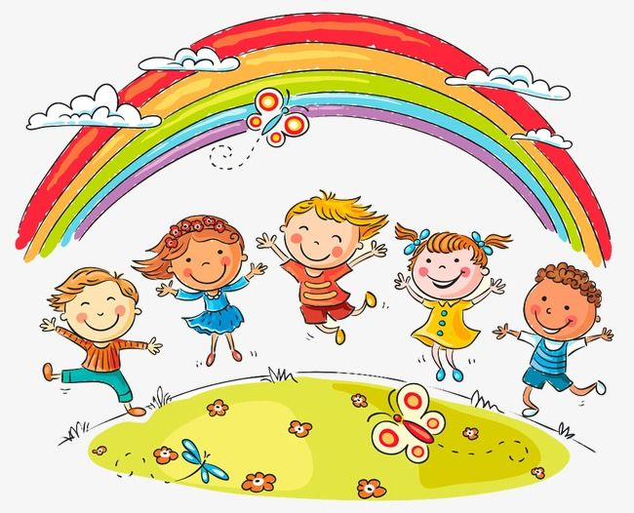
I hope that you all had a lovely Easter break and are taking care.
I’ve enjoyed reading your messages and are really impressed with the work that you have been doing. ☺
Remember that you can email me at
admin.office@farnborough.bromley.sch.uk

Slide 2
Good morning Unicorns!
Here’s your work for today: Monday 20th April

Slide 3
Reading online
Please log on to Bug Club and read for at least 15 minutes.
If you are a Free Reader, we’ve now got Key Stage 2 books on Bug Club, so I’ve moved you up a few levels…
Make sure you answer your bug questions!

Slide 4
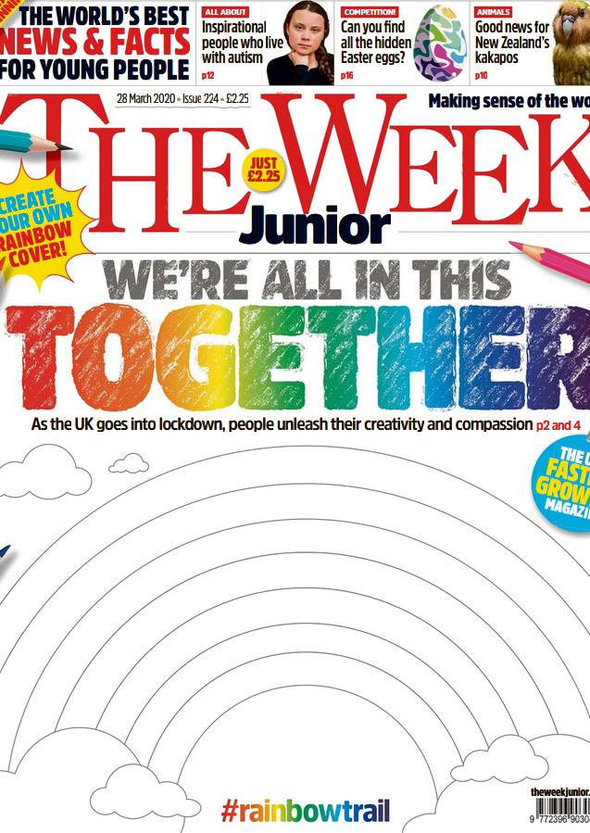
Reading online
You can also read ‘The Week Junior’ newspaper if you would like to:
https://www.yumpu.com/en/document/read/63174530/theweekjunior-224-2703-schools

Slide 5
Maths answers from Friday 3rd April:
Pages 26 and 27
Length- cm, Temperature- °C, Mass- g
The carton holds 2l of milk. The temperature of water in the kettle is 100 °C. The hamster weighs 200g.
Today my temperature is 20 °C. My bed is almost 2m long.
The animal.
300 l, 350 ml, 18 cm, 8 m
10g, 500 cm, 6 ml
°C, ml, g

Slide 6
Challenge a): Dad’s bag is heaviest (because Dad’s bag is 5 times as heavy as Molly’s bag and Jack’s bag is lighter than Molly’s). b): Jack’s bag is lightest (because Jack’s bag is half as heavy as Molly’s bag which is lighter than Dad’s bag).

Slide 7
Maths
Today we are going to look at different ways of measuring.

Slide 8
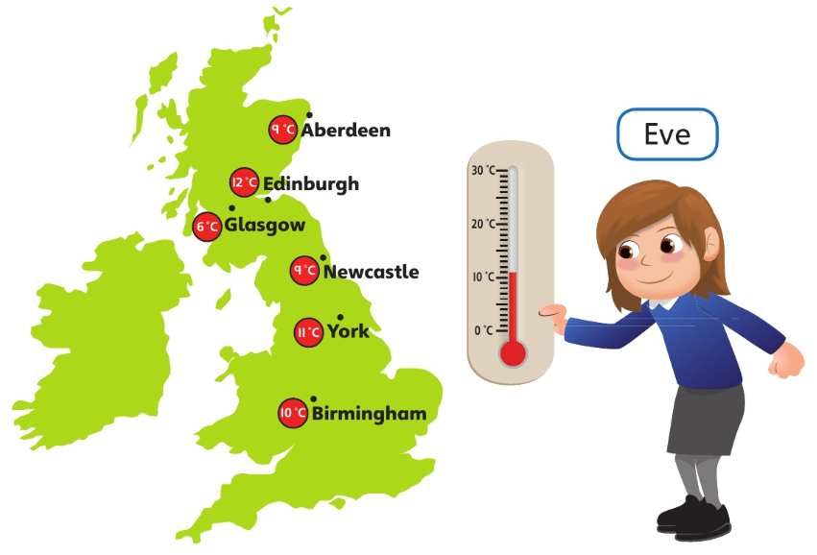
Let’s look at the answers and how you could have worked them out on the next page…

Slide 9
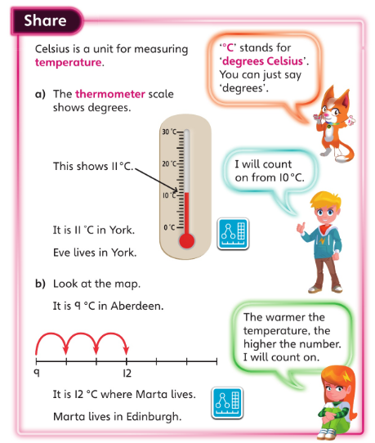
• How did you work out where Eve lived? • How did you read the thermometer? •Does ‘warmer’ mean you have to count on or count back?

Slide 10
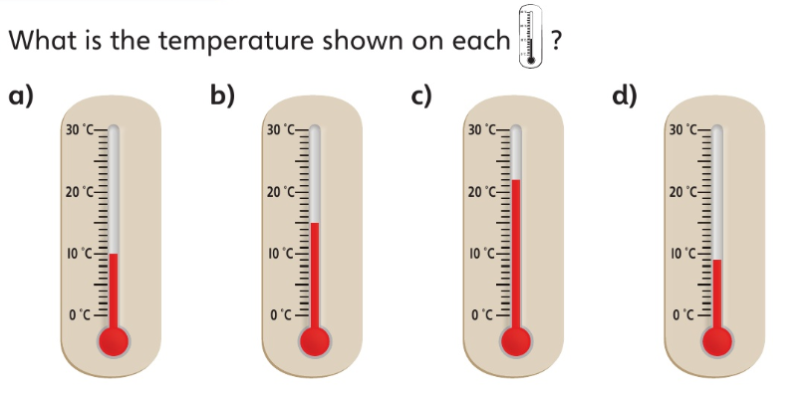
What numbers are marked on the thermometers?
What does each mark stand for?
a): 10 °C
b): 15 °C
c): 22 °C
d): 9 °C

Slide 11
Now I would like you to have a go at completing work in your CGP Maths Reasoning workbook.
If you would like to try Gruffalo work, complete page 28
If you would like to try Horrid Henry work, complete pages 28 and 29
If you would like to try James and the Giant Peach work, complete pages 28, 29 and my Challenge question on the next slide.

Slide 12
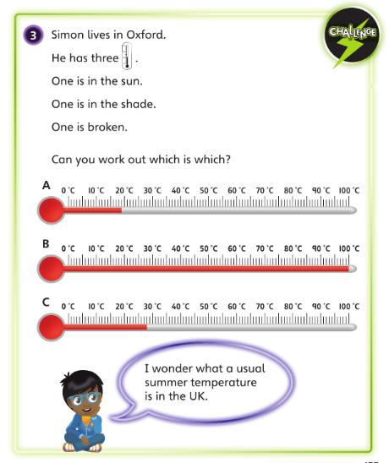

Slide 13
Handwriting
Please complete pages 14 and 15 in your CGP Handwriting Book.

Slide 14
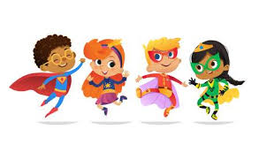
English
This week we are going to write an information text about a superhero.
Who is your superhero going to be?
Here are some examples:
A magical pet, an invincible parent, a flying doctor, a super tutor, a teleporting firefighter…

Slide 15
Your first job is to design and draw your own superhero.
What are they called?
What do they look like?
What do they wear?
What are their special powers?
I’d also like you to write captions describing their special powers.
Look on the next slide for an example of what your poster may look like …

Slide 16
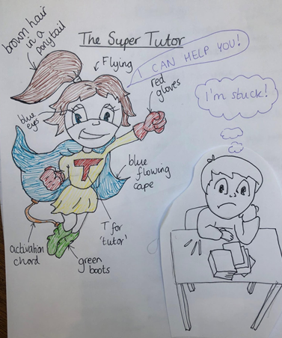

Slide 17
Once you have done all of this, you will be ready to start your writing tomorrow.

Slide 18
Science
I have made a science at home investigations pack for you all to show the people in your house what amazing scientists you all are!
Today I would like you to carry out an experiment that you think will be your favourite.

Slide 19
Enjoy, Unicorns!

