Slide 1
Good Morning Elves!
You have worked so hard this week!
10 house points !!

Slide 2
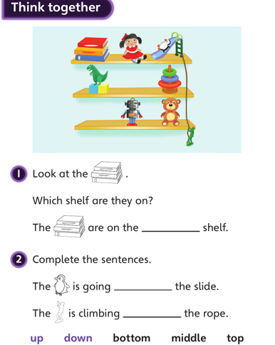
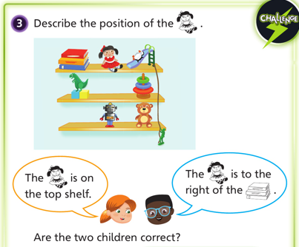
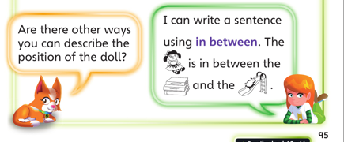
Green group
Thursday’s
Maths Answers
1. top
down
up
2. The children are correct. The doll is on the top shelf. She is
to the right of the books.
3. The doll is above the dinosaur.
The doll is to the left of the slide.

Slide 3
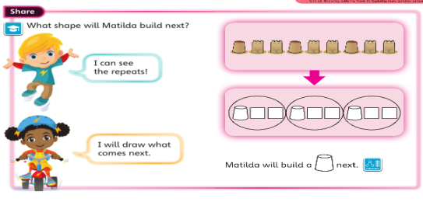
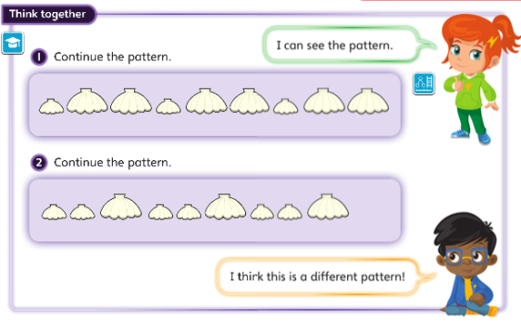
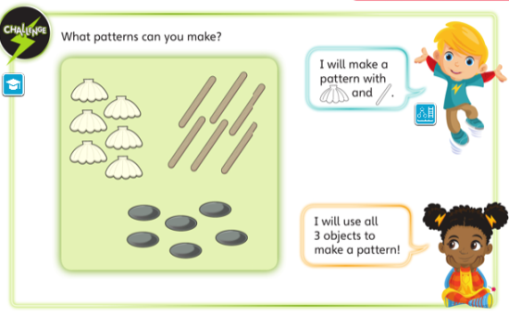
Sandcastle, square, square.
Yellow group
Maths
2. Small shell, small shell, big shell.
3. Shell, stick, stone, shell , stick, stone.
shell, stone , stick, shell, stone, stick.

Slide 4
It’s Friday!
Friday 24th April 2020
Here’s your work for today…
.

Slide 5
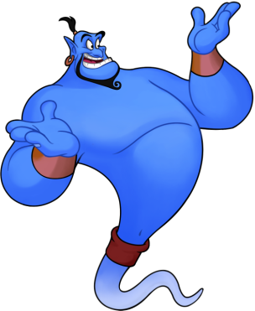
Reading online
I’m so impressed with your reading Elves.
You should be very proud of yourselves!
Please log on to Bug Club
Read for at least 15 minutes.
Please read the key words inside the front cover first.
When you find the bug questions, click and complete them.
Please note down the books you’ve read in your reading
record book.
Your personal login details are on the inside of your reading record book.

Slide 6
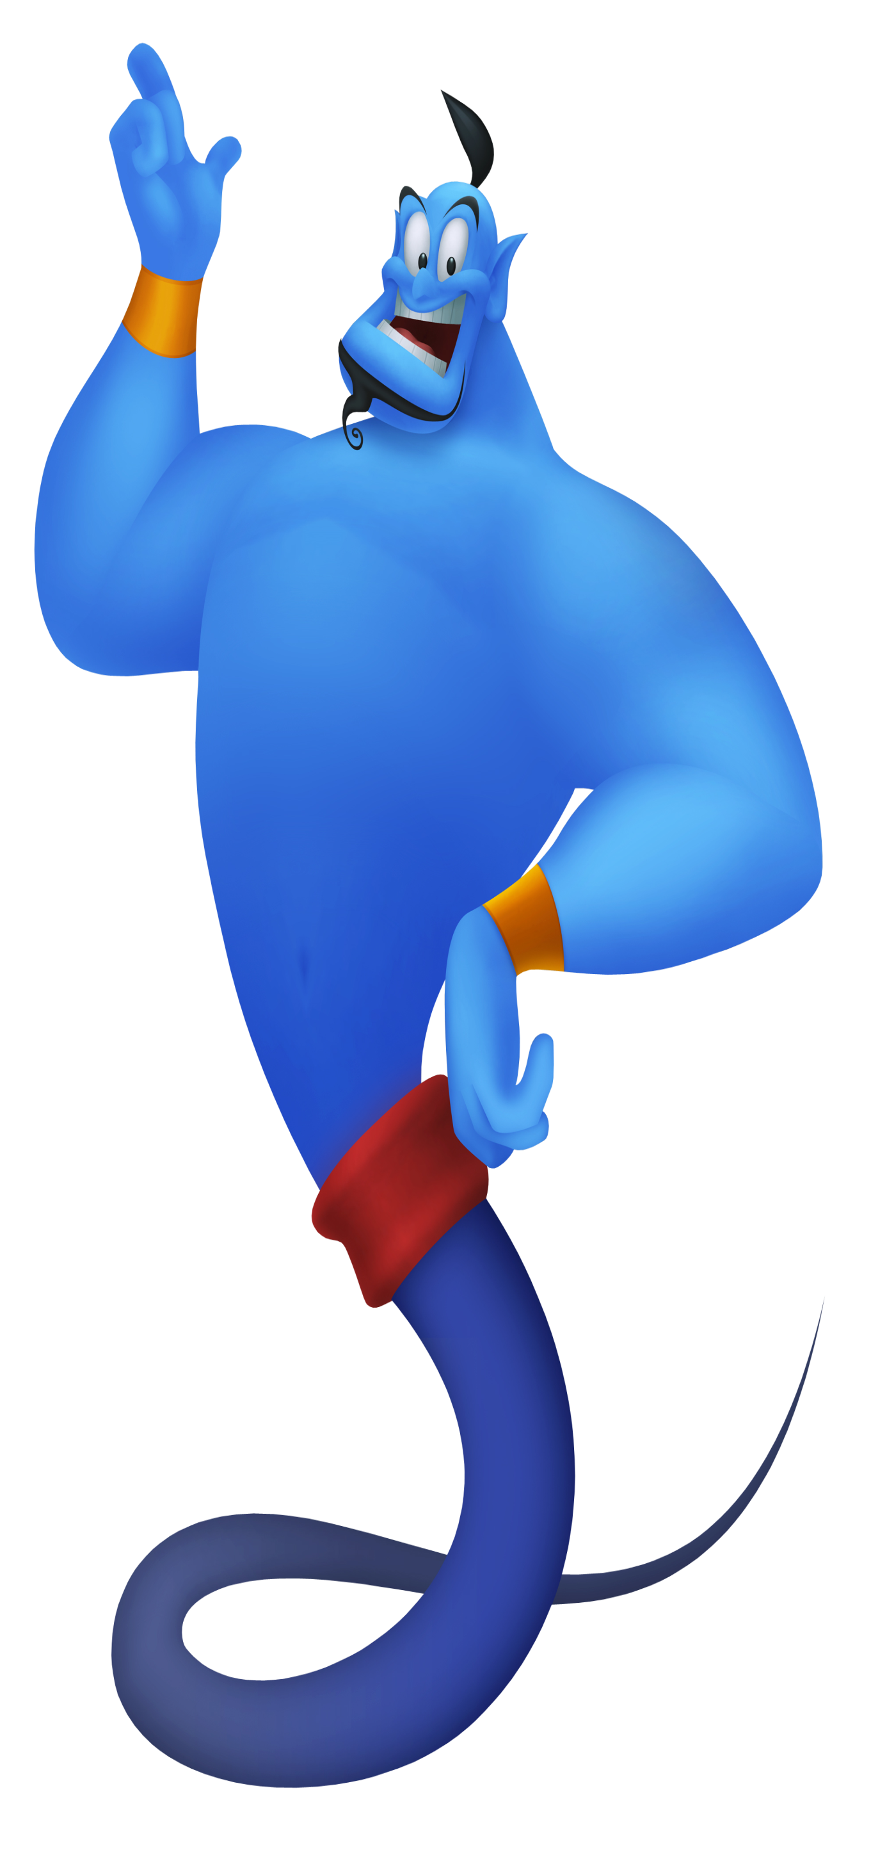
Maths
Today we are going to continue to look at postion and direction.

Slide 7
Maths
Read through these words with a grown up.
Explain the above words you have learnt to your grown up.

Slide 8
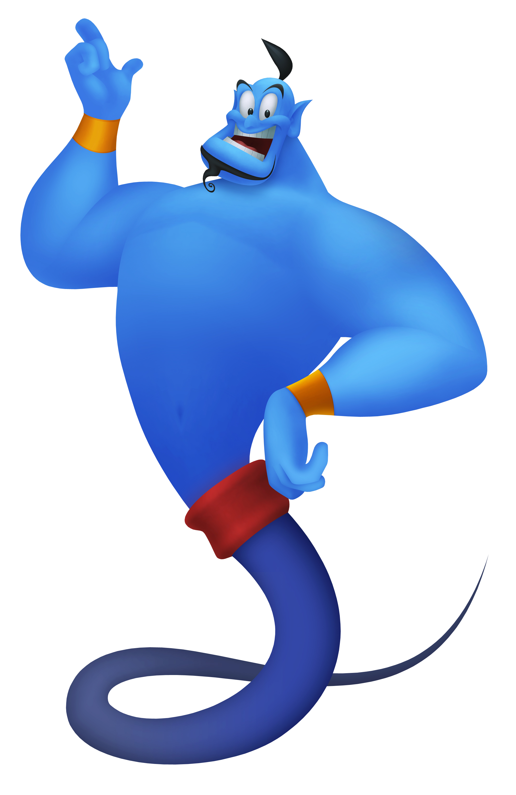
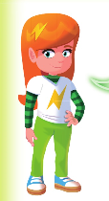
Green group
Maths
Can you jump a whole turn?
This means face an object (a teddy). Then
Jump all the way round to face the teddy when you finish.
Ready Steady Go …..

Slide 9
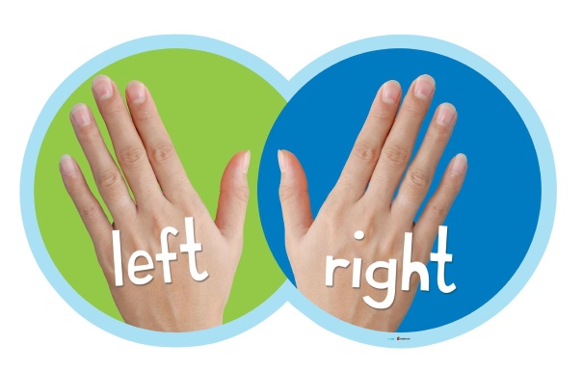
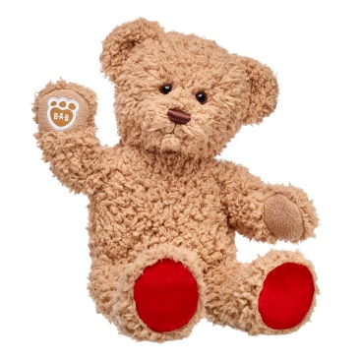
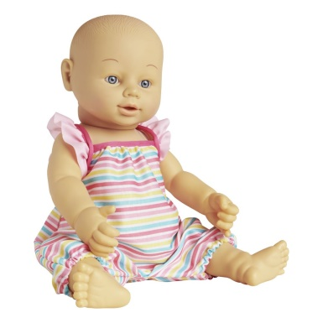
Green group
Maths
Let’s practise finding our left and right.
The doll is on the right side of the boy.
The teddy is on the left side of the boy.
Can you practise your left and right with a grown up?

Slide 10
For today’s work, complete the slides which follow in your blue books. .
If you would like to try Gruffalo work, complete challenge 1 on the next page.
If you would like to try Horrid Henry work, complete challenges 1 and 2
If you would like to try James and the Giant Peach work, complete challenges pages 1,2 and 3.

Slide 11
Green group
Maths
Challenge 1

Slide 12
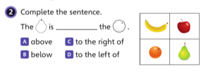
Green group
Maths
Challenge 2

Slide 13
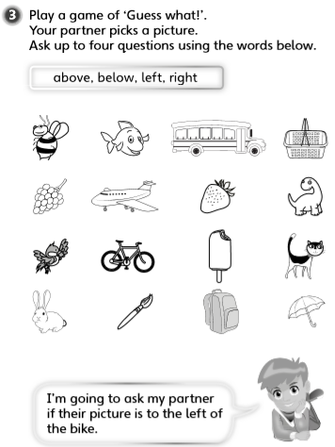
Green group
Maths
Challenge
3

Slide 14
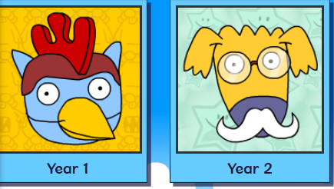
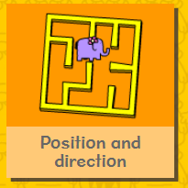
.
.
.
.
Logon on to Busy Things.
Can you score more points today? Are you faster?
Play one or all the games to practise position skills.

Slide 15
If you’ve completed you Maths book and have time for the Maths Challenge below. Have a go at the following question.
Write the answers in your blue book.
Green group
Maths
Gather some objects from around your house and make up a ‘Guess What’ game.

Slide 16
Yellow group
Maths
Maths
Today we are going to continue to create patterns.

Slide 17
Today create a shop in your home. What are you going to sell?
Yellow group
Maths

Slide 18
Yellow group
Maths
Can you complete the tasks below from you CGP book. If you
Complete the challenge questions, draw pictures in your
blue book.
If you would like to try Gruffalo work, complete page 34
If you would like to try Horrid Henry work, complete pages 34 and challenge 1.
If you would like to try James and the Giant Peach work, complete page 34 and challenge 1 and 2.

Slide 19
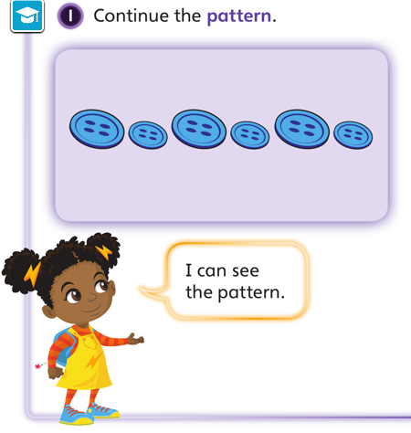
Yellow group
Maths

Slide 20
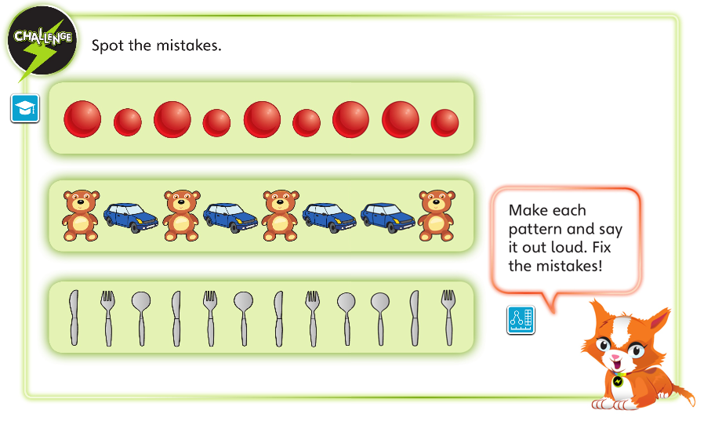
Yellow group
Maths

Slide 21
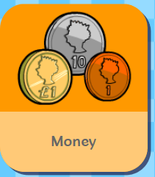
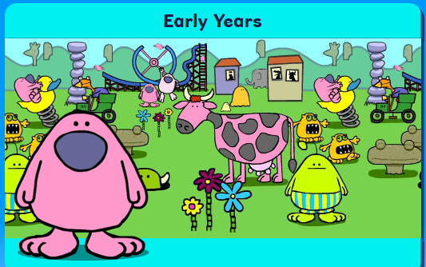
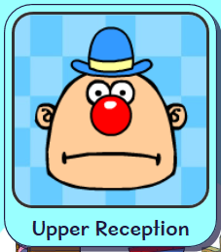
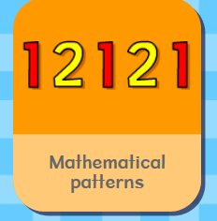
.
Logon on to Busy Things. How did you get on with the games
yesterday.. Play one or all the games to practise your money and
pattern skills.
Can you score more points today? Can you go faster?

Slide 22
Handwriting
Are you impressing your grown ups with your handwriting?
Please complete pages 26 in
your CGP Handwriting Book
.

Slide 23
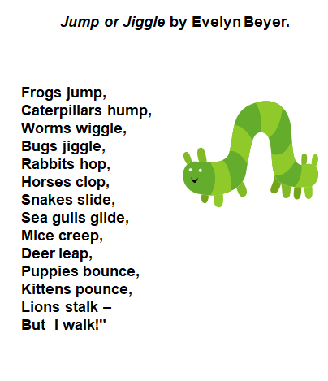
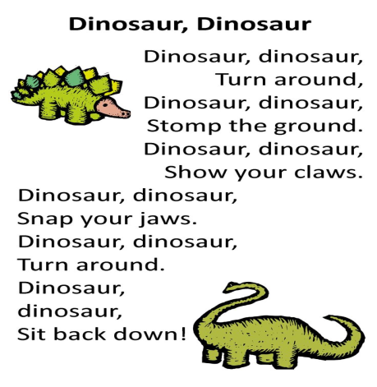
English
Today, have a go and write an amazing poem!
Use one of the poems we have completed this week and create your own.
Have a look at the poetry websites to give you inspiration for your poem.
FizzyFunnyFuzzy: Fun Poetry For Kids
https://fizzyfunnyfuzzy.com/poems
Funny Poems - Kenn Nesbitt's Poetry4kids.com
https://www.poetry4kids.com/poems/

Slide 24
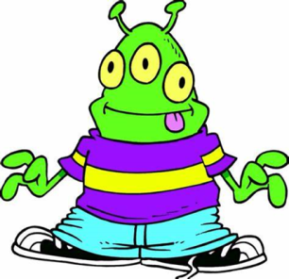
Phonics
Green group
Phonics
Today you are practising the ie sound.
Complete pages 12 and 13 in your CGP phonics booklet.
Follow the orange link to phonics play to practise the ie sound. The web address is in red in case you are unable to access the link. Click on the existing version.
Buried treasure blending game ie sound
https://www.phonicsplay.co.uk/member-only/BuriedTreasure2.html

Slide 25
Phonics
Green group
Phonics
Challenge
Alternative sounds for o
As in hot or no
Follow the orange link to phonics play to practise the o sound. The web address is in red in case you are unable to access the link. Click on the existing version.
Cheeky Chimps Game Phase 5 alternative o sound
https://www.phonicsplay.co.uk/member-only/CheekyChimps.html

Slide 26
Phonics
Yellow group
Phonics
I would like you to work through pages 46 in your Phonics booklet 1.
Follow the orange link to phonics play to practise blending single
sounds. The web address is in red in case you are unable to access the link. Click on the existing version.
Pick a picture game Phase 2
https://www.phonicsplay.co.uk/PictureMatch.html

Slide 27
For our last activity of the week, we
are going to end with a science experiment.
See the following page.
Check out more experiments on the Year One learning page if you want to try a different one.

Slide 28
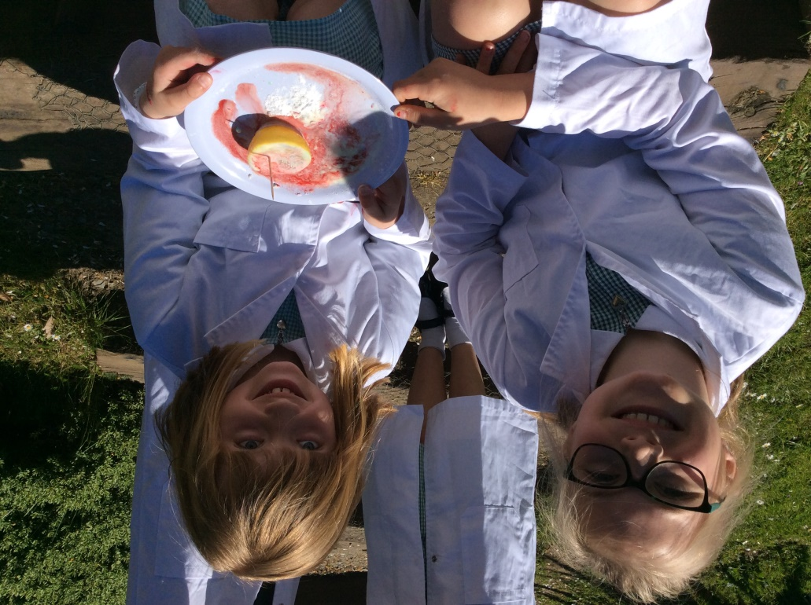
Erupting Lemon Volcanoes
A messy experiment that is best carried out where making a mess doesn’t matter*
You will need:
A Lemon
A toothpick
Food colouring
Washing up liquid
Bicarbonate of soda
A plate
1. Cut your lemon in half and then use a toothpick to poke into the flesh of the lemon to release the juice.
2. Put your lemon on a plate (ready to catch the eruption!)
3. Add a few drops of food colouring.
4. Next, add a little washing up liquid to the lemon.
5. Sprinkle the top of the lemon with a generous layer of bicarbonate of soda.
6. Stand back and watch!

Slide 29
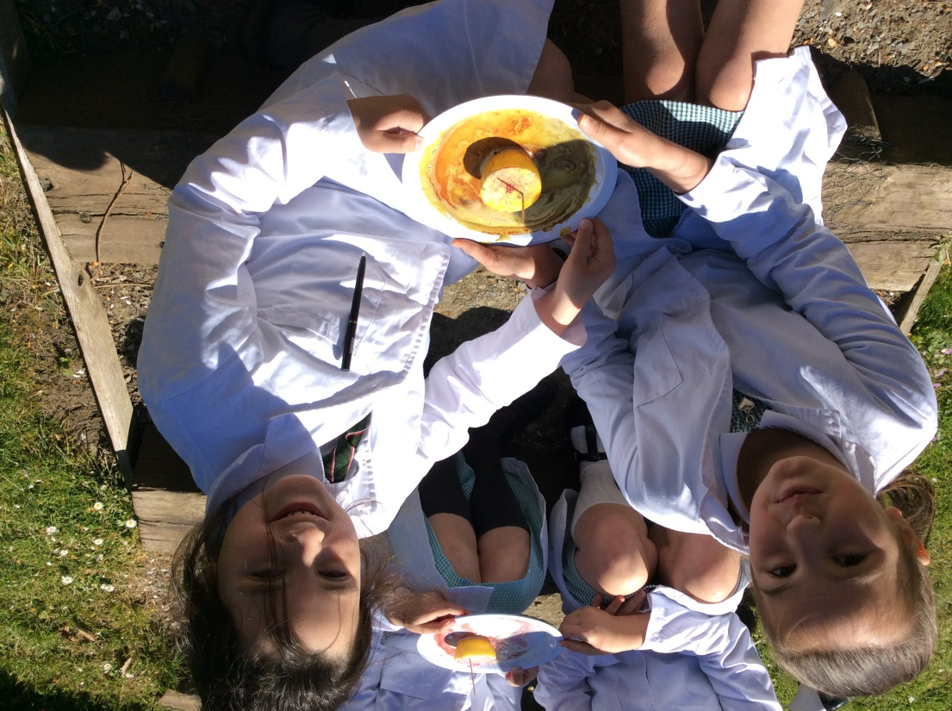
What’s the science behind it?
This is all because of a chemical reaction: The citric acid from the lemon juice is reacting to the bicarbonate of soda creating carbon dioxide gas. The washing up liquid helps capture the gas so we can see it as bubbles during the reaction.
You could try to answer these questions:
Would this work as well with limes?
Would else could you use?

Slide 30
Active Learning

Slide 31
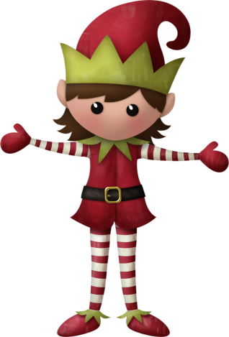
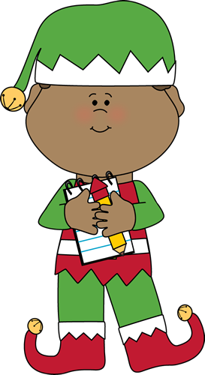
Have a fantastic weekend
Elves.
I would love to hear from you. Send me a photo or message via email on admin@farnborough.bromley. sch.uk

