Slide 1
Good morning Unicorns!
Here’s your work for today: Friday 1st May

Slide 2
Reading answers from yesterday:
Page 38
Outside the door
Warm himself up, run around
The North Wind
Page 39
He asked the North Wind to come to him.
Fully
In the door

Slide 3
Page 40
1a. Yes
1b. There is a snowman or it has snowed or the snowman says he wants to warm himself up inside or the snowman says he’s completely frozen.
2. It’s too warm inside.
Page 41
3, 5, 1, 2, 4
1a. No
1b. Because it would become a puddle

Slide 4
Reading online
Please log on to Bug Club and read for at least 15 minutes.
Make sure you answer your bug questions!

Slide 5
Maths answers from yesterday:
Pages 45 and 46
The arrow will continue across the middle
The box on the right hand side
The third steering wheel along
Two right angle turns clockwise half turn anti-clockwise half turn clockwise
Quarter; 5; clockwise; quarter
Challenge
Harry and Amelia are correct.

Slide 6
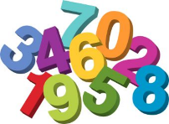
Maths
Today we are going to look at tables showing information.

Slide 7
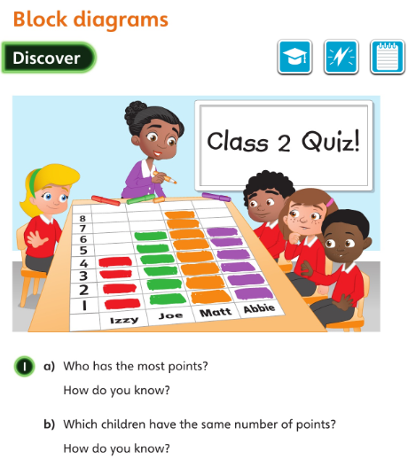
• How do you know those two towers show the same amounts?
Let’s look at the answers and how you could have worked them out on the next page…

Slide 8
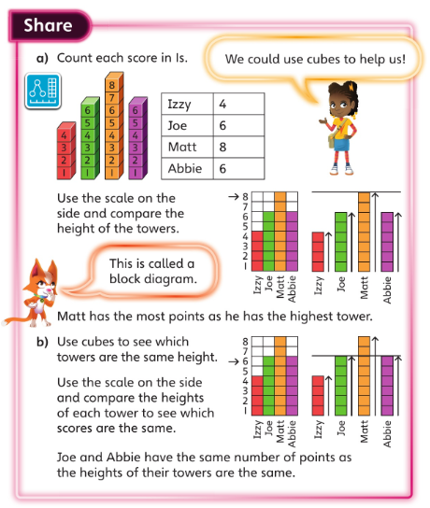
What strategies did you use to work out the answers?

Slide 9
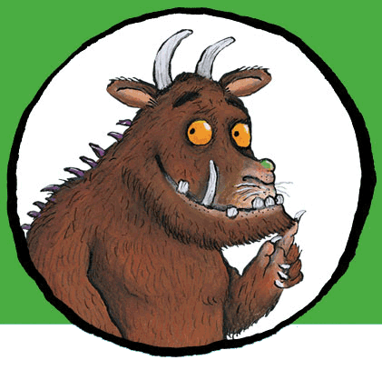
Now I would like you to have a go at completing work in your CGP Maths Reasoning workbook.
If you would like to try Gruffalo work, complete page 47
If you would like to try Horrid Henry work, complete pages 47 and 48
If you would like to try James and the Giant Peach work, complete pages 47, 48 and my Challenge question on the next slide.

Slide 10
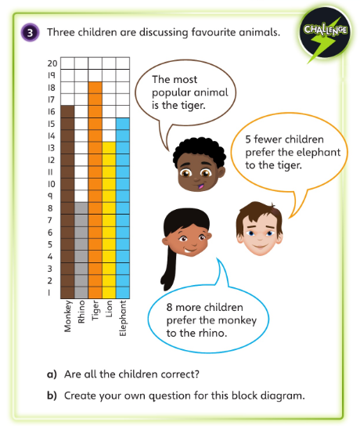

Slide 11
Handwriting
Please complete pages 24 and 25 in your CGP Handwriting Book

Slide 12
English
Today we are going to use your ideas from yesterday to put together your poem about a noisy, fantasy land.

Slide 13
Yesterday you chose the animals that live in your land.
Now you need to decide on the noises that they will make.
Here are my ideas:
hiss, shoo, hum

Slide 14
Now put all your ideas from yesterday and today to write your poem:
On the ______ ______ _____
Where the _______ go _______
And the _______ all say _______!

Slide 15
Here’s my version:
On the Tring, Trang, Trong ,
Where the hamsters go hiss
And the eggcups all go shoo!
There’s a Tring , Trang, Trong,
Where the goldfish go hum
And the squirrels all go stamp !
On the Tring, Trang, Trong
All the unicorns go crash!
And you just can’t catch ‘em when they do!

Slide 16
‘Find Out Friday’ Science!
Let’s hope that the lovely sunshine that we’ve been having has continued for today’s investigation…

Slide 17
Paper Plate Sundial
You will need:
A paper plate
A pencil or straw
Pens
A sunny day!

Slide 18
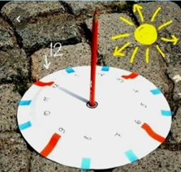
Use a sharp pencil to push a hole through the centre of a paper plate.
Write the number 12 at the top of the plate.
At 12pm om a sunny day, take the plate outside. Push a pencil/straw through the hole so it stands up. Position it so the shadow it makes falls on the 12.
4. Secure the plate to the ground with a stone.
5. One hour later, at one o’clock, check the position of the shadow along the edge of the plate and write the number one on that spot. Continue each hour predicting the position and then checking and marking the actual position and time on the edge of the plate.
6. At the end of the day you will have your very own sun clock. On the next sunny afternoon, you will be able to tell the time just by watching where the shadow of the pencil/straw falls on your clock.

Slide 19
What’s the Science behind it? The sun looks as though it moves in the sky throughout the day. Actually, it is the Earth moving around the sun. Shadows change direction depending upon the time of the day. A sundial like this one uses a shadow’s position to tell the time.

Slide 20
Well done for all your hard work; have a lovely weekend, Unicorns and…

