Slide 1
Subject / Lesson | Time
Maths | 1 hour
Grammar | 20 minutes
Comprehension | 20 minutes
English | 40 minutes
Physical Activity | 30 minutes
Science | 30 minutes

Slide 2
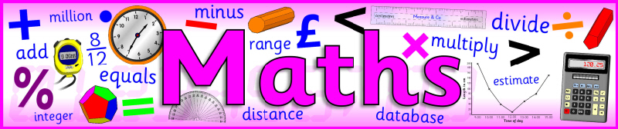
Maths Task | Time
Work from CGP book | 30 minutes
Maths Frame Username: Farnborough / Password: Farnborough https://mathsframe.co.uk/en/resources/resource/366/interactive-maths-quiz Find some Shape games to play to practice your knowledge about shape. | 30 minutes

Slide 3
Grammar Task | Time
Continue working through the CGP Grammar and Punctuation books | 20 minutes

Slide 4
Comprehension Task | Time
Continue working through the Nelson Comprehension book | 20 minutes

Slide 5
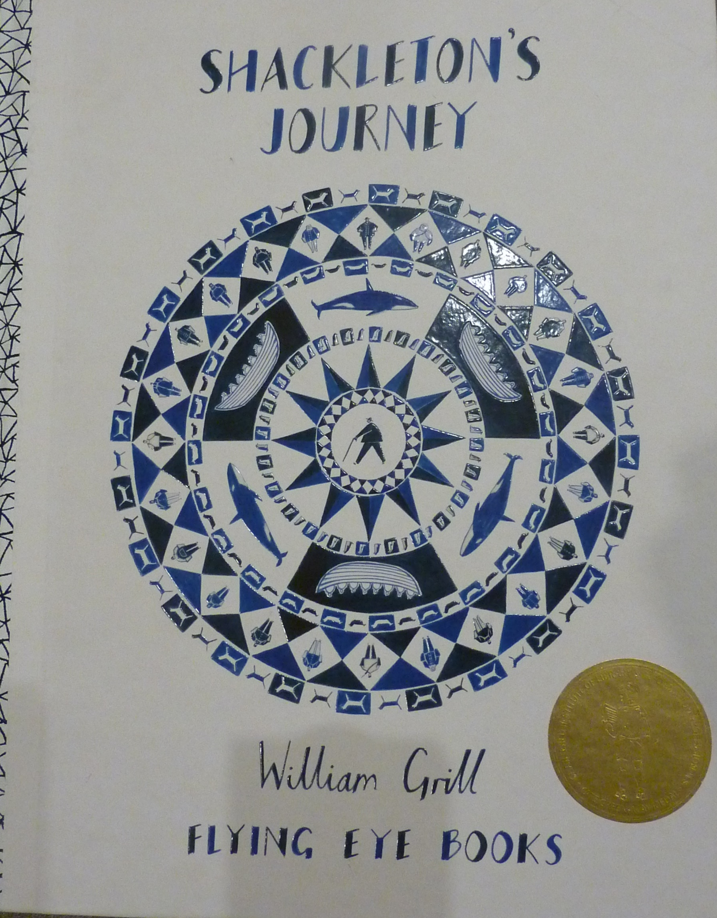
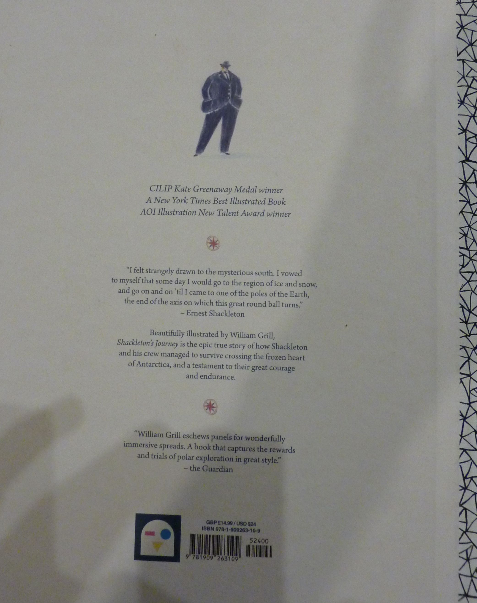

Slide 6
If you have not watched the documentary yet, please watch on the link below:
https://www.youtube.com/watch?v=sgh_77TtX5I

Slide 7
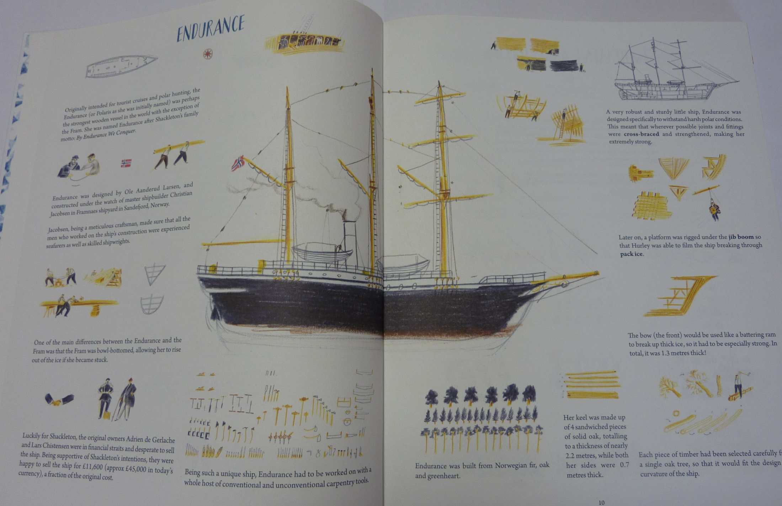

Slide 8

The ship was crucial to Shackleton’s adventure.
Research Endurance further and makes notes about any interesting facts you find, ready to write up an information text tomorrow.

Slide 9
Physical activity – minimum 30 minutes each day | Link to resource
5 a day User Name: FPS53 / Password: JFz4XqG7 | https://player.5-a-day.tv/
Joe Wicks – PE sessions | https://www.youtube.com/channel/UCAxW1XT0iEJo0TYlRfn6rYQ
Cosmic Kids Yoga | https://www.youtube.com/user/CosmicKidsYoga
PE Hub Parents Portal | https://pehubportal.co.uk/
Go Noodle | https://www.gonoodle.com/good-energy-at-home-kids-games-and-videos/
Go for a walk/run. You must go with an adult from your home and make sure you stay 2 metres away from other people.

Slide 10
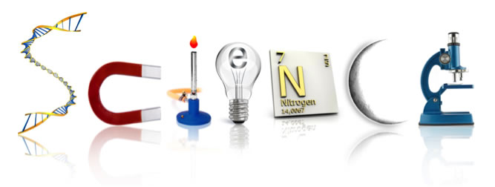
The tale of the giraffe’s neck
Rudyard Kipling wrote a series of stories called `Just So` stories which explained how animals got their special features. Read a couple of his stories from the link below:
http://www.gutenberg.org/files/2781/2781-h/2781-h.htm#link2H_4_0002

Slide 11
Have a go at creating your own story. Some ideas are:
tiger/zebra stripes
crocodile´s teeth
elephant´s trunk
Peacock`s tail feathers
deer´s antlers

