Slide 1
Subject / Lesson | Time
Maths | 1 hour
Grammar | 20 minutes
Comprehension | 20 minutes
English | 40 minutes
Physical Activity | 30 minutes
Topic | 30 minutes

Slide 2

Maths Task | Time
Classroom secrets lesson – Reading and Interpreting line graphs http://farnboroughprimary.co.uk/wp-content/uploads/2020/03/Year-6-Summer-Block-3-Step-1-Read-and-Interpret-Line-Graphs-2.zip | 50 minutes
Times Table Rock Stars | 10 minutes

Slide 3
Grammar Task | Time
Continue working through the Nelson Grammar book | 20 minutes

Slide 4
Comprehension Task | Time
Continue working through the CGP Poetry and Non-fiction books | 20 minutes

Slide 5



Slide 6
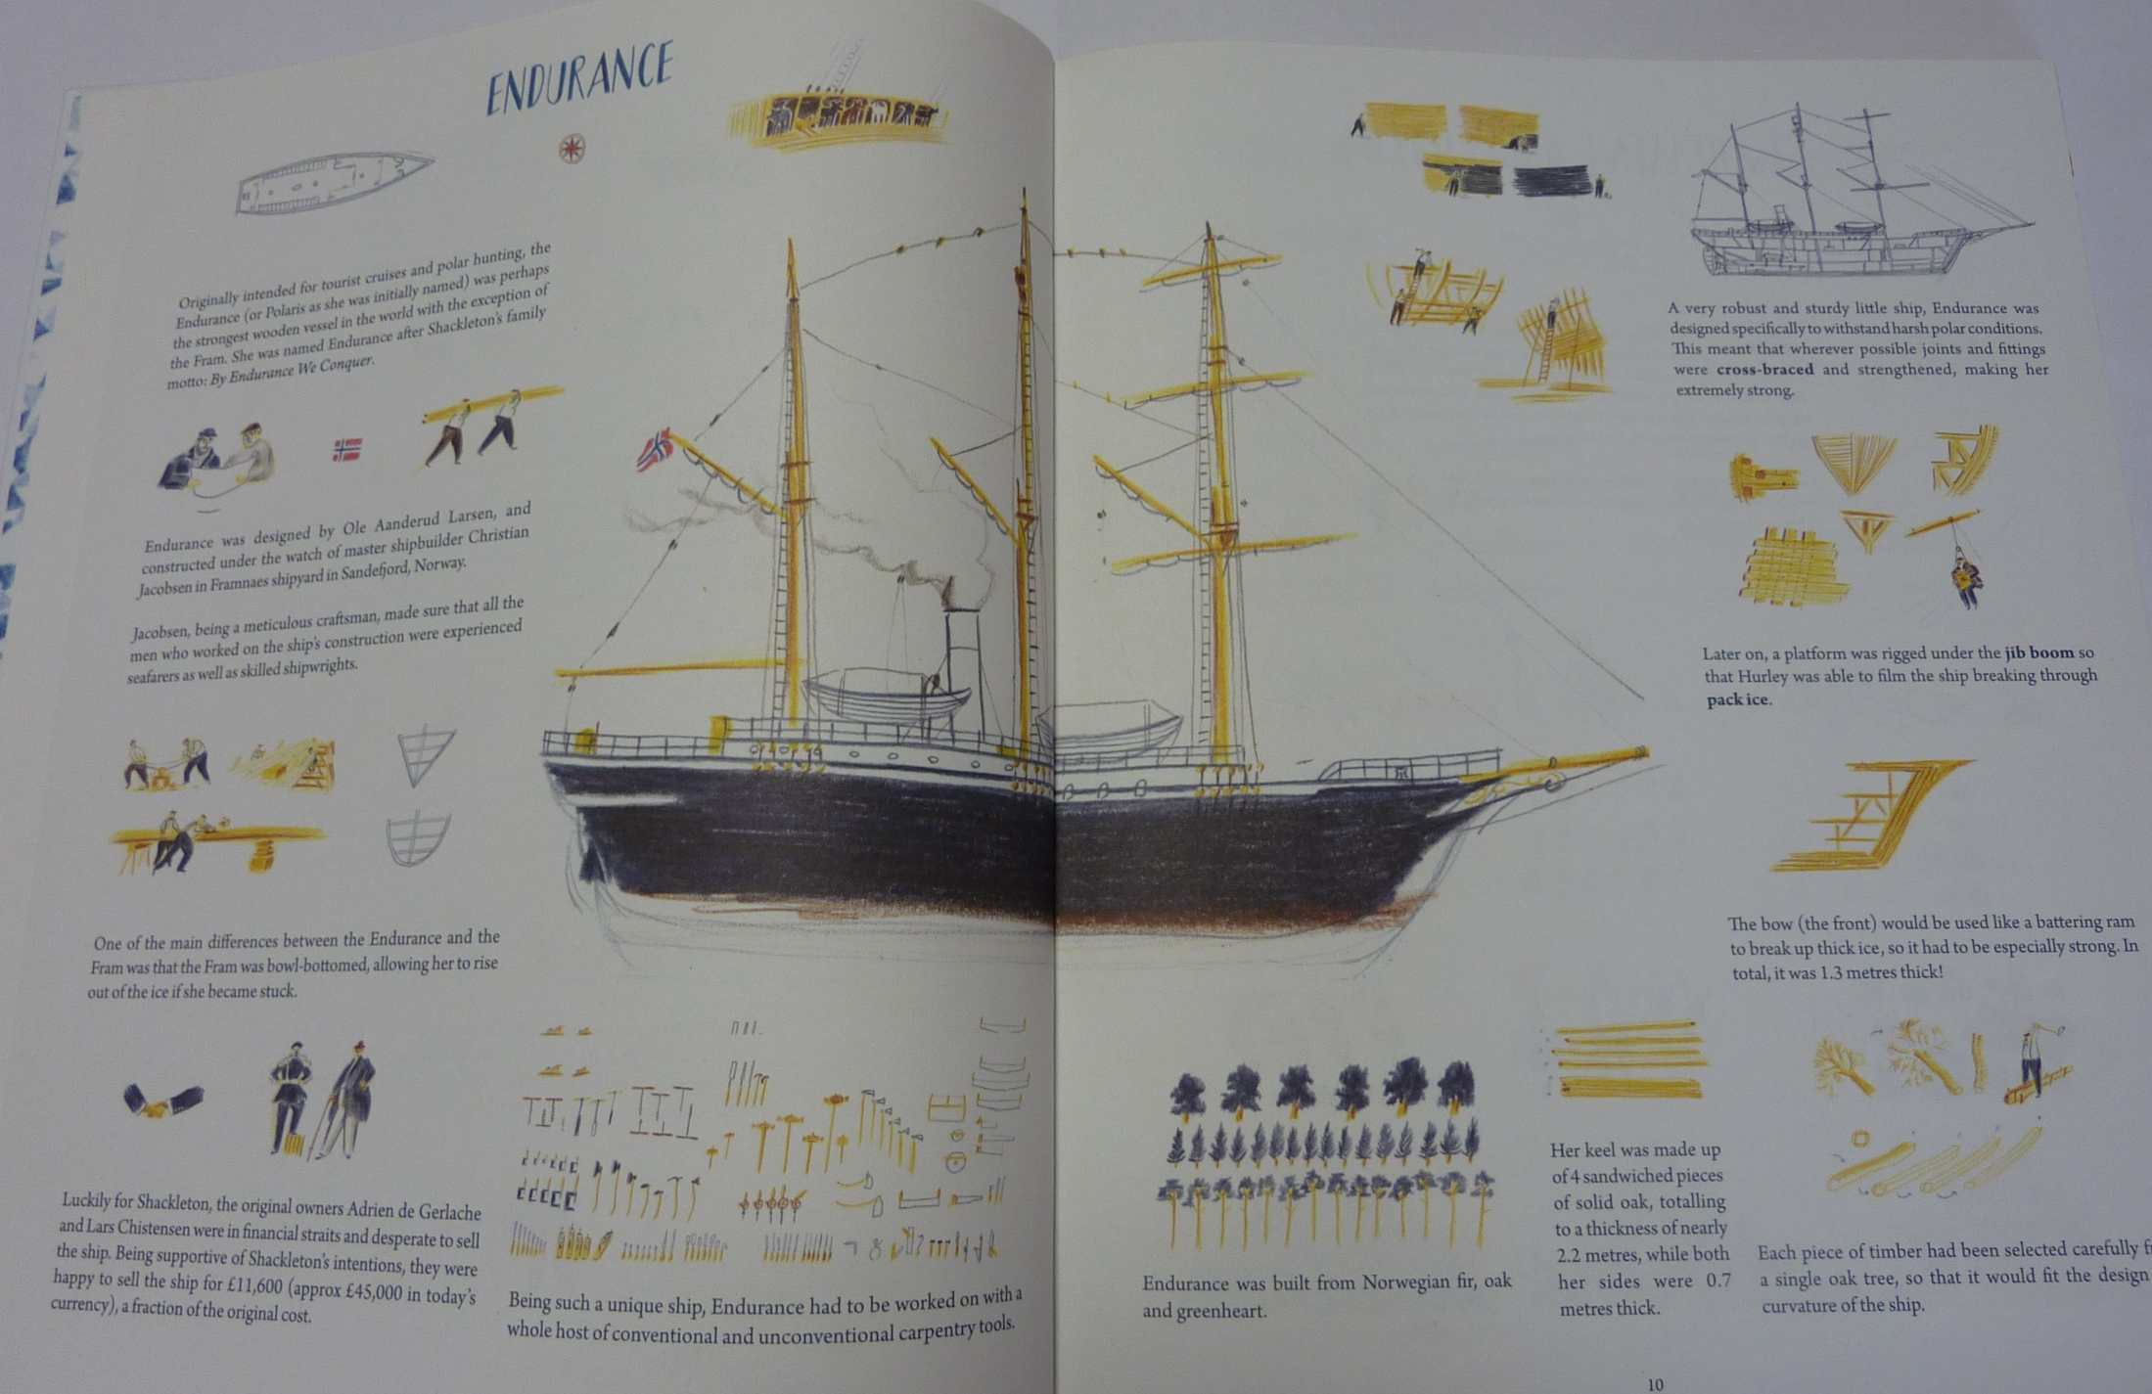

Slide 7
The ship was crucial to Shackleton’s adventure.
Complete your information text.
Make sure you draw a picture of the ship to illustrate your text– it doesn’t have to be the one from the book, try an image search on google for ideas.

Slide 8
Physical activity – minimum 30 minutes each day | Link to resource
5 a day User Name: FPS53 / Password: JFz4XqG7 | https://player.5-a-day.tv/
Joe Wicks – PE sessions | https://www.youtube.com/channel/UCAxW1XT0iEJo0TYlRfn6rYQ
Cosmic Kids Yoga | https://www.youtube.com/user/CosmicKidsYoga
PE Hub Parents Portal | https://pehubportal.co.uk/
Go Noodle | https://www.gonoodle.com/good-energy-at-home-kids-games-and-videos/
Go for a walk/run. You must go with an adult from your home and make sure you stay 2 metres away from other people.

Slide 9

Steve Jobs
Steve Jobs was an amazing inventor who changed technology across the World. We have all used technology he helped to create.

Slide 10
Steve Jobs
Below is a link showing him introducing the first ever iPad.
https://www.youtube.com/watch?v=qxWEpp206lg

Slide 11
Steve Jobs
Whilst it was an amazing product, his delivery was quite restrained. I would like you to have a go at unveiling the product or a product of your choice in an engaging manner.

Slide 12
Steve Jobs
There are some points to think about on the next slide. Make some notes today and tomorrow have a go at presenting it. If you can, film it. You can email it in to me!

Slide 13
What would persuade me?
- a balance of humor and facts
- show the iPad / or product you are selling
- show what it can do
- something to catch your eye
- clear reason(s) why the iPad is the best choice
- persuasive language
- a USP (unique selling point)

