Slide 1
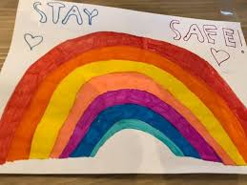
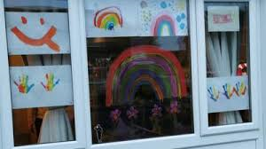
Hi Elves, Great work yesterday!

Slide 2
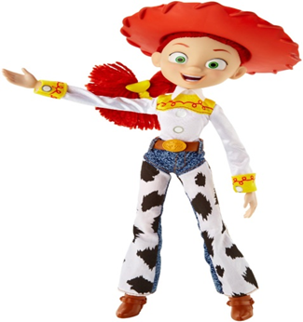
It’s Tuesday
Here’s your work for today…

Slide 3
Reading online
Well done Elves for your reading last week.
Keep it up!
Please log on to Bug Club and read for at least 15 minutes.
Read the key words inside the front cover first.
Click on the bug questions.
Keep on noting down the books you’ve read in your reading
record book.
Your personal login details are found inside the front cover of your reading record book.

Slide 4
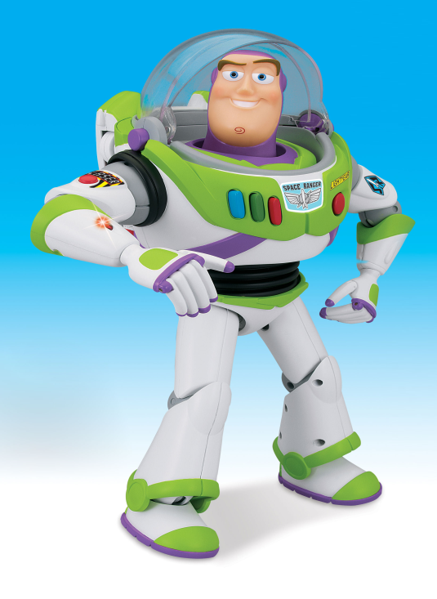
Maths
Today we are going to look at
measuring capacity.

Slide 5
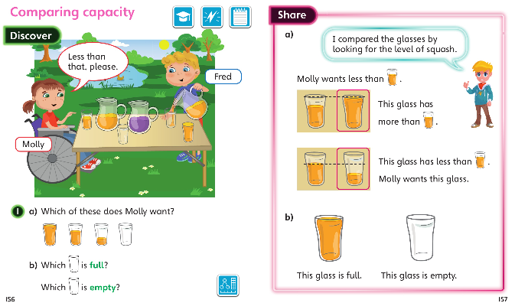
Green group
Maths

Slide 6
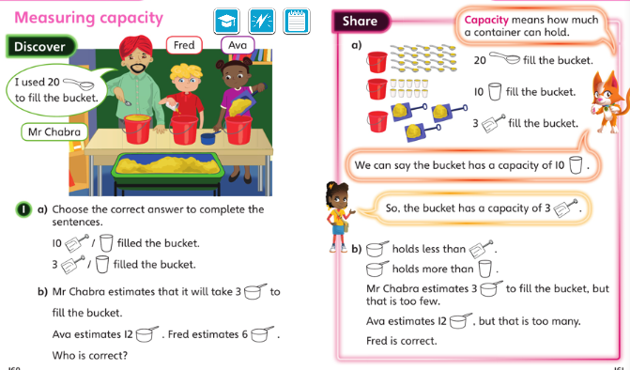
Green group
Maths

Slide 7
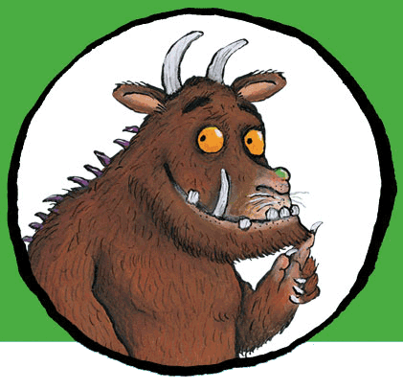
I’d like you to complete the page below from your CGP books and the challenge maths slides which follow this slide. Keep on challenging yourself! You’ll find the answers to CGP questions at the back of the CGP book.
If you would like to try Gruffalo work, complete page 27
If you would like to try Horrid Henry work, complete pages
27 and the challenge sheet 1 (next page and record in your blue book)
If you would like to try James and the Giant Peach work, complete pages 27, challenge pages 1 and 2

Slide 8
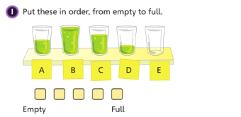
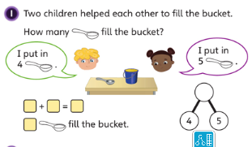
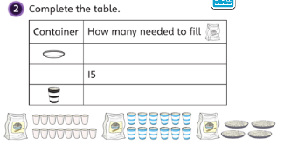
Green group
Maths
Challenge
1

Slide 9
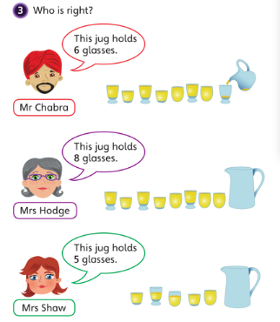
Green group
Maths
Challenge 2

Slide 10
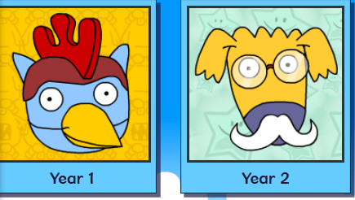
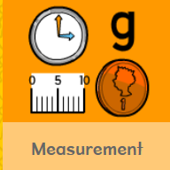
.
.
.
.
Logon on to Busy Things.
On your marks, get set, go. Play one or all the games to practise measuring skills.

Slide 11
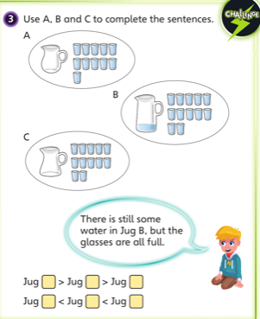
If you’ve completed you Maths book and have time for the Maths Challenge below. Have a go at the following question.
Write the answers in your blue book.
Green group
Maths

Slide 12
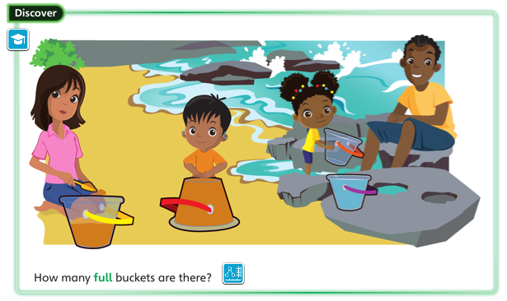
Yellow group
Maths

Slide 13
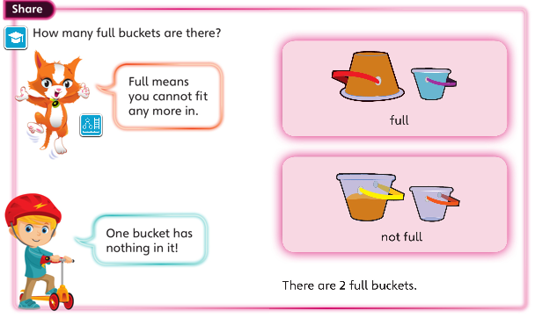
Yellow group
Maths

Slide 14
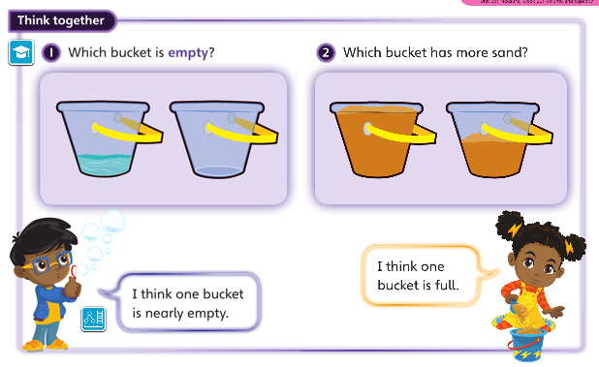
Yellow group
Maths

Slide 15
Now I would like you to have a go at completing work in your CGP Maths workbook. The answers are in the back of the book.
Yellow group
Maths
If you would like to try Gruffalo work, complete page 24
If you would like to try Horrid Henry work, complete pages 24 and the challenge sheet 1 found on the next slide.
If you would like to try James and the Giant Peach work, complete pages 24 and the challenge sheet 1 and 2 found on the next slides. Write/Draw pictures to show your answers in the blue book
(Parents/carers can scribe for the children in their blue books.)

Slide 16
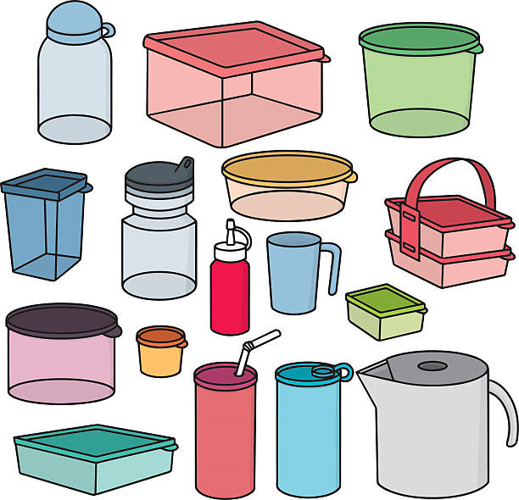
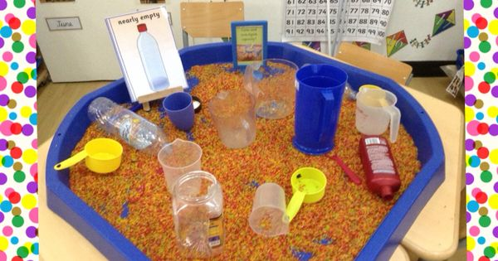
Yellow group
Maths
Challenge 1
Using a variety of plastic containers,
fill these up with different quantities.
Make a container full, make another
Half full. Can you spot the empty container? Use water, lentils, rice to fill up the containers.
Enjoy exploring!

Slide 17
Yellow group
Maths
Challenge 2
Select 3 different containers and try this out!
Which container holds the most?

Slide 18
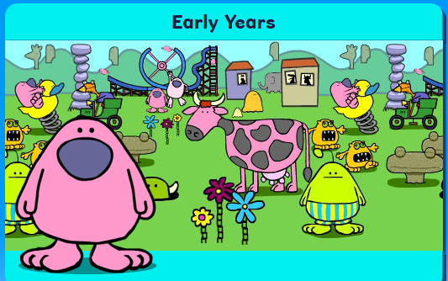
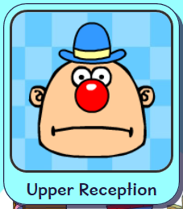
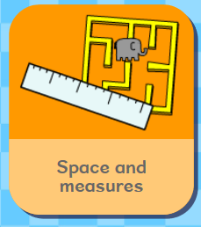
.
Logon on to Busy Things. On your marks, get set and go. Play one or all the games to practise your measuring skills.

Slide 19
Handwriting
Please complete pages 14 and 15 in
your CGP Handwriting Book
.

Slide 20
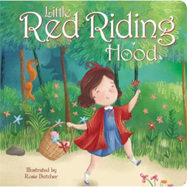
English
First of all, re-read the Power point or PDF version of Little Red Riding Hood which is listed on the Year 1 Learning Page.
If you haven’t already done so, talk through the story
together and add some actions to the story.

Slide 21
English
Little Red Riding Hood is carrying a basket full of food and treats for her Granny. What is inside her basket?
In you blue books, can you draw a picture of a basket and items which are in the basket. Little Red Riding Hood has hidden some treats for her Granny to make her feel special and loved. What has she put in?
Then can you write a list to describe what is in basket. Have a look on the next page for some
ideas.

Slide 22
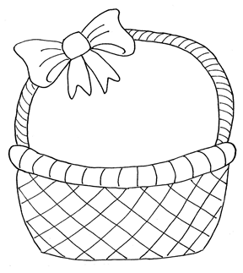
English
I have put a loaf of fresh brown bread, some
some butter and juicy ham in my basket. Also, there are a couple of ripe bananas, a bunch of sweet, green grapes and a chocolate cup cake.
I love my Granny very much so I have drawn a picture for my Granny. The last thing in my basket, is an Easter egg with a pink and blue ribbon.

Slide 23
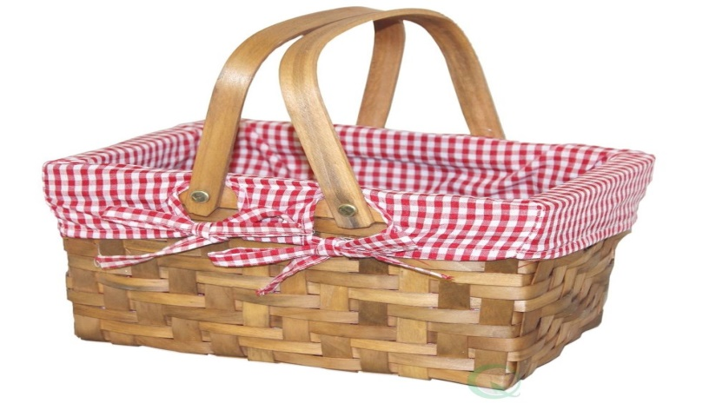
English
Can you make a basket up full of goodies?
What can you find in your home to put in your
basket for someone special?
What can you make for someone special?

Slide 24
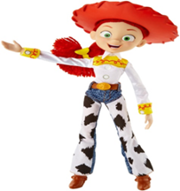
Phonics
Green group
Phonics
Take a look at page 16 and 17 in your Phonics booklet and complete the pages.
Be creative –
Using colouring pens, felt tips.
Create a colourful ‘ ou’ poster.
Include pictures and words with
the ‘ou’ sound.

Slide 25
Phonics
Yellow group
Phonics
I would like you to work through pages 28 and 29 in your Phonics booklet 1.
Practise the Phase 2 sounds with Jolly Phonics.
Teach an adult the actions.
Follow the link below.
https://www.youtube.com/watch?v=1Qpn2839Kro

Slide 26
Phonics
Yellow group
Phonics
Practise your blending skills. Adults, write words clearly on a piece of paper.
Use robot arms to read these words.
p i n p o t
p o p t i p

Slide 27
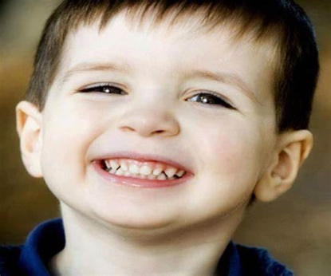
BE KIND!
I challenge you to see how many KINDNESS points you can score in a
day. Here are some examples how a grown up can award you points.
Your grown up needs to spot you:
Helping another member of your family.
Making somebody else laugh or smile in your family
(telling them a joke or leaving a secret note somewhere).
Making something special for someone in your family

Slide 28
Active Learning

Slide 29
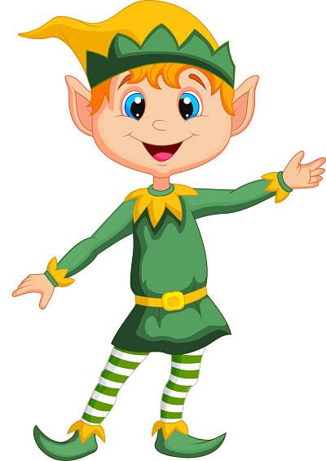
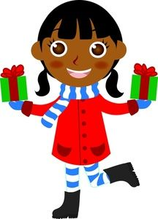
Stay safe and
See you tomorrow.
Well done Elves!

