Slide 2
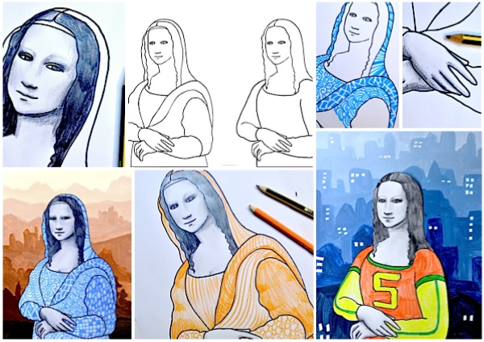

Slide 3
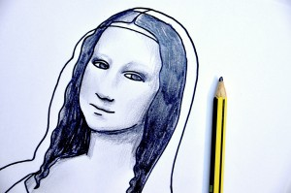
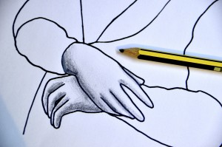
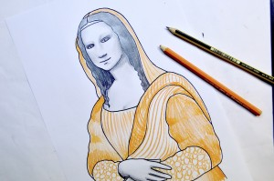
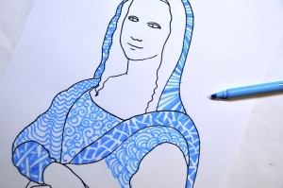
The shadows of the face and hands are drawn in pencil, imitating the shades from the original Mona Lisa.

Slide 4
Create a landscape of hills
Use the technique of tonal gradations which mimics the aerial perspective invented by Leonardo da Vinci
The figure of the Mona Lisa has been cut out from the worksheet and pasted on painted background.

Slide 5
