Slide 1
Good Morning Unicorns!
Here’s your work for today:
Thursday 2nd April

Slide 2
Reading Comprehension
Today you are going to read a text and then answer questions about it.

Slide 3
First…
…read the text ‘The Circus’ on pages 17-20 in your CGP Reading workbook.

Slide 4
Now take a look at the questions…
R
Remember to be detectives- the answers will be hidden somewhere in the text.

Slide 5
Please complete the questions on pages 17-20 of your CGP Reading workbook.

Slide 6
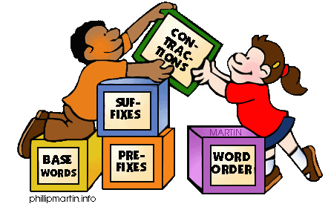
Grammar
Today you will be focussing on:
Proper Nouns
Watch this link to recap:
Proper Nouns

Slide 7
Grammar
Please complete pages 8 and 9 in your Nelson Grammar workbook.

Slide 8
Maths answers from yesterday:
Pages 22 and 23
Two leaves need to have been coloured in.
¾= The box with 3 squares shaded
¼= The box with 1 square shaded
3. ¼ of 8 = 2
¾ of 12 = 9
4. 5 brown horses
5. ½ of the square is grey
2/4 of the square is grey
6. 2 ¾, 3 ¼

Slide 9
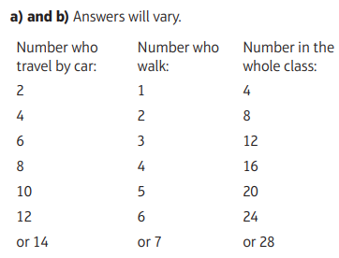
Maths answers from yesterday:
Deepen Activity

Slide 10
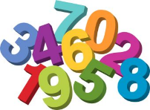
Maths
Today we are going to look at measuring different amounts.

Slide 11
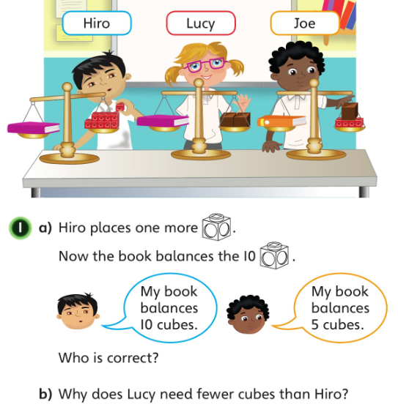
Let’s look at the answers and how you could have worked them out on the next page…

Slide 12
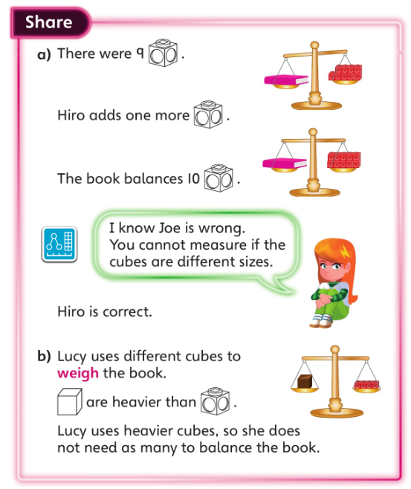
• Why does Astrid say that the cubes need to be the same size?
• Why would Hiro need more cubes than Lucy when they are measuring the same book?

Slide 13
Now I would like you to have a go at completing work in your CGP Maths Reasoning workbook.
If you would like to try Gruffalo work, complete page 24.
If you would like to try Horrid Henry work, complete pages 24 and 25
If you would like to try James and the Giant Peach work, complete pages 24 and 25 and my ‘Deepen Activity’ question on the next slide.

Slide 15
English
Today you are going to use the poster that you created yesterday to help you to write your instructions for how to be a perfect ___.

Slide 16
These are what you will need to include:
A title and introduction.
A ‘you will need’ list. Remember to include quantities (how much).
Numbered instructions.
Imperative Verbs.
Adverbs telling you how to do things.

Slide 17
I had a special request from Noah last week… He wanted to carry on with the coding that we had begun in class. Here’s the link to Lightbot, the program that we have been using in our computing lessons: Lightbot- Hour of Code Which level can you reach?
Computing

Slide 18
Have fun, Unicorns!

