Slide 2
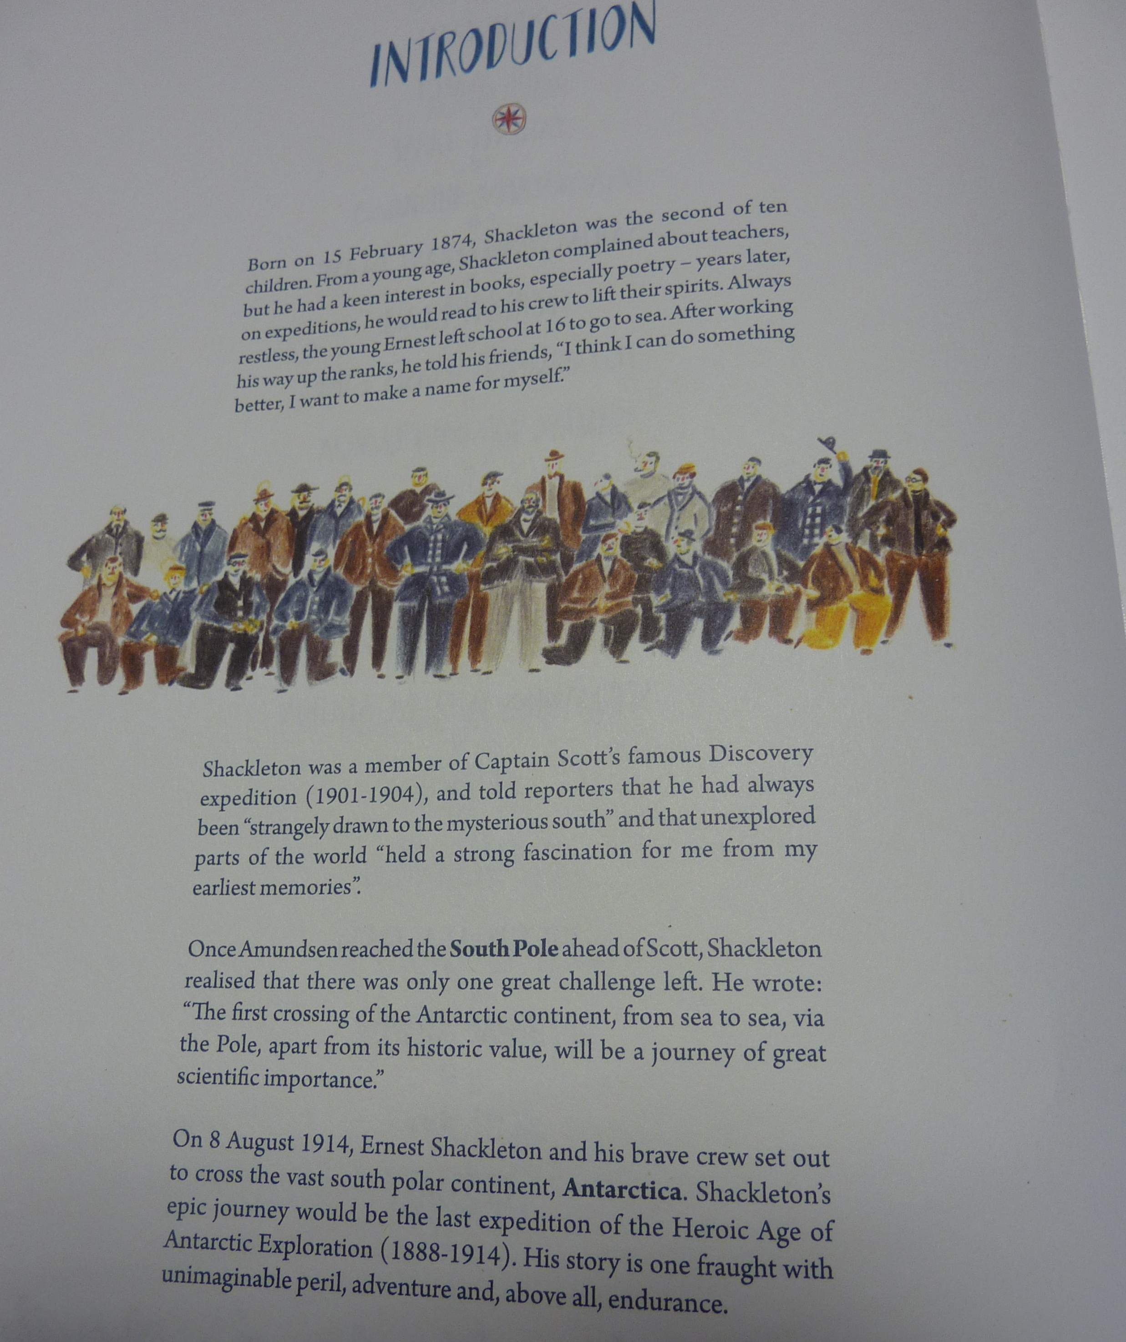
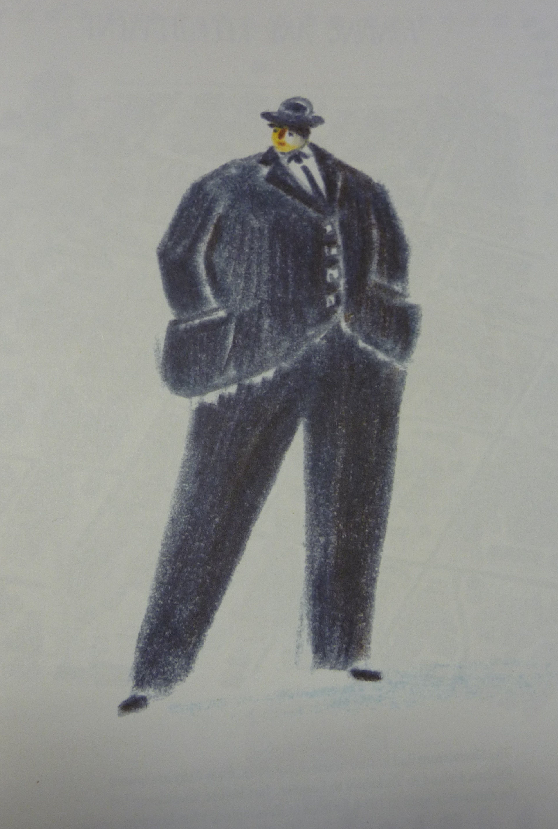

Slide 3
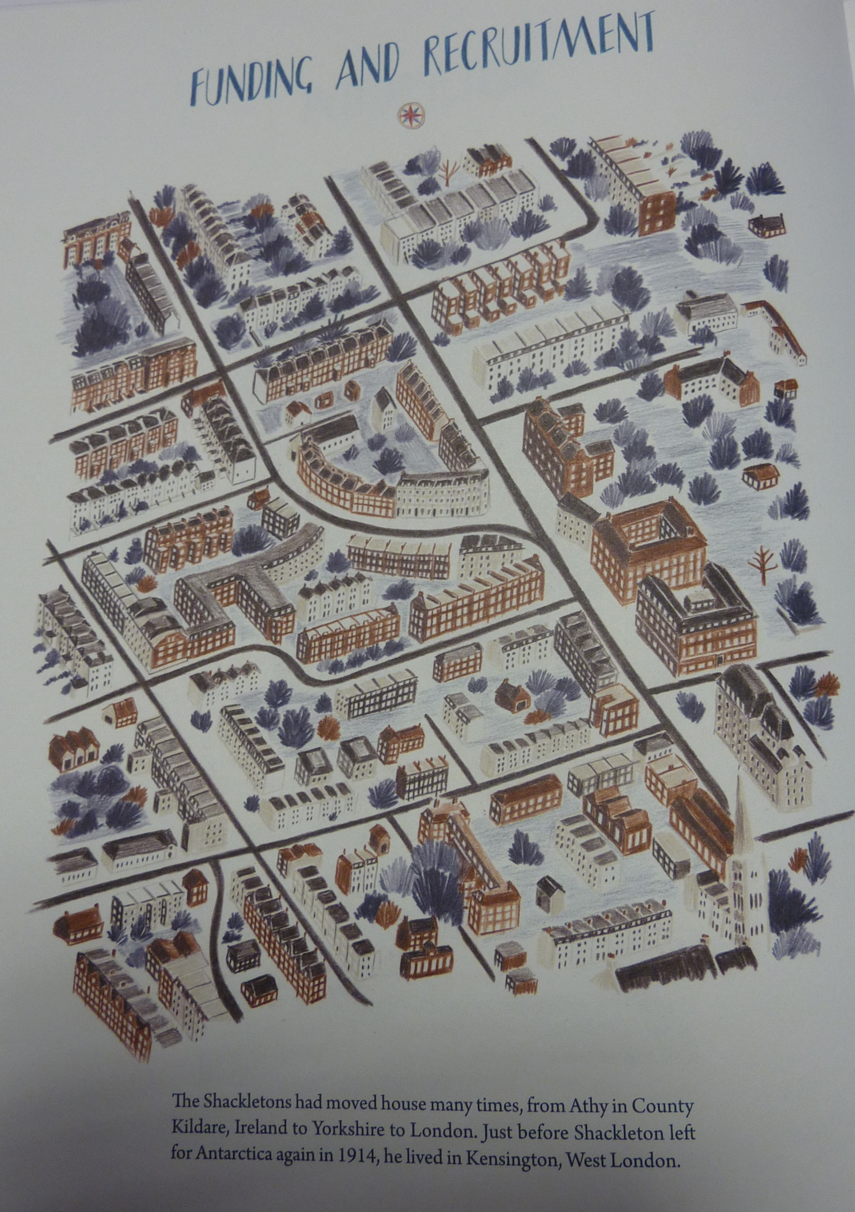
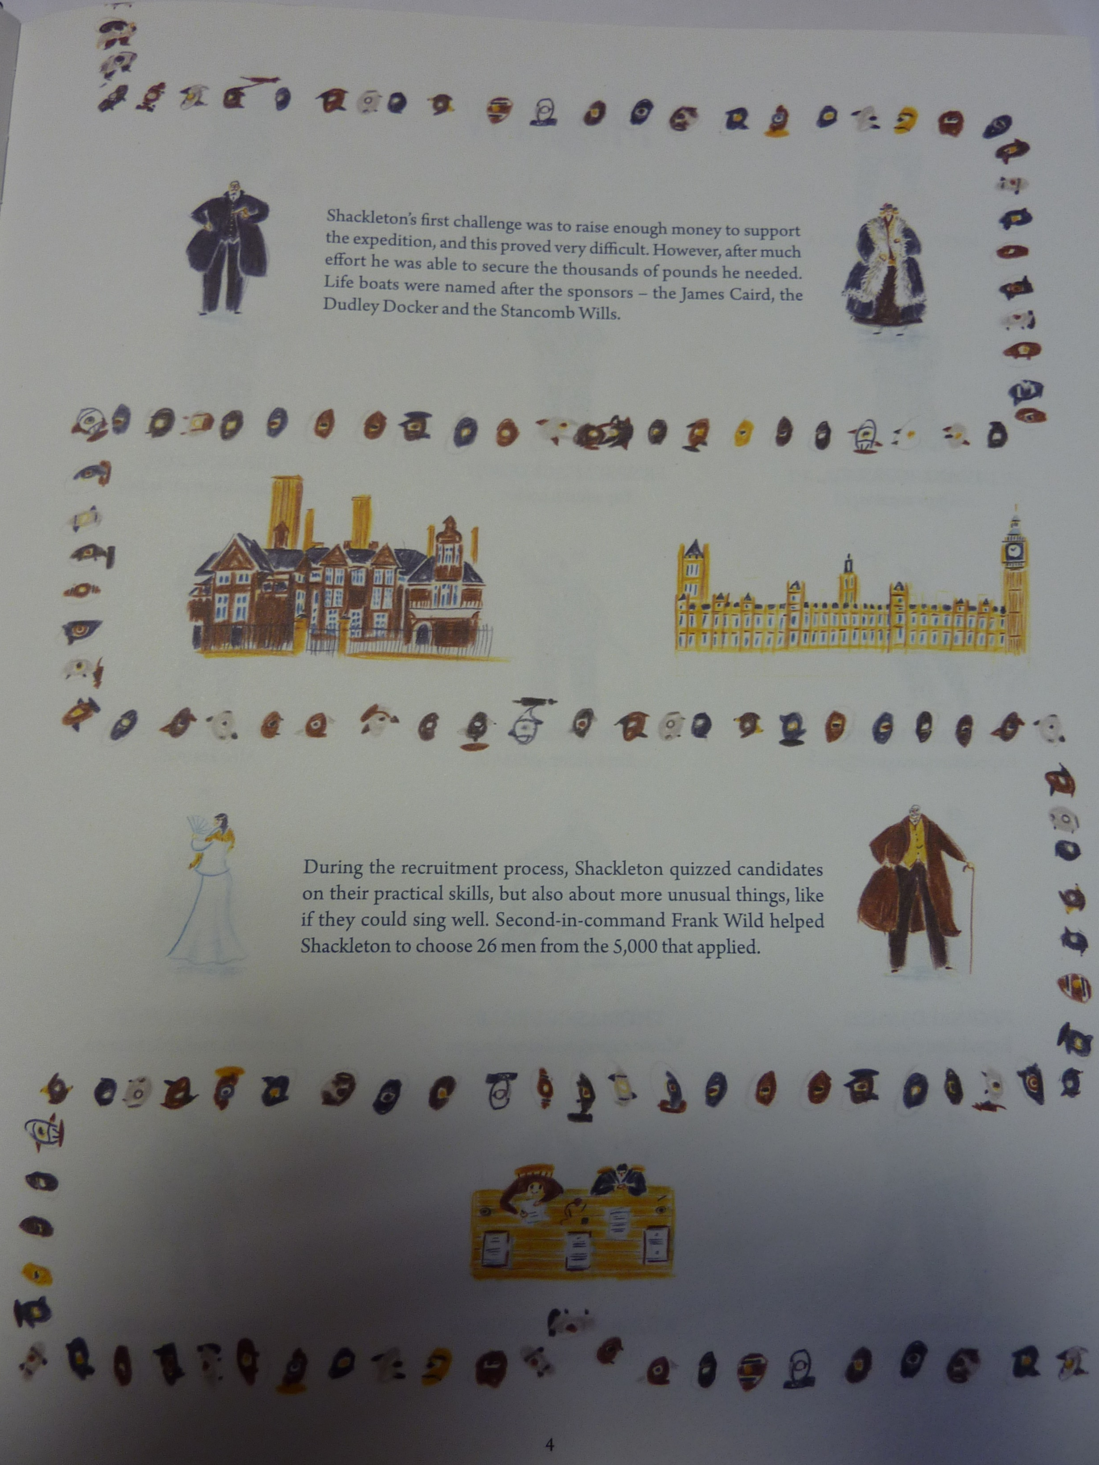

Slide 4
What does it take to explore the Antarctic?
Research what the Antarctic is like.
A good place to start is:
https://discoveringantarctica.org.uk/
https://www.bbc.co.uk/bitesize/topics/zyhp34j/articles/zjg46v4
What other facts can you find out about the Antarctic?
Record the information in your books.

Slide 5
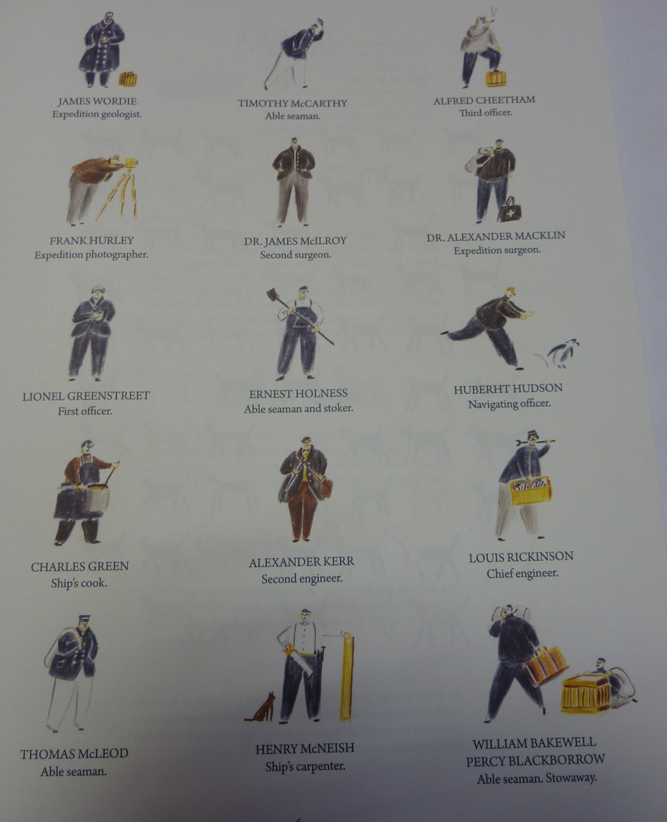
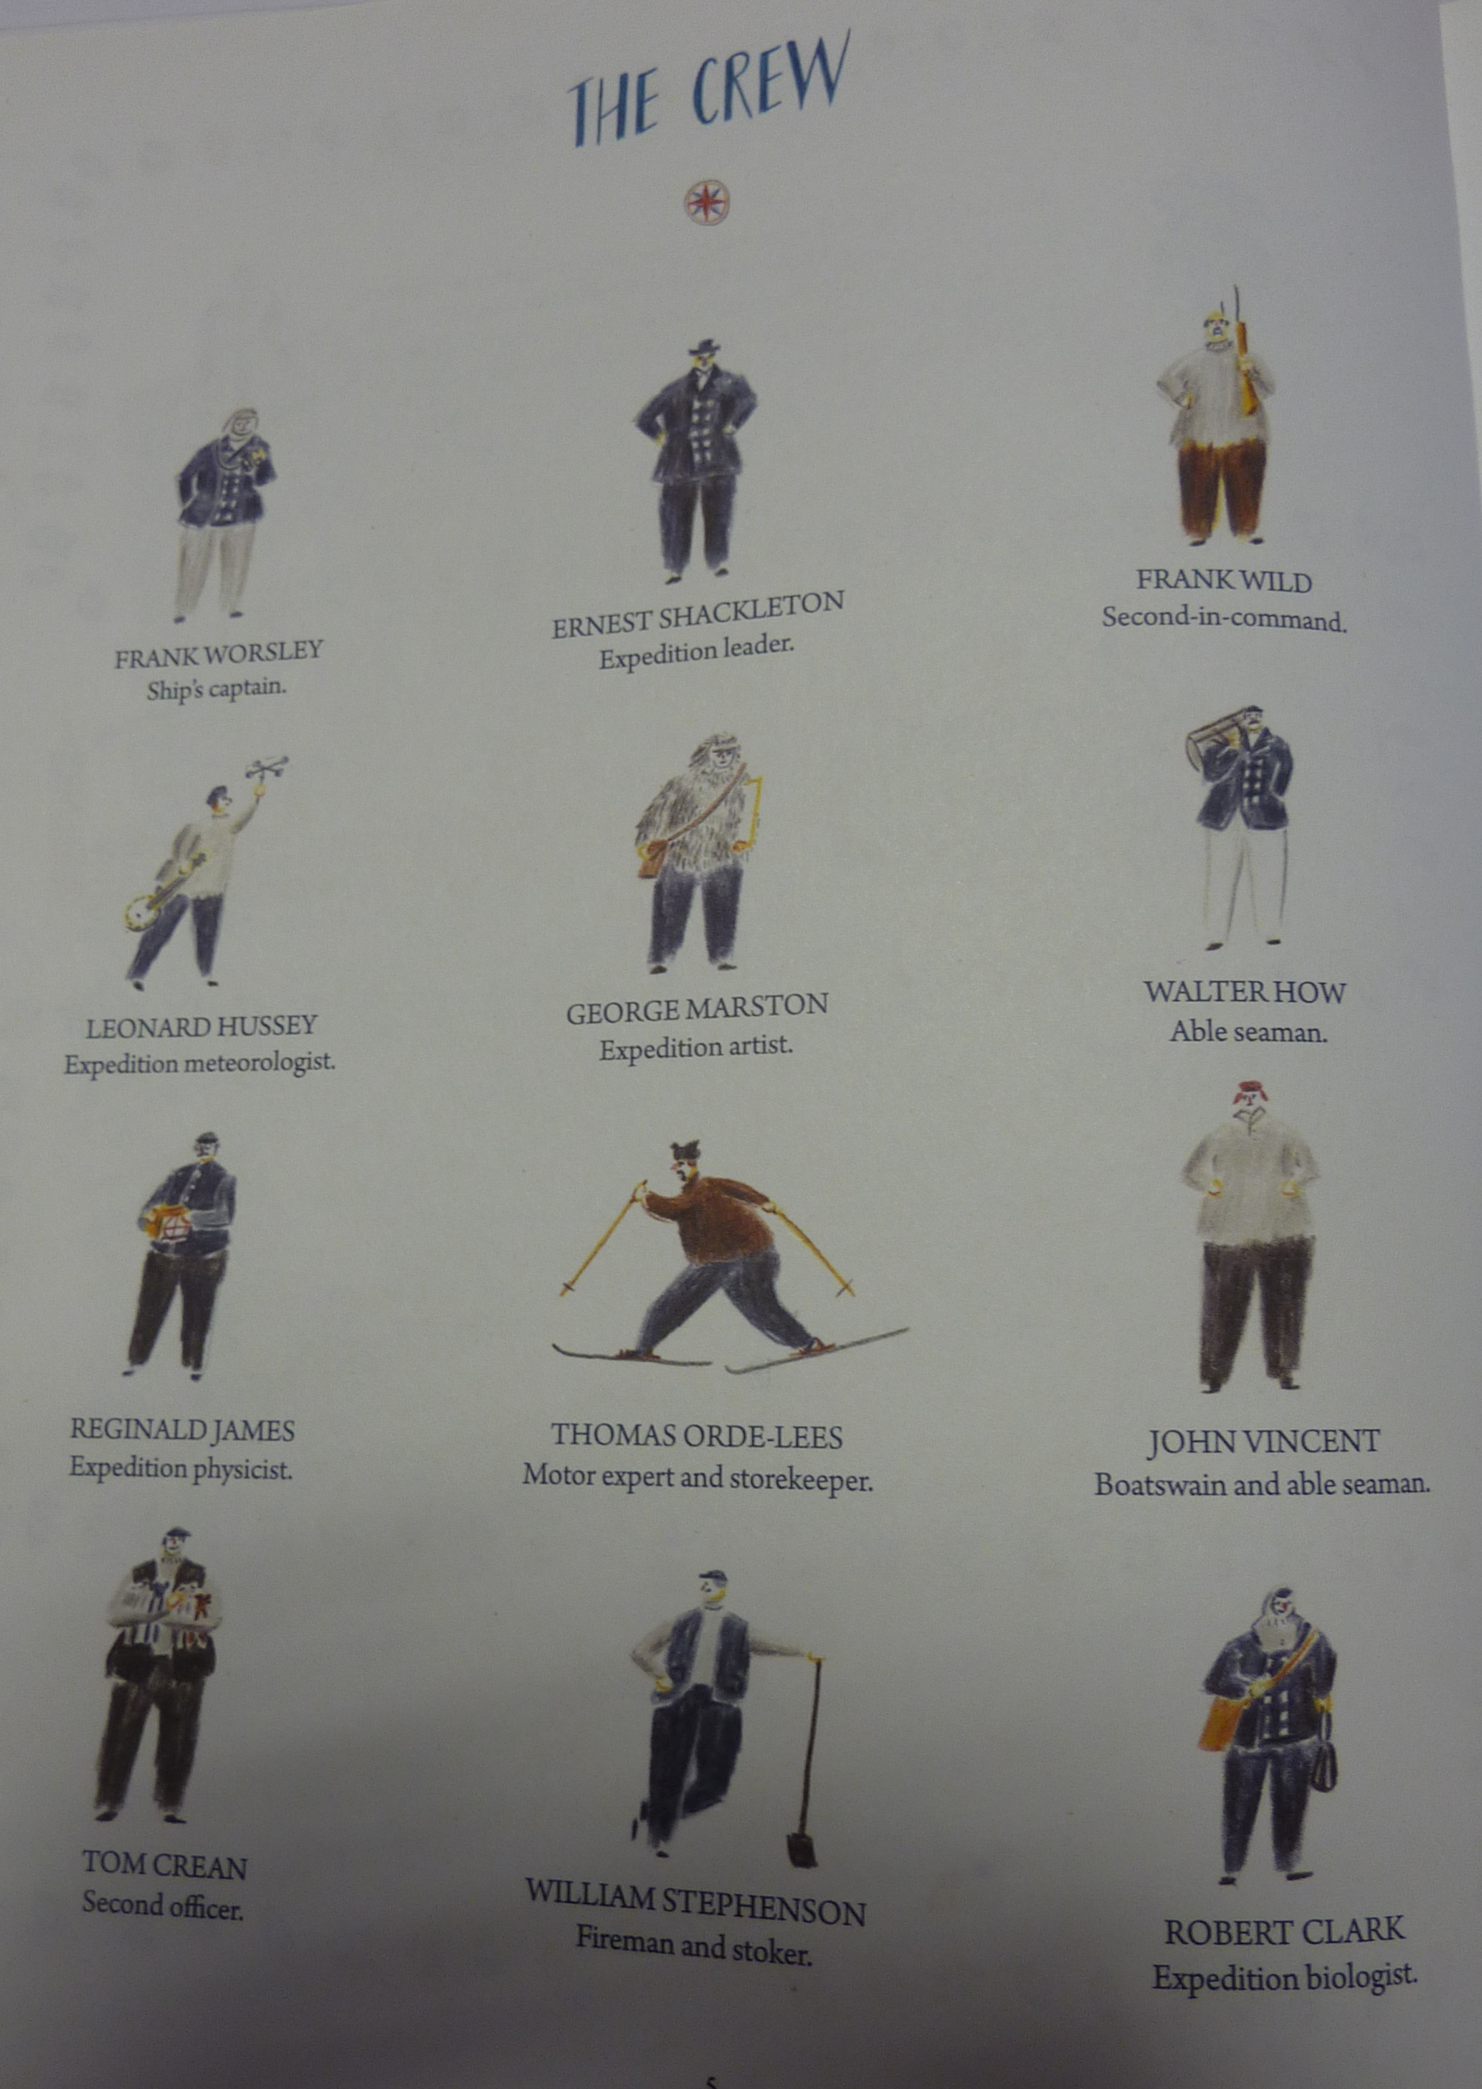

Slide 6
Shackleton wrote the above advert to ‘attract’ crew. What sort of person would apply to an advert like this?

Slide 7
Pick someone from the crew list. Imagine you are writing a letter to Shackleton to convince him to employ you. How would you convince him?
You need to prove to Shackleton that you are invaluable to him. Describe a story showing how brave / ingenious / patient / clever you are.
Look at the 2 documents on the website to help you: ‘Letter to Shackleton template’ and ‘Letter to Shackleton – 3 examples’ (this gives some examples of activities to show your worth)

