Slide 1
Day 2 - Writing

Slide 2
Day 2: WALT: create a mysterious atmosphere
Jimmy has travelled to the setting with the house on slide 4. He feels a little unsettled and decides this place has a mysterious feel to it.
He writes the following words and phrases:
The sky was black
The house looked empty and strange
The bird flew low over the water
The water was still
The bushes and trees were thick and dark
Jimmy re-reads his work; he would like to improve it but is unsure how. Can you improve his sentences and put them together in a paragraph? Try to use some different sentence starters rather than ‘the’.
You may like to magpie some of the ideas below: this doesn’t mean to copy it all but to borrow and use some words or phrases that you like and think are effective.
The grey and threatening clouds loomed over the house. Looking abandoned and forlorn, the derelict building sat sadly on the lake. Swiftly but silently, a bird swooped low over the water and stood perched on a tree stump.

Slide 3
Notes for Maths
Discovery – Children to work independently.
Share – This page shows you different ways the discovery question could have been answered.
Think Together – Complete and then discuss with an adult to consolidate and deepen understanding.
Practice – children practice the skills they have learnt. Please complete 2 of the 3 slides of practice. (Pick the 2 pages you think will challenge you the most!)

Slide 4
Lesson 7 – WALT: Use a number line to 10,000.
What numbers can you see on the counting stick?
What are the numbers at the end of the line? What do you think the numbers in between might be?
How many intervals are there? How could you check?

Slide 5
How could you check what intervals the number line went up in?
Do these number lines go up by the same amount? How do you know?

Slide 6
Where does the number line start and end? What does it go up in?
How do the numbers at the start and end of the number line help you fill in the missing numbers?

Slide 7
Practice Questions

Slide 10
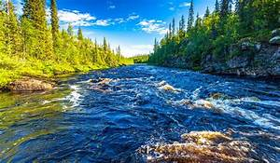
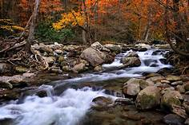
The River by Valerie Bloom
The River's a wanderer.
A nomad, a tramp,
He doesn't choose one place
To set up his camp.
The River's a winder,
Through valley and hill
He twists and he turns,
He just cannot be still.
The River's a hoarder,
And he buries down deep
Those little treasures
That he wants to keep.

Slide 11
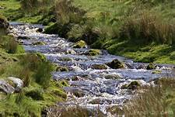
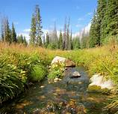
The River by Valerie Bloom
The River's a baby,
He gurgles and hums,
And sounds like he's happily
Sucking his thumbs.
The River's a singer,
As he dances along,
The countryside echoes
The notes of his song.
The River's a monster
Hungry and vexed,
He's gobbled up trees
And he'll swallow you next.

Slide 12
Reading Day 2 WALT: look at word choices within a poem
1) What do the following words mean?
Nomad, hoarder, vexed
2) Why do you think the poet chose to use an apostrophe when saying The River’s instead of the River is?
3) Write down all the verbs you can find from verses 4, 5 and 6.
4) Can you think of your own verbs that you could replace with the poet’s choices? E.g. the River’s a singer, as he croons along. The countryside listens to the notes of his song. Change any 2 verses; or more if you wish.

Slide 13
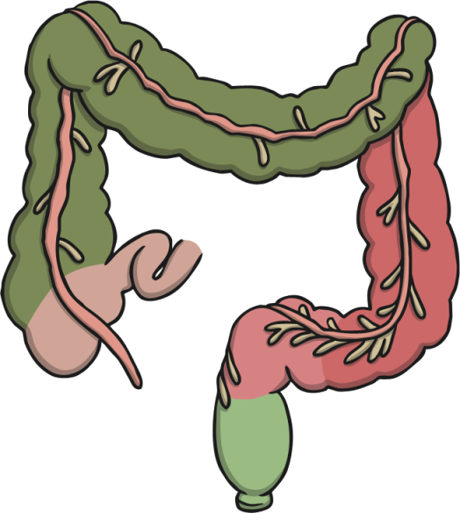
Week 2 Science - Digestive System Quiz
Click on the answer boxes.
Before you start the quiz, click on the link to recap your learning::
https://www.bbc.co.uk/bitesize/topics/z27kng8 Good luck!

Slide 14
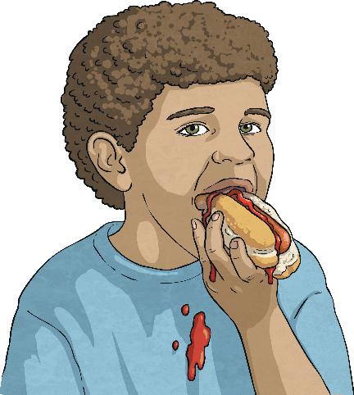
Digestive System Quiz
What part of the digestive system tears, cuts and grinds food?
?
stomach
teeth
salivary glands
pancreas

Slide 15
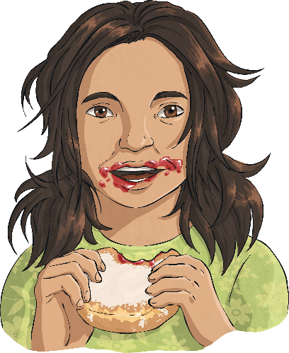
Digestive System Quiz
Which part of the body produces saliva?
?
mouth
gallbladder
salivary glands
liver

Slide 16
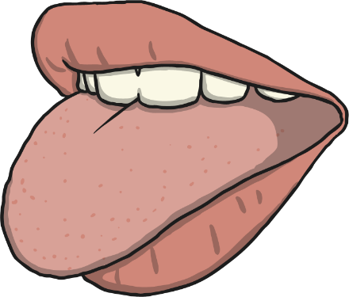
Digestive System Quiz
What is the function of the tongue?
?
mixes food with saliva
cuts food
produces saliva
breaks down food

Slide 17
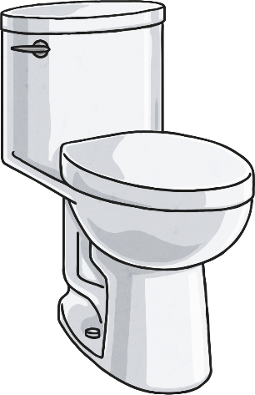
Digestive System Quiz
Which part of the digestive system forms stools?
?
rectum
oesophagus
small intestine
large intestine

Slide 18
Digestive System Quiz
Which is the only part of the digestive system which needs
to send a signal to the brain?
?
rectum
gallbladder
pancreas
anus

Slide 19
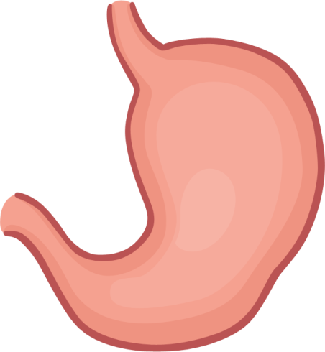
Digestive System Quiz
Which of these is the function of the stomach?
?
produces saliva
produces bile
produces acid
produces stools

Slide 20
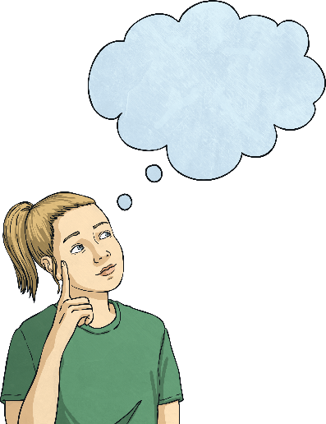
Digestive System Quiz
Where is bile stored?
?
stomach
liver
pancreas
gallbladder

Slide 21
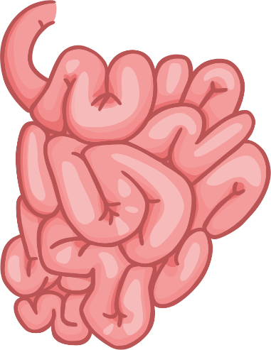
Digestive System Quiz
How many parts of the small intestine are used to digest food?
?
two
one
three
none

Slide 22
Digestive System Quiz
Which part moves the food to the stomach?
?
small intestine
oesophagus
large intestine
mouth

Slide 23
Digestive System Quiz
What do glands do?
?
break down food
keep the pancreas healthy
produce fluids
send signals to the brain

Slide 24
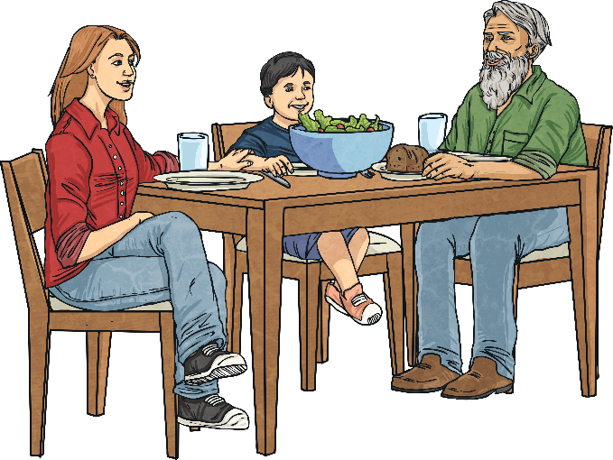
Digestive System Quiz
How many different parts of the digestive system
does food enter?
?
eight
ten
thirteen
three

Slide 25
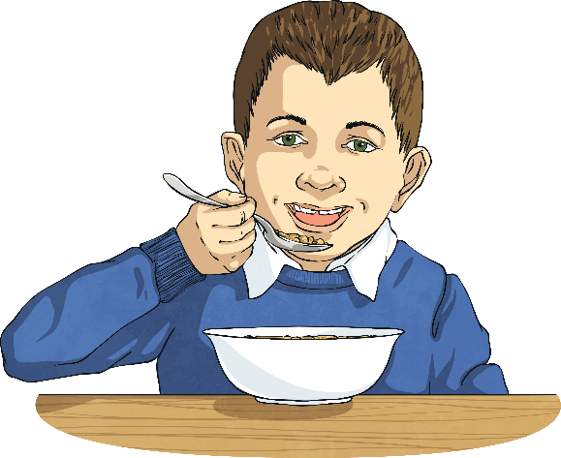
Digestive System Quiz
What are enzymes?
?
cells that break down food
molecules that break down food
glands that break down food
organs that break down food

Slide 26
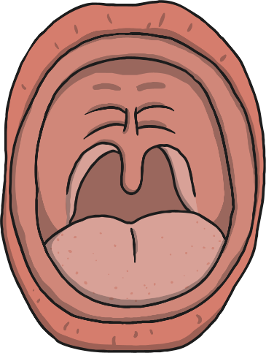
Digestive System Quiz
What is the name of the top part of the mouth?
?
hard palate
soft pilates
soft palate
hard pilates

Slide 27
Digestive System Quiz
What two substances break down food in the duodenum?
?
acid and enzymes
bile and saliva
acid and bile
enzymes and bile

Slide 28
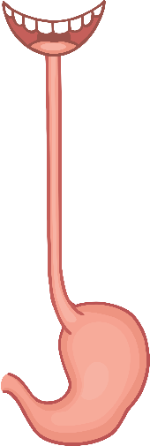
Digestive System Quiz
The name of the wave movement of the muscles in the
oesophagus is called…
?
periscope
perisic
peristalsis
periodic

Slide 29
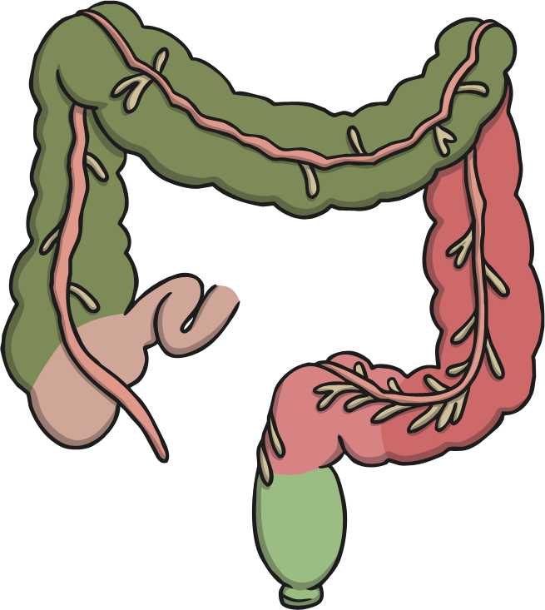
Digestive System Quiz
How did you do? You can play again if you want to improve your score!

